Slide 1
Police Station Locator Using KD-Trees

Slide 2
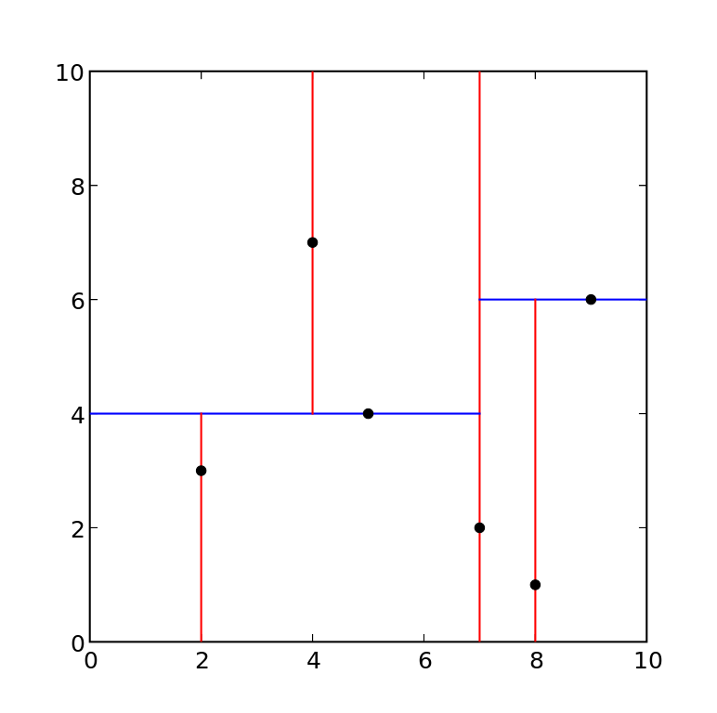
Data Structure Used
What is KD-Tree ?
A K-D Tree (also called as K-Dimensional Tree) is a binary search tree where data in each node is a K-Dimensional point in space. In short, it is a space partitioning.
Why KD-Tree ?
Some parameters that I consider,
Need to insert data semi-frequently
Dimension of data can be more
Need Accuracy
KD-Tree satisfy all these parameters well.

Slide 3
Project Scope
As per the location provided; the search is performed on the KD-Tree to get the accurate location of the nearby police station
The result is based on the radius of search and other parameters like if there is any female officer available or not etc.

Slide 4
References
https://en.wikipedia.org/wiki/K-d_tree
https://stackoverflow.com/questions/17998103/kd-tree-vs-octree-for-3d-radius-search

