Slide 1

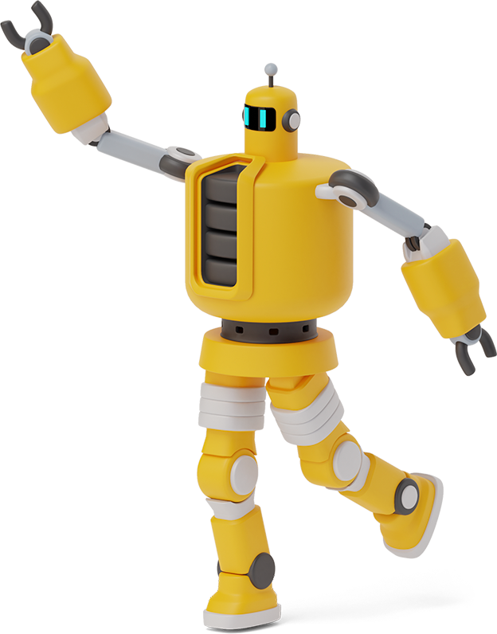
Seminar Presentation
ON
META TALK: LEARNING TO DATA-EFFICIENTLY GENERATE AUDIO-DRIVEN
LIP-SYNCHRONIZED TALKING FACE WITH HIGH DEFINITION
BY
AJITH D
(PRP19CS008)

Slide 2
Contents
Introduction
Key Terms
Literature Survey
Methodologies Used
Phases
Result
Existing vs Proposed system
Conclusion
Future Scope
References

Slide 3

INTRODUCTION
This paper proposes data-efficient audio-driven talking face generation method, which uses just a short target video to produce both lip-synchronized and high-definition face video driven by arbitrary audio in the wild.
In this work, the original target character’s face images are decomposed into 3D face model parameters including expression, geometry, illumination,etc.

Slide 4
Literature Survey
Year | Authors | Title
2017 | Supasorn Suwajanakorn,Steven M. Seitz,Ira Kemelmacher-Shlizerman | Synthesizing Obama: learning lip sync from audio
2020 | Xin Wen, Miao Wang, Christian Richardt, Ze-Yin Chen,and Shi-Min Hu | Photorealistic audio-driven video portraits
2019 | Lele Chen, Ross K. Maddox, Zhiyao Duan, and Chenliang Xu | Hierarchical cross-modal talking face generation with dynamic pixel-wise loss
2020 | K R Prajwal, Rudrabha Mukhopadhyay, Vinay P. Namboodiri, and C.V. Jawahar | A lip sync expert is all you need for speech to lip generation in the wild
2020 | Yang Zhou, Xintong Han, Eli Shechtman, Jose Echevarria, Evangelos Kalogerakis, and Dingzeyu Li | Makelttalk
2021 | Yurui Ren, Ge Li, Yuanqi Chen, Thomas H. Li, and Shan Liu | Pirenderer: Controllable portrait image generation via semantic neural rendering
2021 | Chenxu Zhang, Saifeng Ni, Zhipeng Fan, Hongbo Li,Ming Zeng,Madhukar Budagavi, and Xiaohu Guo | 3d talking face with personalized pose dynamics
2018 | Triantafyllos Afouras, Joon Son Chung, Andrew Senior,Oriol Vinyals, and Andrew Zisserman | Deep audio-visual speech recognition

Slide 5
Year | Authors | Title
2019 | Yu Deng, Jiaolong Yang, Sicheng Xu, Dong Chen,Yunde Jia, and Xin Tong | Accurate 3d face reconstruction with weakly-supervised learning: From single image to image set
2009 | Pascal Paysan, Reinhard Knothe, Brian Amberg, Sami Romdhani, and Thomas Vetter | A 3d face model for pose and illumination invariant face recognition
2019 | Yudong Guo, juyong zhang, Jianfei Cai, Boyi Jiang, and Jianmin Zheng | Cnn-based real-time dense face reconstruction with inverse-rendered photo-realistic face images
2014 | Chen Cao, Yanlin Weng, Shun Zhou, Yiying Tong, and Kun Zhou | Facewarehouse: A 3d facial expression database for visual computing
2001 | R. Ramamoorthi and P. Hanrahan | An efficient repre-sentation for irradiance environment maps
2018 | Phillip Isola, Jun-Yan Zhu, Tinghui Zhou, and Alexei A.Efros | Image-to-image translation with conditional adversarial networks

Slide 6
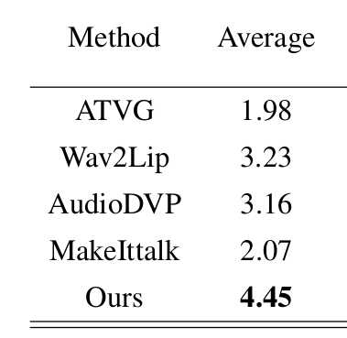
Existing vs Proposed Methods
The existing talking face generation methods can not simultaneously achieve high definition and lip synchronization
Rating

Slide 7
Key Terms
Lip Synchronization
Neural Rendering

Slide 8

What is meant by Lip Synchronization?

Slide 9
Lip Synchronization
It is a technical term for matching a speaking or singing person's lip movements with sung or spoken vocals.

Slide 10
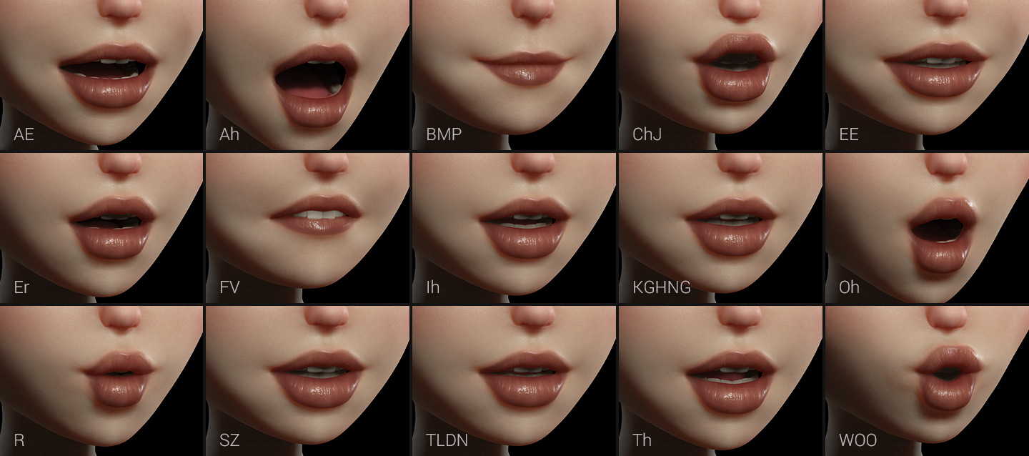

Slide 11
Neural Rendering
Neural rendering is an emerging class of deep image and video generation approaches that enable control of scene properties such as illumination, camera parameters, pose, geometry, appearance, and semantic structure. It combines machine learning techniques with physical knowledge from computer graphics to obtain controllable and photo-realistic models of scenes.

Slide 12
Methodology Used
Training Model
Testing Model
3D Face Construction
Target Video Generation

Slide 13
Let’s get in to the Paper
Talking face generation has attracted intensive attention in the field of multi-modal human-computer interaction.
Accurate lip movements during lip-syncing and realistic video portraits are key to better user experience feedback , natural head poses and eye blinks can also enhance user experience in these application scenarios.

Slide 14
Example:

Slide 15
Phases
Training Phase
Testing Phase

Slide 16
Training Phase
Input:Target Video
Step 1:
Crop the original target video into the target face video, which is then resized to be low-resolution to generate a low-definition talking face video with LRS2 audio using the pre-trained model Wav2Lip.
Output: a pseudo video with excellent lip synchronization.

Slide 17
LRS2
Lip Reading Sentences 2 (LRS2) Dataset.The dataset consists of thousands of spoken sentences from BBC television.
Wav2Lip
It is a neural network that adapts video with a speaking face for an audio recording of the speech. The proposed neural network bypasses state-of-the-art approaches on the task of synchronizing human lips on video recording with an audio track.

Slide 18
Step 2:
Then, the 3DMM parameters are used to re-render the synthetic facial images in the target video. The facial 3D morphable model (3DMM) parameters including expression, geometry, texture, pose, illumination coefficients are extracted from each frame of them.
Output: Synthetic face
3DMM
A 3D Morphable Face Model is a generative model for face shape

Slide 19
Step 3:
Finally, we train a neural rendering network with the lower half of synthetic and real target faces to generate a high-definition photo-realistic talking face video.
Neural rendering
It is a method, based on deep neural networks , which can create novel images and video footage based on existing scenes

Slide 20

Our process is easy
high-definition photo realistic talking face video.
03
Neural Rendering
A pseudo video with excellent lip synchronization
LRS2
&
Wav2
Lip
01
02
3DMM
Synthetic face

Slide 21
Testing Phase
Input : Trained Model
We test the current model using a Audio to Expression network(A2E) to guarantee the accurate lip motion.
A2E
A neural network model used to map audio to expressions

Slide 22
Analysis
synchronization
A Best Quality Lip synchronization is obtained
Efficiency
Achieving data-efficient training
S
E
virtual education, videoconferencing, game,entertainment, film and television animation,etc
OPPORTUNITIES
Generate a high-definition video
Quality
O
Q

Slide 23
Result
Our method generates more synchronized lip movements compared with the other methods.

Slide 24
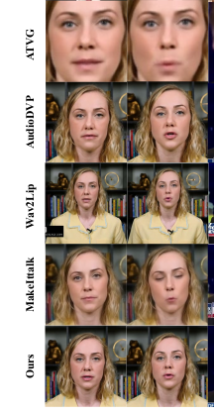

Slide 25
CONCLUSION
In this paper, we propose a new method to generate lip-
synchronized talking face videos with high definition using
only 3min video, achieving data-efficient training. Given
any arbitrary audio input in the wild, it can drive the speech
video generation of the target character in the test process.
This method relieves the burden of target video collection
and reduces the production cost for virtual reality application,
which may lead to various potential applications

Slide 26
Future Scope
Virtual Education
Videoconferencing
Game
Entertainment
Film and Television Animation

Slide 27
References
“Synthesizing obama: Learning lip sync from audio,”ACM Transactions on Graphics, vol. 36, no. 4CD, pp.95.1–95.13, 2017.
Xin Wen, Miao Wang, Christian Richardt, Ze-Yin Chen,and Shi-Min Hu, “Photorealistic audio-driven video portraits,” IEEE Transactions on Visualization and Computer Graphics, vol. 26, no. 12, pp. 3457–3466,2020.
Lele Chen, Ross K. Maddox, Zhiyao Duan, and Chenliang Xu, “Hierarchical cross-modal talking face generation with dynamic pixel-wise loss,” in 2019 IEEE/CVF Conference on Computer Vision and Pattern Recognition (CVPR), 2019, pp. 7824–7833.

Slide 28
K R Prajwal, Rudrabha Mukhopadhyay, Vinay P. Namboodiri, and C.V. Jawahar, “A lip sync expert is all you need for speech to lip generation in the wild,” in Proceedings of the 28th ACM International Conference on Multimedia, New York, NY, USA, 2020, MM ’20, p.484–492, Association for Computing Machinery.
Yang Zhou, Xintong Han, Eli Shechtman, Jose Echevarria, Evangelos Kalogerakis, and Dingzeyu Li,“Makelttalk,” ACM Transactions on Graphics, vol. 39,no. 6, pp. 1–15, Nov 2020.
Yurui Ren, Ge Li, Yuanqi Chen, Thomas H. Li, and Shan Liu, “Pirenderer: Controllable portrait image generation via semantic neural rendering,” 2021.

Slide 29
Chenxu Zhang, Saifeng Ni, Zhipeng Fan, Hongbo Li,Ming Zeng, Madhukar Budagavi, and Xiaohu Guo, “3d talking face with personalized pose dynamics,” IEEE Transactions on Visualization and Computer Graphics,pp. 1–1, 2021.
Chenxu Zhang, Yifan Zhao, Yifei Huang, Ming Zeng,Saifeng Ni, Madhukar Budagavi, and Xiaohu Guo, “FA-CIAL: synthesizing dynamic talking face with implicit attribute learning,” CoRR, vol. Abs/2108.07938, 2021.
Triantafyllos Afouras, Joon Son Chung, Andrew Senior,Oriol Vinyals, and Andrew Zisserman, “Deep audio-visual speech recognition,” IEEE Transactions on Pattern Analysis and Machine Intelligence, pp. 1–1, 2018.

Slide 30
Yu Deng, Jiaolong Yang, Sicheng Xu, Dong Chen,Yunde Jia, and Xin Tong, “Accurate 3d face reconstruction with weakly-supervised learning: From single image to image set,” in 2019 IEEE/CVF Conference on Computer Vision and Pattern Recognition Workshops(CVPRW), 2019, pp. 285–295.
Pascal Paysan, Reinhard Knothe, Brian Amberg, Sami Romdhani, and Thomas Vetter, “A 3d face model for pose and illumination invariant face recognition,” in 2009 Sixth IEEE International Conference on Advanced Video and Signal Based Surveillance, 2009, pp. 296–301.

Slide 31
Yudong Guo, juyong zhang, Jianfei Cai, Boyi Jiang, and Jianmin Zheng, “Cnn-based real-time dense face reconstruction with inverse-rendered photo-realistic face images,” IEEE Transactions on Pattern Analysis and Machine Intelligence, vol. 41, no. 6, pp. 1294–1307, 2019
Chen Cao, Yanlin Weng, Shun Zhou, Yiying Tong, and Kun Zhou, “Facewarehouse: A 3d facial expression database for visual computing,” IEEE Transactions on Visualization and Computer Graphics, vol. 20, no. 3, pp.413–425, 2014.

Slide 32
R. Ramamoorthi and P. Hanrahan, “An efficient repre-sentation for irradiance environment maps,” Proceed-ings of the 28th annual conference on Computer graph-ics and interactive techniques, 2001.
Phillip Isola, Jun-Yan Zhu, Tinghui Zhou, and Alexei A.Efros, “Image-to-image translation with conditional adversarial networks,” 2018.

Slide 33
Thank You

