Slide 1

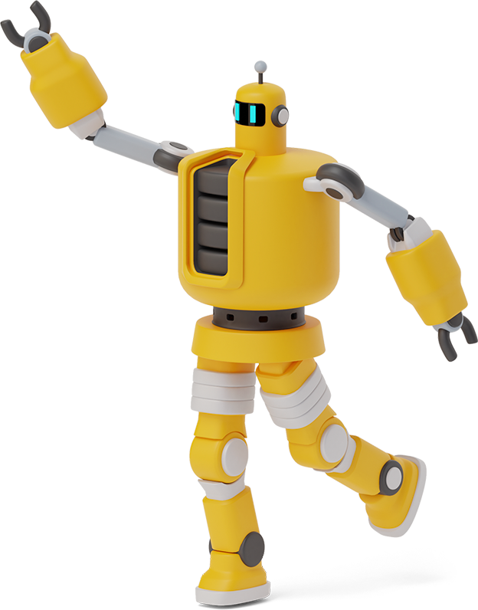
Seminar Presentation
ON
META TALK: LEARNING TO DATA-EFFICIENTLY GENERATE AUDIO-DRIVEN
LIP-SYNCHRONIZED TALKING FACE WITH HIGH DEFINITION
BY
AJITH D
(PRP19CS008)

Slide 2

INTRODUCTION
This paper proposes data-efficient audio-driven talking face generation method, which uses just a short target video to produce both lip-synchronized and high-definition face video driven by arbitrary audio in the wild.
In this work, the original target character’s face images are decomposed into 3D face model parameters including expression, geometry, illumination,etc.

Slide 3

What is mean by Lip Synchronization?

Slide 4
Lip Synchronization
It is a technical term for matching a speaking or singing person's lip movements with sung or spoken vocals.

Slide 5
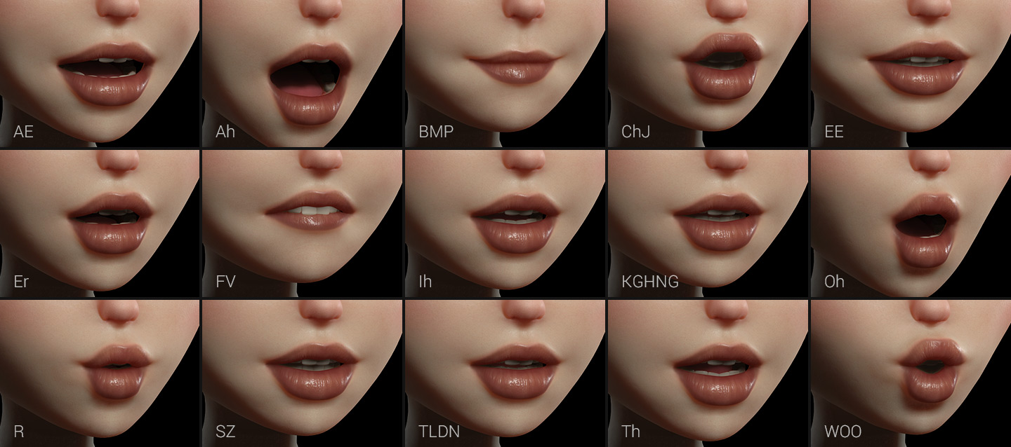

Slide 6
Let’s get in to the Paper
Talking face generation has attracted intensive attention in the field of multi-modal human-computer interaction. Its powerful communication mode makes it widely used in virtual education,videoconferencing,virtualanchor,game, entertainment, film and television animation production and other fields.
Accurate lip movements during lip-syncing and realistic video portraits are key to better user experience feedback , natural head poses and eye blinks can also enhance user experience in these application scenarios.

Slide 7
Example:

Slide 8
Operations:
1)
Crop the original target video into the target face video, which is then resized to be low-resolution to generate a low-definition talking face video with LRS2 audio using the pre-trained model Wav2Lip.
Output: a pseudo video with excellent lip synchronization.

Slide 9
LRS2
Lip Reading Sentences 2 (LRS2) Dataset.The dataset consists of thousands of spoken sentences from BBC television.
Wav2Lip
Wav2Lip is a neural network that adapts video with a speaking face for an audio recording of the speech

Slide 10
2)
Then, the 3DMM parameters are used to re-render the synthetic facial images in the target video. The facial 3D morphable model (3DMM) parameters including expression, geometry, texture, pose, illumination coefficients are extracted from each frame of them.
Output: Synthetic face
3DMM
A 3D Morphable Face Model is a generative model for face shape

Slide 11
3)
Finally, we train a neural rendering network with the lower half of synthetic and real target faces to generate a high-definition photo-realistic talking face video.
Neural rendering
It is a method, based on deep neural networks , which can create novel images and video footage based on existing scenes

Slide 12
Our process is easy
high-definition photo realistic talking face video.
03
Neural Rendering
A pseudo video with excellent lip synchronization
LRS2
&
Wav2
Lip
01
02
3DMM
Synthetic face
<number>

Slide 13
Analysis
synchronization
A Best Quality Lip synchronization is obtained
Efficiency
Achieving data-efficient training
S
E
virtual education, videoconferencing, game,entertainment, film and television animation,etc
OPPORTUNITIES
Generate a high-definition video
Quality
O
Q

Slide 14
References

