Slide 1
USING NLP to DISCERN WHAT UNPOPULAR OPINIONS are made of
BY STEVEN TRAN

Slide 2
EXPRESSING CONTROVERIAL OPINIONS VS SIMPLY RANTING
The digital age has made it relatively easier to voice ideas and reach a large audience
It can be sometimes be difficult to identify when an individual is attempting to contribute to the marketplace of ideas by expressing a controversial opinion or simply ranting
Any inability to distinguish between the two makes it more difficult to elevate the speech platforms for those who are earnestly contributing to important conversations
Social networks, discussion boards, or any virtual platforms which promote and moderate stratified discussion would benefit from a way to better distinguish between the two

Slide 3
The solution
Use Natural Language Processing (NLP) to identify how specific words’ relevance in a sequence of text or speech can classify the writer/speaker as
expressing a controversial opinion or
simply ranting
Being able to distinguish between these two types of expression would allow a moderator to elevate or restrict certain types of speech

Slide 4

METHODS
reddit.com/r/UnpopularOpinion
“Your post must be an opinion. Not a question. Not a showerthought. Not a rant. Not a proposal. Not a fact. An opinion. One opinion. A subjective statement about your position on some topic. Please have a clear, self contained opinion as your post title, and use the text field to elaborate and expand on why you think/feel this way.”
Reddit (/ˈrɛdɪt/, stylized as reddit) is an American social news aggregation, web content rating, and discussion website.
Posts are organized by subject into user-created boards called "communities" or "subreddits", which cover a variety of topics such as news, politics, religion, etc.
~from Wikipedia

Slide 5
METHODS
reddit.com/r/UnpopularOpinion
“Your post must be an opinion. Not a question. Not a showerthought. Not a rant. Not a proposal. Not a fact. An opinion. One opinion. A subjective statement about your position on some topic. Please have a clear, self contained opinion as your post title, and use the text field to elaborate and expand on why you think/feel this way.”
reddit.com/r/Rant
Per dictionary.com:
verb (used without object)
to speak or declaim extravagantly or violently; talk in a wild or vehement way; rave
Reddit (/ˈrɛdɪt/, stylized as reddit) is an American social news aggregation, web content rating, and discussion website.
Posts are organized by subject into user-created boards called "communities" or "subreddits", which cover a variety of topics such as news, politics, religion, etc.
~from Wikipedia

Slide 6
METHODS
reddit.com/r/UnpopularOpinion
“Your post must be an opinion. Not a question. Not a showerthought. Not a rant. Not a proposal. Not a fact. An opinion. One opinion. A subjective statement about your position on some topic. Please have a clear, self contained opinion as your post title, and use the text field to elaborate and expand on why you think/feel this way.”
reddit.com/r/Rant
Reddit (/ˈrɛdɪt/, stylized as reddit) is an American social news aggregation, web content rating, and discussion website.
Posts are organized by subject into user-created boards called "communities" or "subreddits", which cover a variety of topics such as news, politics, religion, etc.
~from Wikipedia
Measuring Success
An NLP machine-learning model which can classify a sequence of text as belonging to the correct subreddit should be able to determine words which are more associated with unpopular opinions
The classification accuracy must be demonstrably better than a model which uniformly classifies all posts as belonging to the target subreddit

Slide 7
About the sample
 | /r/UnpopularOpinion | /r/Rant
Posts collected | 8,000 | 8,000
Posts remaining after data cleaning | 8,000 | 7,715
Post creation date range | Dec 15, 2020 – December 31, 2020 | Nov 2, 2020 – December 31, 2020

Slide 8
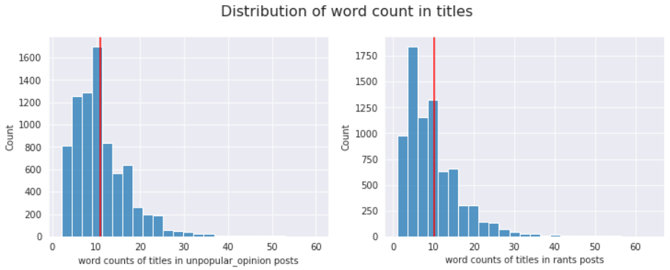
About the sample
 | /r/UnpopularOpinion | /r/Rant
Mean title word count | 10.97 | 10.06
(continued)

Slide 9
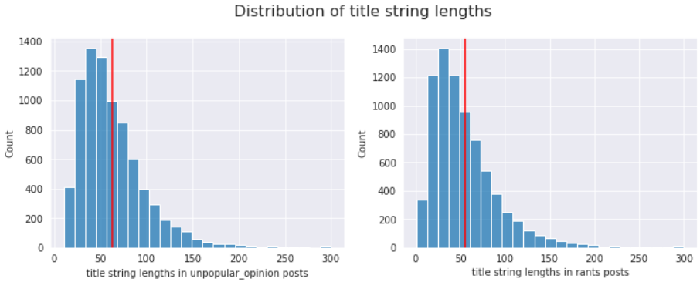
About the sample
 | /r/UnpopularOpinion | /r/Rant
Mean title string length | 62.61 | 54.85
(continued)

Slide 10
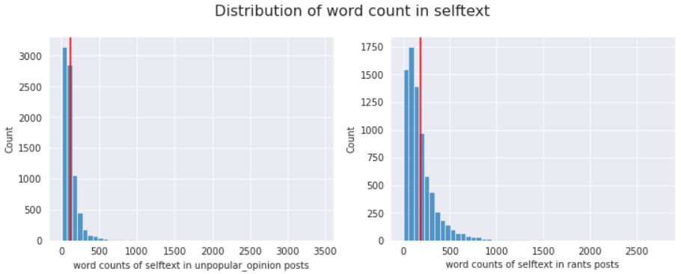
About the sample
 | /r/UnpopularOpinion | /r/Rant
Mean selftext word count | 117.40 | 185.04
(continued)

Slide 11
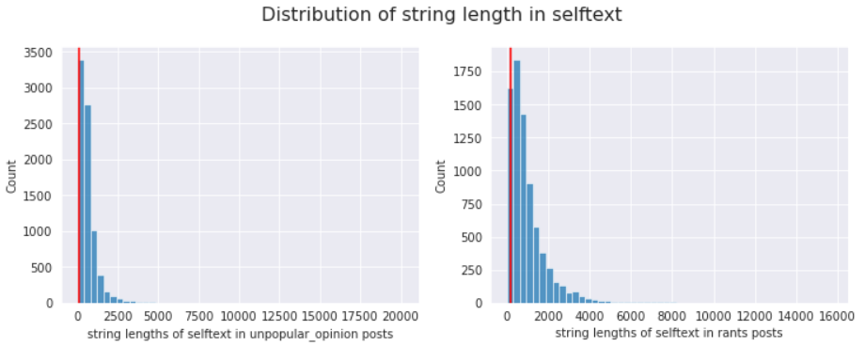
About the sample
 | /r/UnpopularOpinion | /r/Rant
Mean selftext str length | 646.52 | 988.88
(continued)

Slide 12
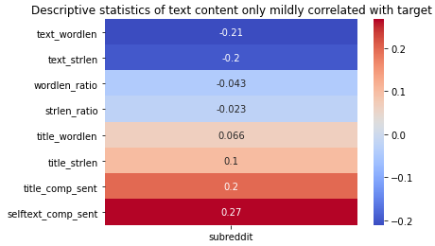
About the sample
(continued)
What we’d hypothesize from this:
The combination of words present or absent from text fields in a reddit post are likely more predictive of whether a post belongs in /r/UnpopularOpinion vs. /r/Rant.

Slide 13
The process
DATA PREPARATION
Scrape posts from both subreddits
Cleanse text fields of special characters, such as line breaks and zero-width space characters; strip leading/trailing spaces; remove URL hyperlinks
Delete observations which had empty text fields after cleansing
Lemmatize (reduce word forms to more elementary versions) words in text fields
MODELING
Split cleaned data in to training and testing sets (75% training 25% testing)
Deploy three (3) classification algorithms to be trained using the training data and evaluated on their accuracy of classification on features in the testing data
Select the production model by determining which model achieves the best classification accuracy

Slide 14
MODELING
Preprocessing
Term frequency – inverse document frequency vectorization would produce the best results for modeling. Specific vectorization hyperparameters would be determined in the steps below
The Classification Models
Logistic Regression
K-Nearest Neighbors Classification
EXtreme Gradient Boosted Ensemble Classifier (XGBoost)
General Method:
Using grid search cross-validation, search for set of vectorizer (TFIDF) and classifier hyperparameters which produce the best classification accuracy
The model with the best accuracy in classifying the testing data is selected as the production model

Slide 15
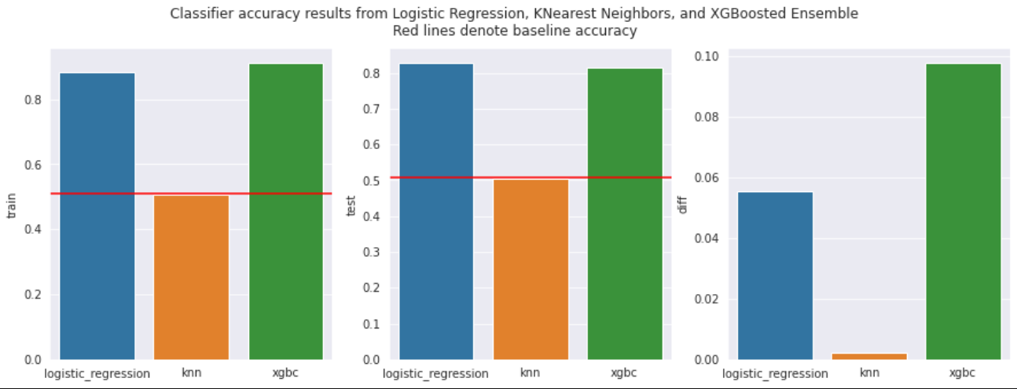
MODELING RESULTS
Findings:
KNN was the worst classifier, failing to achieve better classification accuracy than the benchmark
LogisticRegression and XGBoost achieved similar accuracy in testing, but the XGBoost classifications suffered from greater error due to variance indicating worse overfitting compared to the Logistic Regression model
THEREFORE, the Logistic Regression model becomes the production model for our problem.

Slide 16
PRODUCTION MODEL
Using the best hyperparameters from the grid search, the tuned Logistic Regression model using TFIDF can classify a post as belonging to /r/UnpopularOpinion or /r/Rant approx. 82% of the time, beating the benchmark accuracy by about 31 percentage points.

Slide 17
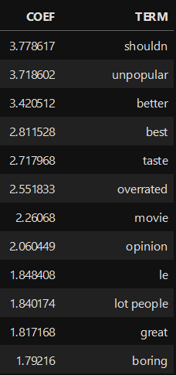
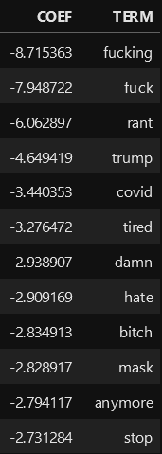
TERM INSIGHTS
Posts in which terms from the left occur more frequently relative to other posts are more likely to be from users expressing unpopular or controversial opinions.
Posts in which terms from the right occur more frequently relative to other posts are more likely to be from users ranting about a topic.
EXPRESSION OF UNPOPULAR OPINION
RANTING

Slide 18
CONCLUSION & RECOMMENDATIONS
Our analysis demonstrates you can construct a Logistic Regression model to identify whether a sequence of words should be classified as an expression of unpopular or controversial opinion vs. an individual ranting, based on specific word relevance.
Our sample was limited in that it only looked at posts from a small window of time. These models would likely benefit from more stratified posts over a greater time period. Further, given unconstrained time, we would have done model-tuning grid searches over larger combinations of hyperparameters.
User-submitted reddit posts to specific subreddits may not be the gold standard for how unpopular opinions or rants should be characterized. To further this research, I would call for more rigorous study into how to characterize a sentiment as being unpopular or controversial and richer characteristics that might define an expression of thought as being a rant.

Slide 19
END
THANK YOU

