Slide 1





ONLINE VOTING SYSTEM
Team Members: Guide:
Pattukota Sai Teja Uma Maheshwari
Shaik Mansoor
C Manasa
Shaik Haseeb
Bachu Sai Kumar
Disclaimer: The content is curated for educational purposes only.

Slide 2
OUTLINE
Abstract
Problem Statement
Aims, Objective & Proposed System/Solution
System Design/Architecture
System Development Approach (Technology Used)
Algorithm & Deployment
Conclusion
Future Scope
References
Video of the Project
Notes:
These are the list of chapters that we are going to cover in these foundation codes. Those are chapter one what are AI and ML? chapter 2 applied Python programming in AI, and chapter 3 is exploratory data analysis for ML.

Slide 3
Abstract
We are developing an on-line voting system by taking advantage of the centralized database with a web interface. The main concept of this project is to build a website, which should be able to allow people to cast their vote by online.
Time saving, working load reduced, information available at time and it provide security for the data. During the election, the election commission of India has introduced a new method of polling by online voting system (OVS). The election commission will maintain this website.
This is a simple, safe and secure method that takes minimum of time. We proceed our project with the assumption that each voter has a voter ID storing his/her unique identity including data.
We are to maintain a centralized database of enrolled voters, the primary key of which is a unique national ID stored on the database. The database administrator is the control the website. Control of the process is entirely in the hands of the computer, and cannot be manipulated by any others.
Integrity of the results is guaranteed; Preventing the chance of false voting (i e) high secured false proof voting. Generally voting has to be performing by user by going to the voting center.

Slide 4
Problem Statement
The traditional voting process is often marred by inefficiencies, accessibility challenges, and security concerns. In order to address these issues and enhance the democratic process, there is a need for the development and implementation of a robust Online Voting System.

Slide 5
Aim and Objective
The aim and objectives of an online voting system project typically revolve around enhancing the efficiency, accessibility, and security of the voting process. Here are some common aims and objectives:
Accessibility: Enable eligible voters to cast their votes conveniently from anywhere with internet access, thereby increasing voter turnout and participation.
Efficiency: Streamline the voting process by reducing queues and waiting times at polling stations, as well as simplifying the counting and tallying of votes.
Transparency: Ensure transparency and accountability in the voting process by providing mechanisms for voters to verify that their votes are accurately recorded and counted.
Security: Implement robust security measures to safeguard the integrity of the voting system, including encryption, authentication, and measures to prevent tampering or manipulation of votes.
Accuracy: Improve the accuracy of the voting process by minimizing errors in vote counting and eliminating issues such as lost or spoiled ballots.
By addressing these aims and objectives, an online voting system project aims to modernize and improve the electoral process, making it more accessible, efficient, secure, and transparent for voters and election administrators alike.

Slide 6
Proposed Solution
1.Planned approach towards working: - The working in the organization will be well planned and organized. The data will be stored properly in data stores, which will help in retrieval of information as well as its storage.
2. Accuracy: - The level of accuracy in the proposed system will be higher. All operation would be done correctly and it ensures that whatever information is coming from the center is accurate.
3. Reliability: - The reliability of the proposed system will be high due to the above stated reasons. The reason for the increased reliability of the system is that now there would be proper storage of information.
4. No Redundancy: - In the proposed system utmost care would be that no information is repeated anywhere, in storage or otherwise. This would assure economic use of storage space and consistency in the data stored.
5. Immediate storage of information: - In manual system there are many problems to store the largest amount of information.

Slide 7
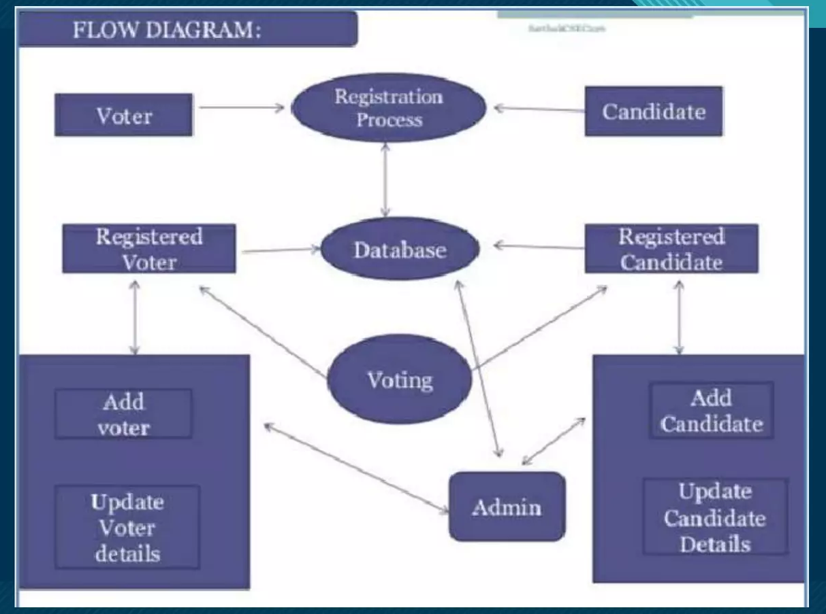
System Architecture

Slide 8
System Deployment Approach
Deploying an online voting system requires careful planning and consideration to ensure its stability, security, and accessibility. Here's a systematic approach to deploying an online voting system:
Requirements Analysis: Begin by understanding the specific requirements of the online voting system, including functionality, security measures, scalability, and compliance needs. Identify key stakeholders, such as election officials, voters, and IT administrators, and gather their input to inform the system design.
Infrastructure Planning: Determine the necessary hardware and software infrastructure for hosting the online voting system. This includes servers, databases, network infrastructure, and security measures such as firewalls, encryption, and intrusion detection systems. Consider factors such as reliability, scalability, and redundancy to ensure continuous operation during peak voting periods.
Software Development: Develop the online voting system software according to the requirements identified in the analysis phase. This may involve building web applications for voter registration, ballot creation, voting, and result tabulation, as well as administrative interfaces for managing elections and monitoring system performance. Use secure coding practices and conduct thorough testing to identify and mitigate potential vulnerabilities.
Security Implementation: Implement robust security measures to protect the integrity and confidentiality of the online voting system.

Slide 9
System Deployment Approach
5.User Training and Support: Provide training and support to election officials, voters, and IT staff to familiarize them with the online voting system and address any questions or concerns they may have. 6.Pilot Testing: Conduct pilot tests of the online voting system with a small group of users to validate its functionality, usability, and security. Gather feedback from participants to identify areas for improvement and refine the system accordingly.
7.Full-Scale Deployment: Once the online voting system has been thoroughly tested and validated, deploy it for use in live elections. Coordinate with election officials to ensure a smooth transition from traditional paper-based voting methods to the online system. Monitor system performance and security during the election period and be prepared to respond to any issues or incidents that arise.
8.Post-Deployment Evaluation: After the election, conduct a post-deployment evaluation to assess the performance of the online voting system and gather feedback from stakeholders. Identify any lessons learned and areas for further improvement to inform future deployments and enhancements.
By following this systematic approach to system deployment, you can ensure the successful implementation of an online voting system that meets the needs of election stakeholders while maintaining the integrity and security of the electoral process.

Slide 10
Algorithm & Deployment
Algorithm Used:
SHA(Secure Hash Algorithm):
SHA (Secure Hash Algorithm) is a family of cryptographic hash functions developed by the National Security Agency (NSA) in the United States.
These algorithms are widely used in various security applications and protocols, including digital signatures, message authentication codes (MACs), and ensuring the integrity of transmitted data.

Slide 11
Conclusion
Generally voting has to be perform by user by going to the voting center. Many users like army person or NRI cannot come to the voting place.
Therefore we have to implement a online voting system by which the users can vote over the online. It is one of the greatest advantage for NRI and person who go outside the country they can vote on online by our software.

Slide 12
Future Scope
The future scope of an online voting system project encompasses various potential enhancements and expansions to address evolving technological, societal, and regulatory needs. Here are some potential avenues for future development:
Enhanced Security Measures:
Continuous improvement of security measures to defend against emerging cyber threats, including advancements in encryption techniques.
Integration of blockchain technology to provide additional transparency, immutability, and tamper-resistance to the voting process.
Accessibility and Inclusivity:
Development of features to enhance accessibility for voters with disabilities, such as support for assistive technologies, alternative voting methods, and multilingual interfaces.
Usability and User Experience:
Iterative refinement of user interfaces and user experience design based on feedback from voters and usability testing.
Implementation of personalized voting experiences tailored to individual preferences and voting histories.

Slide 13
Reference :
http://www.oreilly.com/data/free/the-new-artificial-intelligence-market.csp
AMNA Qureshi ‘‘SEVEP: Verifiable, secure and privacy preserving remote polling with untrusted computing devices,” in Future Network Systems and Security Feb 22(2019)iEe E. [2] S.Ganesh Prabhu,Rachel, Agnes Shiny, and A. R. Roshinee. "Tracking Real Time Vehicle And Locking System Using Labview Applications." In 2020 6th International Conference on Advanced Computing and Communication Systems (ICACCS), pp. 55-57. IEEE, 2020.
https://sci-hub.hkvisa.net/10.1109/ICACCS51430.2021.9441818
Notes:
Reference
These are the references for this session.
13

Slide 14
Links:
GitHub link
Video link

Slide 15
Thank you!
Notes:
thank you very much for joining this PPT, keep learning.
15

