Slide 1
Depth-First Search
A
B
D
E
C

Slide 2
Subgraphs
A subgraph S of a graph G is a graph such that
The vertices of S are a subset of the vertices of G
The edges of S are a subset of the edges of G
A spanning subgraph of G is a subgraph that contains all the vertices of G
Subgraph
Spanning subgraph

Slide 3
Application: Web Crawlers
A fundamental kind of algorithmic operation that we might wish to perform on a graph is traversing the edges and the vertices of that graph.
A traversal is a systematic procedure for exploring a graph by examining all of its vertices and edges.
For example, a web crawler, which is the data collecting part of a search engine, must explore a graph of hypertext documents by examining its vertices, which are the documents, and its edges, which are the hyperlinks between documents.
A traversal is efficient if it visits all the vertices and edges in linear time.

Slide 4
Connectivity
A graph is connected if there is a path between every pair of vertices
A connected component of a graph G is a maximal connected subgraph of G
Connected graph
Non connected graph with two connected components

Slide 5
Trees and Forests
A tree is an undirected graph T such that
T is connected
T has no cycles
This definition of tree is different from the one of a rooted tree
A forest is an undirected graph without cycles
The connected components of a forest are trees
Tree
Forest

Slide 6
Spanning Trees and Forests
A spanning tree of a connected graph is a spanning subgraph that is a tree
A spanning tree is not unique unless the graph is a tree
Spanning trees have applications to the design of communication networks
A spanning forest of a graph is a spanning subgraph that is a forest
Graph
Spanning tree

Slide 7
Depth-First Search
Depth-first search (DFS) is a general technique for traversing a graph
A DFS traversal of a graph G
Visits all the vertices and edges of G
Determines whether G is connected
Computes the connected components of G
Computes a spanning forest of G
DFS on a graph with n vertices and m edges takes O(n + m ) time
DFS can be further extended to solve other graph problems
Find and report a path between two given vertices
Find a cycle in the graph

Slide 8
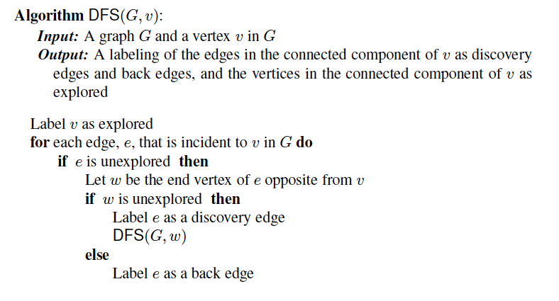
DFS Algorithm from a Vertex

Slide 9
Example
A
unexplored vertex
A
A
visited vertex
B
D
E
unexplored edge
discovery edge
C
back edge
A
A
B
D
E
B
D
E
C
C

Slide 10
Example (cont.)
A
A
B
D
E
B
D
E
C
C
A
A
B
D
E
B
D
E
C
C

Slide 11
DFS and Maze Traversal
The DFS algorithm is similar to a classic strategy for exploring a maze
We mark each intersection, corner and dead end (vertex) visited
We mark each corridor (edge ) traversed
We keep track of the path back to the entrance (start vertex) by means of a rope (recursion stack)

Slide 12
Properties of DFS
Property 1
DFS(G, v) visits all the vertices and edges in the connected component of v
Property 2
The discovery edges labeled by DFS(G, v) form a spanning tree of the connected component of v
A
B
D
E
C

Slide 13
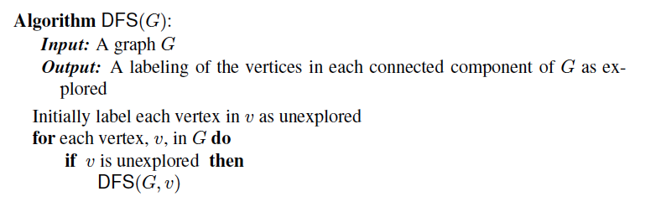
The General DFS Algorithm
Perform a DFS from each unexplored vertex:

Slide 14
Analysis of DFS
Setting/getting a vertex/edge label takes O(1) time
Each vertex is labeled twice
once as UNEXPLORED
once as VISITED
Each edge is labeled twice
once as UNEXPLORED
once as DISCOVERY or BACK
Method incidentEdges is called once for each vertex
DFS runs in O(n + m) time provided the graph is represented by the adjacency list structure
Recall that Σ_{v} deg(v) = 2m

Slide 15
Path Finding
We can specialize the DFS algorithm to find a path between two given vertices u and z using the template method pattern
We call DFS(G, u) with u as the start vertex
We use a stack S to keep track of the path between the start vertex and the current vertex
As soon as destination vertex z is encountered, we return the path as the contents of the stack
Algorithm pathDFS(G, v, z)
setLabel(v, VISITED)
S.push(v)
if v = z
return S.elements()
for all e ∈ G.incidentEdges(v)
if getLabel(e) = UNEXPLORED
w ← opposite(v,e)
if getLabel(w) = UNEXPLORED
setLabel(e, DISCOVERY)
S.push(e)
pathDFS(G, w, z)
S.pop(e)
else
setLabel(e, BACK)
S.pop(v)

Slide 16
Cycle Finding (not in book)
We can specialize the DFS algorithm to find a simple cycle using the template method pattern
We use a stack S to keep track of the path between the start vertex and the current vertex
As soon as a back edge (v, w) is encountered, we return the cycle as the portion of the stack from the top to vertex w
Algorithm cycleDFS(G, v, z)
setLabel(v, VISITED)
S.push(v)
for all e ∈ G.incidentEdges(v)
if getLabel(e) = UNEXPLORED
w ← opposite(v,e)
S.push(e)
if getLabel(w) = UNEXPLORED
setLabel(e, DISCOVERY)
pathDFS(G, w, z)
S.pop(e)
else
T ← new empty stack
repeat
o ← S.pop()
T.push(o)
until o = w
return T.elements()
S.pop(v)

Slide 17
Breadth-First Search
L₀
A
L₁
B
C
D
L₂
E
F

Slide 18
Breadth-First Search
Breadth-first search (BFS) is a general technique for traversing a graph
A BFS traversal of a graph G
Visits all the vertices and edges of G
Determines whether G is connected
Computes the connected components of G
Computes a spanning forest of G
BFS on a graph with n vertices and m edges takes O(n + m ) time
BFS can be further extended to solve other graph problems
Find and report a path with the minimum number of edges between two given vertices
Find a simple cycle, if there is one

Slide 19
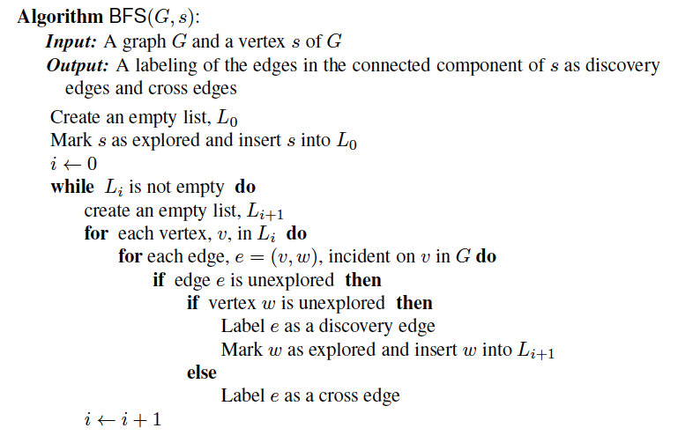
BFS Algorithm
The algorithm uses “levels” L_{i} and a mechanism for setting and getting “labels” of vertices and edges.

Slide 20
Example
L₀
unexplored vertex
A
A
A
visited vertex
L₁
B
C
D
unexplored edge
discovery edge
E
F
cross edge
L₀
L₀
A
A
L₁
L₁
B
C
D
B
C
D
E
F
E
F

Slide 21
Example (cont.)
L₀
L₀
A
A
L₁
L₁
B
C
D
B
C
D
L₂
E
F
E
F
L₀
L₀
A
A
L₁
L₁
B
C
D
B
C
D
L₂
L₂
E
F
E
F

Slide 22
Example (cont.)
L₀
L₀
A
A
L₁
L₁
B
C
D
B
C
D
L₂
L₂
E
F
E
F
L₀
A
L₁
B
C
D
L₂
E
F

Slide 23
Properties
Notation
G_{s}: connected component of s
Property 1
BFS(G, s) visits all the vertices and edges of G_{s}
Property 2
The discovery edges labeled by BFS(G, s) form a spanning tree T_{s} of G_{s}
Property 3
For each vertex v in L_{i}
The path of T_{s} from s to v has i edges
Every path from s to v in G_{s} has at least i edges
A
B
C
D
E
F
L₀
A
L₁
B
C
D
L₂
E
F

Slide 24
Analysis
Setting/getting a vertex/edge label takes O(1) time
Each vertex is labeled twice
once as UNEXPLORED
once as VISITED
Each edge is labeled twice
once as UNEXPLORED
once as DISCOVERY or CROSS
Each vertex is inserted once into a sequence L_{i}
Method incidentEdges is called once for each vertex
BFS runs in O(n + m) time provided the graph is represented by the adjacency list structure
Recall that Σ_{v} deg(v) = 2m

Slide 25
Applications
We can use the BFS traversal algorithm, for a graph G, to solve the following problems in O(n + m) time
Compute the connected components of G
Compute a spanning forest of G
Find a simple cycle in G, or report that G is a forest
Given two vertices of G, find a path in G between them with the minimum number of edges, or report that no such path exists

Slide 26
DFS vs. BFS
Applications | DFS | BFS
Spanning forest, connected components, paths, cycles | √ | √
Shortest paths |  | √
L₀
A
A
L₁
B
C
D
B
C
D
L₂
E
F
E
F
DFS
BFS

Slide 27
DFS vs. BFS (cont.)
Back edge (v,w)
w is an ancestor of v in the tree of discovery edges
Cross edge (v,w)
w is in the same level as v or in the next level
L₀
A
A
L₁
B
C
D
B
C
D
L₂
E
F
E
F
DFS
BFS

Slide 28
Directed Graphs
BOS
ORD
JFK
SFO
DFW
LAX
MIA

Slide 29
Digraphs
A digraph is a graph whose edges are all directed
Short for “directed graph”
Applications
one-way streets
flights
task scheduling
E
D
C
B
A

Slide 30
Digraph Properties
E
D
C
A graph G=(V,E) such that
Each edge goes in one direction:
Edge (a,b) goes from a to b, but not b to a
If G is simple, m < n⋅(n − 1)
If we keep in-edges and out-edges in separate adjacency lists, we can perform listing of incoming edges and outgoing edges in time proportional to their size
B
A

Slide 31
Digraph Application
Scheduling: edge (a,b) means task a must be completed before b can be started
cs21
cs22
cs46
cs51
cs53
cs52
cs161
cs131
cs141
cs121
cs171
The good life
cs151

Slide 32
Directed DFS
We can specialize the traversal algorithms (DFS and BFS) to digraphs by traversing edges only along their direction
In the directed DFS algorithm, we have four types of edges
discovery edges
back edges
forward edges
cross edges
A directed DFS starting at a vertex s determines the vertices reachable from s
E
D
C
B
A

Slide 33
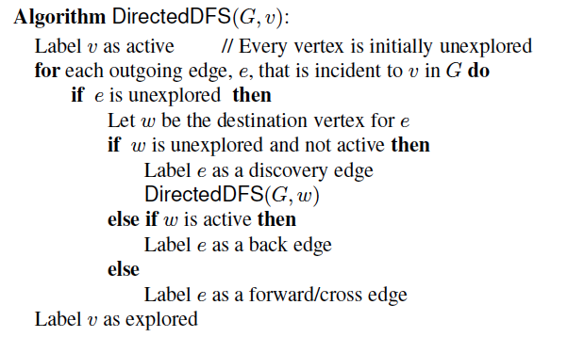
The Directed DFS Algorithm

Slide 34
Reachability
DFS tree rooted at v: vertices reachable from v via directed paths
E
D
E
D
C
A
C
F
E
D
A
B
C
F
A
B

Slide 35
Strong Connectivity
Each vertex can reach all other vertices
a
g
c
d
e
b
f

Slide 36
Strong Connectivity Algorithm
Pick a vertex v in G
Perform a DFS from v in G
If there’s a w not visited, print “no”
Let G’ be G with edges reversed
Perform a DFS from v in G’
If there’s a w not visited, print “no”
Else, print “yes”
Running time: O(n+m)
G:
a
c
g
d
e
f
b
a
G’:
c
g
d
e
f
b

Slide 37
Transitive Closure
Given a digraph G, the transitive closure of G is the digraph G* such that
G* has the same vertices as G
if G has a directed path from u to v (u ≠ v), G* has a directed edge from u to v
The transitive closure provides reachability information about a digraph
D
E
B
G
C
A
D
E
B
C
A
G*

Slide 38
Computing the Transitive Closure
If there's a way to get from A to B and from B to C, then there's a way to get from A to C.
We can perform DFS starting at each vertex
O(n(n+m))
Alternatively ... Use dynamic programming: The Floyd-Warshall Algorithm

Slide 39
DAGs and Topological Ordering
D
E
A directed acyclic graph (DAG) is a digraph that has no directed cycles
A topological ordering of a digraph is a numbering
v₁ , …, v_{n}
of the vertices such that for every edge (v_{i} , v_{j}), we have i < j
Example: in a task scheduling digraph, a topological ordering a task sequence that satisfies the precedence constraints
Theorem
A digraph admits a topological ordering if and only if it is a DAG
B
C
A
DAG G
v₄
v₅
D
E
v₂
B
v₃
v₁
C
Topological ordering of G
A

Slide 40
Topological Sorting
Number vertices, so that (u,v) in E implies u < v
wake up
1
A typical student day
2
3
eat
study computer sci.
4
5
nap
more c.s.
7
play
8
write c.s. program
6
9
work out
bake cookies
10
sleep
11
dream about graphs

Slide 41
Algorithm for Topological Sorting
Note: This algorithm is different than the one in the book
Running time: O(n + m)
Algorithm TopologicalSort(G)
H ← G // Temporary copy of G
n ← G.numVertices()
while H is not empty do
Let v be a vertex with no outgoing edges
Label v ← n
n ← n − 1
Remove v from H

Slide 42
Implementation with DFS
Simulate the algorithm by using depth-first search
O(n+m) time.
Algorithm topologicalDFS(G, v)
Input graph G and a start vertex v of G
Output labeling of the vertices of G in the connected component of v
setLabel(v, VISITED)
for all e ∈ G.outEdges(v) { outgoing edges }
w ← opposite(v,e)
if getLabel(w) = UNEXPLORED
{ e is a discovery edge }
topologicalDFS(G, w)
else
{ e is a forward or cross edge }
Label v with topological number n
n ← n - 1
Algorithm topologicalDFS(G)
Input dag G
Output topological ordering of G n ← G.numVertices()
for all u ∈ G.vertices()
setLabel(u, UNEXPLORED)
for all v ∈ G.vertices()
if getLabel(v) = UNEXPLORED
topologicalDFS(G, v)

Slide 43
Topological Sorting Example

Slide 44
Topological Sorting Example
9

Slide 45
Topological Sorting Example
8
9

Slide 46
Topological Sorting Example
7
8
9

Slide 47
Topological Sorting Example
6
7
8
9

Slide 48
Topological Sorting Example
6
5
7
8
9

Slide 49
Topological Sorting Example
4
6
5
7
8
9

Slide 50
Topological Sorting Example
3
4
6
5
7
8
9

Slide 51
Topological Sorting Example
2
3
4
6
5
7
8
9

Slide 52
Topological Sorting Example
2
1
3
4
6
5
7
8
9

Slide 53
Minimum Spanning Trees

Slide 54
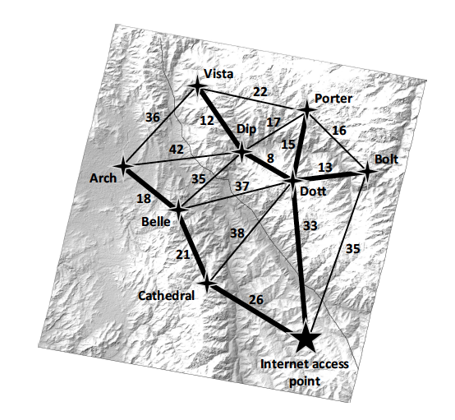
Application: Connecting a Network
Suppose the remote mountain country of Vectoria has been given a major grant to install a large Wi-Fi the center of each of its mountain villages.
Communication cables can run from the main Internet access point to a village tower and cables can also run between pairs of towers.
The challenge is to interconnect all the towers and the Internet access point as cheaply as possible.

Slide 55
Application: Connecting a Network
We can model this problem using a graph, G, where each vertex in G is the location of a Wi-Fi the Internet access point, and an edge in G is a possible cable we could run between two such vertices.
Each edge in G could then be given a weight that is equal to the cost of running the cable that that edge represents.
Thus, we are interested in finding a connected acyclic subgraph of G that includes all the vertices of G and has minimum total cost.
Using the language of graph theory, we are interested in finding a minimum spanning tree (MST) of G.

Slide 56
Minimum Spanning Trees
Spanning subgraph
Subgraph of a graph G containing all the vertices of G
Spanning tree
Spanning subgraph that is itself a (free) tree
Minimum spanning tree (MST)
Spanning tree of a weighted graph with minimum total edge weight
Applications
Communications networks
Transportation networks
ORD
10
1
PIT
DEN
6
7
9
3
DCA
4
STL
8
5
2
DFW
ATL

Slide 57
Cycle Property
Cycle Property:
Let T be a minimum spanning tree of a weighted graph G
Let e be an edge of G that is not in T and C let be the cycle formed by e with T
For every edge f of C, weight(f) ≤ weight(e)
Proof:
By contradiction
If weight(f) > weight(e) we can get a spanning tree of smaller weight by replacing e with f
f
8
4
C
9
2
6
3
e
8
7
7
Replacing f with e yields a better spanning tree
f
8
4
C
9
2
6
3
e
8
7
7

Slide 58
Partition Property
U
V
f
7
Partition Property:
Consider a partition of the vertices of G into subsets U and V
Let e be an edge of minimum weight across the partition
There is a minimum spanning tree of G containing edge e
Proof:
Let T be an MST of G
If T does not contain e, consider the cycle C formed by e with T and let f be an edge of C across the partition
By the cycle property, weight(f) ≤ weight(e)
Thus, weight(f) = weight(e)
We obtain another MST by replacing f with e
4
9
2
5
8
8
e
3
7
Replacing f with e yields another MST
U
V
f
7
4
9
2
5
8
8
e
3
7

Slide 59
Prim-Jarnik’s Algorithm
Similar to Dijkstra’s algorithm
We pick an arbitrary vertex s and we grow the MST as a cloud of vertices, starting from s
We store with each vertex v label d(v) representing the smallest weight of an edge connecting v to a vertex in the cloud
At each step:
We add to the cloud the vertex u outside the cloud with the smallest distance label
We update the labels of the vertices adjacent to u

Slide 60
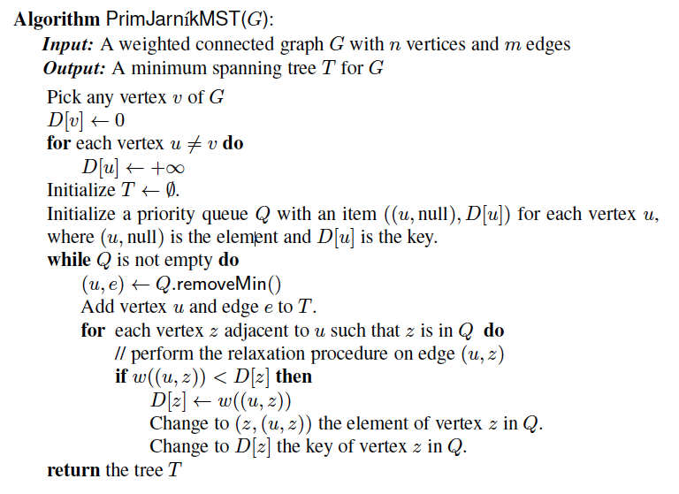
Prim-Jarnik Pseudo-code

Slide 61
Example
∞
7
2
7
D
2
7
D
B
4
B
4
8
9
∞
5
9
∞
2
5
F
2
5
F
C
8
C
8
8
3
8
3
E
E
A
7
7
A
7
7
0
0
7
7
2
7
D
7
D
B
4
2
B
4
5
9
∞
9
4
2
5
F
5
5
C
2
F
8
C
8
8
3
3
E
8
A
7
E
0
7
A
7
7
0

Slide 62
Example (contd.)
7
2
7
D
B
4
5
9
4
2
5
F
C
8
8
3
E
A
7
3
7
0
7
D
2
B
4
5
9
4
2
5
F
C
8
8
3
E
A
7
3
0

Slide 63
Analysis
Graph operations
We cycle through the incident edges once for each vertex
Label operations
We set/get the distance, parent and locator labels of vertex z O(deg(z)) times
Setting/getting a label takes O(1) time
Priority queue operations
Each vertex is inserted once into and removed once from the priority queue, where each insertion or removal takes O(log n) time
The key of a vertex w in the priority queue is modified at most deg(w) times, where each key change takes O(log n) time
Prim-Jarnik’s algorithm runs in O((n + m) log n) time provided the graph is represented by the adjacency list structure
Recall that Σ_{v} deg(v) = 2m
The running time is O(m log n) since the graph is connected

Slide 64
Kruskal’s Approach
Maintain a partition of the vertices into clusters
Initially, single-vertex clusters
Keep an MST for each cluster
Merge “closest” clusters and their MSTs
A priority queue stores the edges outside clusters (or you could even sort the edges)
Key: weight
Element: edge
At the end of the algorithm
One cluster and one MST

Slide 65
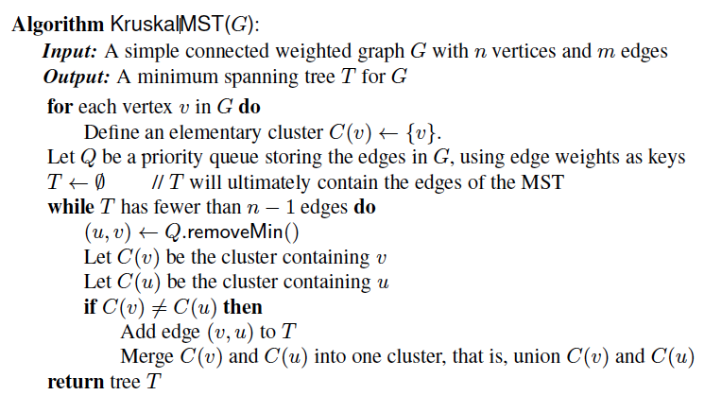
Kruskal’s Algorithm

Slide 66
Example of Kruskal’s Algorithm
G
G
B
8
8
4
B
4
9
E
6
9
E
6
1
5
F
1
5
F
C
11
3
C
11
3
2
2
7
D
H
7
H
A
12
D
12
10
A
10
G
G
B
8
B
8
4
4
9
E
6
9
E
6
1
5
F
1
5
F
C
11
3
C
11
3
2
2
7
D
H
7
H
12
D
12
A
10
A
10

Slide 67
Example (contd.)
G
G
B
8
8
4
B
4
9
E
6
9
E
6
1
5
F
1
5
F
C
11
3
C
11
3
2
2
7
D
H
7
H
12
D
12
A
10
A
10
five steps
two steps
G
G
B
8
B
8
4
4
9
E
6
9
E
6
1
5
F
1
5
F
C
11
3
C
11
3
2
2
7
D
H
7
D
H
A
12
A
12
10
10

Slide 68
Data Structure for Kruskal’s Algorithm
The algorithm maintains a forest of trees
A priority queue extracts the edges by increasing weight
An edge is accepted it if connects distinct trees
We need a data structure that maintains a partition, i.e., a collection of disjoint sets, with operations:
makeSet(u): create a set consisting of u
find(u): return the set storing u
union(A, B): replace sets A and B with their union

Slide 69
List-based Partition
Each set is stored in a sequence
Each element has a reference back to the set
operation find(u) takes O(1) time, and returns the set of which u is a member.
in operation union(A,B), we move the elements of the smaller set to the sequence of the larger set and update their references
the time for operation union(A,B) is min(|A|, |B|)
Whenever an element is processed, it goes into a set of size at least double, hence each element is processed at most log n times

Slide 70
Partition-Based Implementation
Partition-based version of Kruskal’s Algorithm
Cluster merges as unions
Cluster locations as finds
Running time O((n + m) log n)
Priority Queue operations: O(m log n)
Union-Find operations: O(n log n)

Slide 71
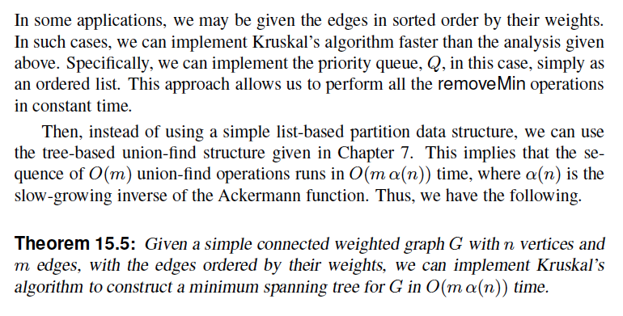
Alternative Implementation

Slide 72
Baruvka’s Algorithm
Like Kruskal’s Algorithm, Baruvka’s algorithm grows many clusters at once and maintains a forest T
Each iteration of the while loop halves the number of connected components in forest T
The running time is O(m log n)
Algorithm BaruvkaMST(G)
T ← V {just the vertices of G}
while T has fewer than n − 1 edges do
for each connected component C in T do
Let edge e be the smallest-weight edge from C to another component in T
if e is not already in T then
Add edge e to T
return T

Slide 73
Example of Baruvka’s Algorithm (animated)
Slide by Matt Stallmann included with permission.
2
4
3
8
5
8
9
4
7
4
9
3
1
6
6
6
5
4
2
4
3
8
5
9
4
7
3
1
6
6
5
4

