Slide 1
Some Special Graphs

Slide 2

1) Barbell graph
the n-barbell graph is a special type of undirected graph consisting of two non-overlapping n-vertex cliques together with a single edge that has an endpoint in each clique

Slide 3
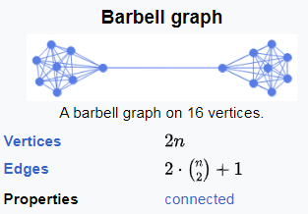
1) Barbell graph

Slide 4
2) Lollipop graph
the (m,n)-lollipop graph is a special type of graph consisting of a complete graph (clique) on m vertices and a path graph on n vertices, connected with a bridge

Slide 5
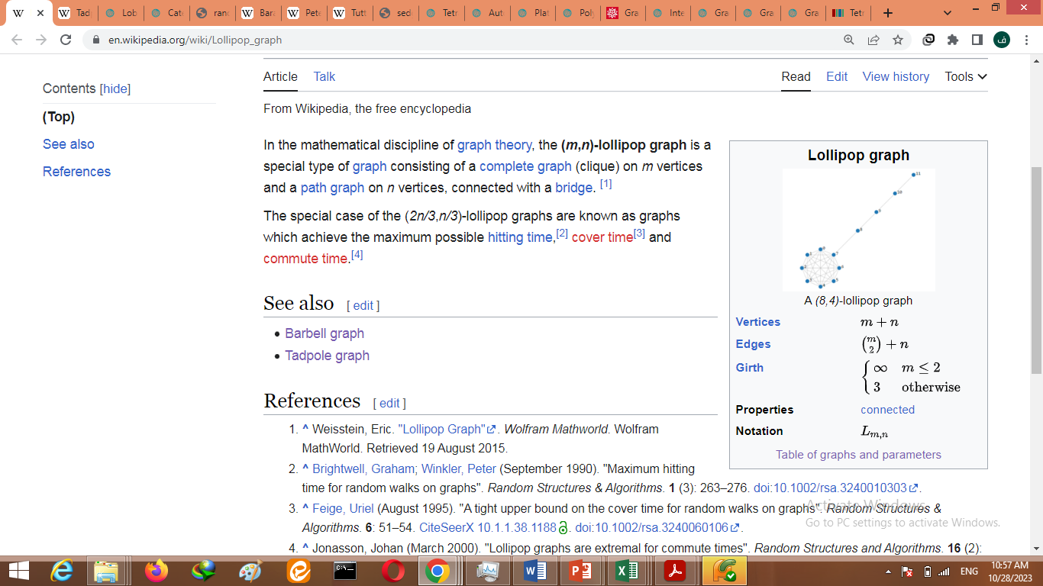
2) Lollipop graph

Slide 6

3) Tadpole graph
the (m,n)-tadpole graph is a special type of graph consisting of a cycle graph on m (at least 3) vertices and a path graph on n vertices, connected with a bridge

Slide 7
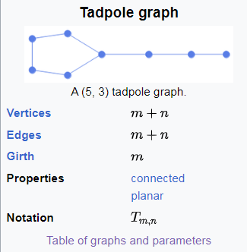
3) Tadpole graph

Slide 8
Diameter and Radius
The diameter of a graph is the length of the shortest path between the most distanced nodes
A radius of the graph exists only if it has the diameter. The minimum among all the maximum distances between a vertex to all other vertices is considered as the radius of the Graph G.

Slide 9
4) Cubic graphs
Cubic graphs, also called trivalent graphs, are graphs all of whose nodes have degree 3 (i.e., 3-regular graphs). Cubic graphs on n nodes exists only for even n (Harary 1994, p. 15).

Slide 10
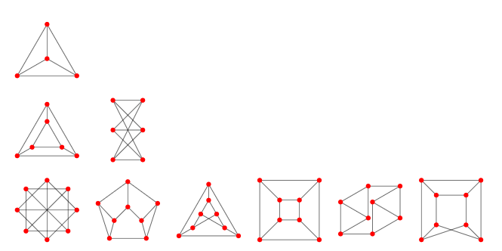
4) Cubic graphs
Not-necessarily-connected cubic graphs on n=4, 6, and 8 are illustrated here.

Slide 11
5) Petersen graph
the Petersen graph is an undirected graph with 10 vertices and 15 edges. It is a small graph that serves as a useful example and counterexample for many problems in graph theory. The Petersen graph is named after Julius Petersen, who in 1898 constructed it to be the smallest bridgeless cubic graph with no three-edge-coloring

Slide 12
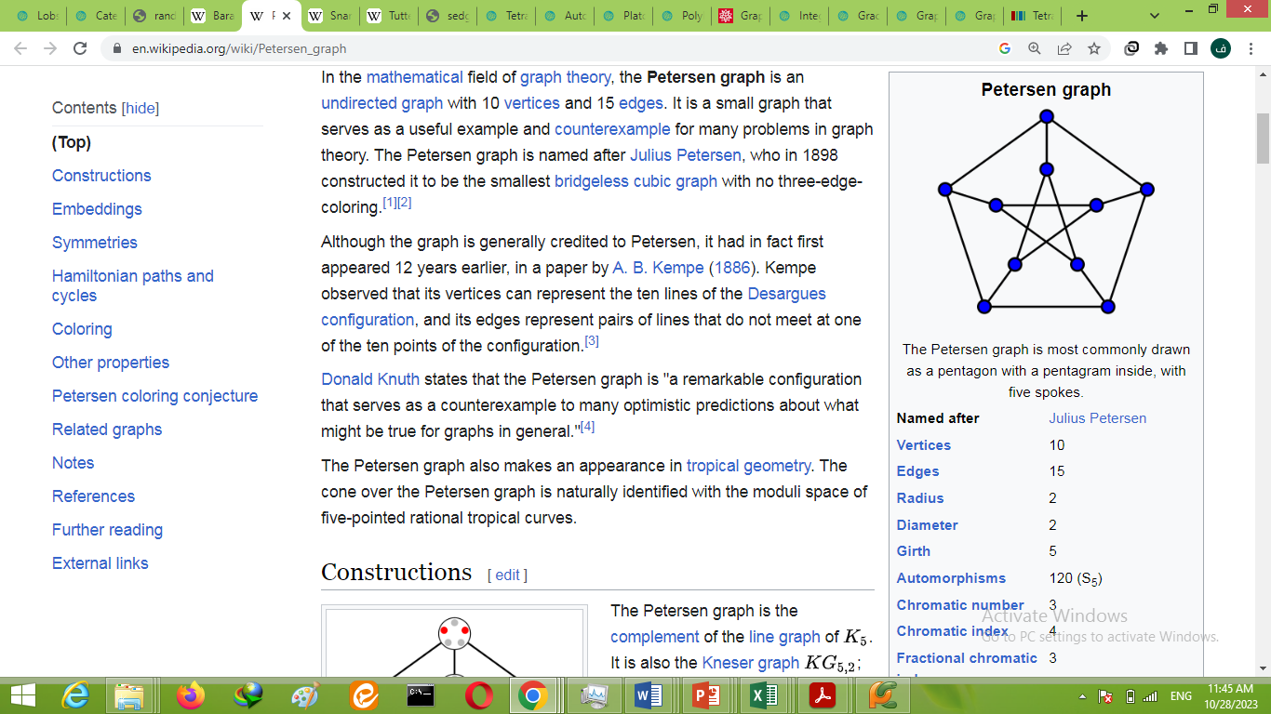
5) Petersen graph

Slide 13
Integral Embedding
An integral embedding of a graph is a graph drawn such that vertices are distinct points and all graph edges have integer lengths. Every graph possesses an integral embedding (Müller 1953, Harborth and Möller 1994).
It is conjectured that every planar graph has a plane integral embedding

Slide 14
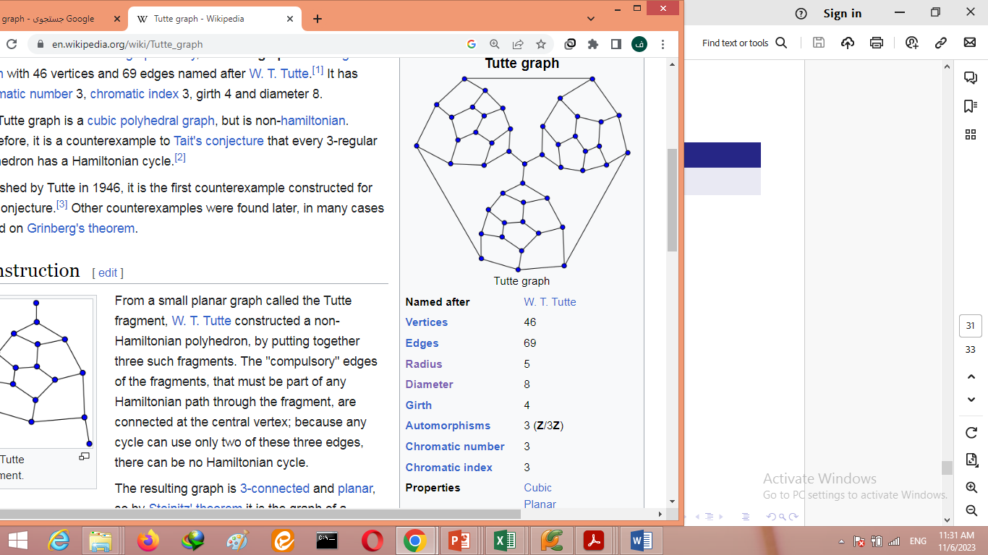
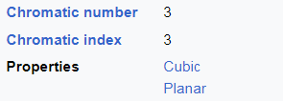
6) Tutte Graph

Slide 15
Lemma:
In a connected graph, if there is a subgraph linked to the rest of the graph by exactly three edges, any Hamiltonian cycle of the whole graph uses exactly two of the linking edges. In particular, the subgraph can be shrunk to a point while preserving Hamiltonian cycles.

Slide 16
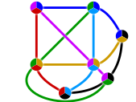
Projective Plane
In mathematics, a projective plane
is a geometric structure that extends
the concept of a plane. In the ordinary
Euclidean plane, two lines typically
intersect at a single point, but there are some pairs of lines (namely, parallel lines) that do not intersect. A projective plane can be thought of as an ordinary plane equipped with additional "points at infinity" where parallel lines intersect. Thus any two distinct lines in a projective plane intersect at exactly one point.

Slide 17
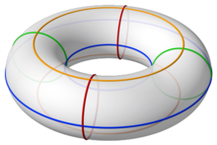
7)Toroidal graph
In the mathematical field of graph theory, a toroidal graph is a graph that can be embedded on a torus. In other words, the graph's vertices and edges can be placed on a torus such that no edges intersect except at a vertex that belongs to both.

