Slide 1
CPG beverages portfolio - 67 SKUs x 6 distribution centers
Demand forecasting & supply order generation
A weekly pipeline that forecasts demand with calibrated uncertainty, flags stock-out risk, and recommends the next replenishment order per SKU and DC - with the business case against today's naive policy.
25%
99%
12 -> 3
28.3M
lower forecast error than a 4-week moving average
implied service level of the recommended order (MA policy: 99%)
SKU x DC lines below 90% service level (moving-average policy -> recommended)
MXN of target stock (19%) freed by forecast-sized safety stock at the same service targets
Tracks delivered: A (forecasting) + B (stock-out risk) + supply-order engine. One command re-runs everything: .\run.ps1
1 / 10

Slide 2
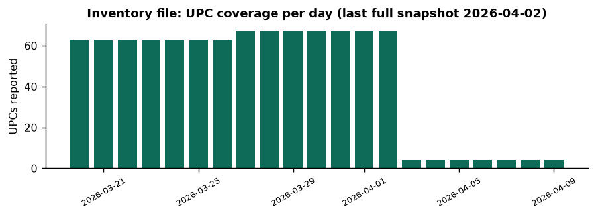
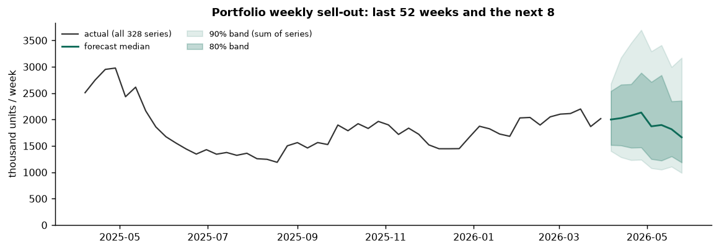
Data analysis & preparation
Data: two years of sell-out, three weeks of inventory
• 328 SKU x DC series, daily sell-out 2024-03-18 to 2026-04-10, modelled on 107 complete weeks.
• Store inventory exists only for 2026-03-20 .. 04-09; the last complete snapshot (2026-04-02) is 'current on-hand'. The final week has 4 UPCs.
• Clean-ups: 3 UPCs mapped to two item numbers (de-duplicated), 7,116 negative store on-hand rows (clipped, kept as a stock-out signal), late-starting series kept as missing, 1,720 daily outliers winsorised for training only.
• Calendar effects engineered: Mexican federal holidays, quincena paydays, Semana Santa, El Buen Fin, December peak. Future price and promos are treated as unknown.
• Clusters (ABC x XYZ): A-X 6, A-Y 114, A-Z 80, B-Y 32, B-Z 90, C-Z 6. Lead time is 7 days and MOQ 100 for every SKU; only safety-stock days vary (3 / 7 / 14).
2 / 10

Slide 3
How it runs
Architecture and data flow
Extraction
sell-out, inventory, catalogs; schema validation
Feature store
daily + weekly parquet: lags, calendar, promo, cover
Training
expanding-window backtest; per-cluster selection; interval calibration
Scoring
8-week quantile forecast per SKU x DC, weekly
Recommendation
risk scores + order-up-to policy -> order file
Consumption
planner queue, S&OP input, API
• Stages communicate only through files (parquet / CSV), so any stage can be re-run alone and every artifact is inspectable.
• All assumptions live in config.toml: as-of date, cold-start threshold, outlier z, stock-out label share, quantiles, folds, service-level targets, cost ratio.
• Typed Python package, argparse CLI, pytest suite (metrics, calendar, aggregation, MOQ rounding, service-level maths, labels).
• Runtime on a laptop: about 3 minutes end to end (LightGBM global model + 328 ETS fits x 8 folds).
3 / 10

Slide 4
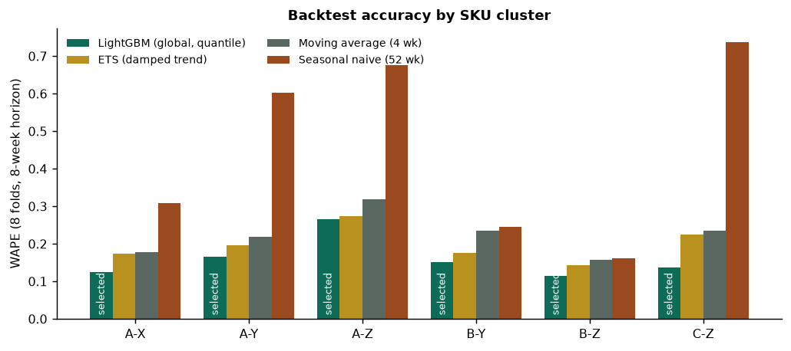
Track A - results
Forecasting: a global LightGBM model wins every cluster
model | wape | bias | cov90 raw
ets | 0.20 | -0.06 | 0.94
lgbm | 0.17 | -0.05 | 0.73
ma4 | 0.23 | -0.08 | 0.93
seasonal_naive | 0.56 | 0.48 | 0.77
• Overall WAPE 0.17 vs 0.20 (ETS) and 0.23 (MA4); seasonal naive 0.56 with +48% bias - last year is not a guide.
• Selection rule: lowest mean WAPE over 8 folds unless a simpler or steadier model is within 0.02. LightGBM wins outright in all six clusters.
• Blind test: with the last 8 weeks sealed and the choice made without them, LightGBM still leads (WAPE 0.115 vs ETS 0.123); the pre-registered choice held in 4 of 6 clusters.
• Bias -0.05: slight under-forecast, concentrated in promo weeks.
4 / 10

Slide 5
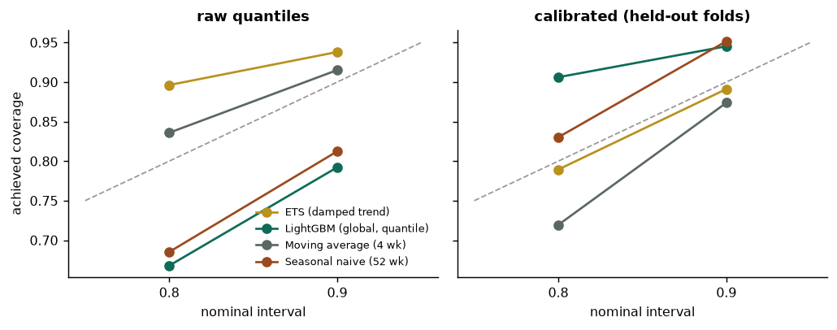
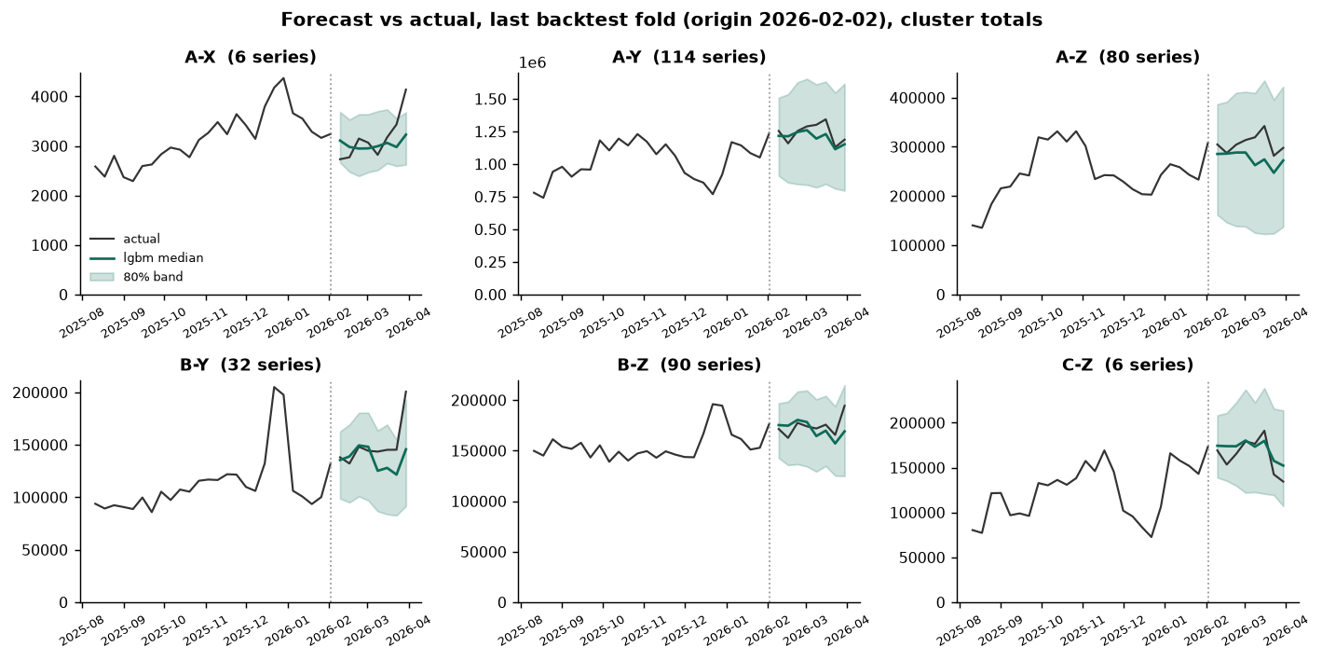
Track A - prediction intervals
Uncertainty: calibrated intervals, honestly measured
• Raw LightGBM quantiles were over-confident (90% band covered 73%). A conformal-style width factor per model x cluster is fitted on folds 1-5 and checked on folds 6-8: calibrated 90% coverage 95%, 80% coverage 91%.
• The calibrated p90 is what sizes safety stock in the order engine; the median drives the expected quantity.
• Error grows with horizon (see report); the 2-week protection period uses the most accurate part of the curve.
5 / 10

Slide 6
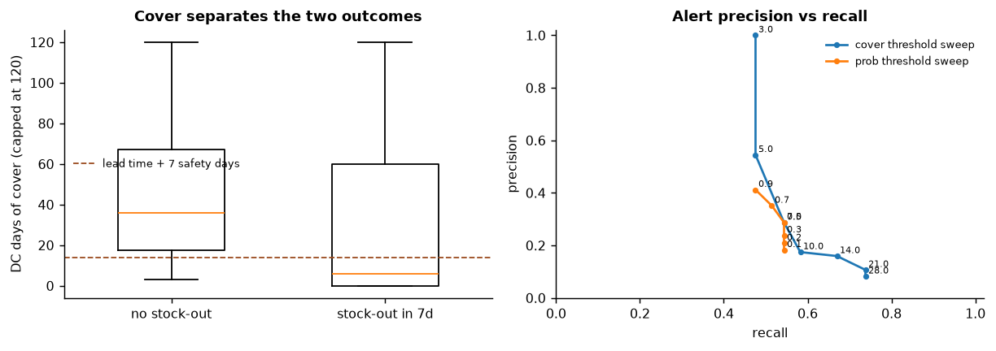
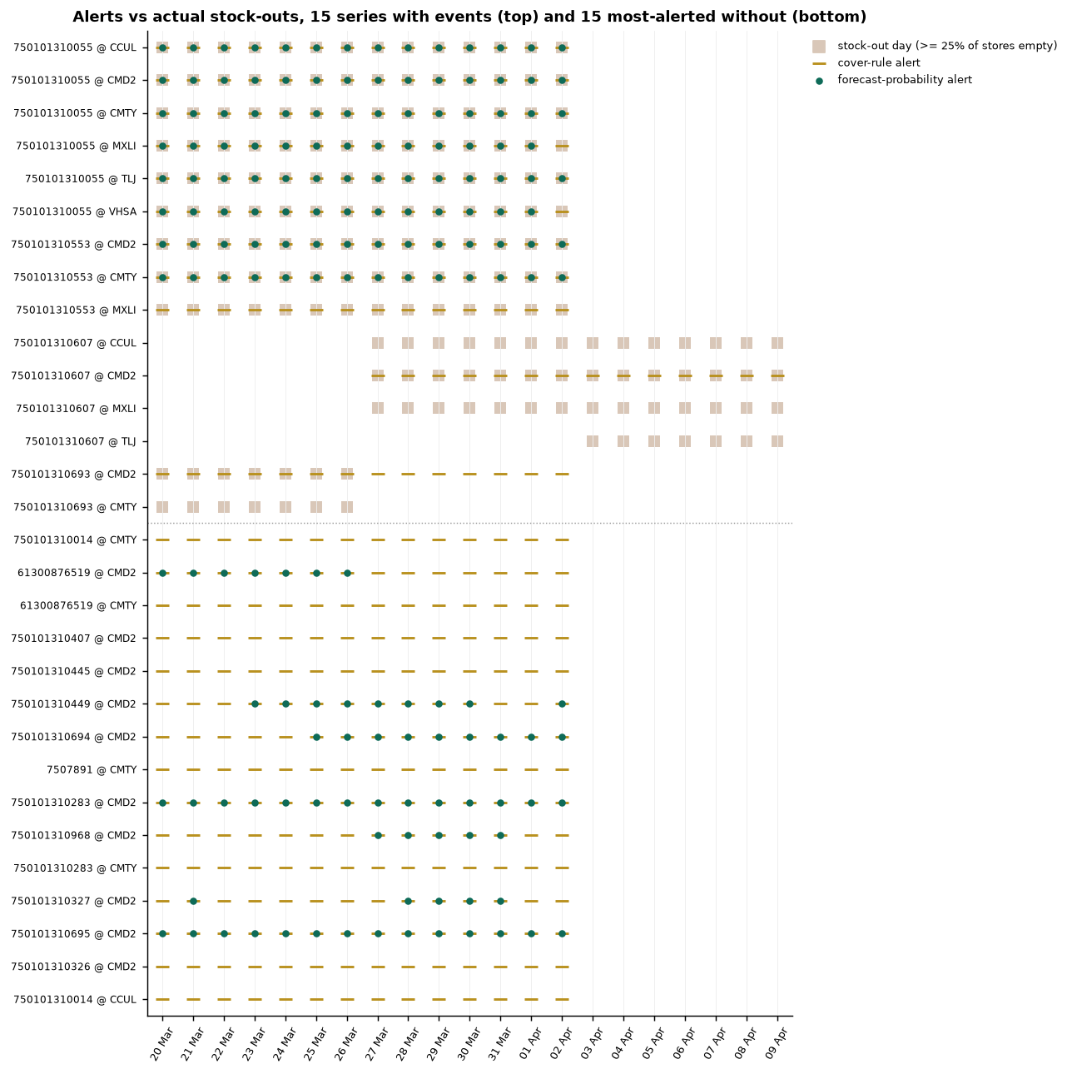
Track B - results
Stock-out risk: an alert planners can read
• Alert = 'on current DC stock and expected demand, this SKU is likely short at stores within the 7-day lead time'. High severity: P(stock-out) > 75% or cover below lead time.
• Three scorers: days-of-cover rule (cover < lead time + safety days), forecast probability P(7-day demand > on-hand) from calibrated quantiles, Isolation Forest on cover / probability / sales-vs-forecast / stock trend.
• Label: >= 25% of a DC's stores at zero. The window holds 189 event days over 15 series - all chronic, so lead-time-to-alert cannot be measured from this file.
• As of 2026-04-02: {'none': 238, 'medium': 58, 'high': 25} alerts across 321 SKU x DC.
method | n_alerts | n_events | precision | recall | false_alarm_rate
cover | 514 | 103 | 0.15 | 0.74 | 0.20
prob | 195 | 103 | 0.29 | 0.54 | 0.06
iforest | 80 | 103 | 0.39 | 0.30 | 0.02
6 / 10

Slide 7
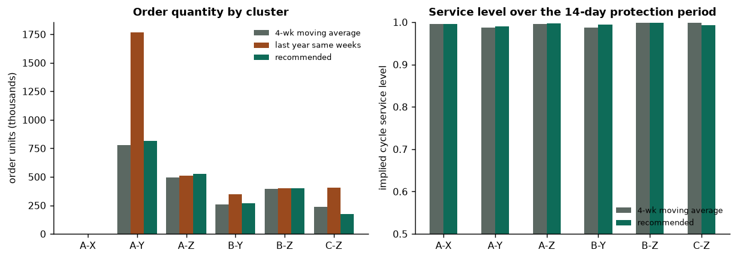
Recommendation engine
Supply order: what to buy next cycle, and what it costs
• Order-up-to over a 14-day protection period (lead time 7 + weekly review 7). Safety stock = max(catalog days policy, stock needed for the ABC service-level target under the calibrated forecast). Rounded up to MOQ.
• Recommended: 2,184,400 units, MXN 53,371,555 working capital, implied service level 99%, expected fill rate 100%.
• 4-week moving-average policy: 2,156,800 units, service level 99%, fill rate 100%.
• Delta this cycle: +1,453,165 MXN working capital for 1,087 fewer expected lost units; the tail matters more: 12 -> 3 lines below 90% service level.
• Forecast-sized safety stock at the same targets (fq variant) would carry 123.2M instead of 151.5M MXN of target stock at 96% service level - the negotiable lever.
• 12 of 328 lines flagged for planner review (discontinued, no inventory snapshot, high promo).
7 / 10

Slide 8
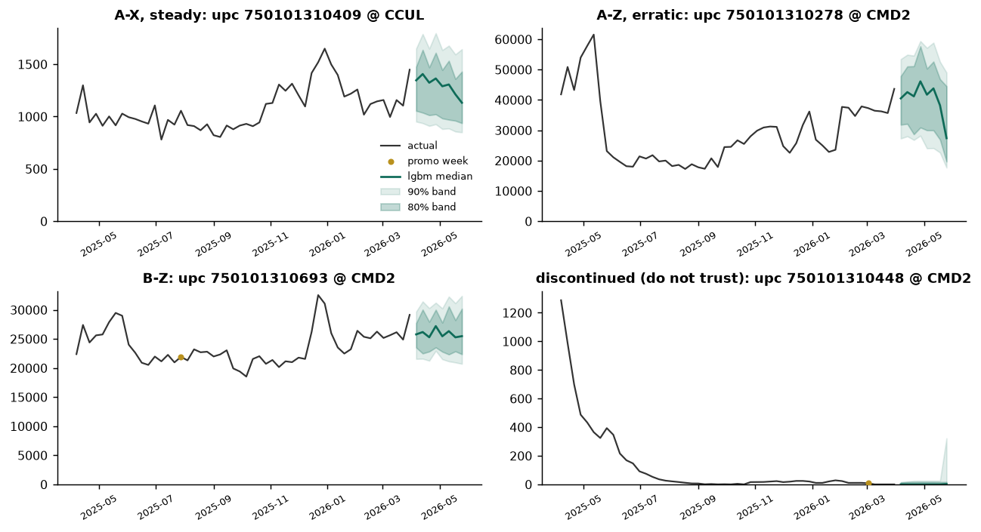
Framing
Business impact and where not to trust it
• Fill-rate lift: 100% -> 100% over the protection period (expected, model distribution).
• Lost-sales reduction: 1,087 units per cycle at portfolio level.
• Inventory cash: 28.3M MXN of target stock freed if safety stock is sized from the calibrated forecast instead of fixed days (shelf-price basis; set cost_ratio for cost).
• Service-level tail: 12 lines below 90% under the moving-average policy vs 3 recommended.
Do not trust the model for
• Discontinued lines (7 series): orders forced to zero, flagged.
• Cold-start SKUs (< 26 weeks): moving-average fallback, flagged.
• Promo-driven weeks: promos are unknown ahead, spikes are under-forecast - overlay the promo calendar.
• A-Z cluster: highest error and widest bands - order on the p90, not the median.
• Lines without an inventory snapshot or with in-transit orders (receipts are not in the data).
8 / 10

Slide 9
Operating the pipeline
Productionization plan
Schedule
weekly scoring Monday after sales close; monthly LightGBM retrain; ETS refit each run
Monitoring
rolling 4-wk WAPE & bias per cluster vs backtest envelope; interval coverage vs nominal; input schema & coverage checks
Alerting
drift breach -> retrain + human review; data gaps -> hold orders for affected DCs
Human in the loop
planner approves / overrides each order line; overrides logged as training signal
Ownership
DS owns models & monitors; supply planning owns policy targets in config.toml
• Failure modes covered: missing inventory day (falls back to last full snapshot and flags), new SKU (cold-start rule), catalog change (schema validation fails loudly), negative stock (clipped and counted).
• Retraining trigger: cluster WAPE above the backtest p90 for two consecutive weeks, or coverage below nominal minus 10 points.
• Reproducibility: pinned dependencies, fixed seeds, one command from a clean clone, tests on every metric and policy rule.
9 / 10

Slide 10
Roadmap
Next steps and integration
• Planner UI: order lines with severity, cover days, p50/p90 demand and the override reason; one click to approve a DC.
• S&OP cycle: monthly cluster-level forecast pack (this report) as the statistical baseline; commercial overlays for promos and launches.
• Data asks: promo calendar and planned prices (largest accuracy lever), receipts / in-transit orders, store-level stock history beyond 21 days to learn true stock-out dynamics.
• Model roadmap: promo-aware features once the calendar exists; hierarchical reconciliation UPC x DC -> UPC; store-level allocation of the DC order.
• API: score-on-demand endpoint returning forecast, risk and recommended order for a SKU x DC; batch file for ERP upload.
10 / 10

