Slide 1
FLOOD PREDICTION USING MACHINE LEARNING
MANISHA RAMESH
MEGHANA KOVUR
ROHITH BIKKINA
Advisor
Don McLaughlin

Slide 2
CONTENT
INTRODUCTION
SIGNIFICANCE
PROBLEM STATEMENT
PRIOR WORK
NOVELTY
METHODOLOGY
BASIC ANN-WORK FLOW
TENSORFLOW-ESTIMATOR API
CODE PROCEDURE
RESULT ANALYSIS
LIMITATION AND FUTURE WORK

Slide 3
INTRODUCTION
Floods are the most destructive, causing massive damage to human life, infrastructure, agriculture, and the socioeconomic system
Sustainable flood risk management focusing on prevention, protection, and preparedness is the need of the hour.
Prediction of flood lead time and occurrence location is fundamentally complex due to the dynamic nature of climate condition.
Therefore, today’s major flood prediction models are mainly data-specific and involve various simplified assumptions.

Slide 4
SIGNIFICANCE
Since floods cause a lot of damage to human life, animals and property, we want to find the way to help with this natural disaster.
We know preventing floods is far more daunting task since it involves climate changes and bringing awareness among people about deforestation.
Prediction can help various relief groups and people in suburbs to be prepared.
Having a more accurate prediction will allow the damage to be mitigated so counties can even save money for disaster relief in those areas.

Slide 5
FACTORS
Global Warming
Climate Change
Heavy Rains
Melting Snow and Ice
Lack of Vegetation
Overflowing Rivers
Storm Surges and Tsunamis

Slide 6
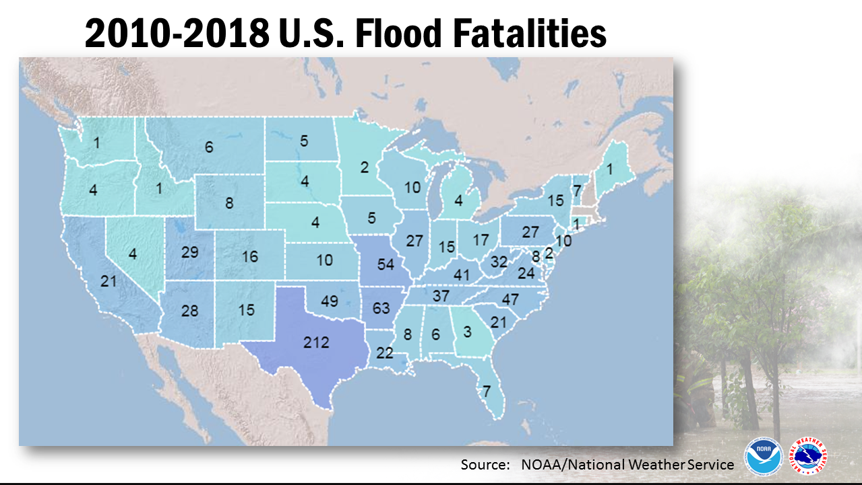
FLOODS: IMPACT ON SOCIETY

Slide 7
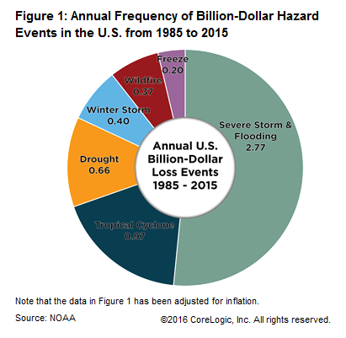
FLOODS: IMPACT ON ECONOMY

Slide 8
PROBLEM STATEMENT
A machine learning model is developed for predicting floods for certain geographic location and environmental conditions.
Model : Deep Neural Network in TensorFlow.
Geographic Location : Dallas, Chicago and Los Angeles (Flood prone areas)
Environmental Factors : Humidity, Temperature, Dewpoint, Pressure, Snowfall Index, Precipitation
The final output will show error % in average loss (Mean Squared Error) and the total loss (Sum of Squared Errors) --- Variation between predicted and actual value

Slide 9
PRIOR WORK
Initially, we had decided on a linear regressor model for flood prediction.
Based on review comments, we had decided to modify the algorithm used for our model.
We are implementing Machine Learning using TensorFlow’s Estimator API.
The dataset we have targeted is in Chicago, Dallas and Los Angeles.

Slide 10
NOVELTY
Flood Prediction using Deep Neural Network and TensorFlow is a novel approach that hasn’t been experimented so far.
The features taken into consideration are all the natural weather conditions like Temperature, Pressure, Humidity, Precipitation and Dew-Point.
Combining all these factors as input to dataset to predict water levels in a region is the challenging new effort of the project.
The places for which the model is run is flood-prone region of the United States like Chicago, Dallas and Los Angeles.

Slide 11
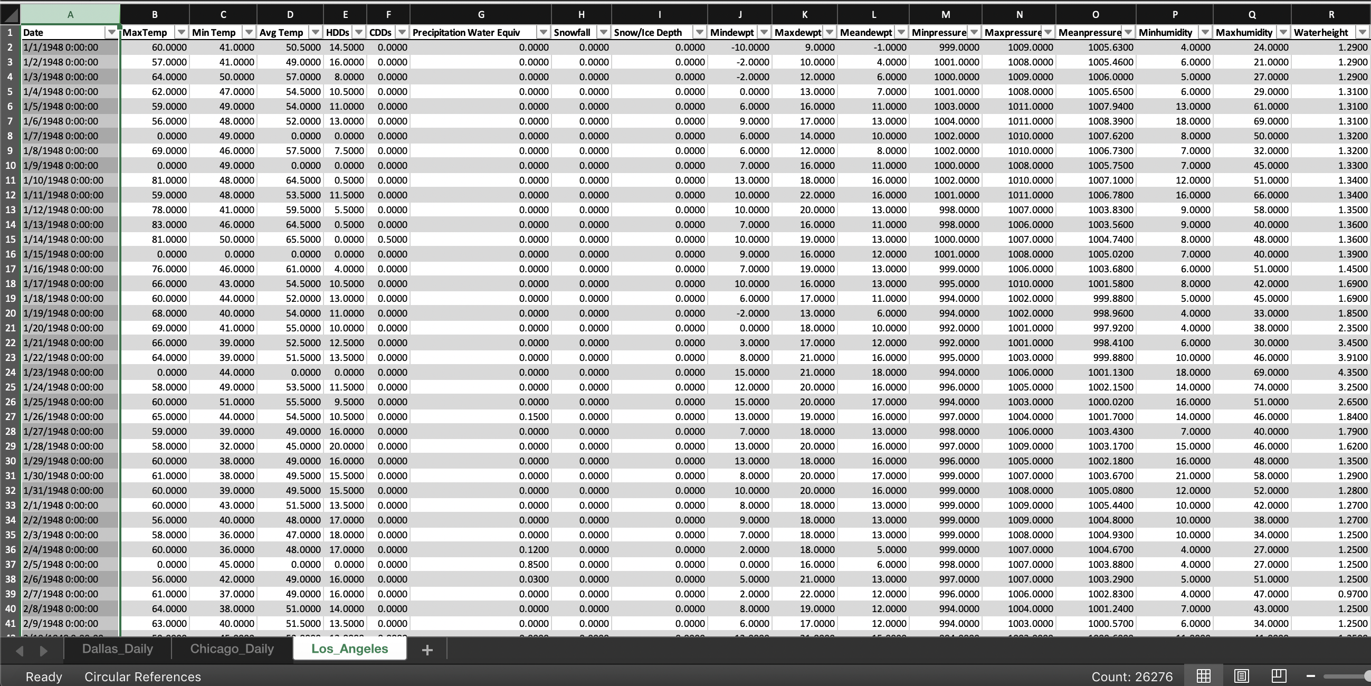
DATASET

Slide 12
DATASET FEATURES
Max/Min/Avg Temp
HDD (Heating Degree Day)
CDD (Cooling Degree Day)
Precipitation Equivalent
Snowfall
Snow/Ice Depth
Min/Max/Mean DewPoint
Max/Min/Mean Pressure
Min/Max Humidity
RiverWaterLevel – Target Variable (y)

Slide 13
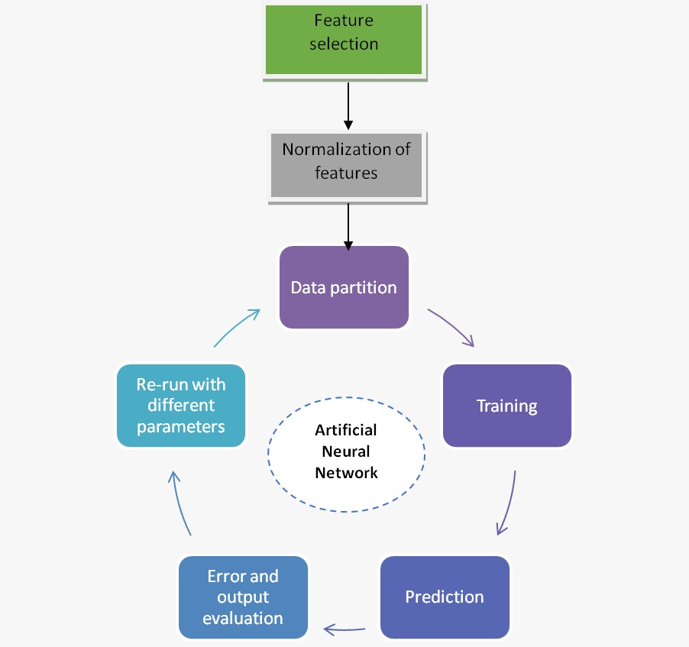
METHODOLOGY

Slide 14
APPROACH
We are making use of a specific type of machine learning called supervised learning.
In supervised learning, the models trained are built using data that has known target outcomes that the model is trying to predict.
The type of predictions being made are numerical real values, which means we are dealing with regressor prediction algorithms.

Slide 15
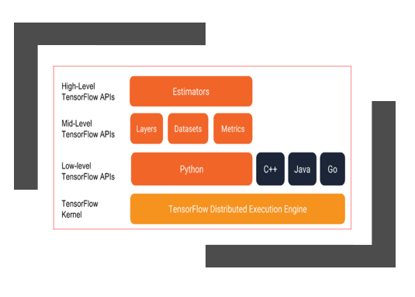
TENSOR FLOW – ESTIMATOR API
Google has developed a high level API to define and train machine learning algorithms.
Estimator API is one such high-level API that encapsulates the following functions used in machine learning:
Training the model
Prediction
Evaluating the model
Exporting the model

Slide 16
What are Tensors?
Tensors are the data structures used by TensorFlow for all computation.
They are n- dimensional array or list
Each element of the tensor is of the same of a data type like float32, float64, int32, int64 etc
Data type of the tensor is always known
Tensor in the context of a single execution can have only a single value but when we evaluate the same tensor twice we get different values

Slide 17
ADVANTAGES OF ESTIMATORS
Estimator can be run locally, can be distributed across multiple CPU or GPU without changing the model
Estimators builds graph
Estimators provide a safe distributed training loop that allows us to control how and when to
Build the graph
Initialize variables
Load the data
handling exception
Recover from failure
save summaries for Tensorboard

Slide 18
IMPLEMENTATION
The code is divided in following steps:
Load CSVs data
Filtering Categorical and Continuous features
Converting Data into Tensors
Selecting and Engineering Features for the Model
Defining The Regression Model
Training and Evaluating Our Model
Predicting output for test data

Slide 19
READING AND ANALYZING DATA
Read the data from csv file.
Check all the columns and identify the target variable(y).
Water-level is the target variable and all the other columns will serve as input to the function.
Finally, we check if all the variables are continuous or some of them are categorical.
Handling null values if any
Handling missing values.

Slide 20
CREATE TRAIN AND TEST DATASET
Splitting the dataset into train and test set.
Test set will have 20% of the data and training set will use 80% of the data from the dataset.

Slide 21
Convert Raw Data To Dense Vector
Estimators use feature columns to describe how the model should interpret the raw input data.
Estimators always accept vector of numeric inputs.
Features
We add all the input features in feature_cols that will contain all the input variables to be used in the model.
Feature columns bridge raw data with the data your model needs.

Slide 22
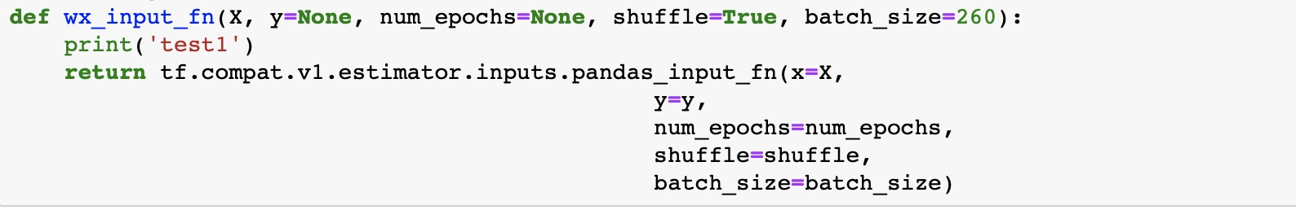
Input Function for Train, Test and Evaluate
Input function for training takes input features which are X, target variable which is y, 260 is the size of batches to return, the number of epochs to iterate is None and we want to shuffle the data.

Slide 23
Why DNN Regressor?
The use of the DNNRegressor is very similar (almost identical) to that of the Classifier,
The only significant difference is that while the Classifier predicts discrete labels as classes, the Regressor predicts a continuous qualitative result with the provided data.

Slide 24
DNN REGRESSOR FUNCTION
We now create a regressor for Tensorflow the DNN model. We have 10 hidden layers with units
We are defining a model to store the generated models.

Slide 25
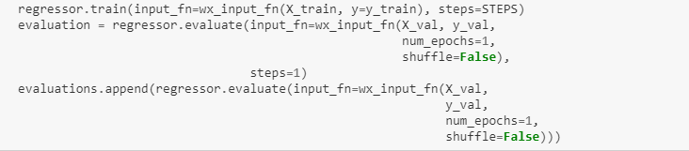
EVALUATE FUNCTION
Once the model is trained, we can evaluate the accuracy of the model. We can evaluate the test data and the model’s accuracy using evaluate function.

Slide 26
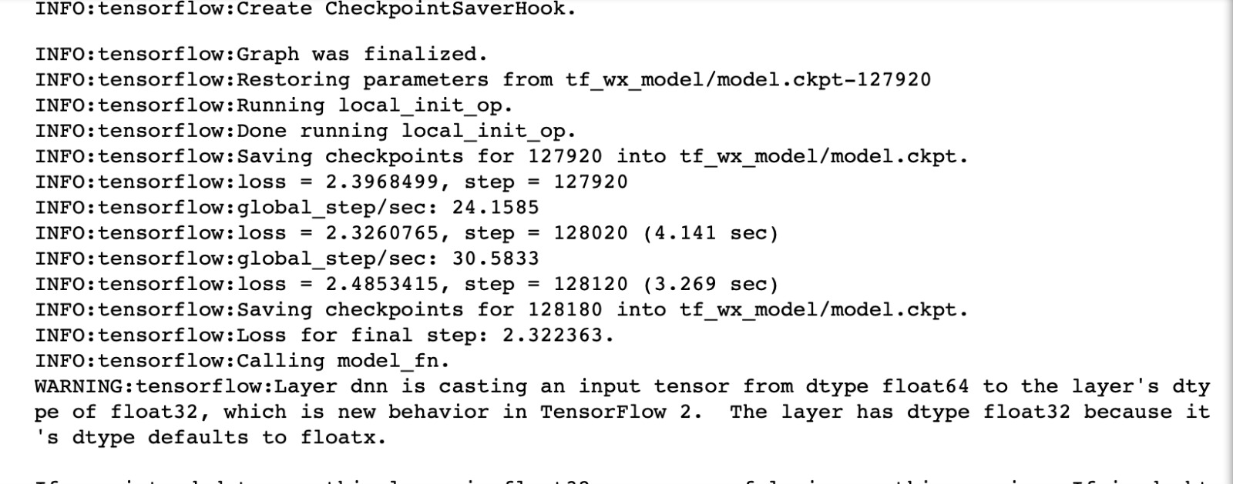
EVALUATION METRICS

Slide 27
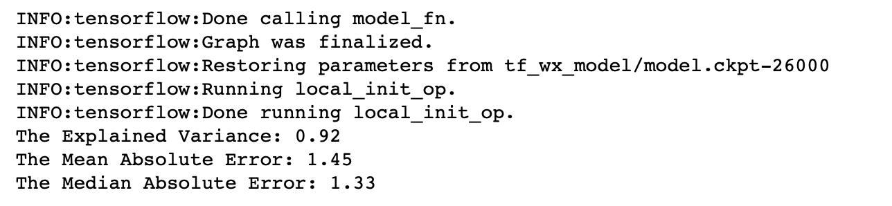
PREDICTION
The evaluation losses never exhibit a significant change in direction toward an increasing value.
Sum square of errors(SSE) or Residuals, how far did we predict a value when compared to the actual value
SSE = Actual value -Predicted value

Slide 28
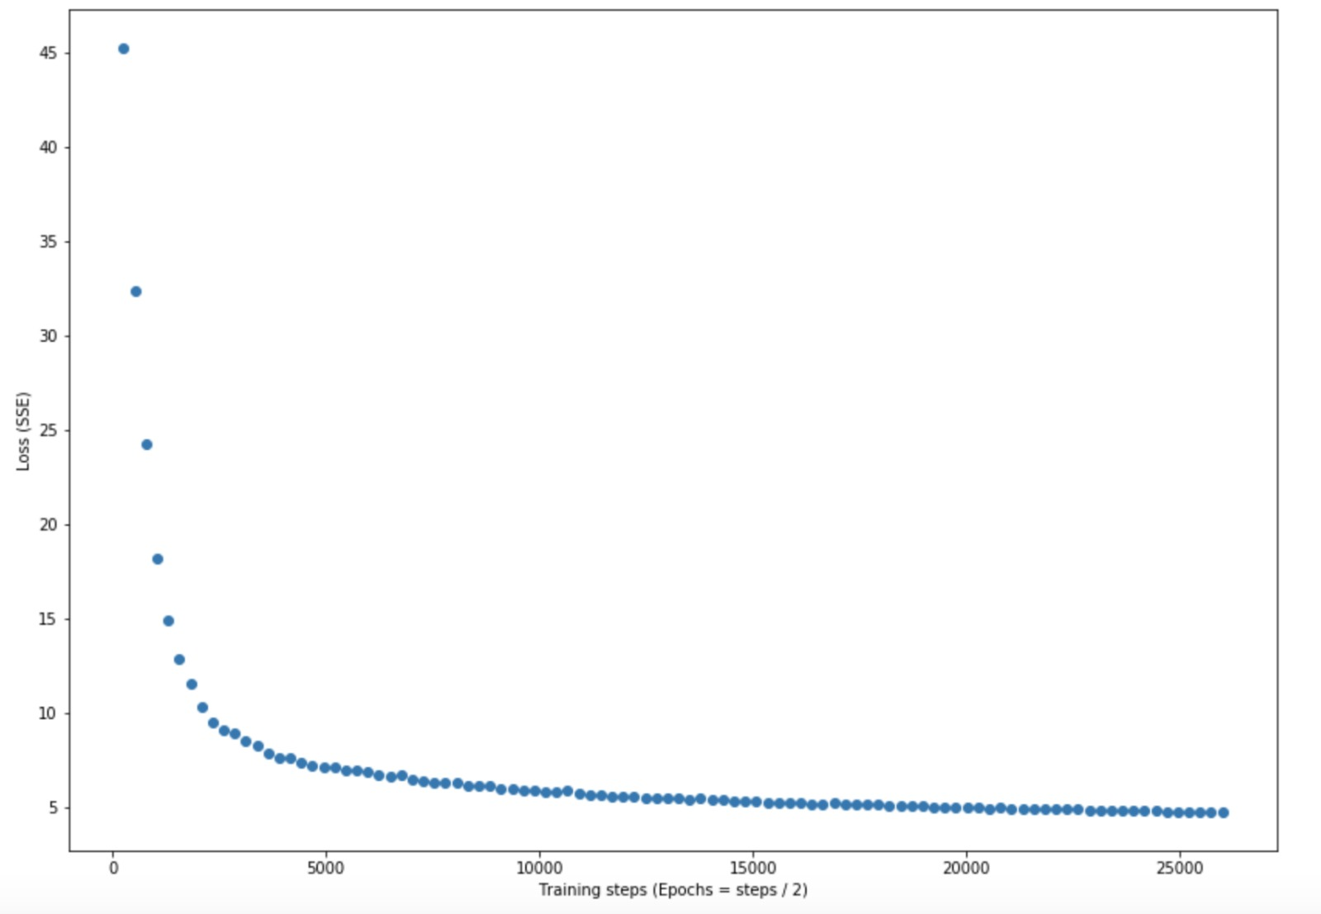

Slide 29
CONCLUSION AND LIMITATION
From this model, we have tried to achieve 80% accuracy.
We have limited our features to natural climatic conditions.
There could be scenarios where floods occur due to damage of dams or reservoirs.
This prediction can further be made accurate by considering cross-validation of our dataset.

Slide 30
FUTURE WORK
We can do a comparative study of linear regression and DNN and compare the accuracy.
We can use cross validation technique to acquire more accurate results.
Build a website so that we could able to get flood status/ occurrence of any place by configuring an inbuilt-API.

Slide 31
REFERENCES
DataSetCollection:
https://www.kaggle.com/selfishgene/historical-hourly-weather-data
ftp://ftp.ncdc.noaa.gov/pub/data/gsod/
https://www.weather.gov/
https://www.ncdc.noaa.gov/cdo-web/search;jsessionid=F2E7F9378D1D019B83CBC9EAA41926D5
Learning and Research:
https://www.tensorflow.org/api_docs/python/tf/compat/v1/estimator/DNNRegressor
https
https://www.tensorflow.org/tutorials/estimator/premade://www.tensorflow.org/guide/estimator
https://www.kaggle.com/usersumit/tensorflow-dnnregressor
https://www.researchgate.net/post/How_to_decide_the_number_of_hidden_layers_and_nodes_in_a_hidden_layerhttps://medium.com/datadriveninvestor/how-to-evaluate-the-performance-of-a-machine-learning-model-45063a7a38a7
https://medium.com/datadriveninvestor/linear-regression-using-tensorflow-estimator-9aa570914375

