Slide 1

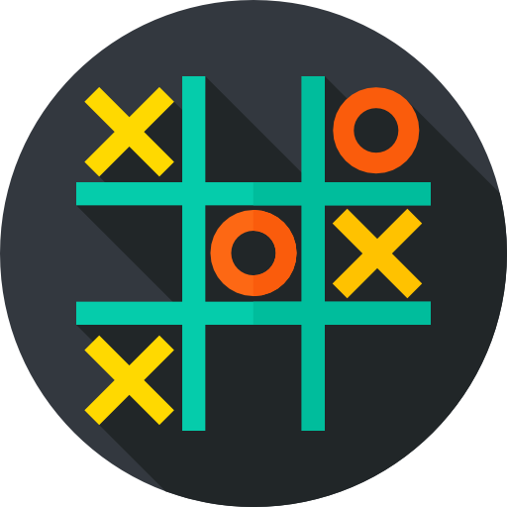
Tic-Tac-Toe
By:
Abrar Sohail
Muhammad Ali Raza
Zaki Majid
Taher Qutub

Slide 2
Table of Contents
Introduction to the Game
Design of the Game
Game Explanation
Problems & Challenges

Slide 3

Introduction
to the Game
Our proposed project for the course “Data Structure and Algorithms” is based on the classic “Tic-Tac-Toe” game. The idea of the game is pretty basic; two players use a 3 x 3 grid to place their selected mark, at each alternative turn. Whoever succeeds in placing three marks in a row, column or diagonal will be announced as the winner. At the end of each game, a scoreboard appears that shows the updated number of wins of each player. The players can then decide if they wish to continue or quit the game.

Slide 4
Objectives
Our objectives for this game were to:
design a 3 x 3 grid which updates after each game
provide alternate turns to each player
design a user-friendly interface
maintain a scoreboard which updates after each game
ensure that we make use of the techniques that we have learnt throughout this course

Slide 5
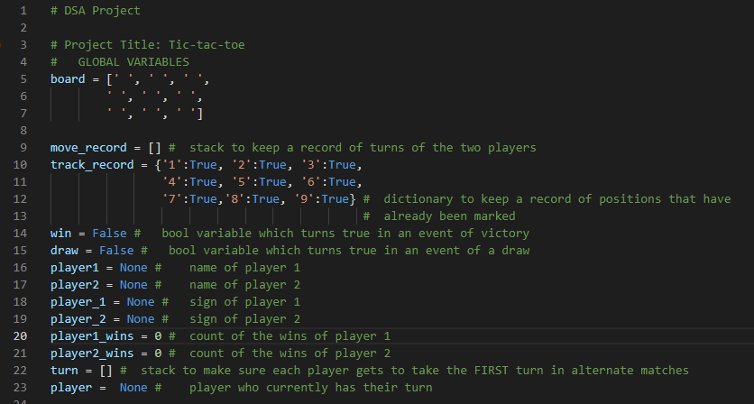
A little peak
into the Game

Slide 6
Design
of the Game
To design our game, we implemented some of the techniques that we had learnt from the course throughout the semester. These techniques involve:
stack to keep a record of turns of the two players
dictionary to keep a record of positions that have already been marked
stack to make sure each player gets to take the FIRST turn in alternate matches

Slide 7
What it took...
The Game includes a total of eleven modules and three sub-modules, as listed below:
initialise()
names()
disp_board()
marks()
current_player_sign()
current_player_name()
input_mark()
check_win() → check_row, check_column, check_diagonal
check_draw()
disp_scoreboard()
game()

Slide 8
Contributions
Zaki:
marks()
disp_scoreboard()
check_win
Abrar:
names()
current_player_name()
check_draw
Taher:
initialize()
current_player_sign()
Ali Raza:
game()
input_mark()
disp_board()

Slide 9
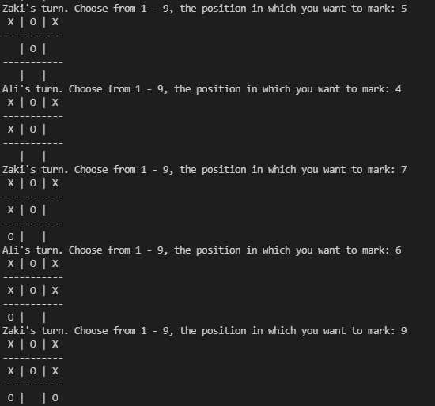
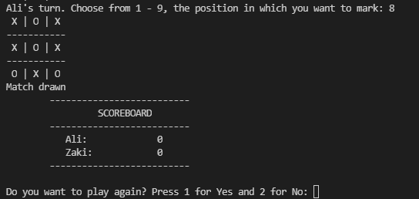
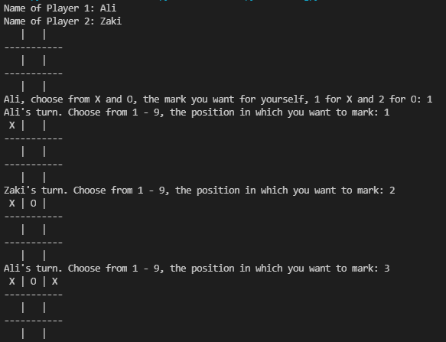
let's
dive into
the game

Slide 10
Debugging the errors
Working out the way to implement DSA techniques for this game
Trouble in communication and reaching out
Problems &
Challenges

Slide 11
Thank you!
Hope you had a good time!

Slide 12
References
https://www.askpython.com/python/examples/tic-tac-toe-using-python

