Slide 1
Home
Login
Sign up
User name: Kalai@12
Email: kalaiarasimasilamani@gmail.com
Password: Supri@12

Slide 2
Home
Nowadays millions of people are admitted in hospital in emergency situations. At the time of critical conditions, most of the patients are unconscious or unable to communicate their medical history. So, the doctor may lack some important information on other medical problems the patient may have, which must be taken into consideration for current treatment. To overcome this scenario we are going to introduce a simple creativity called MEDICARD. Medicard is used for storing and updating our medical reports sequentially. The Medicard contains all the medical issues that the patient has gone through in their early life .The Medicard helps the doctors by ensuring the medical records of the patient to treat them in emergency situations. So the doctors can efficiently treat the patients by knowing their medical history. The Medicard not only helps in emergency situations but can also be used in our day to day life.
The medical reports can be accessed by scanning the Medicard.
Only the doctors and patients can login to view medical reports .The login notifications are popped to the respective patients, which contains the location (where it has been accessed), doctor's name and the hospital name. It is categorized into namely, emergency, non-emergency, scanning and Pharmacy mode.

Slide 3
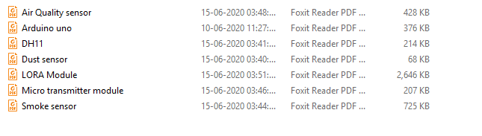
Login
Emergency mode
Eg

Slide 4
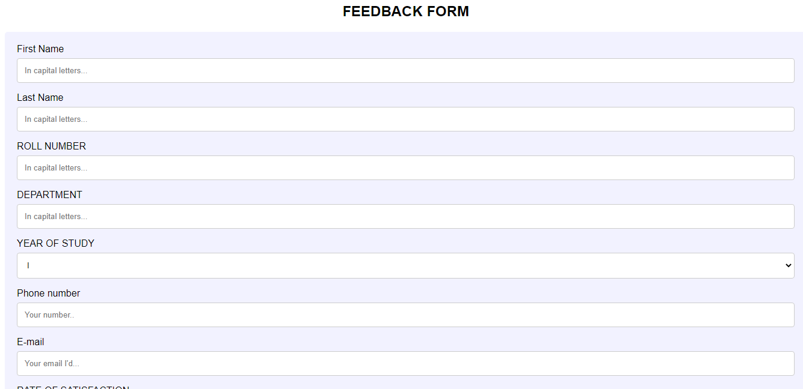
Login
Non - emergency
Reports
Eg

Slide 5

Reports
Eg.
Contains all reports

Slide 6
Login
Scanning
Upload the new report

Slide 7
login
Pharmacy
Date | Disease | Medicine and dosage | Quantity
04.05.2020 | Fever | Aspirin(For every 6 hrs) | 3 / day – for 3 days
 |  | Paracetamol (For every 6 hrs) | 3 / day – for 3 days
 |  | Dolo 650 (For every 6 hrs) | 3 / day – for 3 days
Only displayed

