Slide 1

SoC Security
Mahima Rathore | Richa Pallavi

Slide 2





Project Overview
System-on-Chip (SoC)
NOT SECURE!
Notes:
A brief recap about this project
As you might remember from our previous talk, most of the modern technology is based on System on Chip or SoC. These SoCs are the host of numerous confidential information, which needs to be protected from unauthorized access.
This project aims at securing the system by extending its architecture to include secure interfaces to interact with the outer world.
This also helps to evaluate the threat of having hardware accelerators

Slide 3
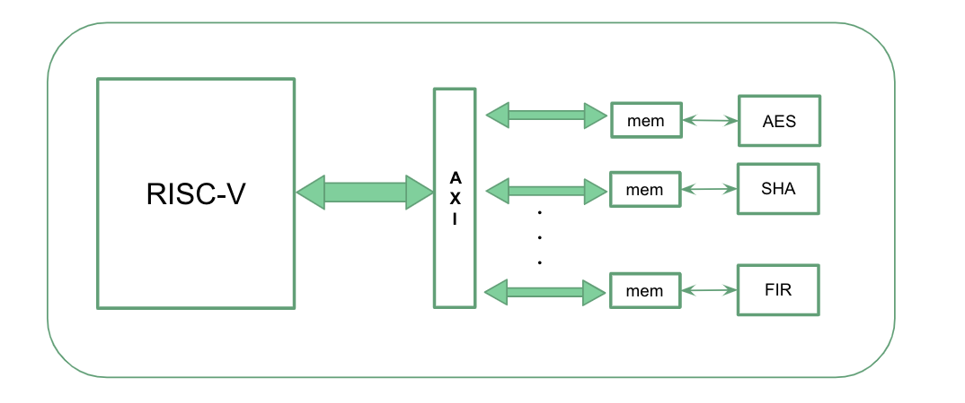
Project Overview
Notes:
Diving a little deeper into the project’s specifics.
Multiple cores from different vendors are connected in this SoC
It could be quite challenging to ensure that these cores are securely initialized, configured, and connected.
That’s where we come in: we plan to extend the SoC architecture by developing and integrating AXI machines for secure interface.

Slide 4
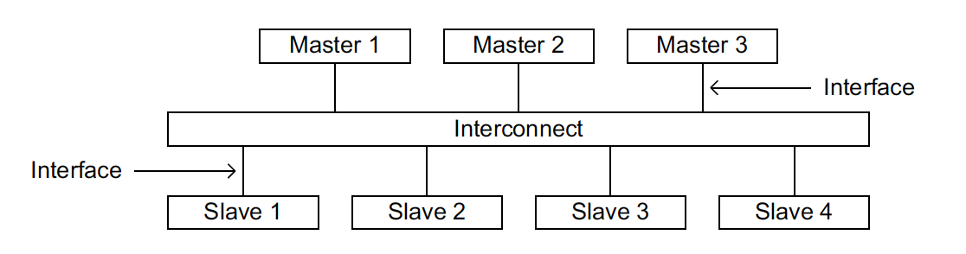
What’s AXI?
- Stands for Advanced eXtensible Interface (AXI) protocol
Notes:
AXI protocol is a handshake mechanism where data can be transferred between Masters and slave through a interconnect.

Slide 5
What’s AXI? - In simpler terms
- Information exchange protocol between master & slave machines.
Professor
Students
AXI Master
AXI Interconnect
AXI Slave
Notes:
Here is our classic example for everyone to relate –
Our zoom classroom , where the students and professor exchange knowledge/information over a secured interface(zoom)

Slide 6
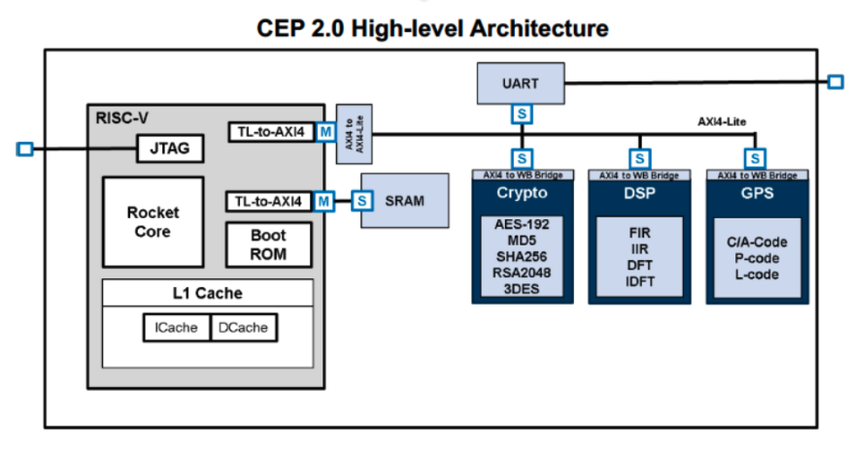
Project Plan
Notes:
This is CEP( Common Evaluation Platform) Architecture.
The Common Evaluation Platform (CEP) is intended as a surrogate System on a Chip (SoC) allowing users to test a variety of tools and techniques.
CEP architecture itself defines just a simple bus architecture for the hardware accelerators, in which the hardware accelerators do not have direct access to memory, instead, the processors are in charge of moving the data for them (hardware accelerators are slaves on the bus).

Slide 7
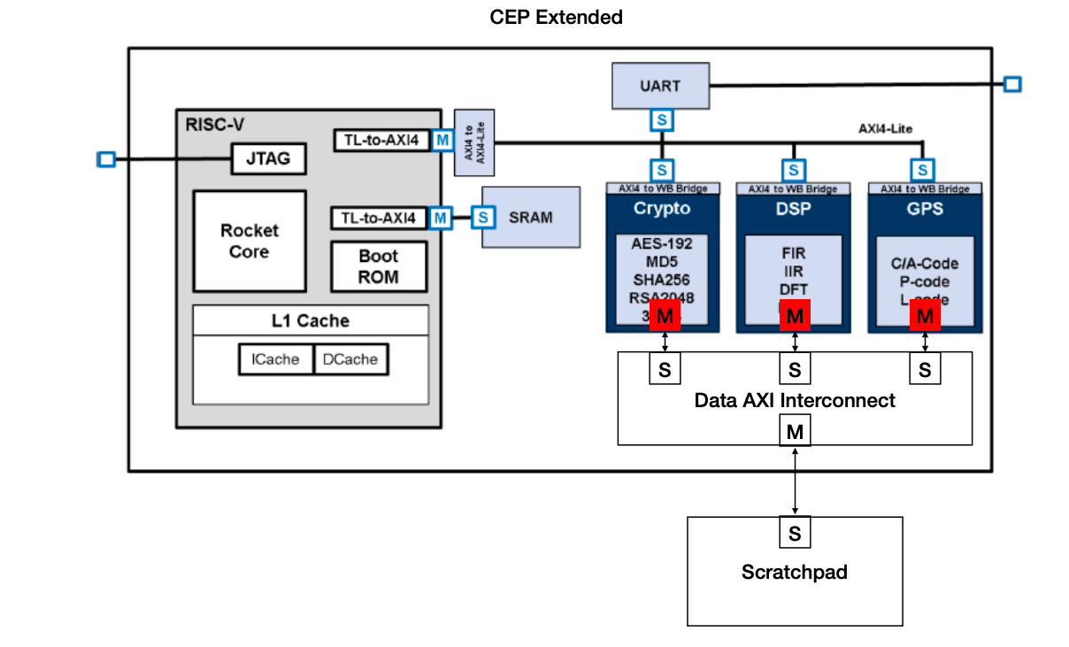
Project Plan

Slide 8
Project Plan
Notes:
The step to address to extend the architecture would be:
- Extend each hardware accelerator with a high-performance full AXI master Interface. This mainly means developing an AXI machine with burst capabilities and integrate the machine with the code of each hardware accelerator in the system.
- We would also need to choose a data AXI Interconnect.
- Choose or develop a target shared scratchpad memory for the hardware accelerators.
- Integrate everything in the CEP architecture.

Slide 9
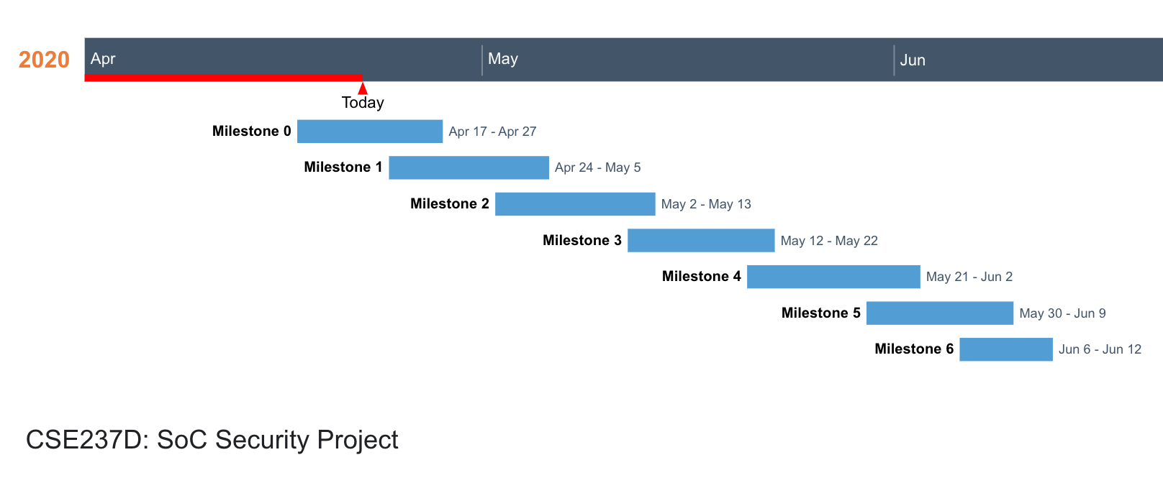
Accomplishments
Project Specification
Notes:
This project was ongoing and it has 2 parts 1) developing Security policies and 2) extension of CEP Architecture with AXI machines – find out best fit in
Delayed start to the project
Then we took a few days to go through the entire project hierarchy and decide our role with team leaders. Came up with detailed project specifications.

Slide 10
Accomplishments
Understanding & Setting up CEP SoC
Notes:
We took this week to understand and setting up CEP architecture and what modules needs to be developed in CEP extended architecture.
With little background from past experience about AXI , we took time to familiarize ourselves with AXI 4 full & lite standard AXI protocols.
Took time to understand the complex CEP architecture.
Faced initial issues for server permission and we couldn’t complete build.
Huge architecture , couldn’t migrate to local machine. Find workaround to get started.

Slide 11
Accomplishments
Developing & Integrating AXI Master
Notes:
In this week we developed AXI master for MD5 core (which is 1 of the hardware accelerators).
Register interface handshake
Testbench to verify our Master

Slide 12
Accomplishments
S
AXI to WB Bridge
Developed AXI Master:
Talks to the MD5 core – Hardware accelerator through register configuration
Reads & writes to it.
Provide full AXI4 standard interface
Replicate it for other hardware accelerators
MD5 Core
Pancham
M

Slide 13
Next Steps
Developing & Integrating AXI Interconnect
Notes:
Our next milestone will be to develop and integrate AXI interconnect

Slide 14
Next Steps
S
AXI to WB Bridge
Developing AXI Interconnect
MD5 Core
Pancham
M
S
AXI Interconnect
Notes:
We need to have slave interface in interconnect to interact with Master

Slide 15
Next Steps
Developing & Integrating AXI Slave

Slide 16
Next Steps
S
AXI to WB Bridge
Developing AXI Slave
Support AXI interconnect with master interface to interact with scratchpad
MD5 Core
Pancham
M
S
AXI Interconnect
M
S
Scratchpad

Slide 17
Future Goals
Integrating & Verifying with CEP SoC

Slide 18
Future Goals
Integrating with the SoC
Verifying it

Slide 19
Conclusion
We are on schedule as per now ,we have kept a buffer of a week.
If time permits, we can look into our future goal to integrate our developed design with CEP SoC.

