Slide 1

SoC Security
Mahima Rathore | Richa Pallavi

Slide 2
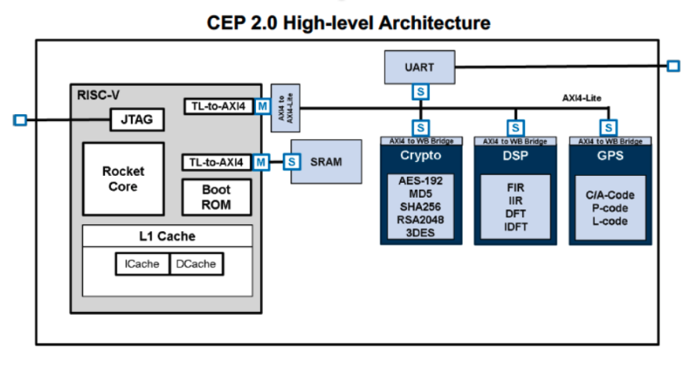
Project Overview
Notes:
● This is the system on chip or SoC that we use for this project., it is called CEP or Common Evaluation Platform.
● Dark blue boxed are HW Accelerators, which come from different vendors.
● They do not have direct access to memory, instead, the processor oversees moving the data for them.
● This type of indirect access can make our system very slow and add unintentional latency.
● So a simple solution would be to let these cores directly access the shared memory.

Slide 3
Security Threat
RISC-V
MD5
DSP
AES/FIR..
Shared Mem
SAFE
NOT SAFE
Notes:
● This is where we let all the cores have direct access to memory.
● But that introduces the problem of security threat.
● here the Processor to memory interaction is completely safe – given it is within the SoC and all the data stays within the SoC. No outer world interaction.
But these cores to memory interaction is not safe – as the parent vendors can access this data through these cores and for worst manipulate or steal it.

Slide 4
Security Threat - Solution
RISC-V
AXI
MD5
DSP
AES/FIR..
Shared Mem
Notes:
That’s the reason for adding AXI to control this interaction, solution to the security threat and latency problem.
If any HW accelerators try to access a restricted memory region, the AXI master can monitor that and throw an erro

Slide 5
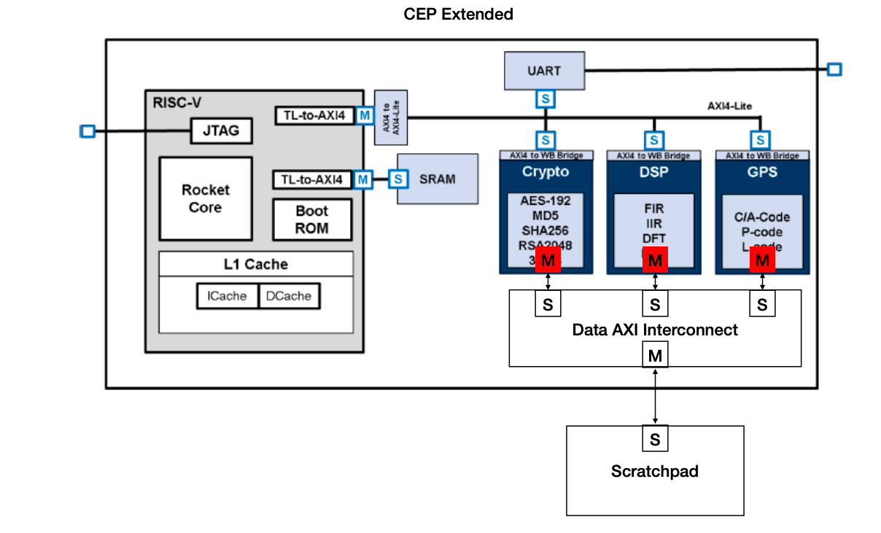
Project - Solution
Notes:
-This is what we proposed, i.e. to develop & integrate AXI machines to control and monitor the hardware accelerator cores. This approach highlights addition of AXI Master to the HW ACCr, AXI Interconnect & AXI slaves.

Slide 6
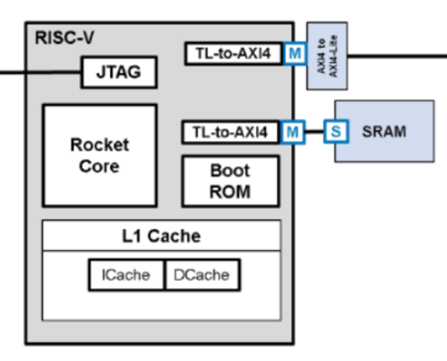
Updated Project Solution
MD5 Top Wrapper
AXI4 Lite Interface
MD5 Core
Pancham
M
MD5 Registers
Configurable access control
S
AXI to WB Bridge
M
TestBench
* MD5 = Hardware Accelerator Core
Notes:
Due to some reasons, our project solution changed midway. Our new approach involved focusing on making the AXI Master machine better.
We did extend one hardware accelerator – MD5, with a high-performance full AXI master Interface. This master access allowed independent memory access to MD5.
We used the AXI lite slave interface for the MD5 & processor interaction. This part overlapped with our older approach.
The new additions were development of a register access mechanism for the processor to control MD5.
Also based on these control registers we will configure our AXI Master machine & control its interaction with the MD5 core also called pancham.

Slide 7
Step 1 – Register Development & Register Access Mechanism
MD5 Top Wrapper
MD5 Core
Pancham
MD5 Registers
Configurable access control
AXI4 Lite Interface
S
AXI to WB Bridge
* MD5/Pancham = Hardware Accelerator Core
Notes:
Let’s dig in a little deeper into the specifics.
Our first step was to develop registers internal to MD5
and then implement a register access mechanism for AXI lite Slave interface.
This also involved developing AXI Slave design within the MD5 top wrapper.
Mostly focussing on generating the ready and valid signals for the 5 AXI channels.
Using these protocol signals, we generated register Read & Write Enable signals for the register access.

Slide 8
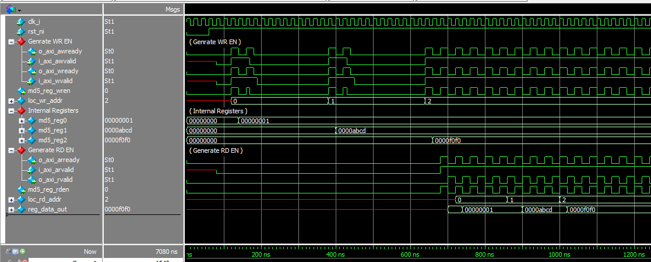
Register Access Waveform
Notes:
This waveform here, shows a successful read & write register access by the AXI Slave
The processor is the testbench which acts likes AXI Master requesting for write and read to the AXI slave.
This shows that the internal registers were written by these values for these address.
This here shows, the registers being read correctly.

Slide 9
Step 2 – Processor & MD5 Interaction
AXI4 Lite Interface
MD5 Core
Pancham
MD5 Registers
Configurable access control
S
AXI to WB Bridge
* MD5 = Hardware Accelerator Core
Processor = Testbench
Notes:
Once we had the register access mechanism in place, we drove the AXI slave interface from our testbench to read and write these registers, emulating the processor basically.

Slide 10
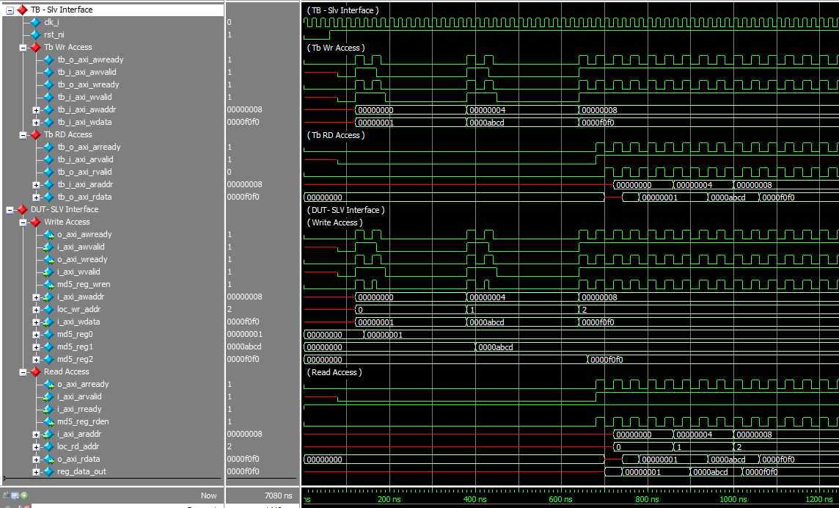
AXI Lite Slave & MD5 Interaction Waveform
Notes:
This waveform here shows the same read write as before but now at the top most level. Earlier we saw it inside the design.
This shows the write. We can see the testbench signals going into the design and writing the registers.
This is the read.We can see the testbench signals going into the design and reading the registers & returning the read values.

Slide 11
Step 3 – AXI Master Development & Master Activation
MD5 Top Wrapper
MD5 Core
Pancham
M
MD5 Registers
Configurable access control
AXI4 Lite Interface
S
AXI to WB Bridge
M
Notes:
Next up we developed our AXI Master design, referring to the Xilinx AXI master. And we used the control registers written by slave interface, to configure this Master.
one register was used to activate or initiate the Master
other two were to set up the source & destination register, which will be used by the master for reading and writing to the shared memory.

Slide 12
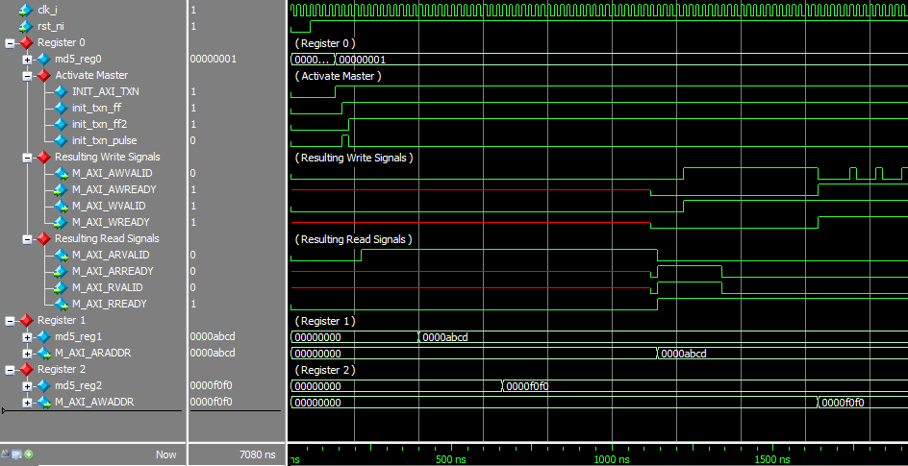
Waveform
Notes:
This waveform shows how these control registers configure the master.
This shows the master getting activated by register0. The master’s write & read channel signals get initiated based on the protocol
This shows master’s read address getting set by register 1
This shows master’s write address getting set by register 2

Slide 13
Step 4 – AXI Master & MD5 Core Interaction
MD5 Top Wrapper
MD5 Core
Pancham
MD5 Core
Pancham
Tb
M
M
S
MD5 Registers
Configurable access control
S
AXI to WB Bridge
M
Notes:
AXI4 Master reads data from the source address (register Reg1) & write it into an internal buffer into the axi_top (this is the input buffer for the pancham)
we connect wishbone interface in top which has pancham instantiated. So we write this input_buffer value in the pancham through WB interface.
AXI4 Master should write data into the destination address (register Reg2 ), this data is read from a output buffer implemented into the axi_top (connected to pancham).
Similarly we capture the pancham output from WB interface and write in the output buffer.

Slide 14
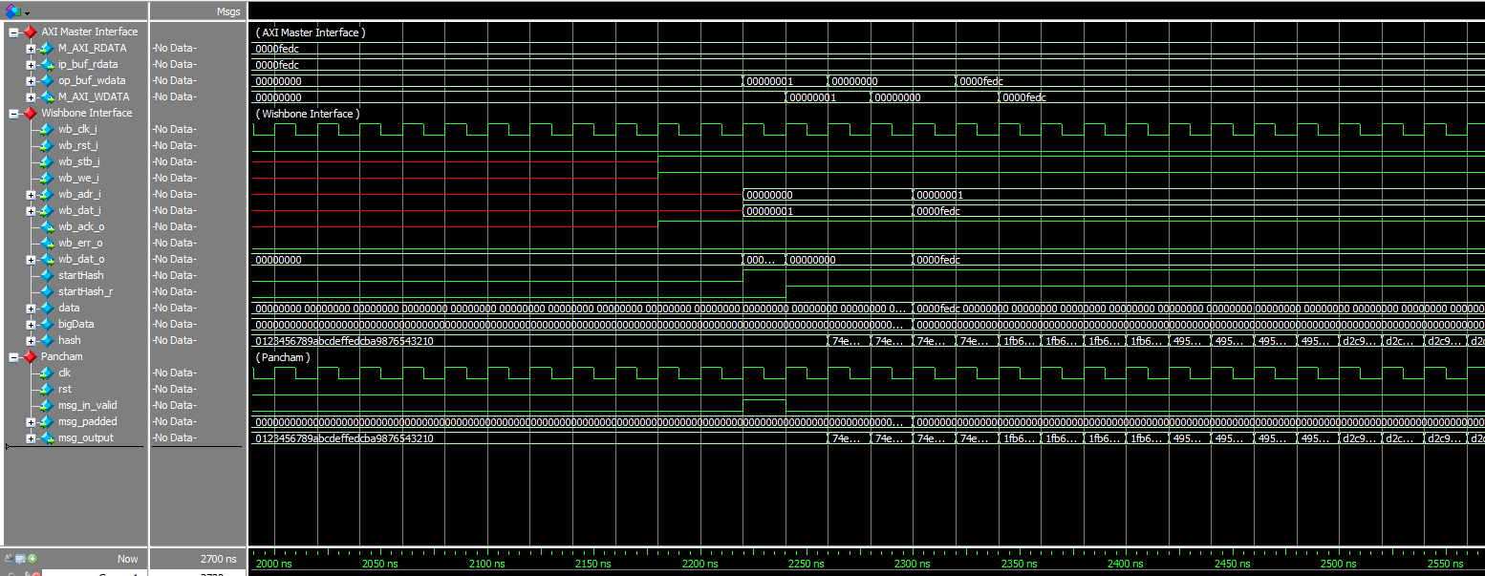
Waveform
Notes:
Here, we can see the AXI Master interface rdata has value FEDC in hex which is written to input buffer.
The input buffer is fed to WB and we can see wb_dat_i holding the same value when clk & reset and address is set. (with other design control signals stb & we)
The input to WB/pancham is 512 bits and output bus is 128 bits. There are 16 array of 32 bits(max data bus) which store value depending on the address provided and hash together to give 128 bits output. Similarly this 128 bits are captured in 4 array of 32bit (DW bus) and written to output buffer.
big data is 512 bits holding 16 array of data (which is 32 bits each) which is sent to pancham when mesg_in is high and we can see the same 512 bit of message padded.
The mesg_ouput from pancham is same reflected on hash value in WB interface. This is further divided in chunks of 32 bits and stored in wb_data_o(32 bits) and fed further to output buffer in top and written to AXI Master.

Slide 15
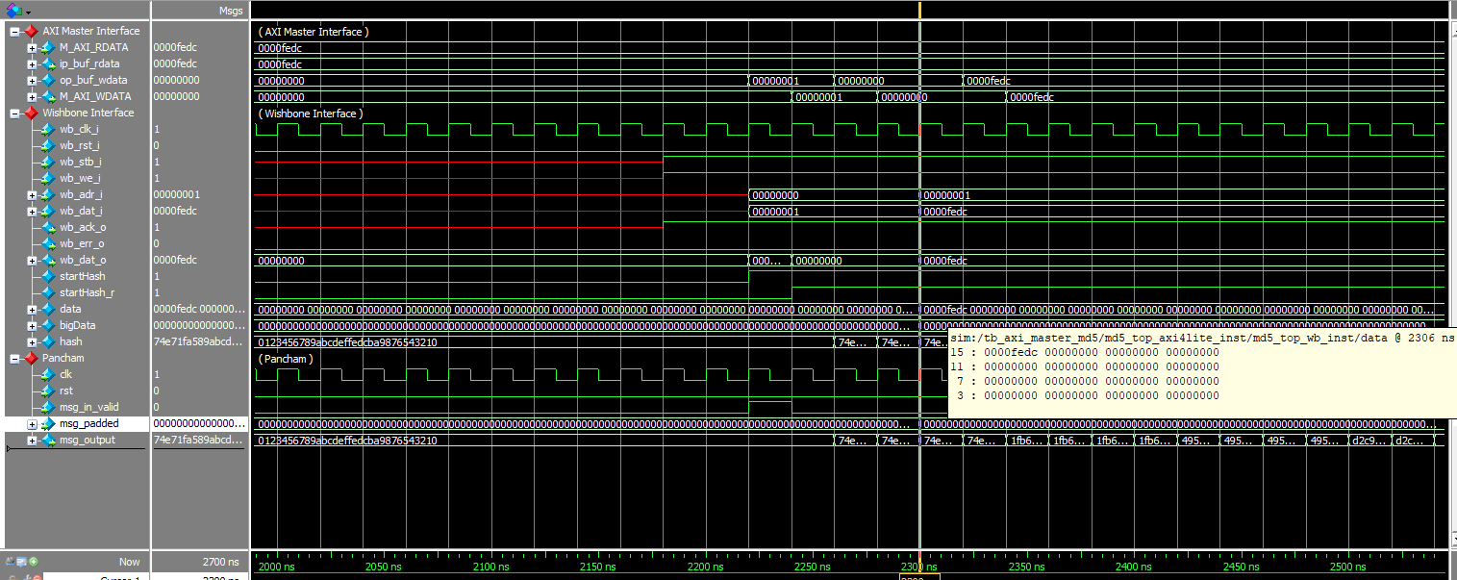
Waveform with pancham output value displayed
Notes:
just to expand a little , this big data value holds FEDC in 15th array (this depend on the address that we provide between 0-15 , address 1 feeding array 15th)

Slide 16
Problems Faced & Major Challenges
Initial setup issues
Complexities of the SoC (CEP) Architecture
Change in initial work plan to match customer need
Wastage of debug time in Xilinx AXI master. Development of new AXI master to cater our needs.
Notes:
Initial setup issues --- access to the servers & build setup.
Complexities of the SoC (CEP) Architecture --- Apart from the AXI spec we have to understand how the Core interact/Connected with the SoC to make them accessible from outside
Change in initial work plan - Changes in the work plan based on customer needs, in the middle of the project we decided to have different access mechanism. Our plan for AXI interconnect went on hold as we added more features in Master for better security
Xilinx designs didn’t exactly cater to our needs, took expensive time on debugging things -- We planned to initially instantiate AXI Master from xilinx, but it was not developed according to our need. Then we finally made a new Master and TB to verify and used that. This involved lot of debug time.

Slide 17
What we didn’t do!
Our initial plan was to make a slave memory & AXI interconnect.
But with the mid way changes, we put that on hold and made our Master-MD5 wrapper better with TestBench as replacement for interconnect.
Notes:
Our initial plan was to make a slave memory & AXI interconnect to interact with Master interface of MD5 and other hardware accelerator.
But with the mid way changes, we put that on hold and made our Master-MD5 wrapper better.
We have to develop and verify AXI master core which was earlier planned to instantiate xilinx master.
Register development and register access mechanism
AXI master activation through these register which were accessed by AXIlite slave interface.
AXI master and MD5 core interaction with input and output buffers.
The purpose of slave and interconnect is served by our developed TB and we added features in TB to verify all these access.

Slide 18
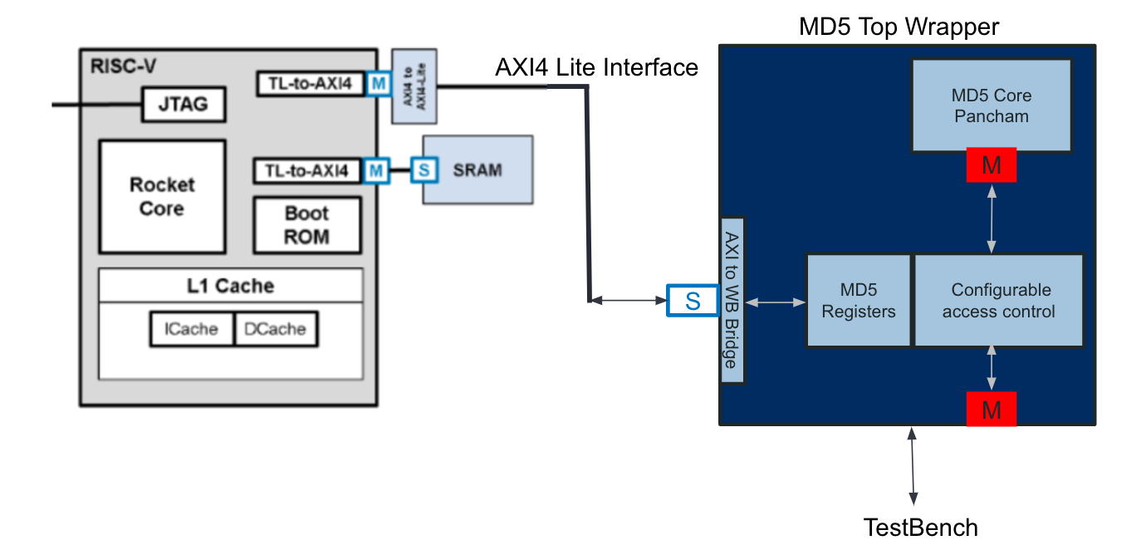
Conclusion
Initial Plan Vs Final Execution
Notes:
Our initial plan was to make a slave memory & AXI interconnect to interact with Master interface of MD5 and other hardware accelerator.
But with the mid way changes, we put that on hold and made our Master-MD5 wrapper better.
We have to develop and verify AXI master core which was earlier planned to instantiate xilinx master.
Register development and register access mechanism
AXI master activation through these register which were accessed by AXIlite slave interface.
AXI master and MD5 core interaction with input and output buffers.
The purpose of slave and interconnect is served by our developed TB and we added features in TB to verify all these access.

Slide 19
Conclusion
Our delivered design will be adding features in making this architecture secure.
Since this is an ongoing project, development of other security features are in progress.

Slide 20
Questions ?

