Slide 1


PKB
Quality Disposable Paper Plates
Eco-Friendly | Affordable | Premium Quality

Slide 2
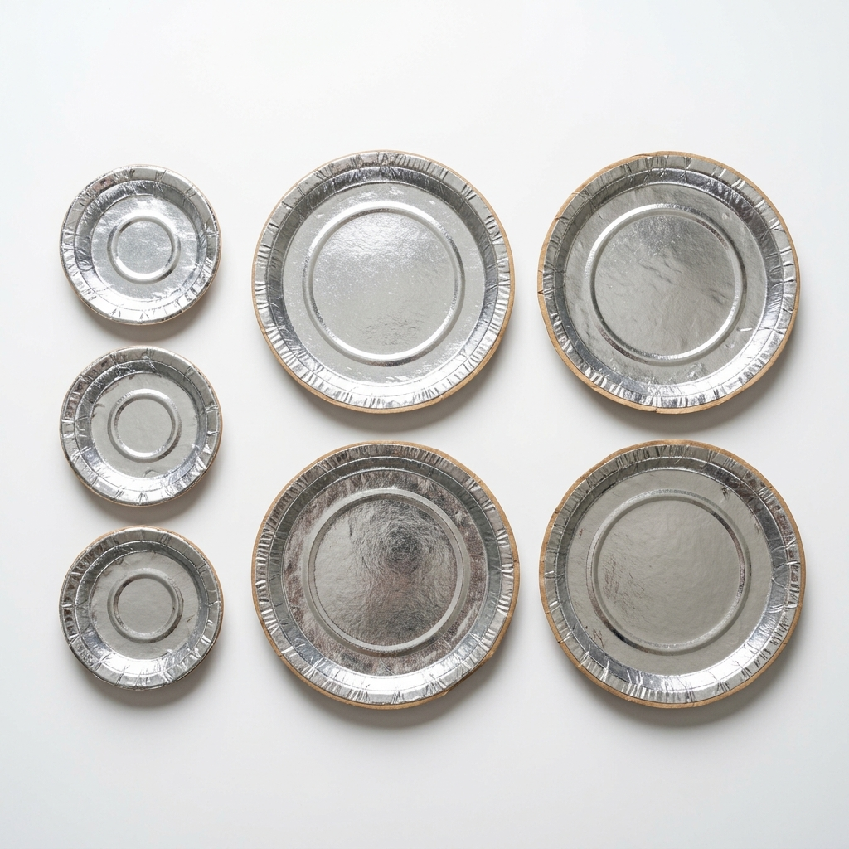
🏢 About PKB
PKB - Aapka Bharosemand Brand!
Hum provide karte hain best quality disposable paper plates jo perfect hain:
✅ Shaadi & Functions ke liye
✅ Parties & Events ke liye
✅ Street Food & Catering ke liye
✅ Daily Use ke liye
✅ Hotel & Restaurant ke liye
Hamari plates silver foil coated hain jo food-safe aur leak-proof hain.

Slide 3
📦 Our Products & Pricing
🍽️
🍛
Small Size Plate
Large Size Plate
Perfect for snacks & starters
Perfect for meals & rice
Only ₹20
Only ₹40
* Bulk orders pe special discount available hai! Contact karein.

Slide 4
⭐ Why Choose PKB?
🏆
💰
🌿
Premium Quality
Best Price
Eco-Friendly
High-grade silver foil coated paper plates
Starting from just ₹20 - sabse sasta!
Biodegradable & environment friendly
🚚
📦
🔒
Fast Delivery
Bulk Orders
Food Safe
Quick delivery at your doorstep
Special discount on bulk & wholesale orders
100% hygienic & leak-proof plates

Slide 5
🛒 Order Kaise Karein?
📱 Order Details
Direct WhatsApp message bhejein ya call karein:
📞 Phone / WhatsApp: +91-9318421157
🔗 Order Link (WhatsApp Click to Chat):
https://wa.me/919318421157
Steps to Order:
1. Link pe click karke message karein | 2. Plate size aur quantity batayein | 3. Delivery Address confirm karein
⚡ Bulk orders pe special discount available hai!

Slide 6
🙏 Thank You!
PKB - Quality Disposable Paper Plates
📞 Call / WhatsApp: +91-9318421157
📍 Location: Your City, India
🌐 Order Online: https://wa.me/919318421157
Abhi Order Karein! 🛒

