Slide 1
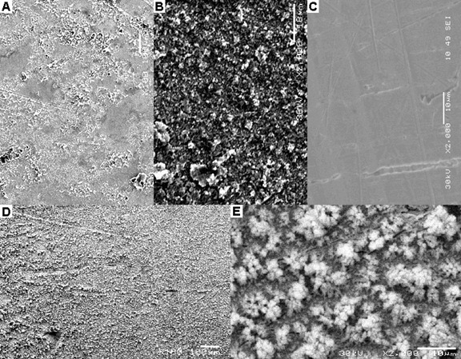
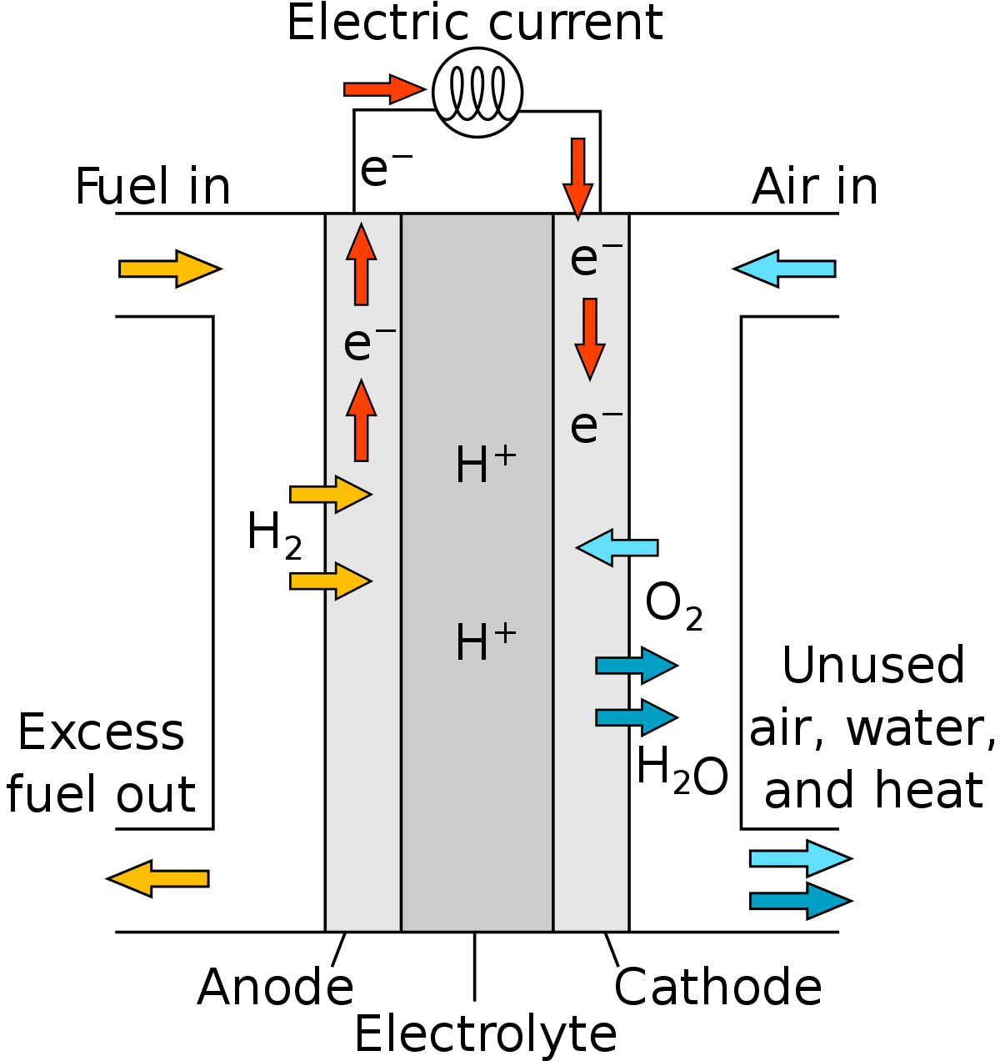
Electrolytic method of hydrogen production.
By Ellis Lunnon
The simplest way: ^{[1][2]}
There is no catalyst involved to aid the rate of reaction.
A common electrolyte for cells like this is KOH.
Reduction occurs at the cathode, where 2H⁺ + 2e⁻ -> H₂
Oxidation occurs at the anode, where 2H₂O -> 4H⁺ + 4e⁻ + O₂
In the standard state, this reaction has E⁰_{cell} = -1.228V.
In practice, at higher O₂ partial pressure or higher pH this reaction can be even more energetically expensive.
While this process is valuable, it can be improved on.
Why produce hydrogen in the first place?^{[1]}
Hydrogen when used in a fuel cell is an extremely clean and efficient way of storing energy.
Water as a source of fuel is a very good idea, it is a naturally abundant feedstock.
PEM fuel cells operate by the following route:^{[1][2]}
H₂ -> 2H⁺ +2e⁻ at the anode.
These protons are in solution and pass through the membrane to the cathode.
O₂ + 4H⁺ + 4e⁻ -> 2H₂O
The movement of electrons generates an electric current.
Improvements on the uncatalysed method can be made through various optimizations. We can use a catalyst, control the pH and O₂ and H₂ partial pressure inside the reaction as well as the type of electrodes used.
Catalysts which are suitable for this kind of reaction generally help the oxidation reaction, as the evolution of O₂ is generally slower than H₂.^{[2]} Amorphic metal catalysts such as NiFe can have high performance in these applications.
[1] P. Hoffmann and B. Dorgan, in Why Hydrogen? The Grand Picture, MIT Press, 2012, pp. 1–17.
[2] M. D. Merrill, Thesis, 2006, 1–86.
Fig. 1 – SEM image at 5 levels of the NiFe catalyst surface.
Fig. 2 – Schematic diagram of a PEM fuel cell

