Slide 1

3
Notes:
Everyone introduces themselves. James starts introduction. Jacob, Josh, Allen, and Ethan.

Slide 2

Robot nKISA Perks
nKISA has been UPGRADED!
What’s nKISA?
  nerdy Knights In Shining Armor
More fire power with range
More strength (in drive train)
Superior maneuverability
Superior light weight shielding
Better technological radar and sensory
Notes:
Ethan – improve comparison between old fashioned knight/horse and air warfare now as new battle ground – go Ethan!!!
This slide should take 60-90 seconds

Slide 3
Teamwork
This year our team has expanded with two other members joining the team
Bringing these new people into the fold was a fairly smooth seamless operation
Starting this year, we had more experience than before, so we could get working on the robot straightaway.
Brainstorming and debating sessions for robot design and presentation
Working together to understand programming
Encouraging input from all team members
Notes:
Jacob and Allen– work out between you two how you want to do this. ONE MINUTE LONG.

Slide 4
Robot Design
Prototype 1 – Plastic Tank treads = bad traction on painted tiles of competition mat.
Prototype 2 – Half track with rubber treads
Prototype 3 – Final and Current Design
Notes:
Josh – wave around plastic treads – then flash to next picture for CAD of Prototype 1
All 6 Robot Design slides total should take 2-3 minutes max

Slide 5
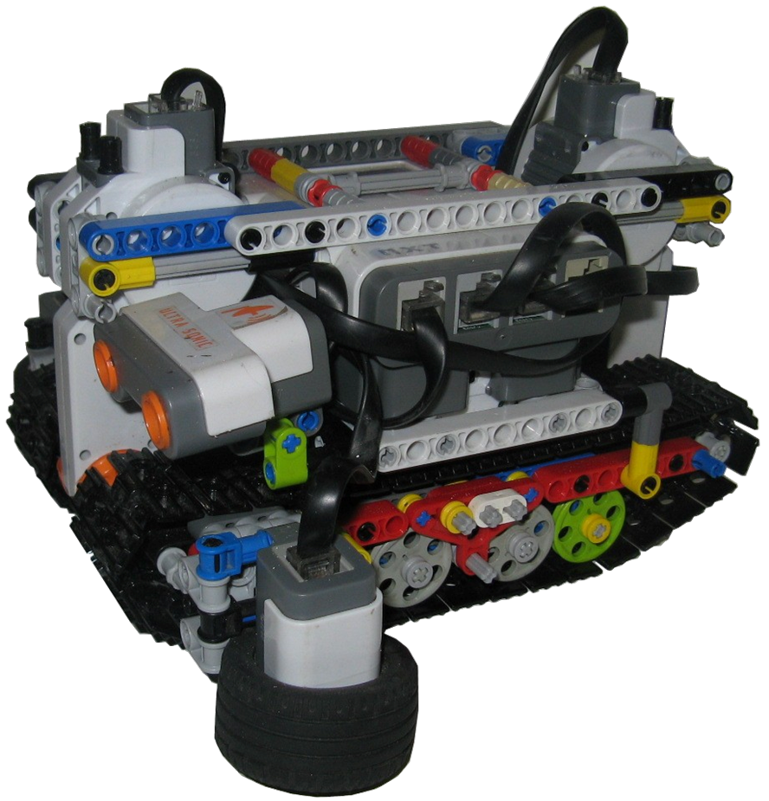
Prototype 1
Notes:
Drew - Point out the size of the NXT brick (it is there just for reference) putting it on top would have made this top heavy

Slide 6
Robot Design
Prototype 1 – Plastic Tank treads = bad traction on painted tiles of competition mat.
Prototype 2 – Half track with rubber treads
Prototype 3 – Final and Current Design
Notes:
Josh – wave around rubber treads – then flash to next picture for CAD of Prototype 1
All 6 Robot Design slides total should take 2-3 minutes max

Slide 7
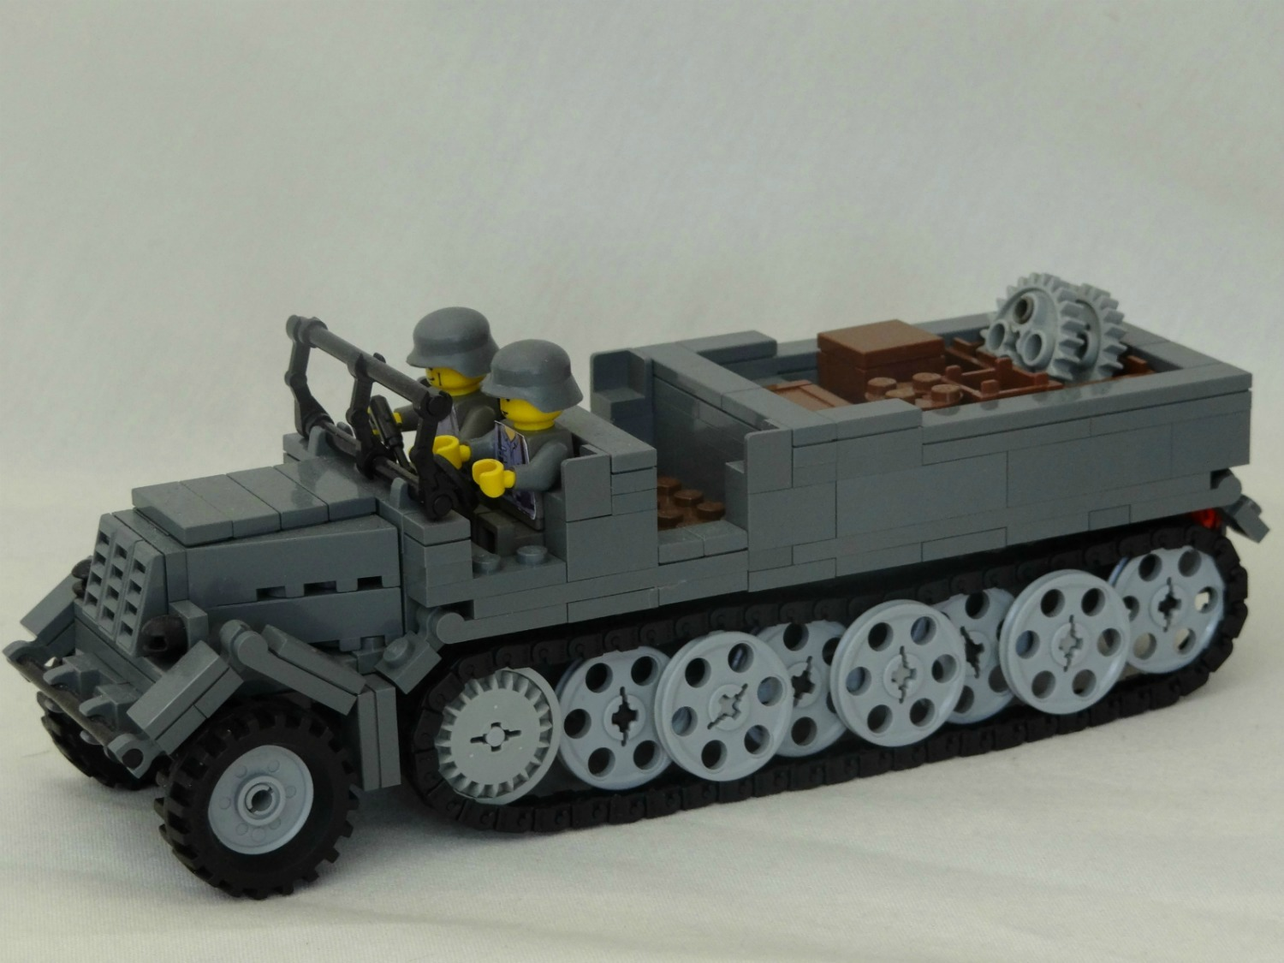
Prototype 2
Notes:
Josh – point out NXT brick upside down

Slide 8
Robot Design
Prototype 1 – Plastic Tank treads = bad traction on painted tiles of competition mat.
Prototype 2 – Half track with rubber treads
Prototype 3 – Final and Current Design
Notes:
Drew – wave around rubber treads – then flash to next picture for CAD of Prototype 1
All 6 Robot Design slides total should take 2-3 minutes max

Slide 9
Prototype 2
Notes:
Drew – point out NXT brick upside down

Slide 10
Programming the NXT Brick
Used ROBOTC from Carnegie Mellon University in Pittsburgh, PA
Line following – full PID controller with dynamic values depending on line color and curve of road
Systematic list of 3-digit direction codes
Notes:
James – PID values change based on line color (speed), curve of road, and parking, BC a higher gain is needed. Explain 3-digit code on next slide

Slide 11
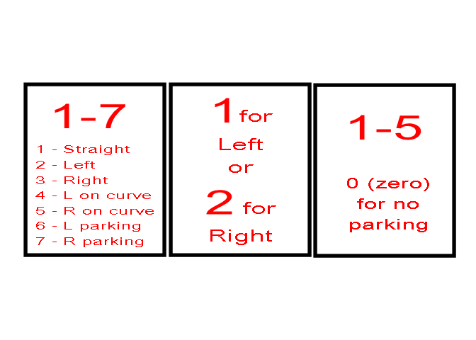
3-Digit Direction Code
Direction at
Intersection
Line to
Follow
Parking Space
612 would be Parking on Left following Left hand line Parking space 2
Notes:
James – First digit is what robot does when it gets to the stop sign, and how to proceed through the intersection. Second digit is which side of the road to follow until it reached the stop sign. Third digit is which parking spot to park in if we are parking. (0 or ignored if not parking)

Slide 12
Programming the NXT Brick
Motor controlled for speed limits regardless of battery voltage
Conservative use of sensors – color sensor used as both color and light sensors simultaneously
Notes:
James – Motors ramp up and down to maintain perfect speed, regardless of battery voltage. Use the raw color counts to generate a 0-255 number that we use to follow the line.

Slide 13
Development Process
Build Robot
  Three Robot Prototypes
Line Following
  Started with simple proportional line follower
  Moved to full PID line following algorithm
Stopping
  One color sensor following line, other sensor looking for stop sign
Turning
  Started with an arcing turn, but found it was not predictable, and was not suitable for leading into parking
  Move forward into intersection, then point turn 90 degrees, then look for L/R line to follow
Notes:
James

Slide 14
Development Process
Parking
  First, we tried dead reckoning from beginning of blue line, then 90 degree point turn into parking spot
  Current parking process
    Robot gets approximately in front of correct parking spot
    Turn till sensor sees white perimeter of parking spot
    Follow line to back of parking spot
    Stop when other sensor sees back white line
    Back out of parking spot, square up on blue line, turn to face forward on road and continue line following
Notes:
James

Slide 15
Robot Testing
Developmental Testing Phase Cycle
  Write/Revise Code
  Test on Robot
  Observe Results
  Determine Code Changes
Final Testing Phase
  Test every possible scenario
Notes:
Drew - Ethan
This slide should take less than 1 minute

Slide 16
ROBOTC Bugs
We found that the only some ROBOTC commands recognize our one reversed motor and we had to work around that
We found that when we set the motor PID off, after a synched turn it would remain on
Notes:
James – nSynchedTurnRatio and nMotorEncoderTarget not recognizing reversed motors.

