Slide 1

GATEKEEPER 2013
Educational Overview
Presented by Jubilee BEST Robotics
Mobile, AL

Slide 2
GATEKEEPER 2013
This PowerPoint is ONLY to be used as a reference once the Gatekeeper Game Specific Rules have been read in their entirety.
We hope you enjoy Gatekeeper in your community. It has been our honor and privilege to design and develop the
2013 BEST National Game.
BEST of Luck!
The Jubilee BEST “A” Team
Mobile, Alabama

Slide 3
Educational Goals of Gatekeeper
Real-world relevance of current technology (the “T” in BEST)
Critical thinking skills and strategy
Teamwork between driver and spotter
Rigorous and educational yet FUN

Slide 4
Introduction to Gatekeeper
Squeaky, the original BEST robot needs upgrades to become Squeaky 2.0
All upgrades have been complete, but one component is missing: the BEST CPU
We need your help in building the newest and fastest CPU on the market

Slide 5
History of Squeaky
Ted Mahler and Steve Marum, Co-Founders of BEST, created Squeaky
Squeaky has appeared over the last 21 years at Official BEST Prototype Games and other BEST events
Let’s meet Squeaky!

Slide 6
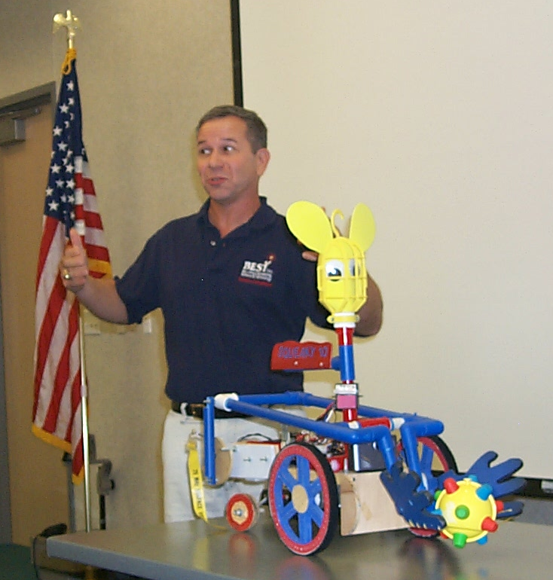
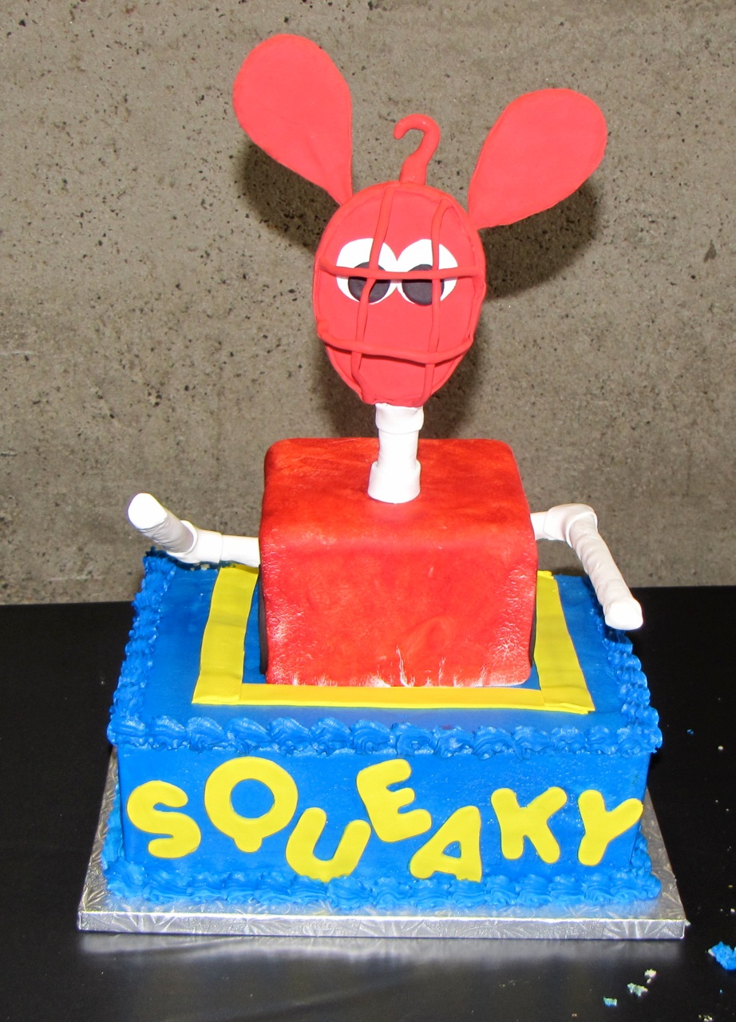
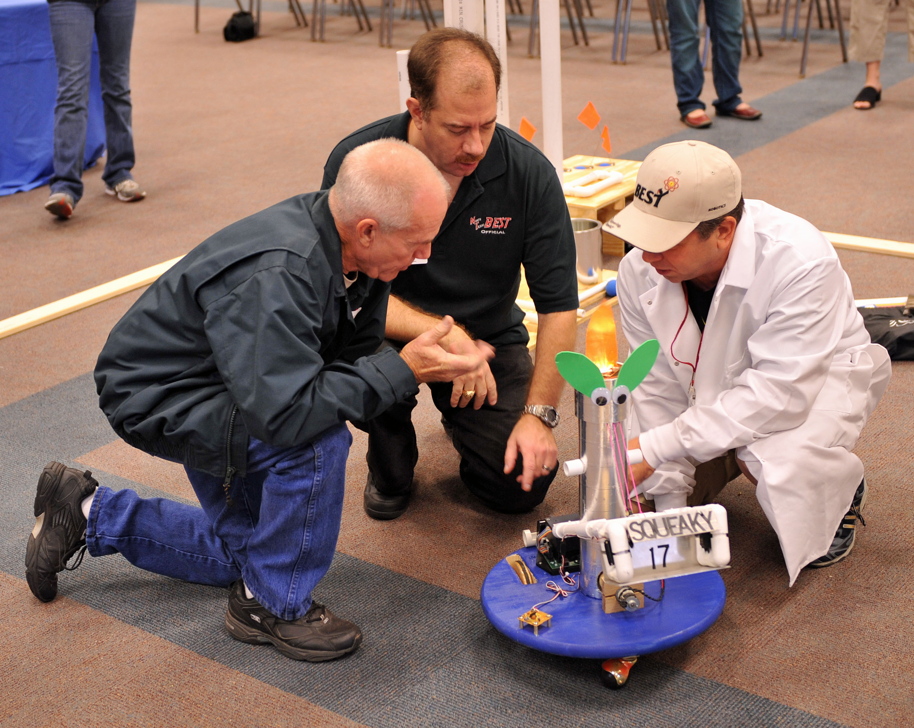
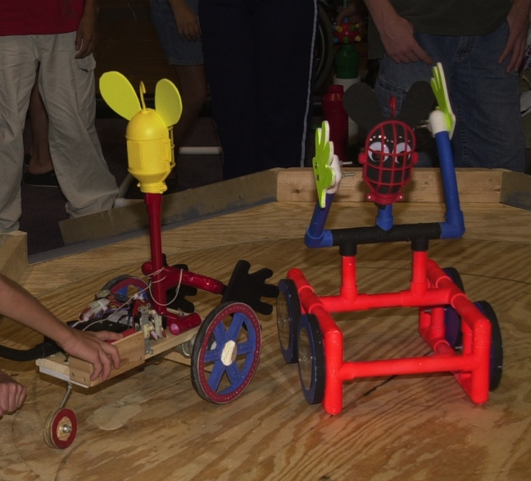
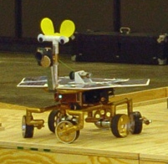
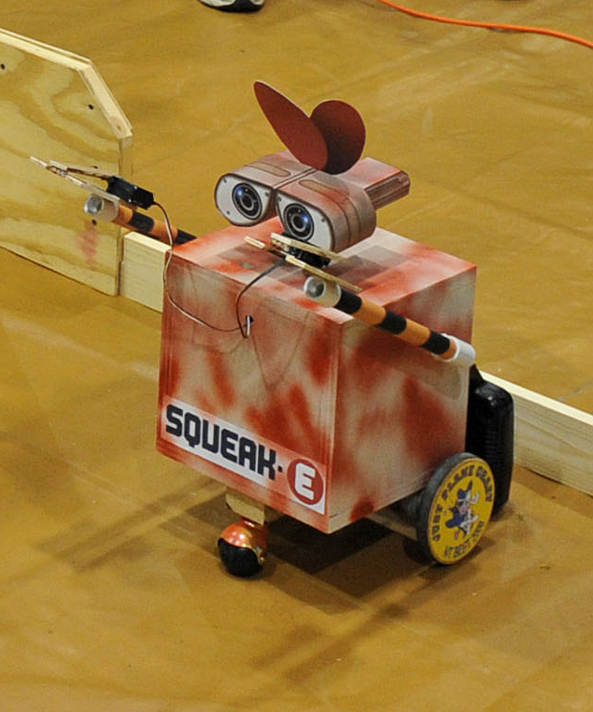

Slide 7
Ready to build a BEST CPU?
Let’s begin by asking a few questions…

Slide 8
What is a CPU and what are the components of a BEST CPU?
The CPU (Central Processing Unit) is the part of a computer that performs the arithmetic, logic and control functions.
The internal components are composed of different combinations of logic gates to perform various logical functions for the CPU.

Slide 9
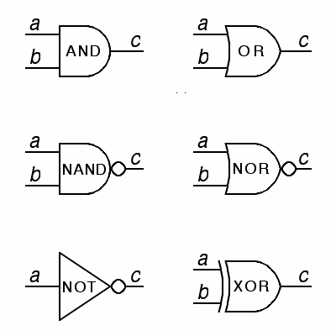
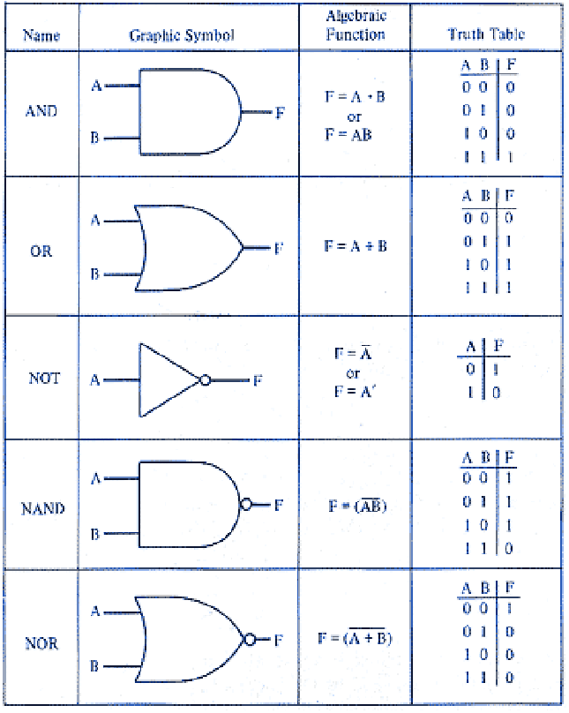
What is a Logic Gate?
A gate is a device implementing a Boolean function. A gate performs a logical operation on one or more Boolean inputs, and produces a single Boolean output. A gate consists of transistors

Slide 10
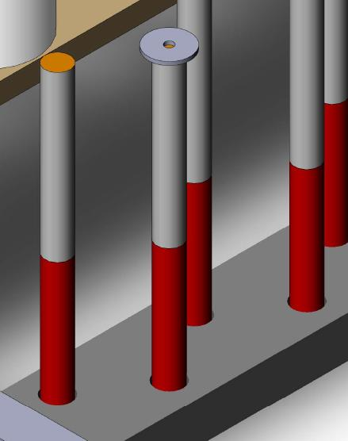
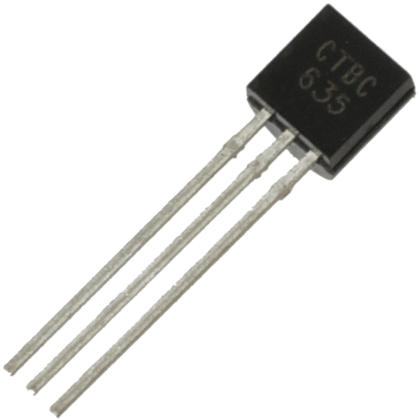
What is a Transistor?
A transistor is a small electronic semiconductor device having at least three electrical contacts, used in a circuit as an amplifier or switch
In Gatekeeper, a dowel represents a container holding a large number of transistors
Notes:
Transistor pic: http://www.tandyonline.co.uk/media/catalog/product/cache/1/image/9df78eab33525d08d6e5fb8d27136e95/b/c/bc635-transistor.png

Slide 11
Gatekeeper Transistor Values
--Gate Fabrication Area--
Transistor values for AND, OR and NOT gates
Non-painted
end
48
transistors
96
transistors
Painted
end
Upper Assembly Line
Lower Assembly Line
24
transistors
48
transistors

Slide 12
Gatekeeper Transistor Values
--Gate Fabrication Area--
Transistor values for NAND gates
Non-painted
end
Painted
end
48
transistors
96
transistors

Slide 13




Transistors to Gates
Collect large numbers of transistors to make gates (chips)
  Gates
  AND Gate = 24 transistors
  OR Gate = 24 transistors
  NOT Gate = 24 transistors
  NAND Gate = 16 transistors
Once enough transistors are collected to create gates, teams will put various gates together to create integrated circuits
  Integrated Circuits
  Multiplexer: 2 AND + 1 OR + 1 NOT vs. 3 NAND
  Adder: 1 AND + 1 OR + 1 NOT vs. 2 NAND
  Decoder: 1 AND + 1 NOT vs. 2 NAND
  Data Latch: 1 AND + 1 OR + 1 NOT vs. 1 NAND
Once integrated circuits are complete, teams will begin building their BEST CPU
  Core Processor Area
  ALU: 1 Multiplexer + 1 Adder
  3 Registers: 1 Data Latch each
  1 Instruction Decoder
  Memory Module Area
  8-bit: 1 Data Latch
  32-bit: 4 Data Latches + 1 Address Decoder

Slide 14
Transistor Point Values
--Gate Fabrication Area--
  # of Gates # of Transistors Point Value
  1 AND Gate = 24 transistors = 10 points
  1 OR Gate = 24 transistors = 10 points
  1 NOT Gate = 24 transistors = 10 points
  1 NAND Gate = 16 transistors = 8 points
Example #1
1 AND Gate
24 transistors
10 points
Example #2
4 AND Gates
96 transistors
40 points

Slide 15
What is an Integrated Circuit?
There are four (4) types of integrated circuits in the Stage 2 Fabrication Area:
Multiplexers (MUX)
Adders
Decoders
Data Latches (D-Latch)

Slide 16
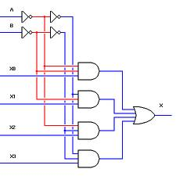
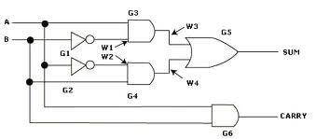
A Multiplexer (MUX) is a device that selects one of several analog or digital input signals and forwards the selected input into a single line.
Image: play-hookie.com
An Adder is a digital circuit that performs addition of numbers. The most common adders operate on binary numbers.
Image: ami.ac.uk

Slide 17
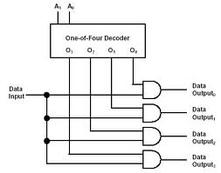
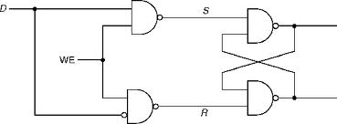
A Decoder is a device which does the reverse operation of an encoder, undoing the encoding so that the original information can be retrieved.
Image: cpuville.com
A Data Latch (D-Latch) is a latch which has a feedback path, so information can be retained by the device. Therefore latches can be memory devices, and can store one bit of data for as long as the device is powered. As the name suggests, latches are used to “latch onto” information and hold in place.
Image: c-jump.com

Slide 18
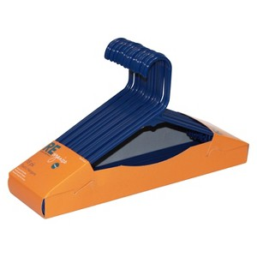
Building Integrated Circuits
Gatekeeper: Clothes hangers represent gates. To build an integrated circuit, calculations must be made to determine the number and type of gates needed to create each circuit. Remember, inventory is required from Stage 1: Gate Fabrication Area.
1 Red hanger = 1 AND gate
1 White hanger = 1 OR gate
1 Blue hanger = 1 NOT gate
1 Black hanger = 1 NAND gate

Slide 19
Integrated Circuits (IC)
--IC Fabrication Area--
AND
OR
NOT
MUX
Adder
Decoder
D-Latch
NAND
or
or
or
or
Squares represent colored hangers and the number required
to build each integrated circuit. Strategy will determine whether
a team uses NAND gates or AND/OR/NOT gates.

Slide 20
Gates to Integrated Circuits
Collect large numbers of transistors to make gates (chips)
  Gates
  AND Gate = 24 transistors
  OR Gate = 24 transistors
  NOT Gate = 24 transistors
  NAND Gate = 16 transistors
Once enough transistors are collected to create gates, teams will put various gates together to create integrated circuits
  Integrated Circuits
  Multiplexer: 2 AND + 1 OR + 1 NOT vs. 3 NAND
  Adder: 1 AND + 1 OR + 1 NOT vs. 2 NAND
  Decoder: 1 AND + 1 NOT vs. 2 NAND
  Data Latch: 1 AND + 1 OR + 1 NOT vs. 1 NAND
Once integrated circuits are complete, teams will begin building their BEST CPU
  Core Processor Area
  ALU: 1 Multiplexer + 1 Adder
  3 Registers: 1 Data Latch each
  1 Instruction Decoder
  Memory Module Area
  8-bit: 1 Data Latch
  32-bit: 4 Data Latches + 1 Address Decoder

Slide 21
Integrated Circuits (IC) Point Values
--IC Fabrication Area--
Manufactured MUX 80 points
Manufactured Adders 60 points
Manufactured Decoder 40 points
Manufactured D-Latch 60 points
NOTE: Upper assembly line operates twice the
speed as the lower assembly line.
Example #1: 3 NAND gates on the upper Adder
assembly line = 2 manufactured Adders.
Example #2: 3 NAND gates on the lower Adder
assembly line = 1 manufactured Adder.

Slide 22
Integrated Circuits to CPU
Collect large numbers of transistors to make gates (chips)
  Gates
  AND Gate = 24 transistors
  OR Gate = 24 transistors
  NOT Gate = 24 transistors
  NAND Gate = 16 transistors
Once enough transistors are collected to create gates, teams will put various gates together to create integrated circuits
  Integrated Circuits
  Multiplexer: 2 AND + 1 OR + 1 NOT vs. 3 NAND
  Adder: 1 AND + 1 OR + 1 NOT vs. 2 NAND
  Decoder: 1 AND + 1 NOT vs. 2 NAND
  Data Latch: 1 AND + 1 OR + 1 NOT vs. 1 NAND
Once integrated circuits are complete, teams will begin building their BEST CPU
  Core Processor Area
  ALU: 1 Multiplexer + 1 Adder
  3 Registers: 1 Data Latch each
  1 Instruction Decoder
  Memory Module Area
  8-bit: 1 Data Latch
  32-bit: 4 Data Latches + 1 Address Decoder

Slide 23
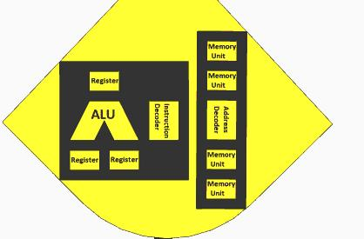
The BEST CPU Fabrication Area
The BEST CPU Fabrication Area consists of
two sub-areas:
Core Processor Area (located on the left)
Memory Module Area (located on the right)

Slide 24
What are the components of the Core Processor?
A BEST Core Processor requires:
(3) Registers (made by placing one D-Latch into
each designated area)
(1) Instruction Decoder (made by placing one
Decoder into the designated area)
(1) Arithmetic Logic Unit (ALU) (made by placing
one MUX and one Adder into the designated areas

Slide 25
Fabricating a Memory Module
A BEST Memory Module is capable of fabricating two
types of memory modules:
8-bit Memory Module (made by placing one D-Latch
into the designated area)
32-bit Memory Module (made by placing four
D-Latches and one Address Decoder into the
designated area)

Slide 26
CPU Fabrication Point Values
--CPU Fabrication Area--
Register installed 90 points
Instruction Decoder installed 60 points
MUX installed in ALU 120 points
Adder installed in ALU 90 points
8-bit Memory Module completed 90 points
32-bit Memory Module completed 420 points
8-bit CPU completed 512 points
32-bit CPU completed 1024 points

Slide 27
Inventory System
Gatekeeper utilizes an inventory system that is independent from scoring values:
Components fabricated in each stage are placed in a team’s inventory
This inventory is NOT represented physically, but is instead maintained by the BEST Scoring Software
Hubs will provide a display for viewing team inventory, but it is highly recommended that teams track their own inventory

Slide 28
What is 5S?
The 5S system is a workplace organization method to organize a workspace to improve efficiency and effectiveness. The five S’s are:
Sort
Set in order
Shine
Standardize
Sustain

Slide 29
The 5S Bonus
The 5S Bonus is awarded at the completion of each match for maintaining a clean and safe work environment:
5S Bonus is calculated at the end of each match but is not finalized until the end of the round
5S Bonus will be awarded at the end of a match, if no game pieces have been removed from play, and any game pieces in contact with the floor are also in contact with the robot
The maximum 5S per round is 10% of the scored amount

Slide 30

Tie-Breaker
In the event of a tie, the winner will be the team with the highest notebook score
If the notebooks are tied, the winner will be determined by flipping a standard U.S. Quarter (preferably from Alabama!)

Slide 31

Good Luck!
Please remember to read the rules FIRST. Any remaining questions can be addressed on the Official BEST Q&A!

