Slide 1
2013 Prototype Game Weekend Hub Development
All About BEST Kits
Prepared by: David Kwast 27 April 2013

Slide 2
Outline
What’s New for 2013
Kit Spreadsheet Overview
2013 Kit Related Schedule
Resources
Other Kit Topics

Slide 3
What’s New for 2013

Slide 4

2013 Consumable Kit Changes
Removed 1/8” hardboard sheet
Added 1/2” plywood sheet
Removed 1/4”-28 nylon nut
Added 1/4”-28 nylon screw (for igus rod end bearing)
Increased rotary potentiometer quantity from one to two

Slide 5
2013 Consumable Kit Changes (continued)
Added #10-32 x 3/4” hex head screw
Added painters tape
Removed 1/4”-20 x 4” eyebolts (for 2012 game)
Removed 9V battery
Removed large 10A micro switches

Slide 6
2013 Returnable Kit Changes
Added three wire sensor terminal cable
  2 minimum per kit
Added roller blade wheel and axle
Added 1/16” hex wrench (optional)
  for pulley set screws
Changed quantity of two wire sensor terminal cable
  maximum of 6 per kit now
Removed Bourns' rotary potentiometer

Slide 7
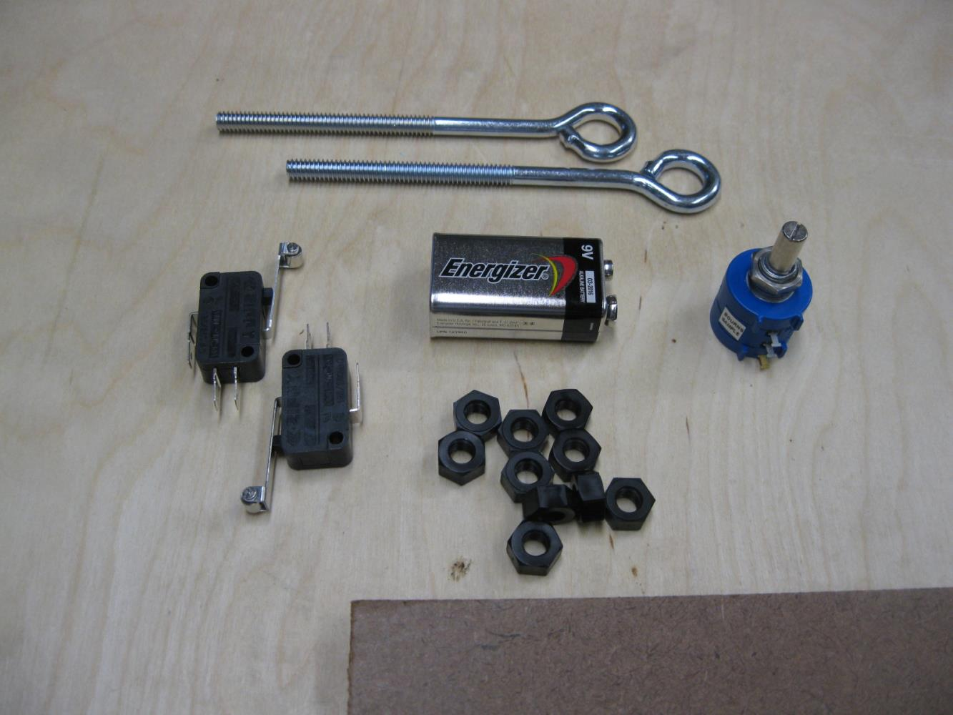
Items being removed from the kit.

Slide 8
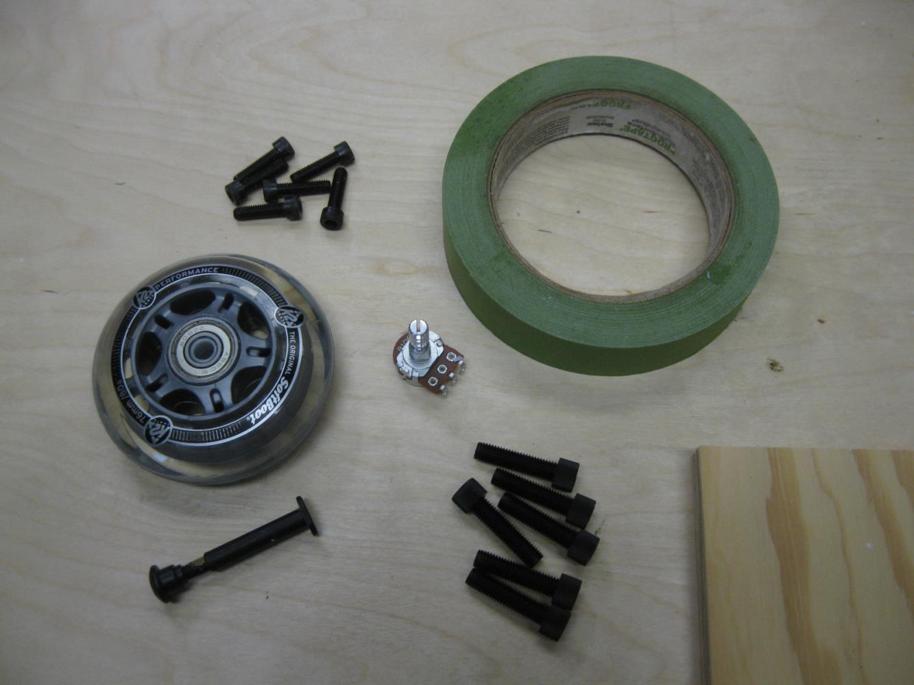
Items being added to the kit (three wire sensor terminal cables not shown).

Slide 9
2013 Kit Related Rules Changes
Allow use of painters tape on all Returnable Kit items except the Joystick

Slide 10
Kit Spreadsheet Overview
(live walkthrough)

Slide 11
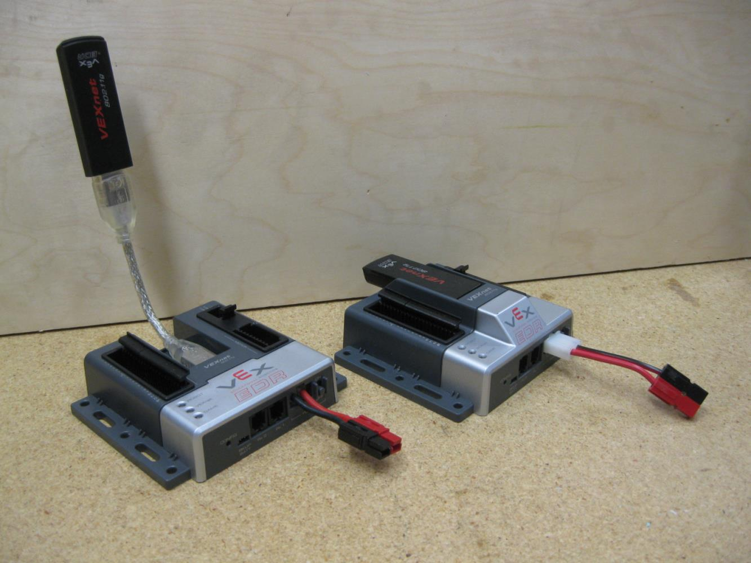
High profile Cortex with Molex to Powerpole adapter.
Low profile Cortex with optional USB extension and Powerpole conversion.

Slide 12
2013 Schedule
31 April – Final Kit Lists are scheduled to be published
  Dependent upon VEX
?? 2013 Controller System Kits are available for ordering
31 June VEX ordering deadline for 1 August delivery
No planned firmware update this year
  Okay to just load the default program when it becomes available

Slide 13
Resources
General
  \Public Files\Kit Info\2012_Genric_Kit_Usage_Guide.doc
All the following files are posted at \Hub How-To Files\Kit Stuff\
Kit Preparation
  New Kits [Return_Kit_Preparation.pdf]
  Used Kits [Used_Return_Kit_prep.pdf]
How to Guides
  Battery Powerpole Conversion [Changing_Battery_Connectors Rev2.pdf] (I recommend the 15A connector and no soldering)
  Cortex Powerpole Conversion [Cortex Powerpole Conversion v2.pdf]
  Auxiliary Joystick Power Supply Cable [joystick auxiliary battery cable instructions.pdf]
Wi-Fi Guide
  Field WiFi Guide v2.pdf (also a version of this on the BRI Wiki)

Slide 14
2013 Kit Issues
Cortex battery connect does not retain cables well
  Replacement connector is available
Small motor gear boxes are not robust
  Safe kinetic energy load is 16 in².lb/sec²
  Scheduled for replacement this year
VEXnet keys have a high failure rate
  Improved keys are in development

Slide 15
2013 Avoidable Kit Issues
Fried motor controllers due to sloppy wiring
  Warn students about shorting out the motor controllers
  Improved units are in development
Stripped servo gears due to overload
  Warn students about applying external loads to the servos

Slide 16
2013 Kit Tips
Use caulking on the screw terminal cables
  for stress relief
Tin motor terminals
  increases tab strength
Ask VEX for Cortex retention clip replacements when you place an order
  make a note in the shipping instructions area
Recommend use of thumbscrew for joystick battery cover
  avoid screw damage
  more convenient

Slide 17
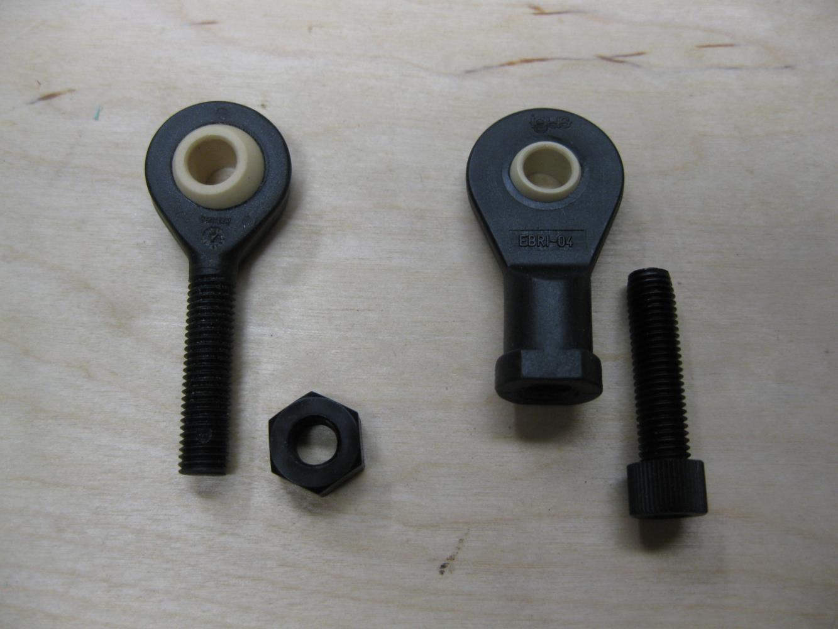

Old
New

Slide 18
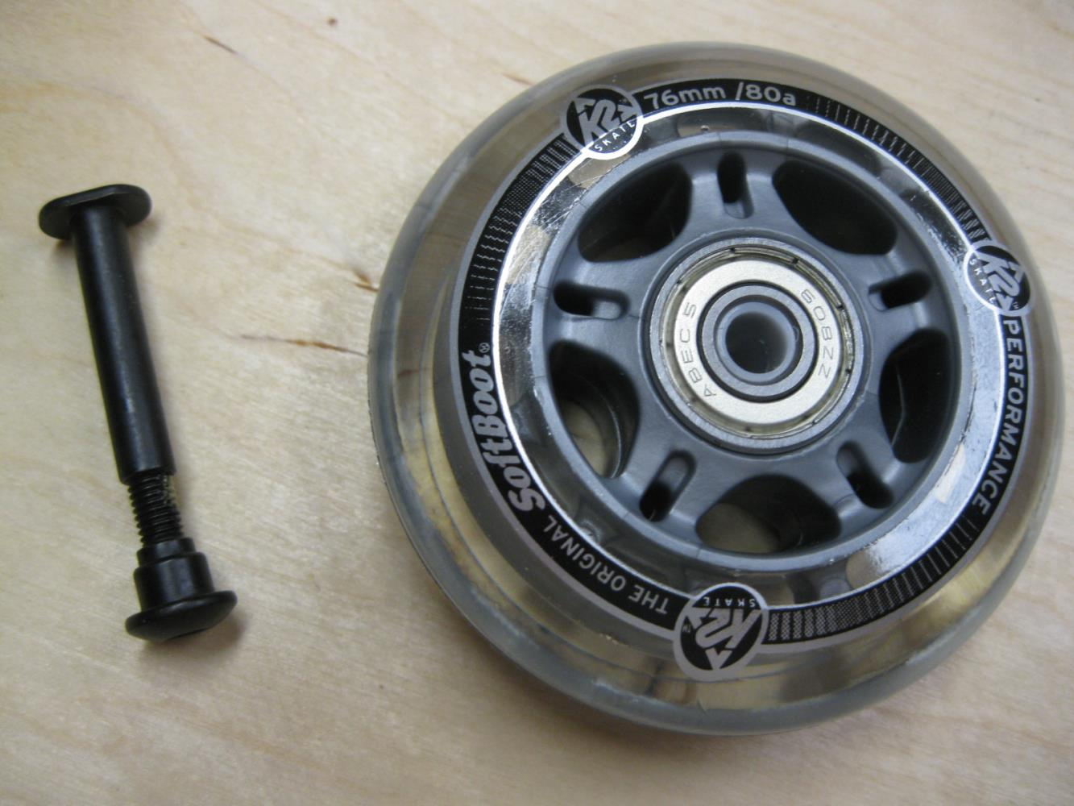

Slide 19
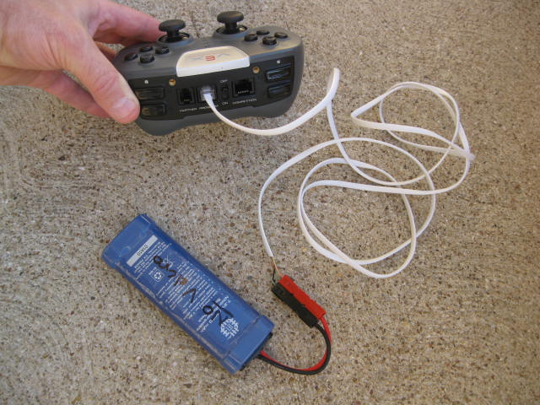
Joystick auxiliary battery cable.

Slide 20
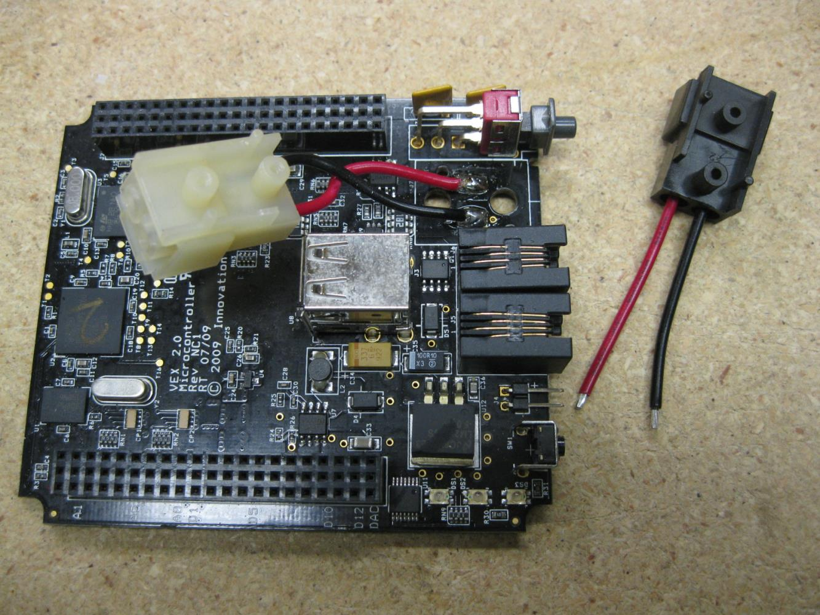
2012 Kit Tips
Ask for Cotex black Molex pigtail connector.

Slide 21
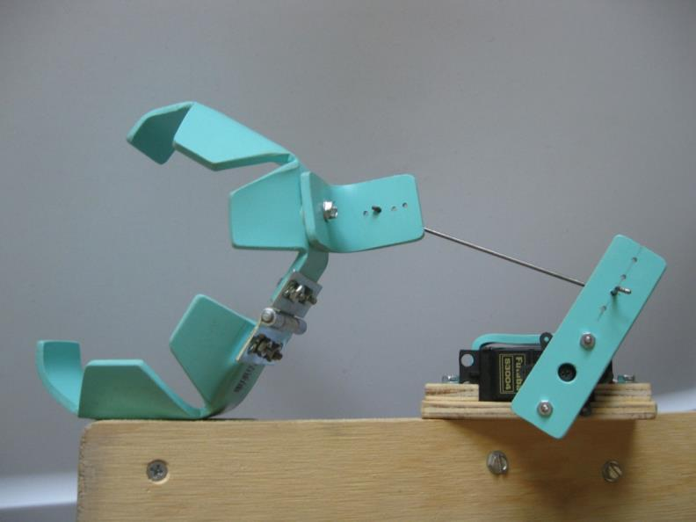
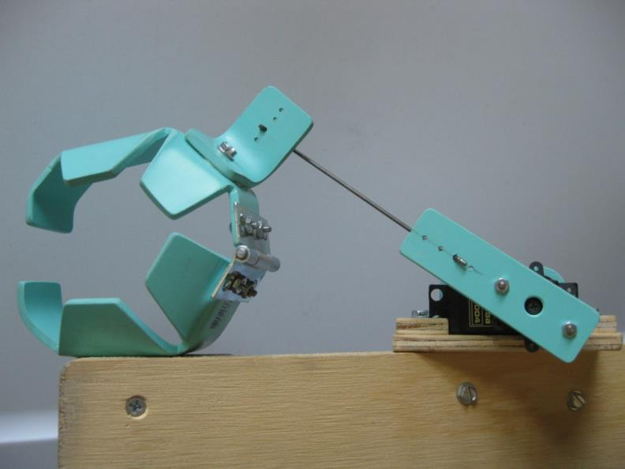
Running into something with this gripper open will strip the servo gears.
In the closed position, the servo is protected (a lot of force would be required to snap off the drive shaft).

Slide 22
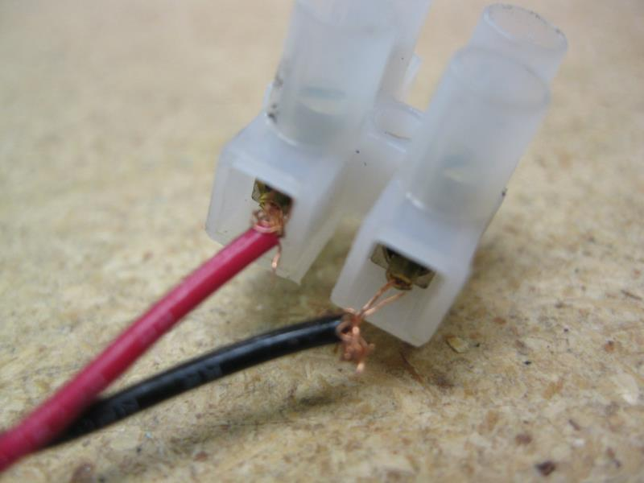
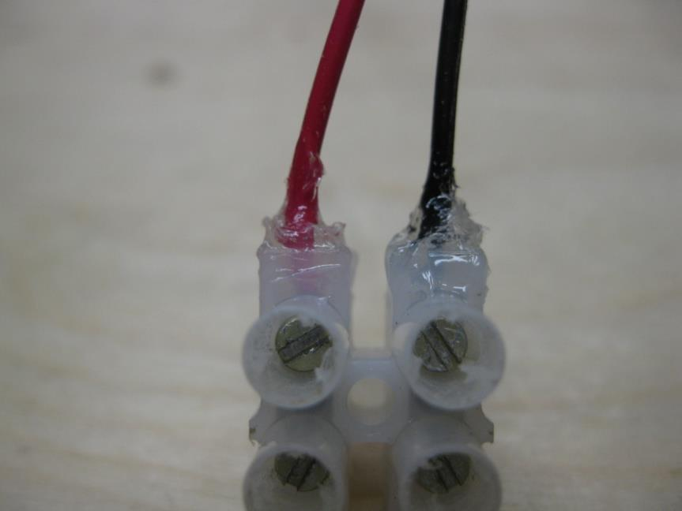

Slide 23
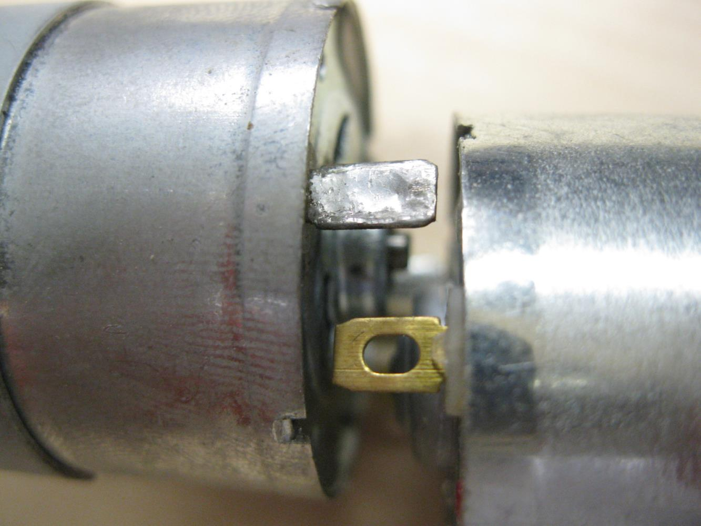
2012 Kit Tips

Slide 24
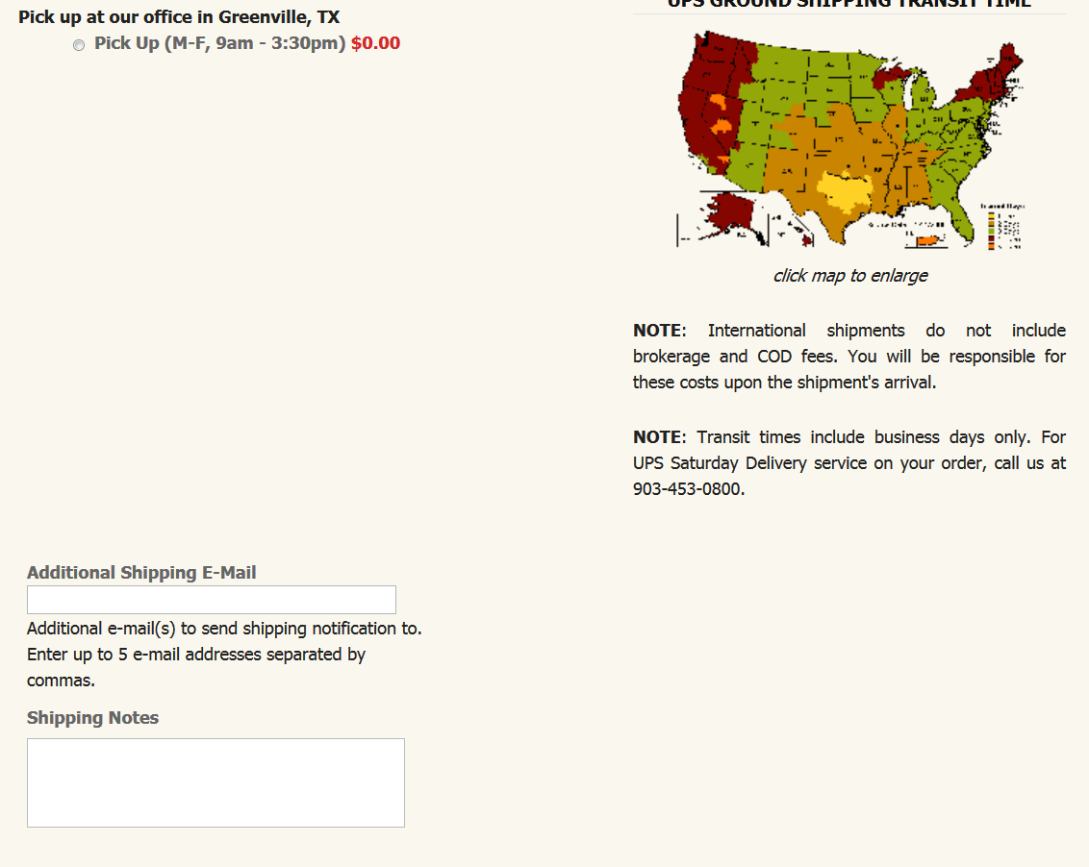
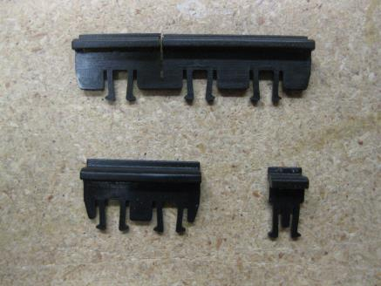
2012 Kit Tips
I/O clip
motor clip
UART clip
Please send (xx) of the black Molex pigtail connectors and (xx) of the motor retention clips for the Cortex. Thanks.

Slide 25
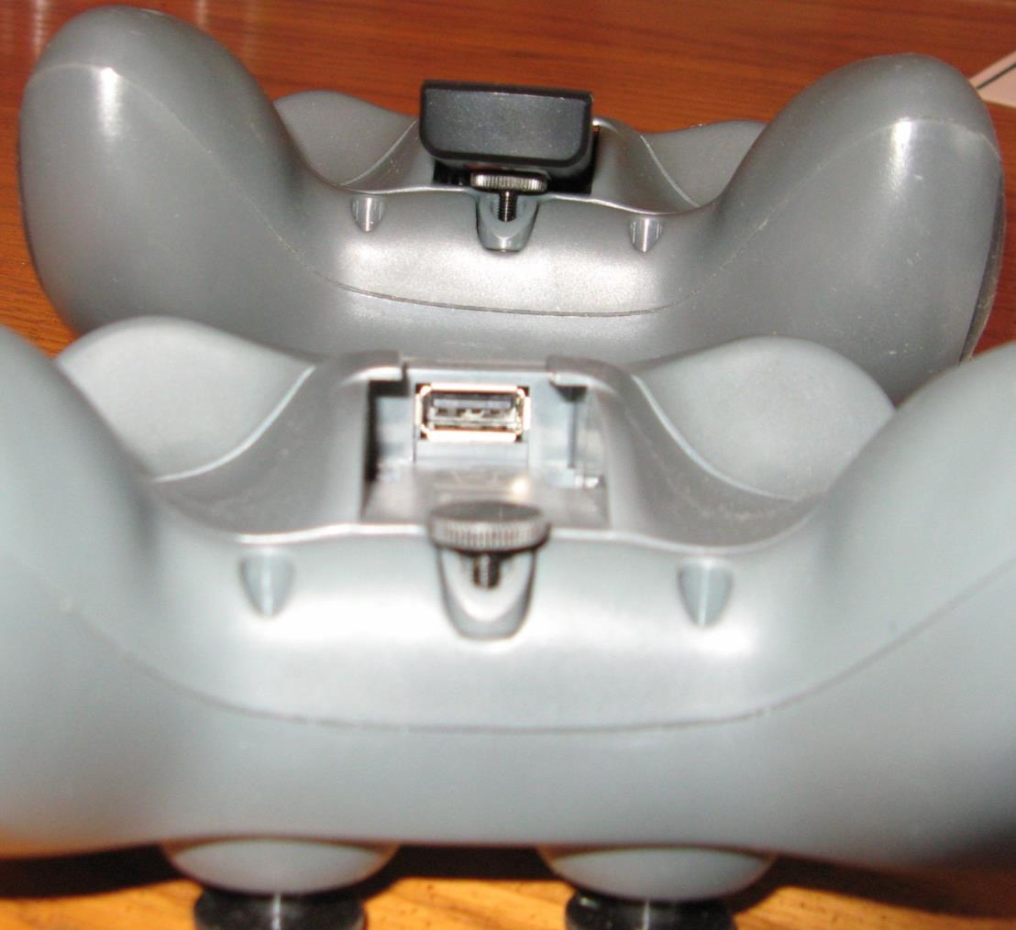
2012 Kit Tips
Ordering info from McMaster-Carr:
Thumb Screw - Part #92552A418
http://www.mcmaster.com/#92552a418/=dfnvlv

