Slide 1


2012 BEST Robotics Design Competition: ‘Warp XX’
Dallas BEST
Dallas, Texas
Notes:
Welcome to the 2012 BEST Robotics Design Competition.
This years game is called “Warp 20”, and comes to us from Dallas BEST, in Dallas Texas.

Slide 2
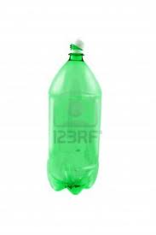

Warp XX
Notes:
Warp20 may require …

Slide 3
A new perspective
Notes:
A new perspective

Slide 4
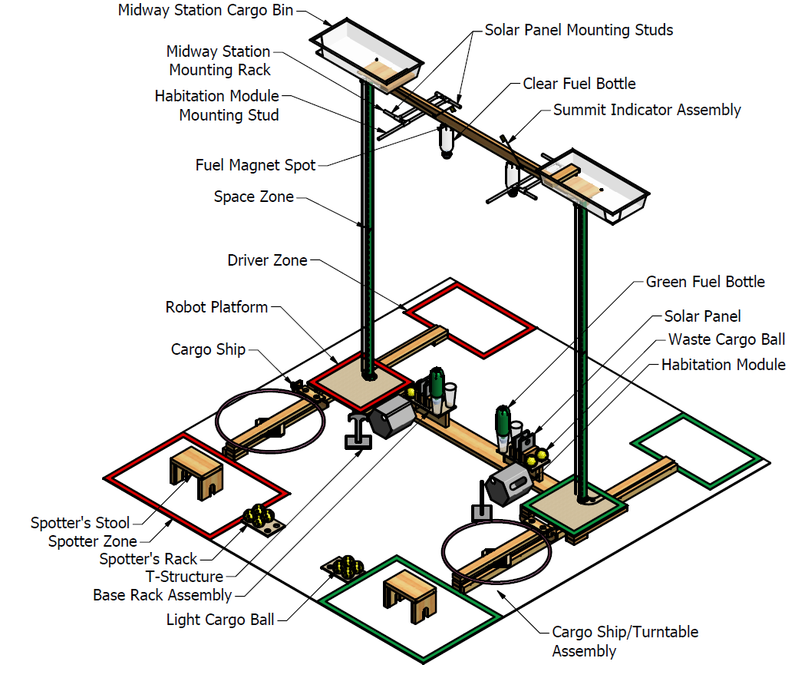
Warp XX : Field description
Drivers
Space Zone
audience
Spotters
Notes:
Field description:
The Warp 20 field represents a Space Elevator, stretching from a platform floating in mid-ocean,
to Midway Station, located a minority* of the way to Low Earth orbit.
The Space Elevator has 4 towers, constructed in two pairs.
One pair is shown here.
From the view point of the (^click) audience,
The Red and Yellow fields will use the Left towers (^click)
The Green and Blue fields will use the Right towers
The Driver box is located behind the tower, (^click)
while the Cargo Ship and the spotters are in front
The Base Rack and Midway Station racks are between the towers, (^click)
The midpoint of each tower is designated as the Space Zone.
*Ten feet certainly is only a minority of the way to orbit!

Slide 5
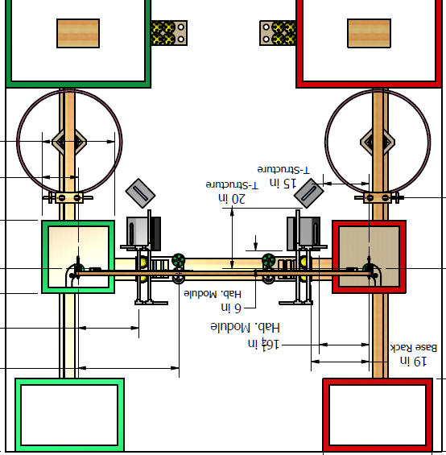


Drivers / Top view Perspective
Notes:
Here is an overhead view of the field, view from the drivers side

Slide 6
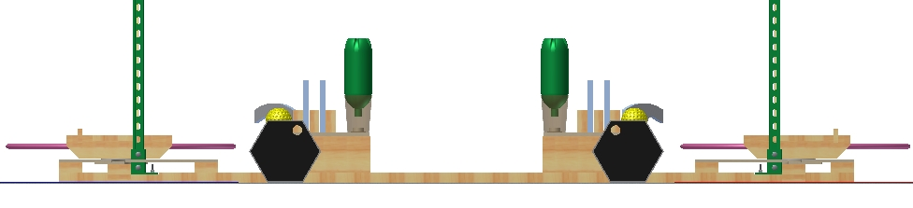
Driver’s (Shoes) Perspective showing Left/Right field variations
Base Rack
to the
Green Driver’s Right
Base Rack
to the
Red Driver’s Left
Notes:
And the view from the Drivers shoes:
The Base Rack and Midway Station racks are between the towers
Creating Right Handed and Left Handed layouts.

Slide 7
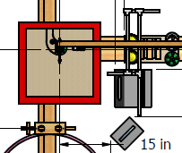
Ground Zone driver’s top-down view close-up
Cargo Ship
T - structure
Habitation Module
Green Fuel Bottle
Base Rack
Empty Fuel Holder
Solar Panels (2)
Waste Cargo (2)
Starting platform
Notes:
At the base of each tower is the Ground Zone,
The starting platform is 24” square, with the tower rising up through it.
The Cargo Ship is on the far side of the tower from the driver.
The Base Rack is between the towers, and is laid out in mirror image.
The base rack holds two Waste Cargo Balls, two Solar Panels, and a Green Fuel Bottle.
Also in the Ground zone, are a T structure, and Habitation Module
Robots may interact with the Ground Zone as long as every part of the robot is below the Space Zone.

Slide 8
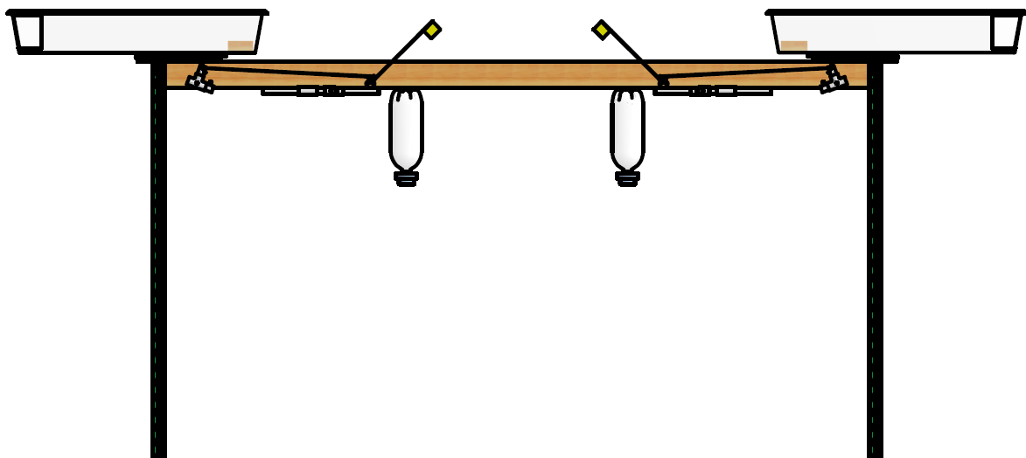
Midway Station drivers view
Midway Cargo Bins
Summit Indicators
Fuel Bottle Magnets
Summit Indicator Linkage
Summit Indicator Linkage
Mounting Studs for Solar Panels, T-Structure, Habitation Module
Midway Station
is to the
Green Driver’s Right
Midway Station
is to the
Red Driver’s Left
Notes:
Far above the ground, is our destination: Midway Station.
Midway Station is mostly between the towers, creating Right Handed and Left Handed layouts.
The Midway Cargo Bin is directly above the Tower, and is the final destination for Cargo Balls from the Cargo Ship
The Clear Fuel Bottle starts on Midway Station, and is scored when it is deposited in the Base Rack.
The Mounting studs for Solar panels, T structures, and Habitation Modules are attached to the Midway Station Beam.
Robots may interact with Midway Station as long as every part of the robot is above the Space Zone.

Slide 9
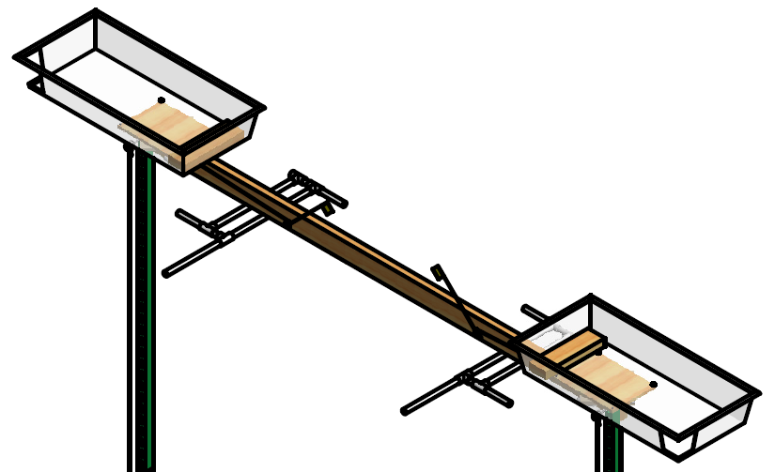
Midway Station top oblique spotter view
Mounting Slot for the
T-Structure (2 each side)
Mounting Studs for the
Solar Panels (2 ea side)
Habitation Module Mounting Studs
Notes:
Here is a top view of Midway Station from the Spotter side, which more clearly shows
The mounting studs for Solar Panels and Habitation Modules,
And the slot for the T-structures, attached to the Midway Station Beam

Slide 10
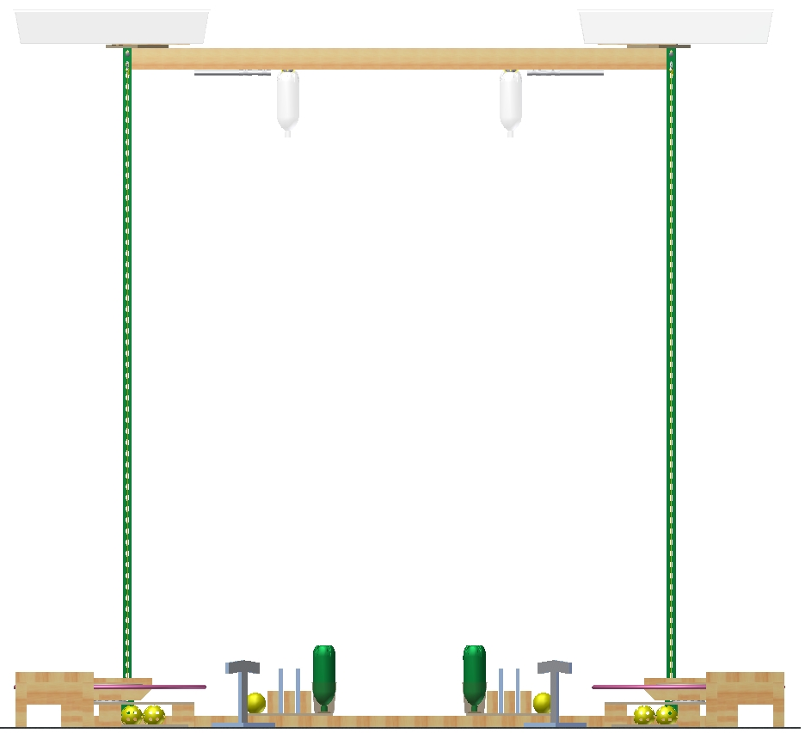
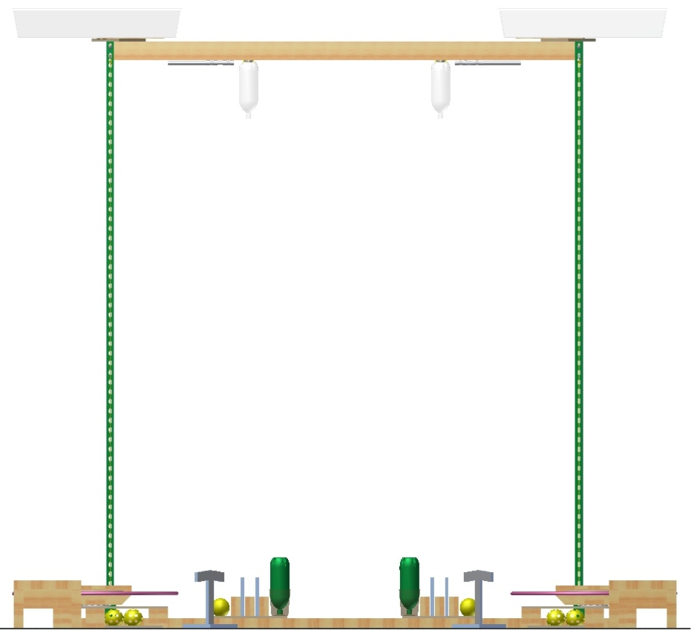
WarpXX : Match procedure, starting position: Audience view
Notes:
Warp 20 Match procedure:
Four teams compete at a time, each on their own Tower.
Driver and spotter put (^click) their robot on the start platform,
and install (^click) the safety wire,
They may also attach (^click) their robot to the unobtainium cable if desired.
While the robot must fit in the usual generic rules 24” cube of compliance at check-in
and at the start of each match,
For this year’s game Warp20, the robot starting position need not be constrained (^click) within the starting box,
Or even to orthogonal orientation.

Slide 11
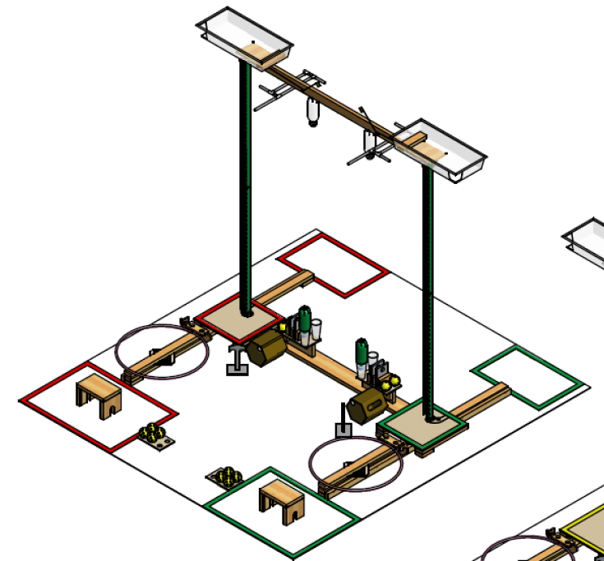
Warp XX Operations
Notes:
Warp 20 Operations:
A match lasts 3 minutes:
The spotter can move (^click) cargo between the Cargo Ship and spotter rack,
and operate (^click) the Cargo Ship with the handle.
The robot is responsible ^click
- for moving The Cargo Ball from the Ship to Midway Station Cargo Bin
and moving The Waste Cargo to the Cargo Ship
The robot is responsible ^click
for moving The Clear Fuel Bottle to the Base Rack
for moving The Green Fuel Bottle to Midway Station magnet
The robot is responsible ^click
for moving The Solar Panels from the Base Rack to the mounting studs on Midway Station
Also the T-structure, and the Habitation Module.

Slide 12

Object Descriptions & Scoring Table
Game Piece Name | Common Name | Diameter | Max Weight (Oz) | Point value each | Starting Location | Scoring Location | #Pieces per Tower
Waste Cargo Ball | practice softball | 4” | 7 | 1 | Base rack | Spotter Rack | 2
Light Cargo Ball | softball whiffleball | 4” | 2 | 3 | Spotter Rack | Midway Cargo Bin | 4
Green Fuel Bottle | 2-liter bottle | 5.25” | 2 | 7 | Base rack | Midway Magnet | 1
Clear Fuel Bottle | 2-liter bottle | 5.25” | 2 | 5 | Midway Magnet | Base rack | 1
T-Structure | Foamboard 8” x 12” Tee | 1.5"x.75” Stem | 2 | 8 | Floor | Midway T -Slot | 1
Solar Panel | Foamboard 6x8”; 1-3/4” hole | 0.75” thick | 1 | 6 for each stud with a panel | Base rack | Midway Solar Panel Stud | 2
Habitation Module | cardboard hex prism, 11” long | 9” across flats | 11 | 12 | Floor | Midway HM Stud | 1
Notes:
Here is an overview of the Game Objects, Descriptions, Weights, Scoring locations, and point values.
As usual, in case of any conflict between this presentation and the Game Specific Rules,
The Game Specific Rules, and answers in the BEST Robotics Incorporate website Q&A, take precedence.
See also the packet of the hundred pages of field drawings that make this contest possible. .

Slide 13
Warp XX: Scoring Bonuses
Bonus Type | Achieved by | Additional Points
Fuel Tank Exchange Bonus | Placing clear fuel bottle from station into base rack holder and taking the green fuel bottle and attaching it to the mounting point on the station | 4
Cargo Diversity Bonus | Scoring a lightweight cargo ball, a solar panel, and the T-structure | 9
Rapid Turnaround Bonus | Scored if the entire robot is below the Space Zone at the end of the match | 1
Summit Bonus | Toggling summit indicator at Midway Station | 2
Notes:
Warp 20 Scoring bonuses:
In addition to the individual points for each piece, there are 4 scoring bonuses.
To encourage Rapid Turnaround between matches,
there is an incentive bonus for Robots that finish the match completely below the Space Zone.
Note that even robots that don’t lift off the ground can earn this 1 point Rapid Turnaround Bonus,
All robots that can toggle the summit indicator at the top of the tower during the match
earn the 2 point Summit Bonus.

Slide 14

Notes:
This concludes the introduction to the 2012 BEST Robotics Design Contest “Warp 20”.
Climb Swiftly,
Climb Safely.

