Slide 1
Generalized tiebreaker wiring diagram
National Instruments LabVIEW box
USB 6501
COM microswitch NO
When wiring to the microswitch, wire to the normally open (NO) contact and to the common (COM) contact. Polarity does not matter.

Slide 2
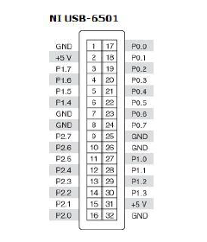
NI 6501 connections used
Pin No | Tower Color
17 | Yellow
18 | Red
19 | Blue
20 | Green
25 | Common
NI 6501 pin outs
Wiring is run from the microswitch to the back of the switch
standoff, down the base rack mount to the hole in the base beam.
Wire is stapled in place along standoff and base rack. Wire
runs through the hole to the channel, where it is directed to the
desired end of the tower assembly and to the NI box which is
collocated with the scoring PC. Any small gauge wire can be used.
Least expensive is option is probably one pair from an unbundled
cat 5 cable for each switch.

