Slide 1
Agenda - Wolverine BEST Kick-Off Day
9:30 - 10 Registration (sign in out front if you didn't already), do NOT open your packets until told
10 - 10:30 Introductions and kit discussion
10:30 - 11 Introduce Warp XX
11-12 Meet with your team, in groups you will be told when to go pick up your parts kits
12-1 (optional) Training sessions in the Hall of Arts and Letters

Slide 2
Most Important Things about the Kits
I want everything in the Returnables Kit back - in good shape
  best to turn it in at the end of Game Day
  if you break a Returnables item, you need to replace it (ordering information available on the kit list)
I want the big, blue tub back, but none of the Consumables parts

Slide 3
Kit Safety
Some of the items have sharp edges - be careful
The plywood can give you splinters - be careful
Aluminum and steel can be dirty - don’t handle them while wearing light colors!

Slide 4
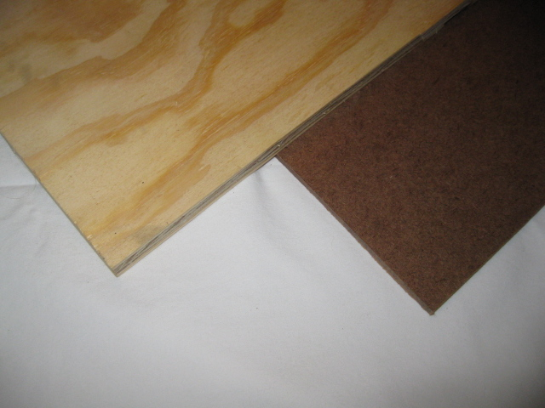
Kit and Rule Changes for 2012 – 1/10
1/2“ Plywood was replaced by 1/8“ Hardboard
Old
New

Slide 5
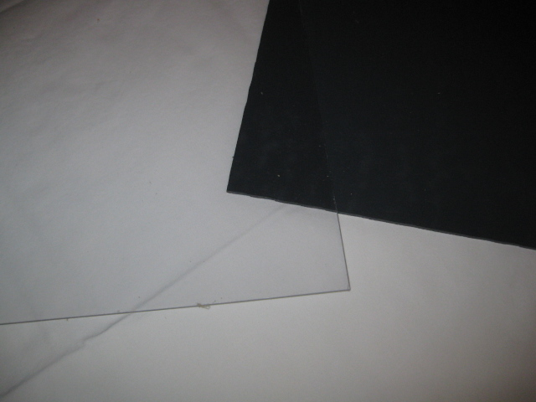
Kit and Rule Changes for 2012 – 2/10
1/8“ Polycarbonate was replaced by 1/8“ PVC
New
(opaque)
Old
(clear)

Slide 6
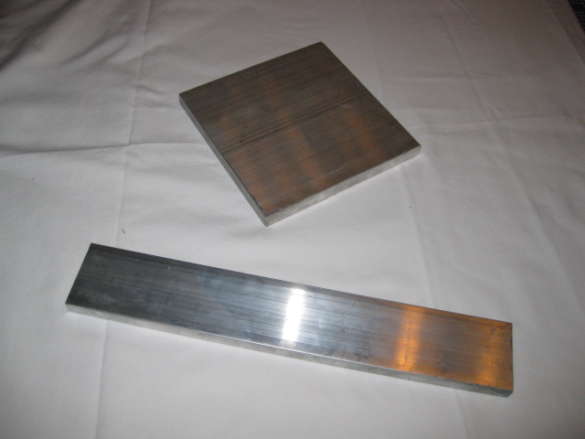
Kit and Rule Changes for 2012 – 3/10
Aluminum plate stock size was changed from 1/2“x6”x6” to 1/2“x2”x12”
Old
New

Slide 7
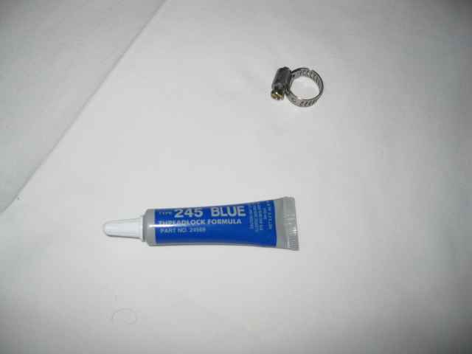
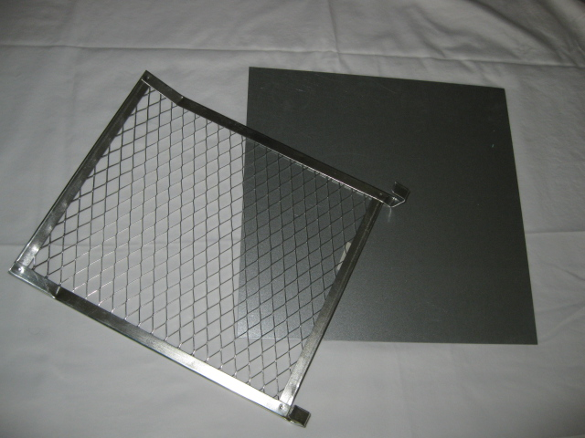
Kit and Rule Changes for 2012 – 4/10
Removed 22 Gauge Steel plate
Removed hose clamps
Removed nut locker
Removed paint grate from the Consumable Kit (but it is still in team supplied list)

Slide 8
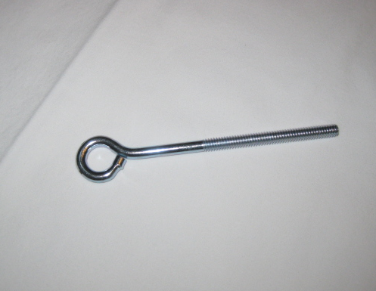
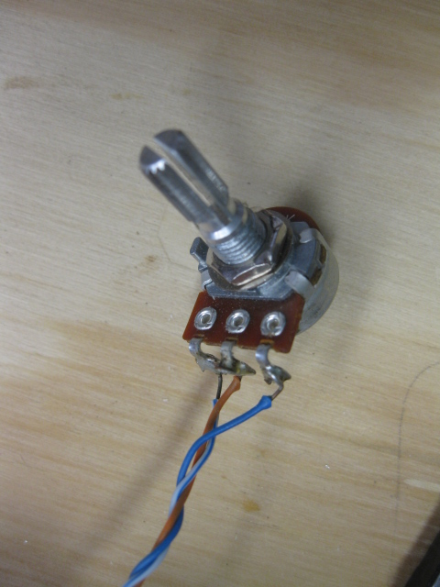
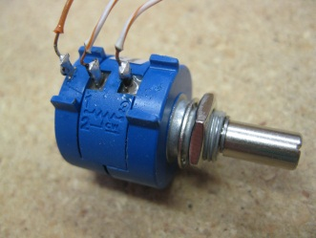
Kit and Rule Changes for 2012 – 5/10
Added 1/4” – 20 x 4” eyebolt to Consumable Kit
Added 300° turn potentiometer to Consumable Kit
Added 10 turn potentiometer to Returnable Kit
300°
10 Turn

Slide 9
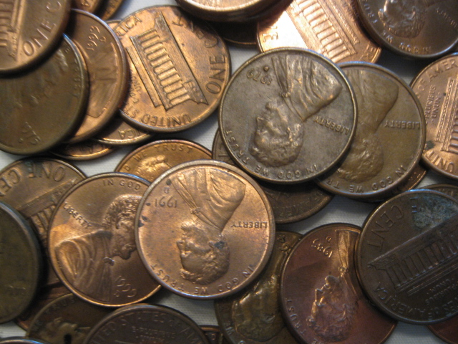
Kit and Rule Changes for 2012 – 6/10
Added pennies to team supplied items
  Cannot be altered (gluing okay and nonstructural soldering okay, does not “alter” the pennies)
  Less than 24 lb

Slide 10
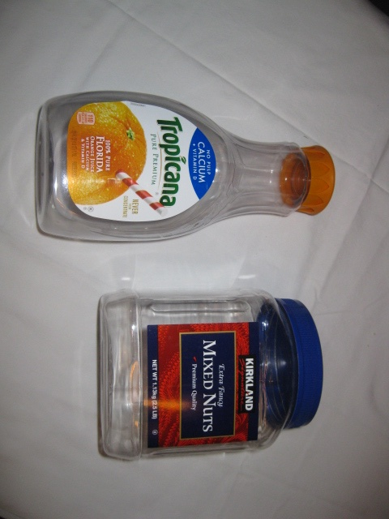
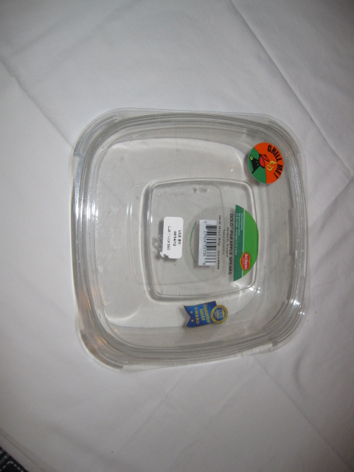
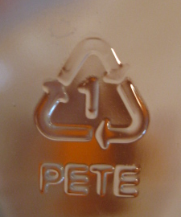
Kit and Rule Changes for 2012 – 7/10
Added PETE food/beverage container to team supplied items
  One container with screw-on lid allowed
  Less 2 liters in size
  Look for the number 1 recycling symbol
okay
not okay (no screw-on lid)

Slide 11
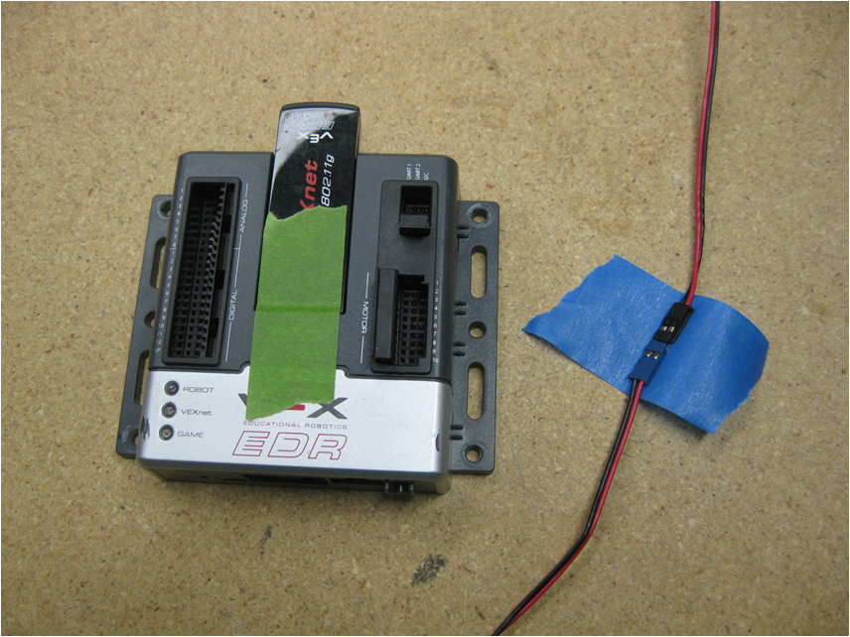
Kit and Rule Changes for 2012 – 8/10
No residue “painters” tape may be used to secure VETnet key and cable-to-cable connectors.

Slide 12
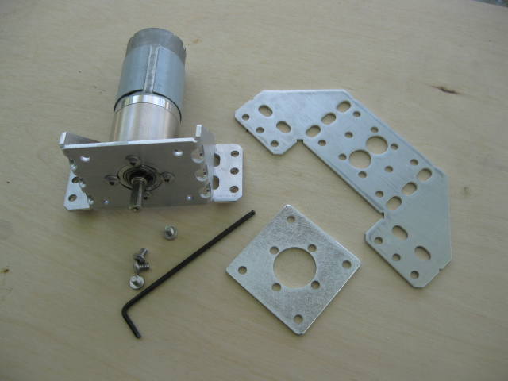
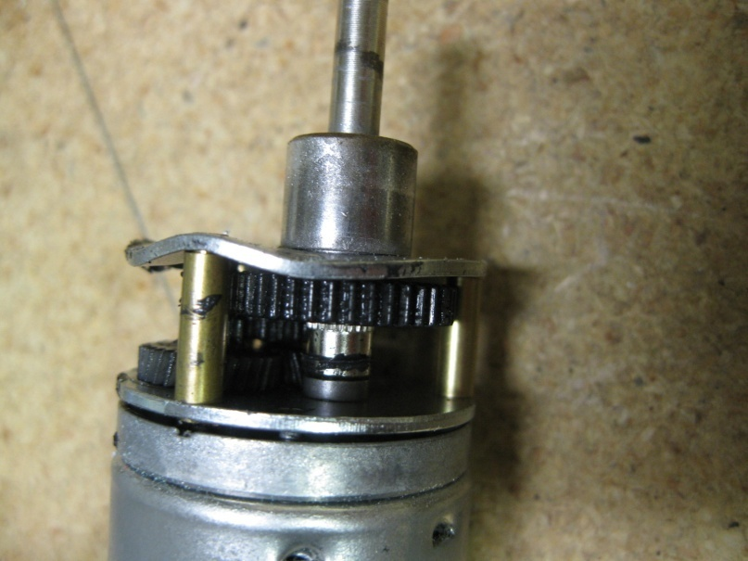
Kit and Rule Changes for 2012 – 9/10
Use of motor mounting plates to mount the motors is no longer required. HOWEVER, if they are not used when face mounting the small motor, it is easy to damage the internal gear plate.

Slide 13
Kit and Rule Changes for 2012 – 10/10
Rules now allow the use of the Cortex analog ports
  Required for the potentiometers
Added rule that the only Consumable Kit item that can conduct electricity is the provided wire. Exception being that any Consumable Kit provided/allowed metallic material can be used as part of a sensor circuit.

Slide 14
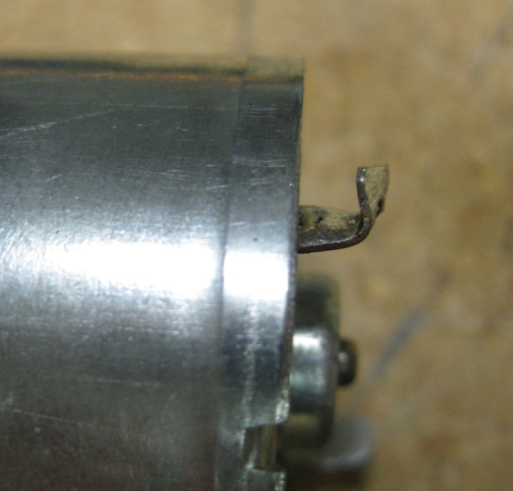
Kit Kindness – 1/5
Please be kind to your Returnable Kit (and follow the rules)
  No paint, adhesives, tape (except as allowed) or Velcro on any Returnable Kit item!
  Secure the Cortex and the batteries on the robot
  Do not bend the motor tabs
Your team will be charged for damaged or painted items

Slide 15
Kit Kindness – 2/5
To prevent breaking the gears in the small motor, do not exceed kinetic energy load levels of
16 in^{2.}lb/sec².
Higher levels of load/energy can be driven, but unless you are careful (slow and gentle) when reversing directions, the gears will be broken (and your team will be expected to pay for the motor).

Slide 16
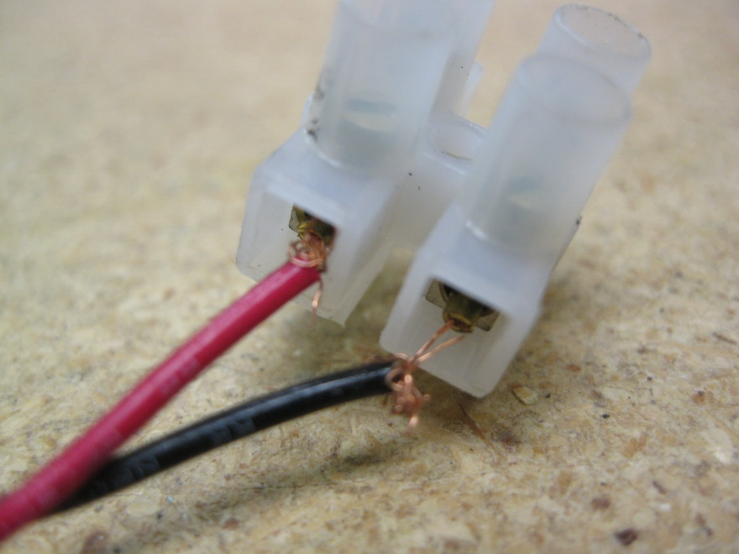
Kit Kindness – 3/5
Secure cables/wiring to prevent stress at the connections

Slide 17
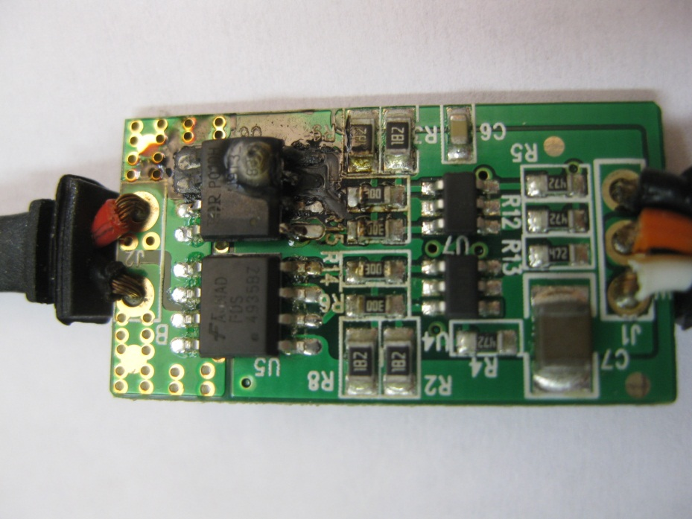
Kit Kindness – 4/5
Avoid sloppy wiring in the motor circuits, the external motor controllers will fry if the wires are shorted

Slide 18
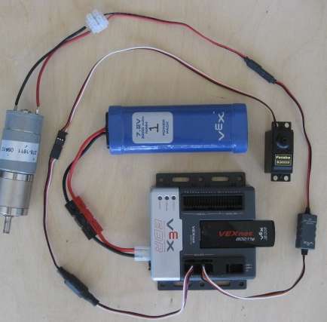
Kit Kindness – 5/5
connect/disconnect here
leave connected here

Slide 19
Finally
Check over your kits at your first meeting
If you are missing 1 of your 25 rubber bands (or similar thing) - I don't care
If you are missing a lot of something or an entire part - let Mike Bright know (mwbright@gcc.edu ) and we will get it to you

