Slide 1
Branches Counter

Slide 2
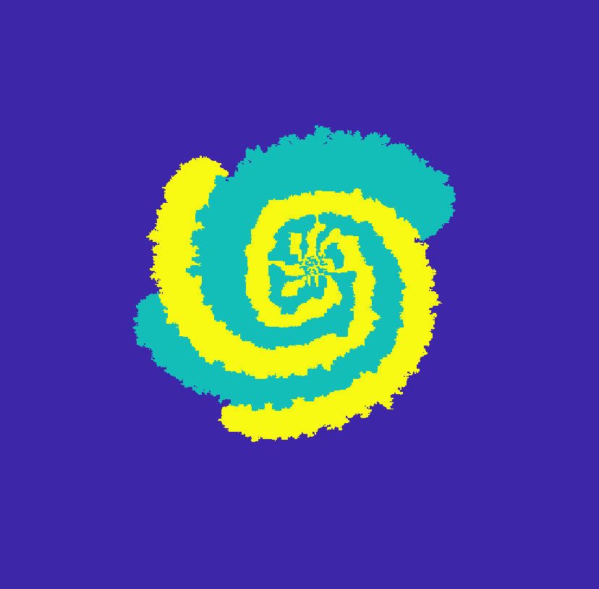
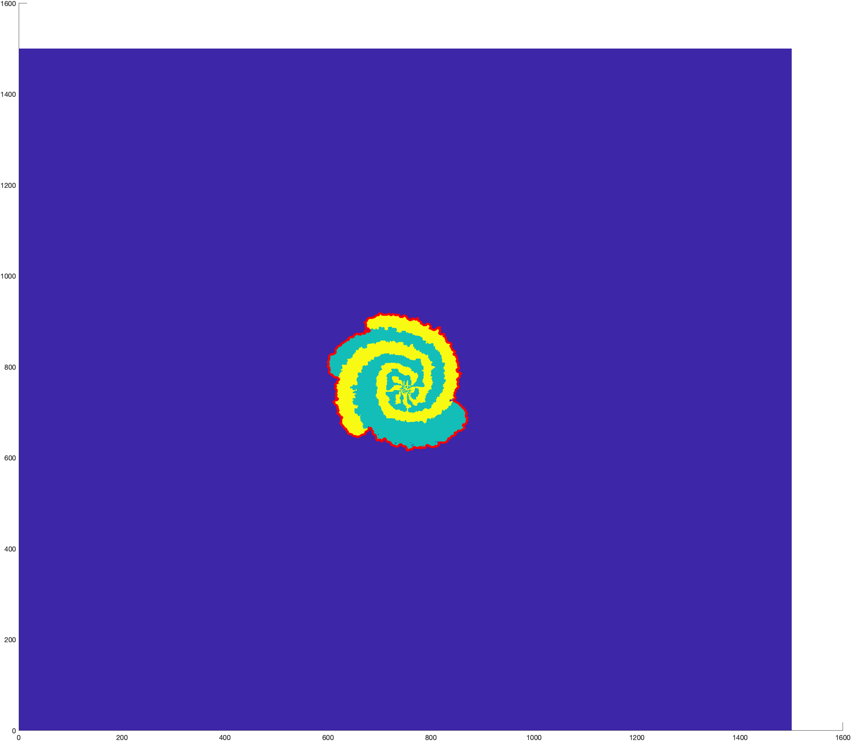
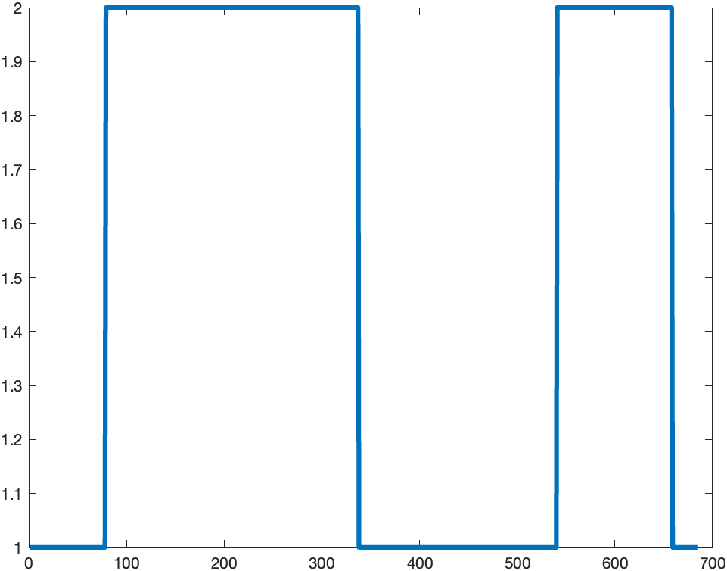
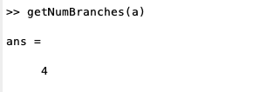
Procedure
Initial Colony
Get Boundary Cells
Transfer to signal
Calculate gradient of signal

Slide 3
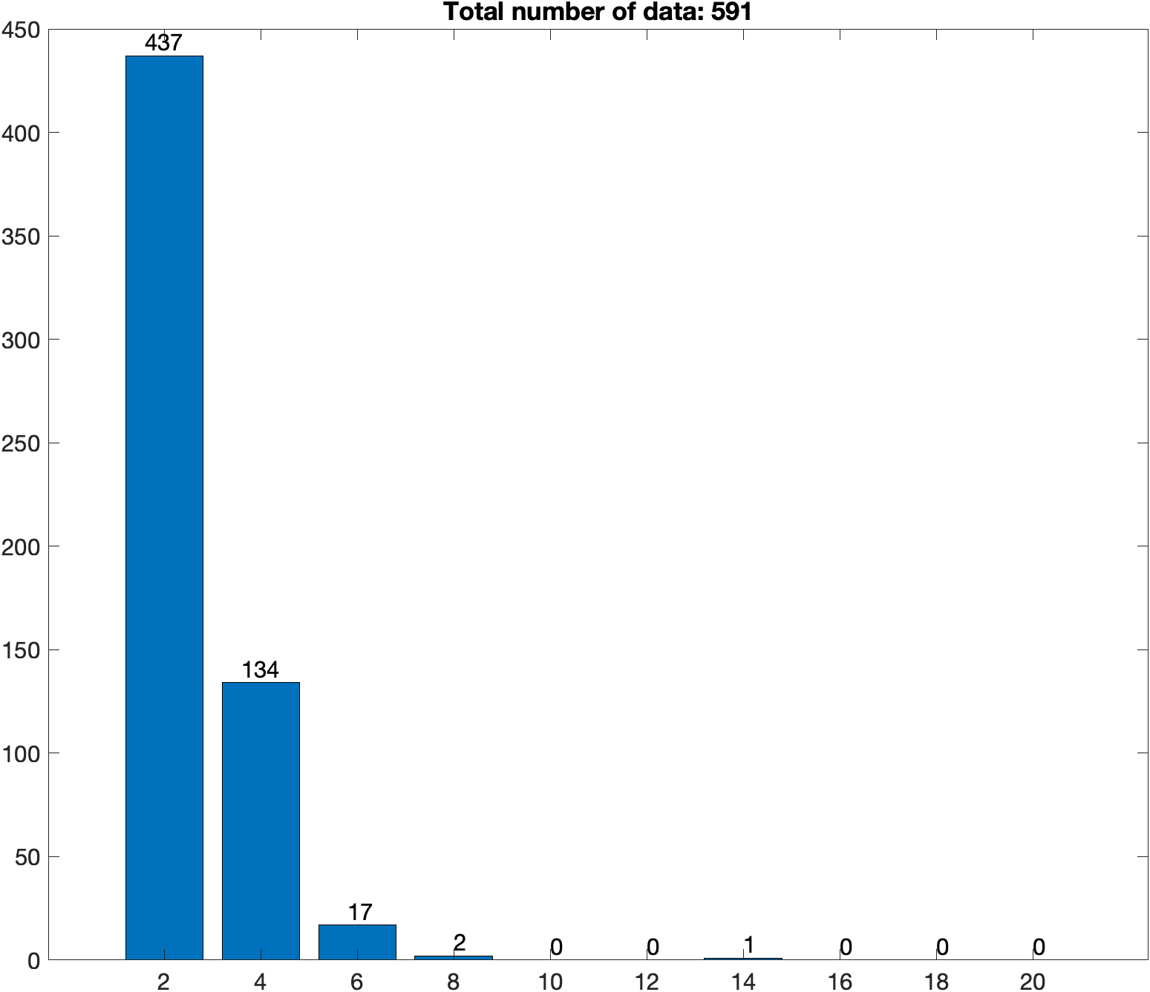
Result Number of initial cells 100 Side length 20 Density 0.25 Total number of data: 1033 Number of spiral pattern: 591 Number of engulf pattern: 442 Ratio is (spiral / engulf): 1.33710

Slide 4
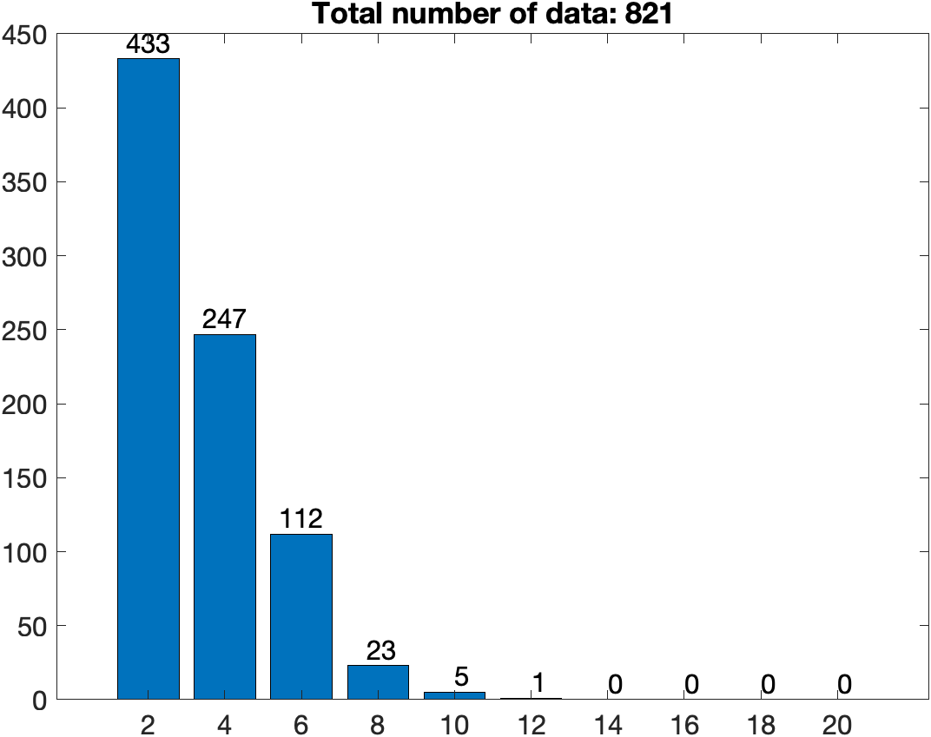
Result Number of initial cells 2500 Side length 100 Density 0.25 Total number of data: 1129 Number of spiral pattern: 821 Number of engulf pattern: 308 Ratio is (spiral/engulf): 2.66558

Slide 5
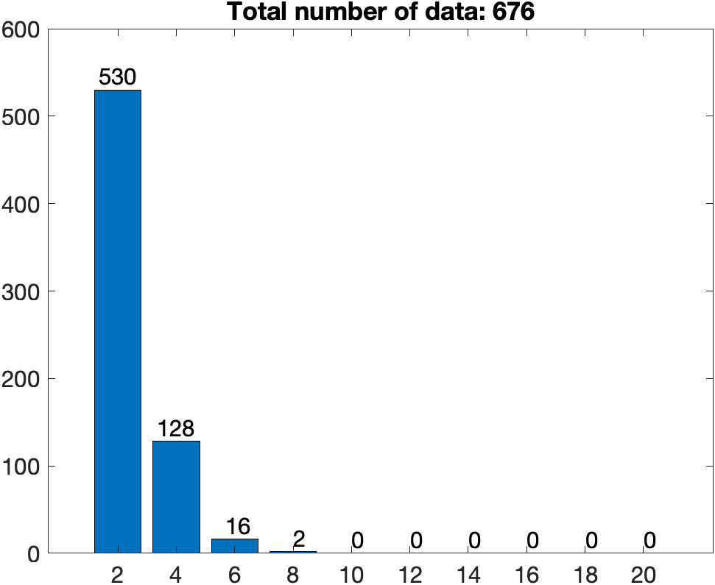
Result Number of initial cells 200 Side length 20 Density 0.5 Total number of data: 1093 Number of spiral pattern: 676 Number of engulf pattern: 417 Ratio is (spiral / engulf): 1.621103

Slide 6
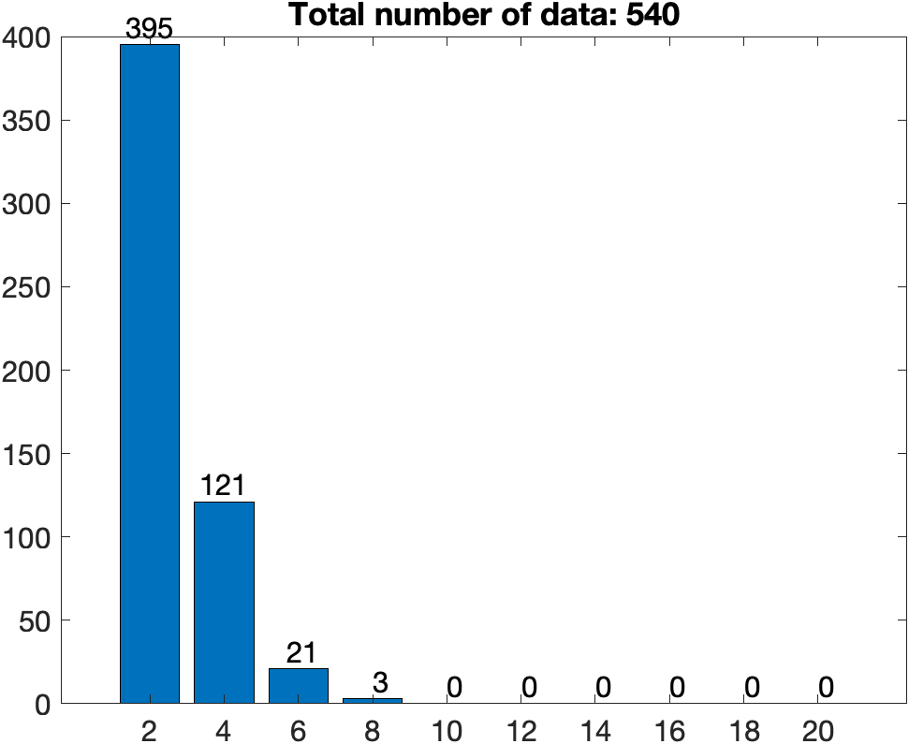
Result Number of initial cells 225 Side length 30 Density 0.5 Total number of data: 783
Number of spiral pattern: 540
Number of engulf pattern: 243
Ratio is (spiral / engulf): 2.222222

Slide 7
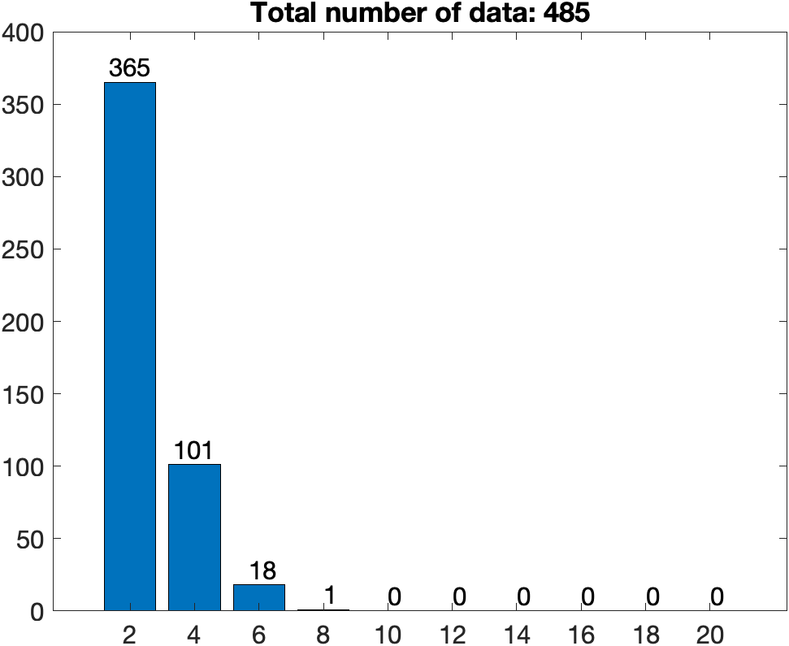
Result Number of initial cells 150 Side length 20 Density 0.5 Total number of data: 780
Number of spiral pattern: 485
Number of engulf pattern: 295
Ratio is (spiral / engulf): 1.644068

Slide 8
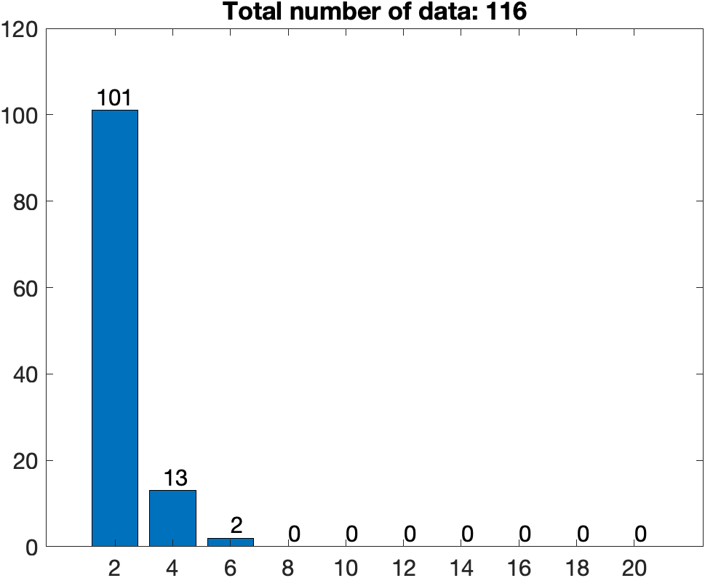
Result Number of initial cells 25 Side length 10 Density 0.25 Total number of data: 195
Number of spiral pattern: 116
Number of engulf pattern: 79
Ratio is (spiral / engulf): 1.468354

