Slide 1
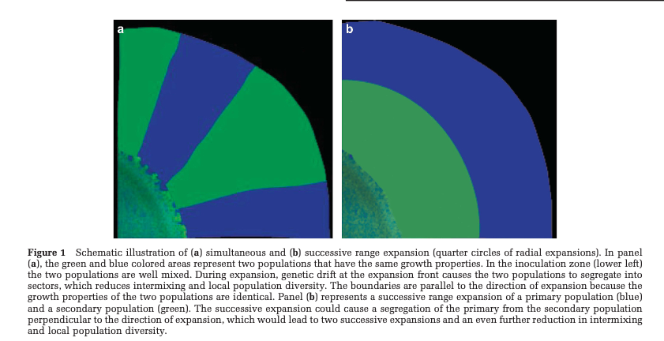
(Goldschmidt, Regoes, & Johnson, Successive range expansion promotes diversity and accelerates evolution in spatially structured microbial populations 2017)

Slide 2
How does sectors changes into spiral branches?

Slide 3
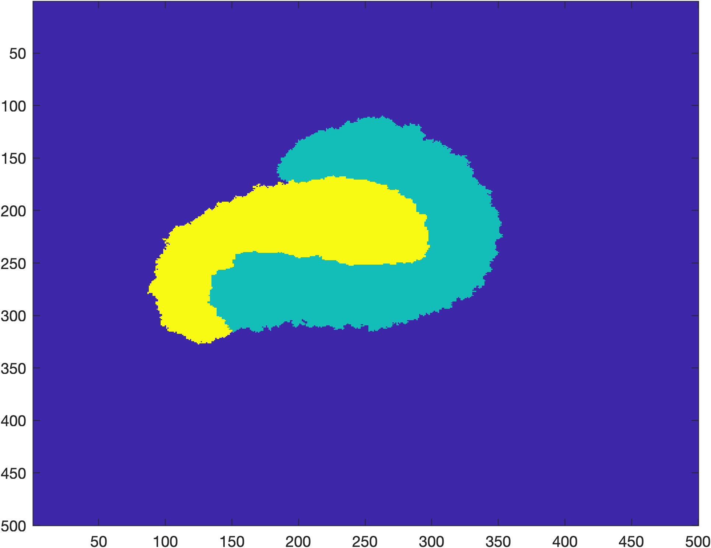
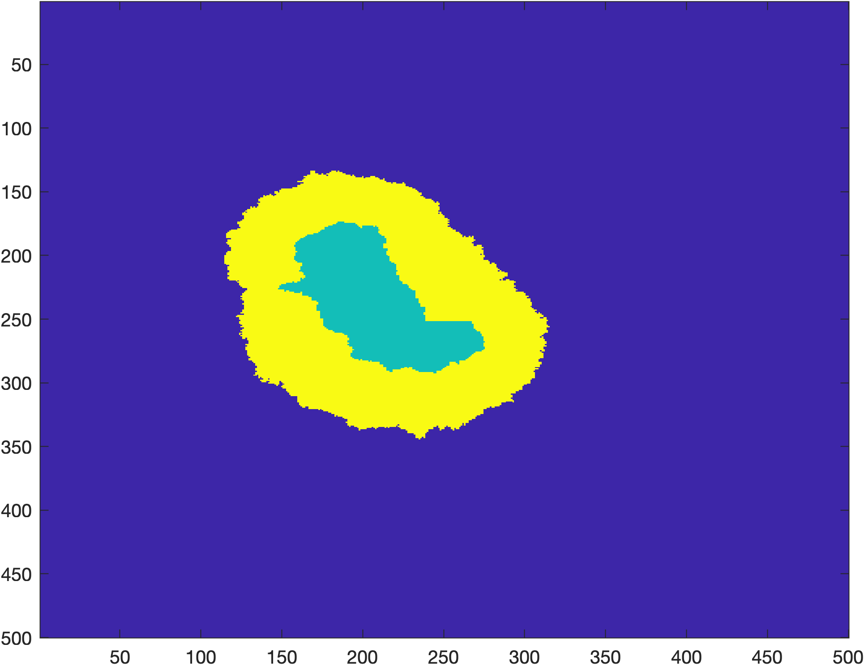
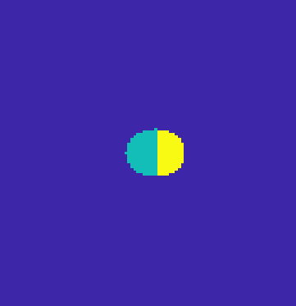
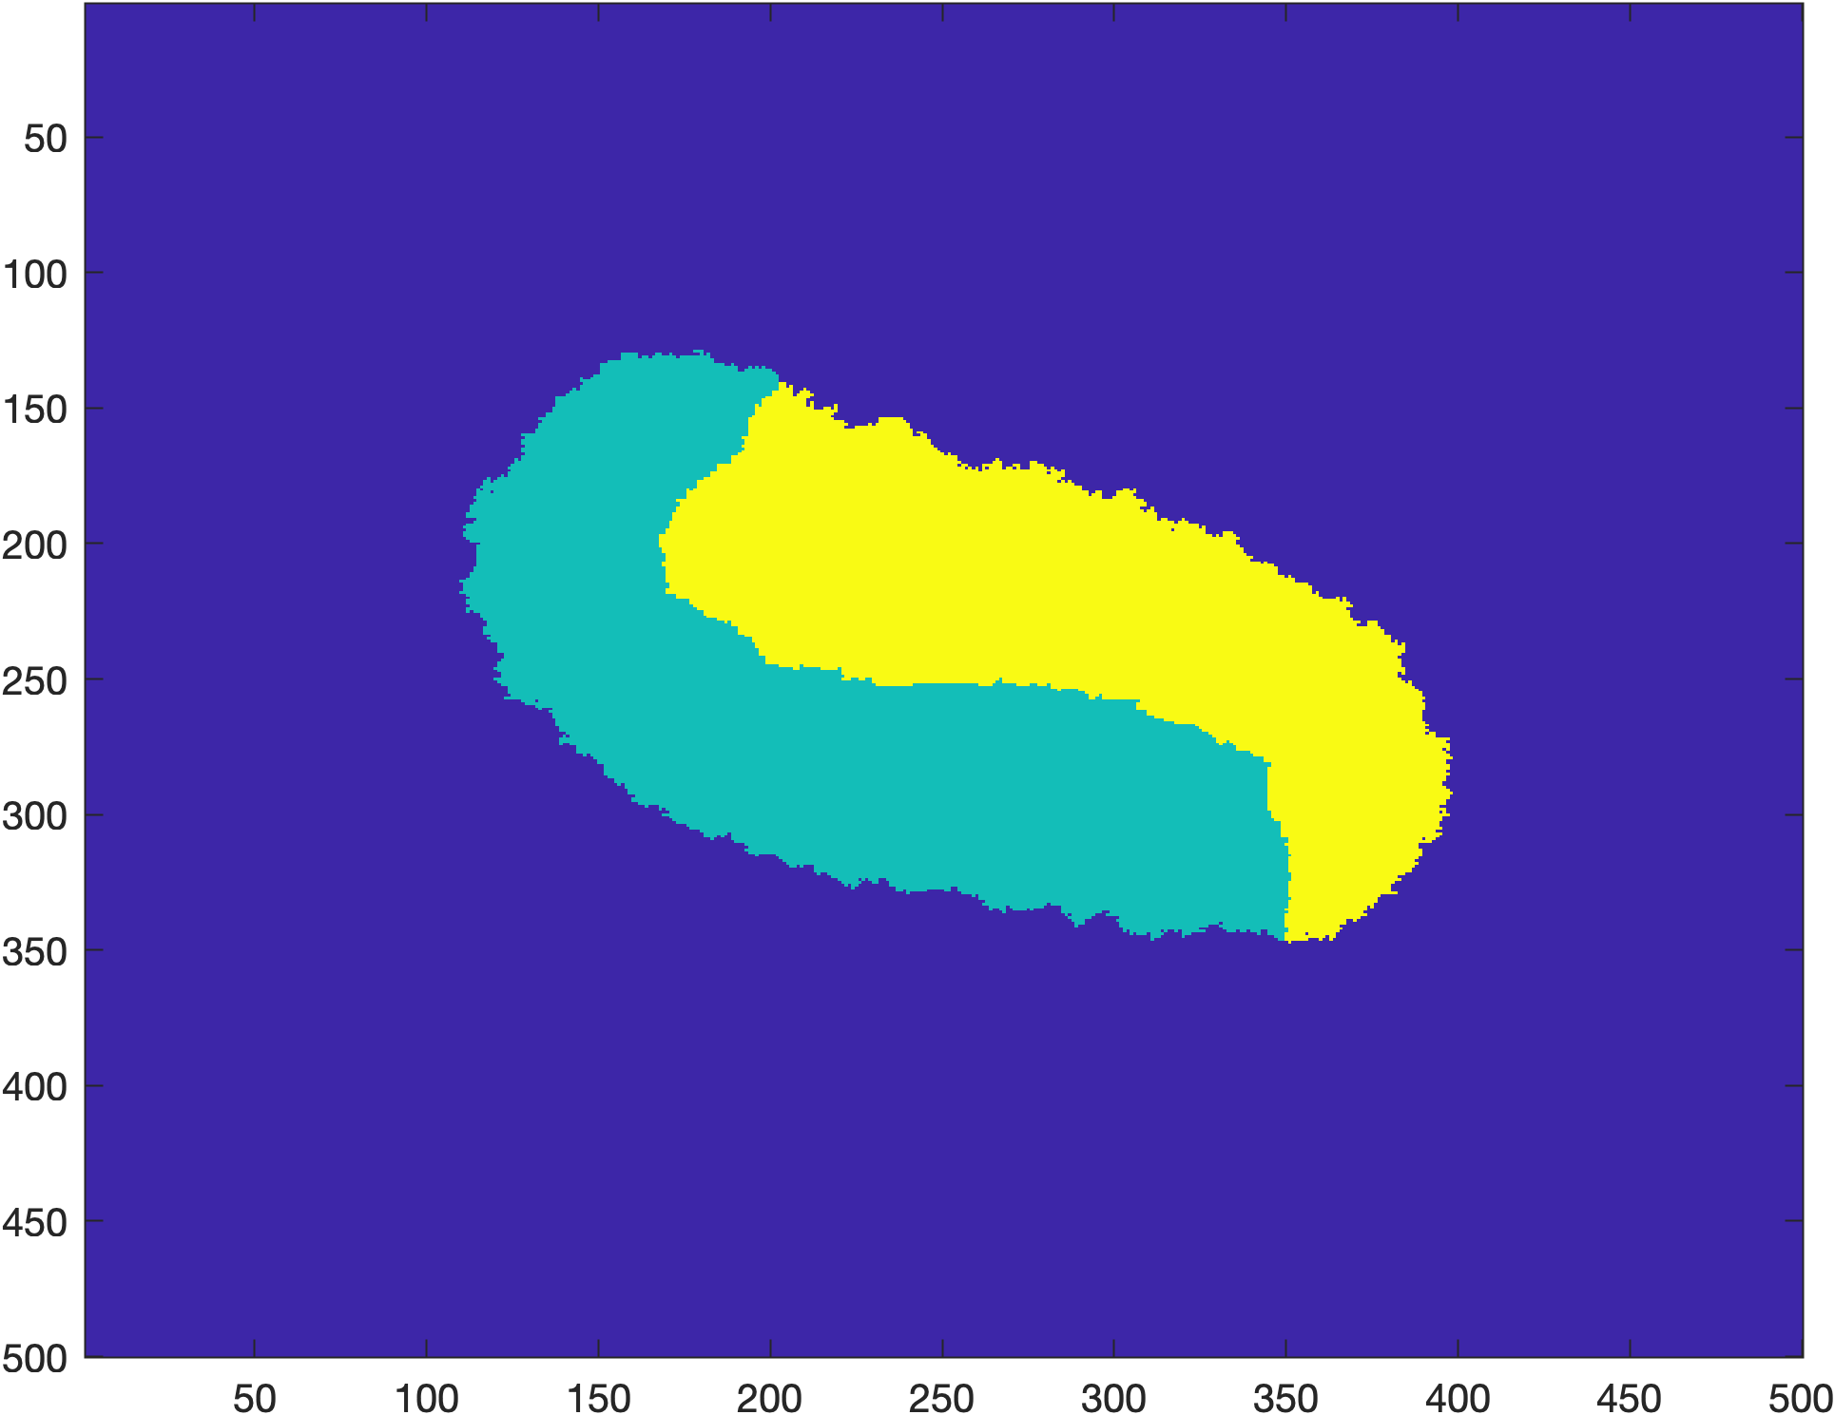
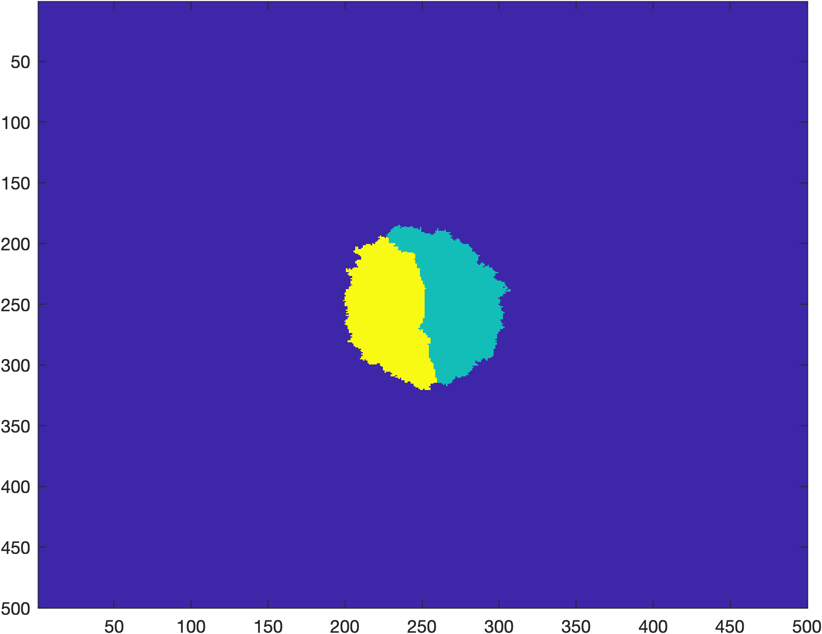
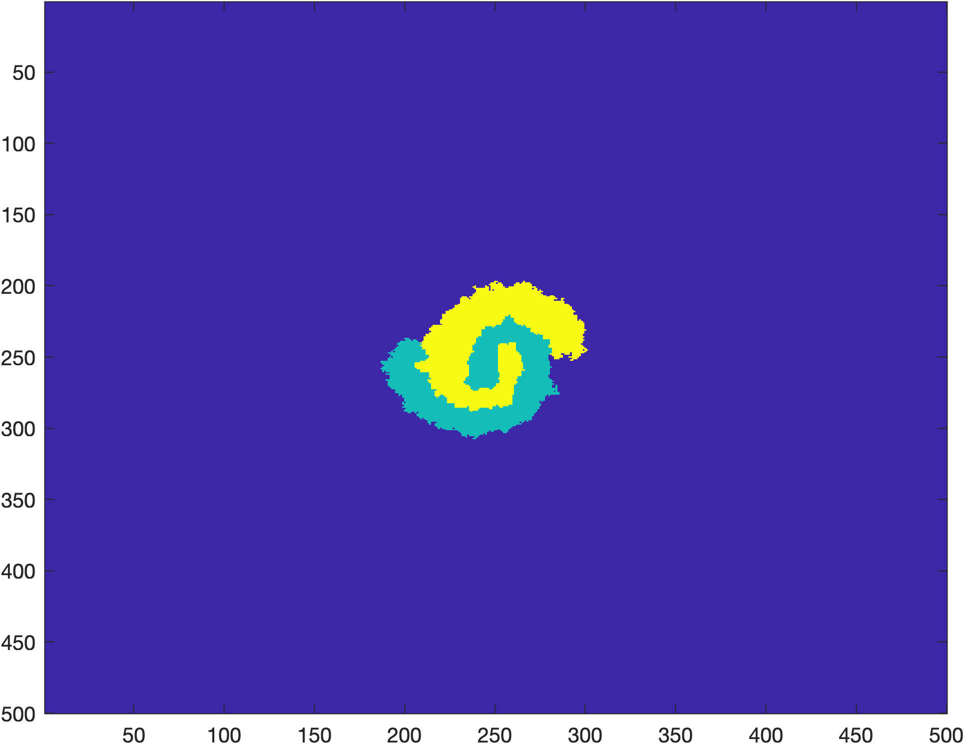
T_max = 300
At 90/100
Nutrient Diff = 250
Nutrient Diff = 125
Nutrient Diff = 500
Nutrient Diff = 1000
Nutrient Diff < 10

Slide 4
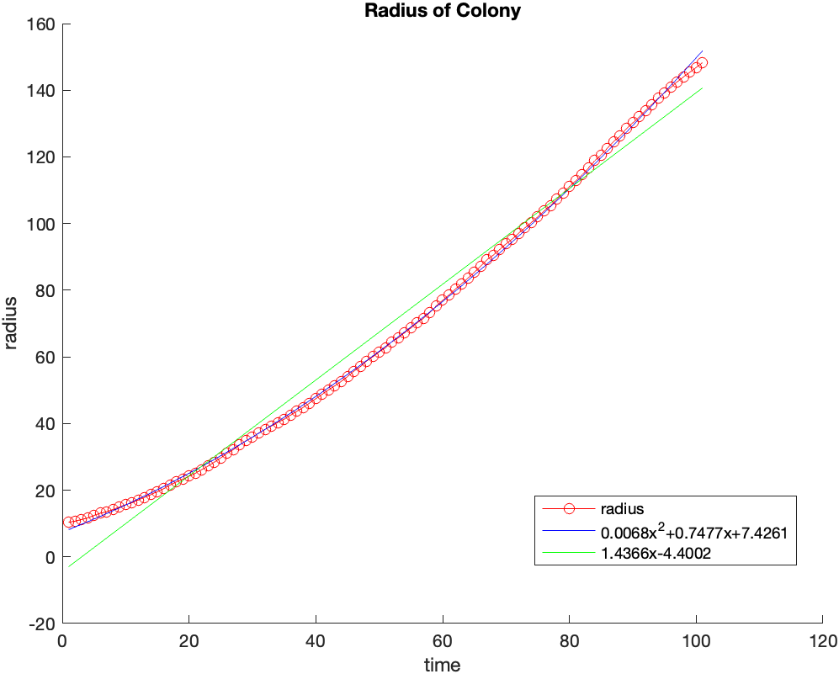
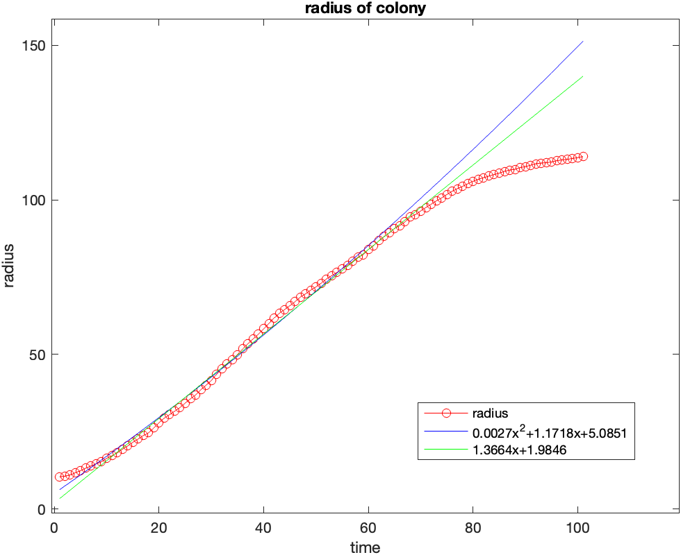
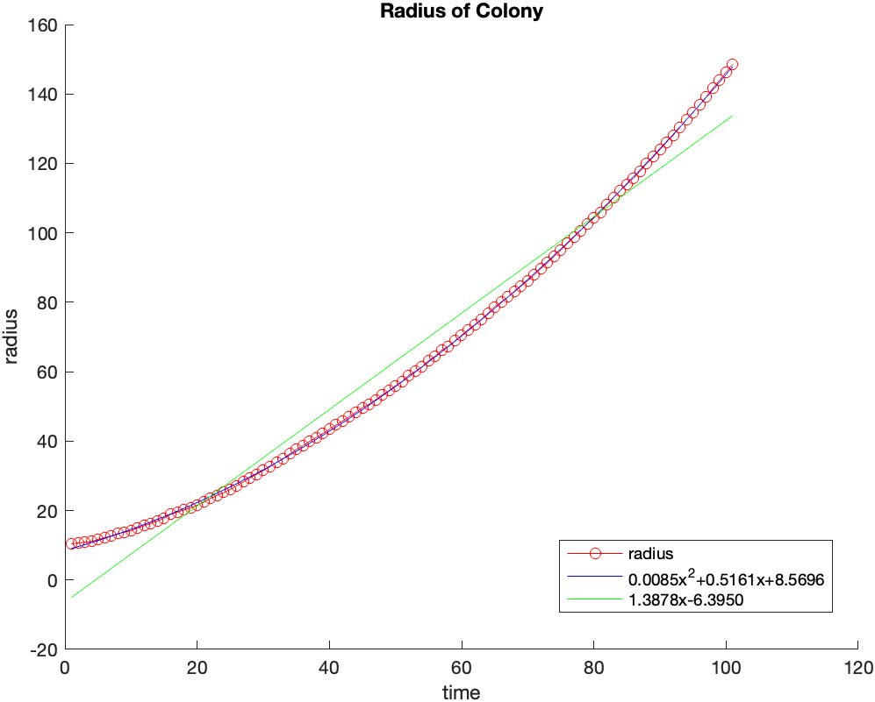
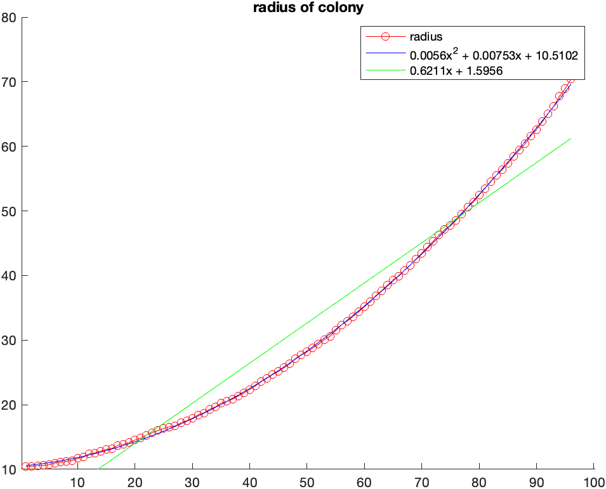
Nutrient Diff = 250
Nutrient Diff = 125
Nutrient Diff = 500
Nutrient Diff = 1000

Slide 5
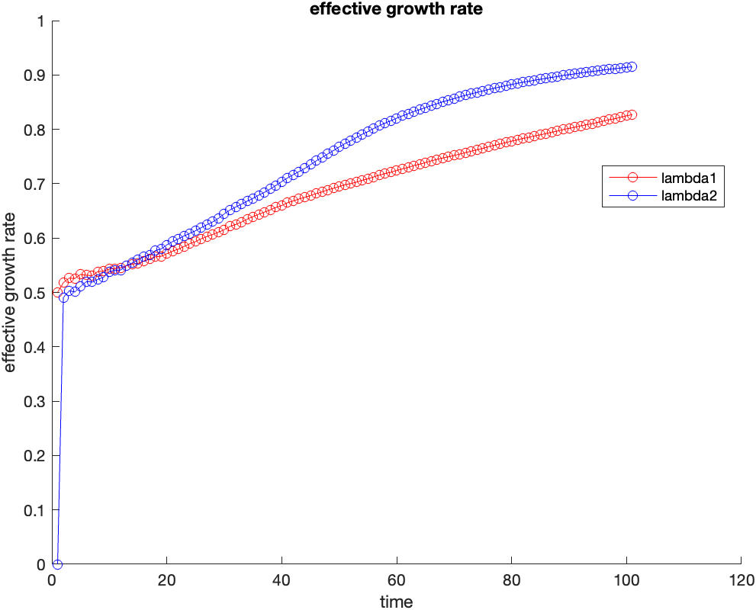
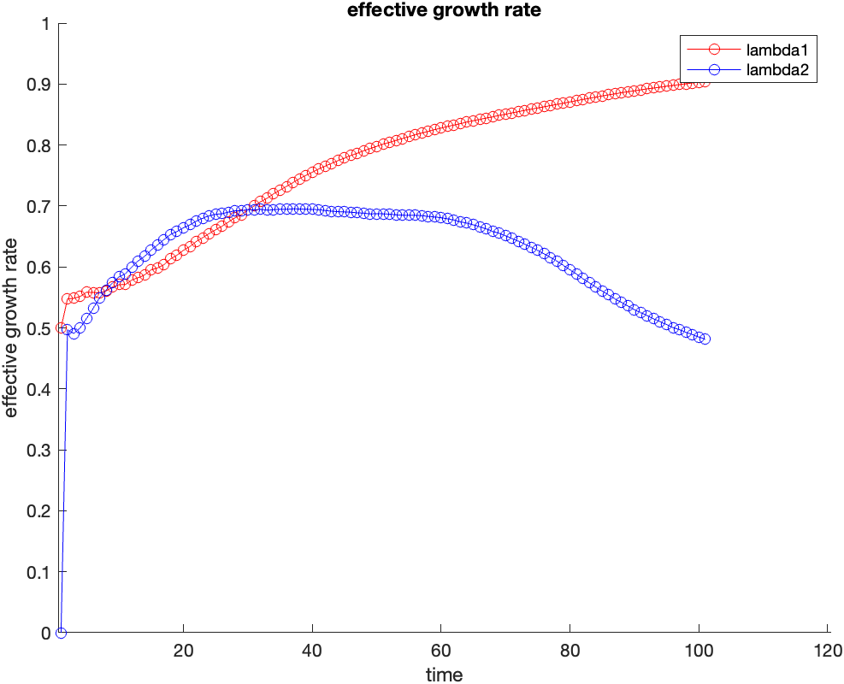
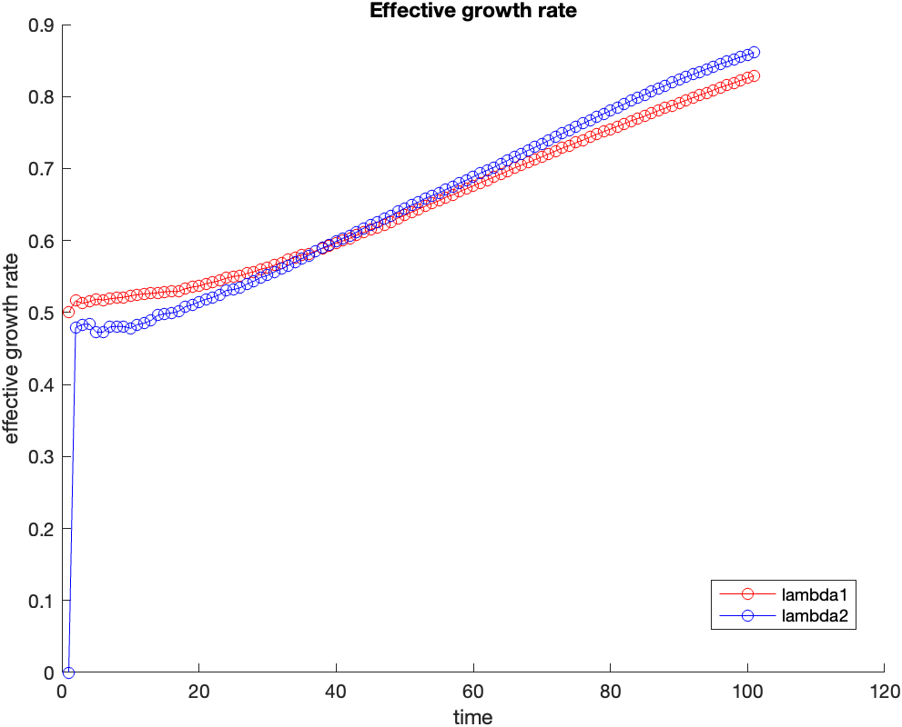
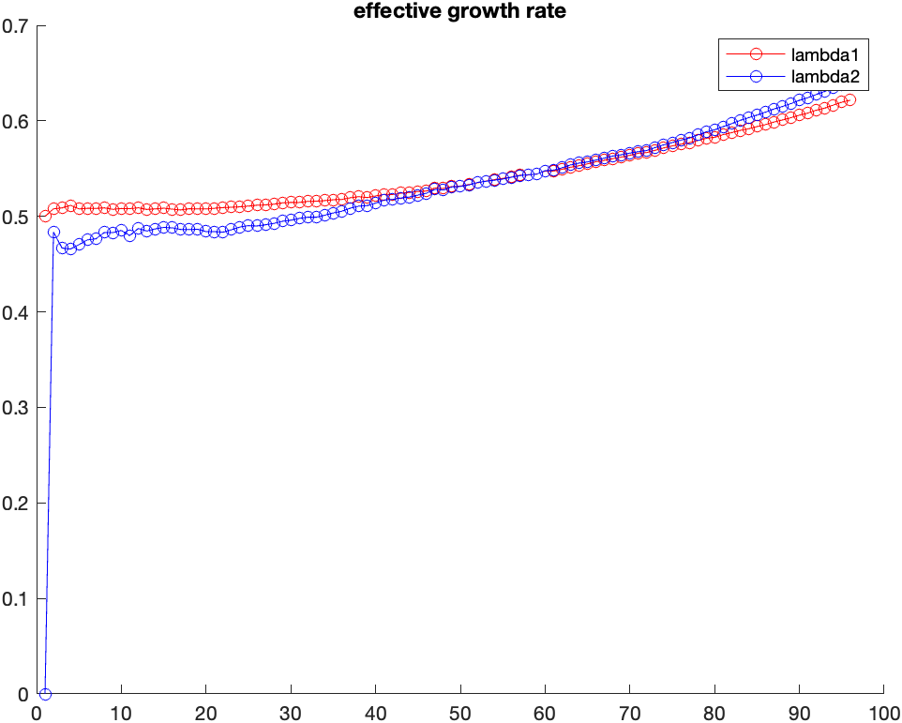
Nutrient Diff = 250
Nutrient Diff = 125
Nutrient Diff = 500
Nutrient Diff = 1000

