Slide 1
Emotion Detection from Text
Present by Artificial Psychologists:
Jacky Lin, Melissa Tjong, Chengcheng Ding, Hanzheng Wang

Slide 2
Introduction

Slide 3
What is our project?
This project focuses on detecting positive, neutral, or negative feelings based on text. These feelings include but are not limited to anger, fear, happiness, sadness, and surprise. We design and implement the neural network that imitates human ability of text-based empathy of emotions. To train our neural network, we use existing datasets ISEAR and TWEETS, containing information of texts and their corresponding emotions. The goal of this neural network is to predict human emotion based on the input sentence.

Slide 4
Background
Emotion recognition is the process of identifying human emotion. People vary widely in their accuracy at recognizing the emotions of others. Use of technology to help people with emotion recognition is a relatively nascent research area. To date, the most work has been conducted on automating the recognition of facial expressions from video, spoken expressions from audio, written expressions from text, and physiology as measured by wearables

Slide 5
Motivation
Our main topic is to judge the emotion of a person from his words. This could be widely used because every person would speak emotionally. Judging the emotions from words by AI is complicated but interesting. Also, this topic is closely related with the AI & Cognitive system. We can use what we learned in the class to facilitate making our program.

Slide 6
Previous Work
Most Art of state work of predicting emotion are based on SVM model or LSTM
Other common techniques include:
Bi-LSTM
The K-nearest neighbors
Decision Tree
BERT

Slide 7
Design

Slide 8
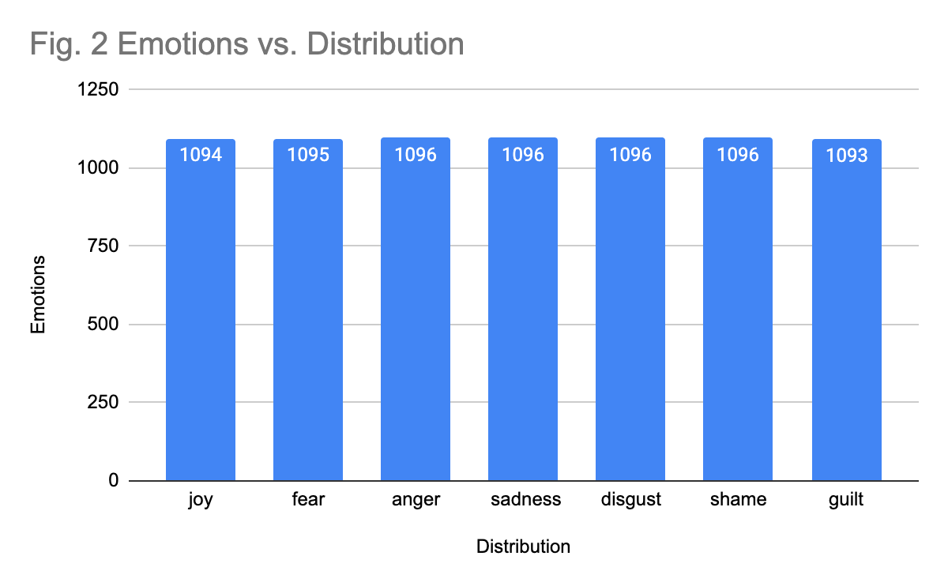
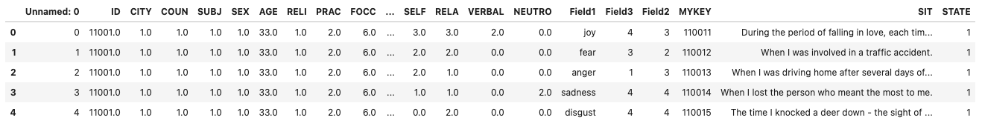
ISEAR - Dataset
ISEAR has 7 emotions: the number of different kinds of emotion in ISEAR are relatively evenly distributed. (See Fig 2).
This dataset includes many kinds of information about a person such as country, city, sex, relationship, characteristics, and conditions etc.
The text in ISEAR corresponding to different emotions is description of events (3rd Person Perspective) rather than expression of emotions (1st Person Perspective).
Notes:
https://docs.google.com/spreadsheets/d/1Amt1fLPbhhg5vkCNQVqrkvUXUgtyhZjaZgF1E92QB74/edit?usp=sharing
Plot link

Slide 9
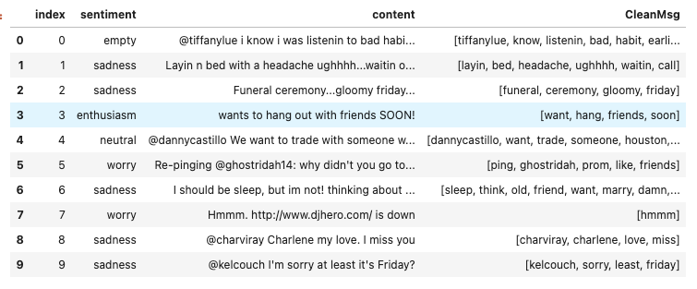
Tweets - Dataset
The kinds of data in Tweets dataset are much simpler than in ISEAR, which contains only Tweet ID, sentiment, author and content of text.

Slide 10
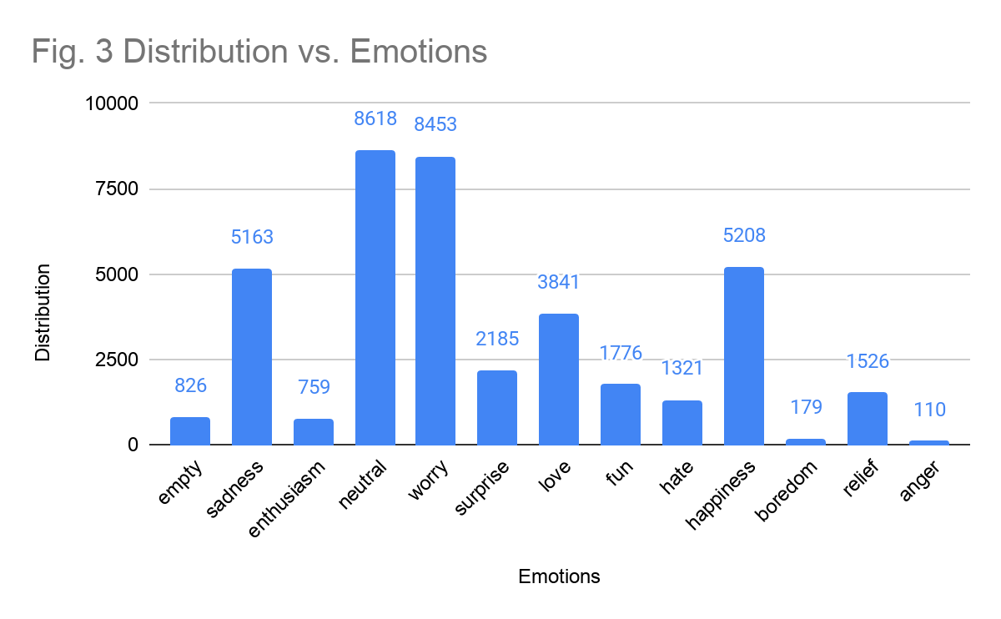
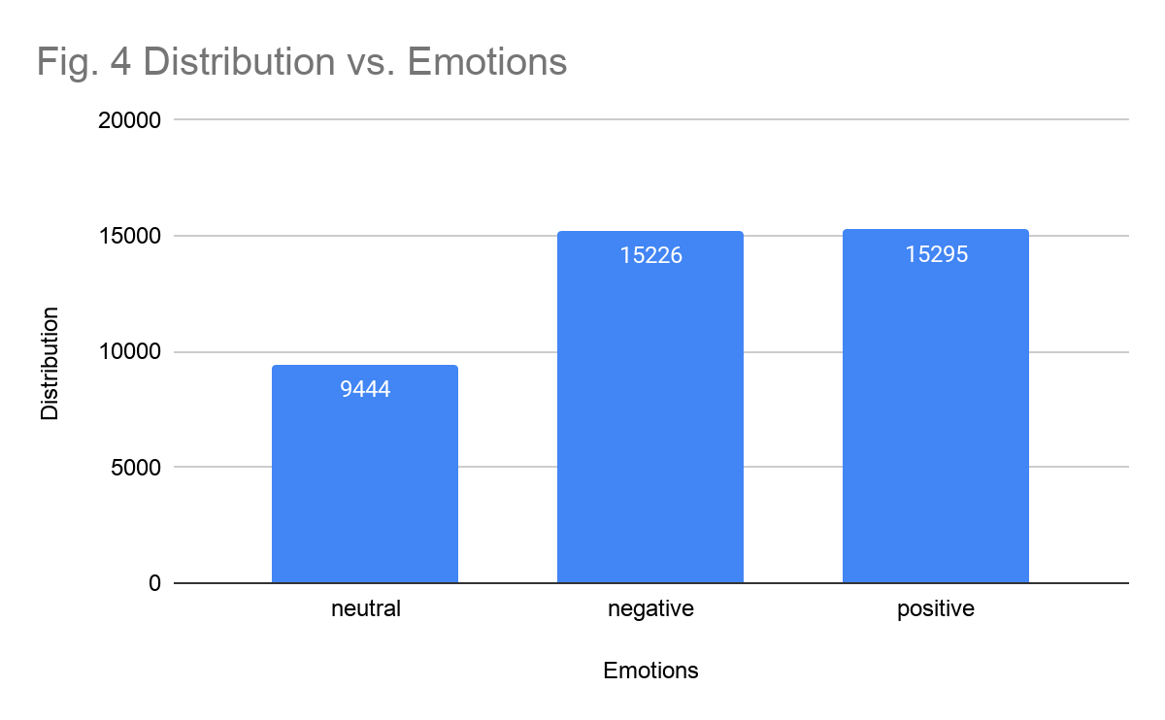
Tweets - Dataset
Originally Tweets has 13 emotions (See Fig 3) : some emotions have data than the other.
But when we relabel emotions with 3 categories, the data is relatively evenly distributed (See Fig 4)
Notes:
https://docs.google.com/spreadsheets/d/1Amt1fLPbhhg5vkCNQVqrkvUXUgtyhZjaZgF1E92QB74/edit?usp=sharing
Plot link

Slide 11
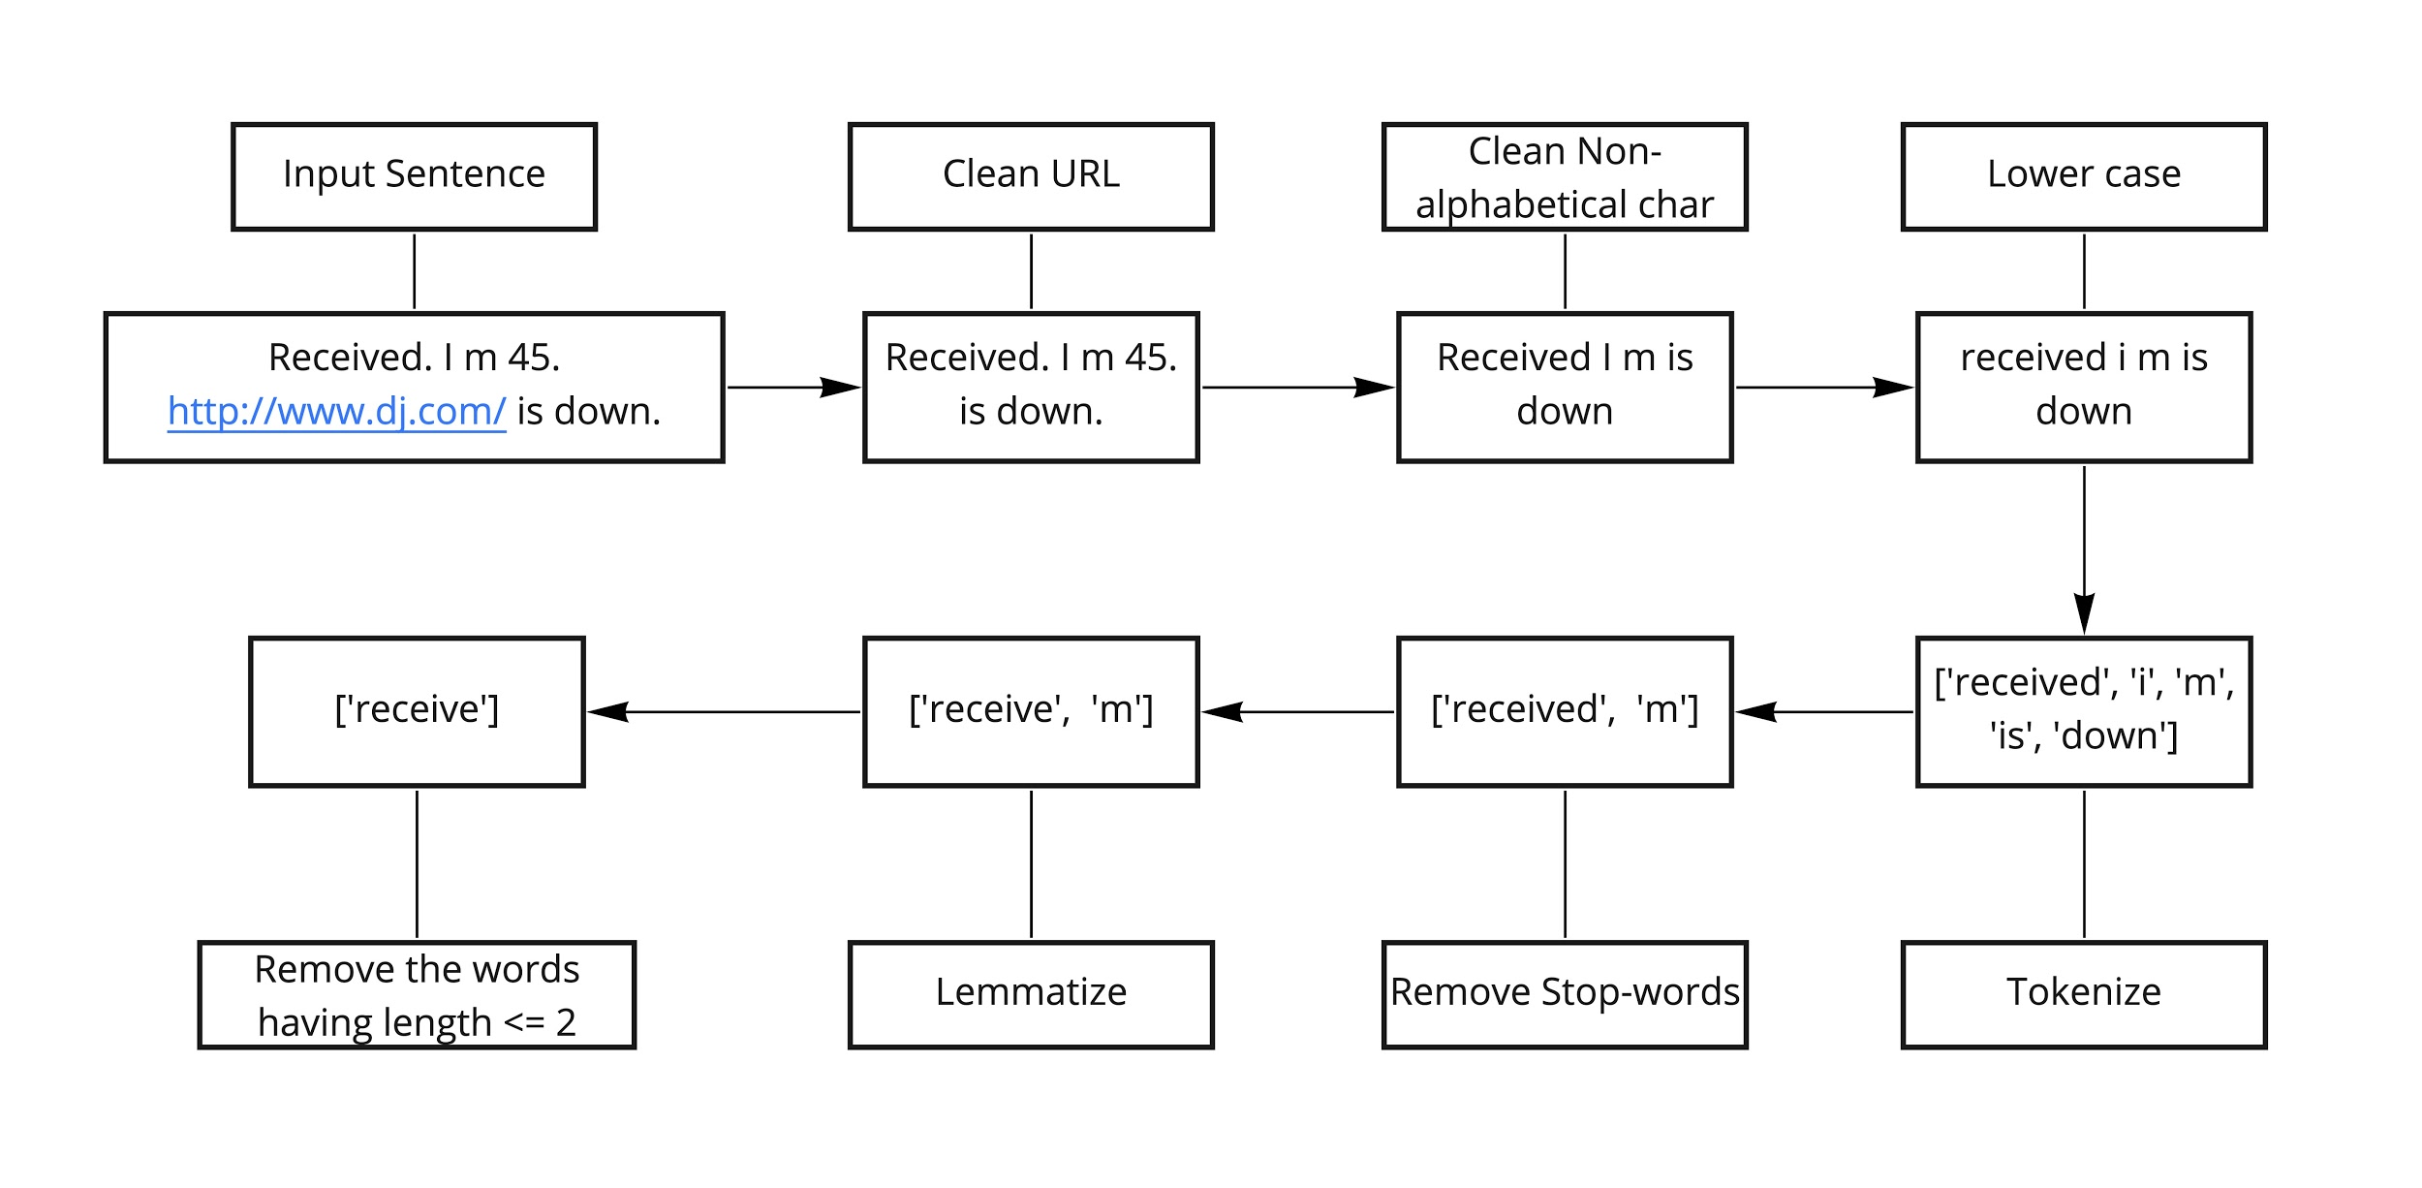
Preprocessing Text

Slide 12
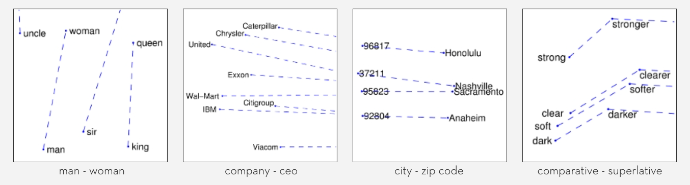
Glove Embeddings
GloVe is a model for distributed word representation. The model is an unsupervised learning algorithm for obtaining vector representations for words. This is achieved by mapping words into a meaningful space where the distance between words is related to semantic similarity
E.g. “ice” co-occurs more frequently with “solid” than it does with “gas” (Semantic Similarity)
Image src: https://nlp.stanford.edu/projects/glove/

Slide 13

LSTM
Long Short Term Memory networks (LSTMs) are a special kind of a recurrent neural network, capable of learning long-term dependencies.
Long-term dependencies: connect previous information to the present task
RNNs, by passing input from last output, are able to retain information, and able to hold all information at the end to make predictions.
Each words in sentence is related to one another in certain ways.
Image src: https://colah.github.io/posts/2015-08-Understanding-LSTMs/

Slide 14
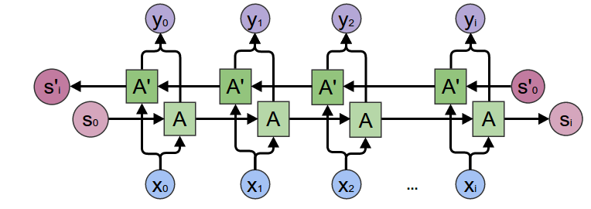
Bidirectional LSTM
Bidirectional LSTMs are an extension of traditional LSTMs that can improve model performance on sequence classification problems.
Bidirectional LSTMs train two instead of one LSTMs on the input sequence. The first on the input sequence as it is and the second on a reversed copy of the input sequence. This can provide additional context to the network and result in faster and even fuller learning on the problem.
Image src: http://colah.github.io/posts/2015-09-NN-Types-FP/

Slide 15
Neural Network Structure
Pretrain weighted layer for text vectors
Embedding Layer
Add noises to neural network for robustness
Gaussian Noise
Regularization to prevent overfitting
Spatial Dropout
Obtain features from input text in both directions
Bidirectional LSTM
Regularization to prevent overfitting
Dropout
Relu
max(0,x)
Softmax
A activation function for categorization

Slide 16
Optimizer: Adam Optimization
Adaptive Moment Estimation (Adam) is a method that computes adaptive learning rates for each parameter. In addition to storing an exponentially decaying average of past squared gradients, Adam also keeps an exponentially decaying average of past gradients, similar to momentum.
Momentum can be seen as a ball running down a slope, Adam behaves like a heavy ball with friction, which prefers flat minima in the error surface.
Loss function: Categorical Cross-entropy
Cross-entropy loss, measures the performance of a classification model whose output is a probability value between 0 and 1. This cross-entropy loss function is used when there are two or more label classes, where labels are provided in a one hot representation.
One hot representation example: [0 0 0 0 1], [0 0 0 1 0]

Slide 17
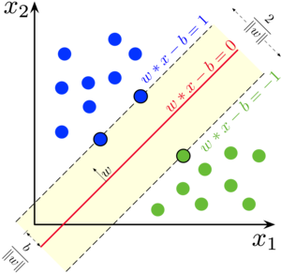
Other Methods - SVM
A support vector machine (SVM) is a supervised machine learning model that uses classification algorithms to categorize data into different categories by finding optimal hyperplanes
In our project, we use this method with a hyperdimension around 100.

Slide 18
Other Methods - CNN
A support vector machine (SVM) is a supervised machine learning model that uses classification algorithms to categorize data into different categories by finding optimal hyperplanes

Slide 19
Show Time

Slide 20
Results

Slide 21
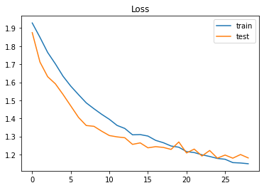
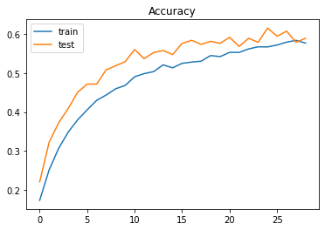
ISEAR
7 Categories:
Changes of accuracy and loss show a good shape
When accuracy and loss become stable, they behaves fluctuation.
Test results are close related to training results (accuracy ~ 60%)

Slide 22
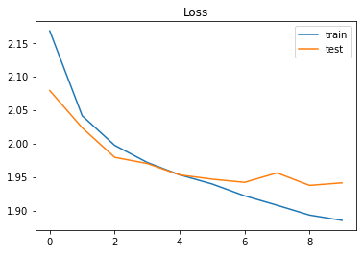
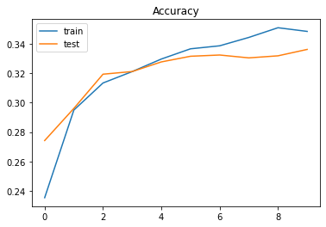
TWEETS
13 Categories:
Hard to train
Growth rate of accuracy of slows down around 32 % (Low)
Training loss is above 1.9 (High)
Shows a sign of overfitting.

Slide 23
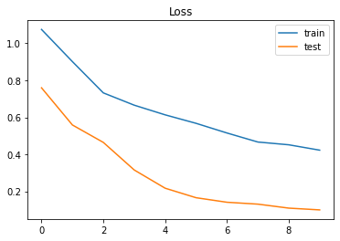
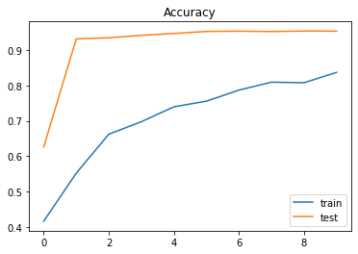
TWEETS
3 Categories (5000 data for each):
Positive, Negative, Neutral
https://en.wikipedia.org/wiki/Emotion_classification
Easier to train
High Accuracy at early stage of training (> 90%)
Low loss for whole time (< 1)
Test results is much better than training results

Slide 24
Best Performance on Each Training Sets
Dataset | Categories | Max Train Accuracy | Max Validation Accuracy | Test Accuracy | Min Training Loss | Min Validation Loss
ISEAR | 7 | 0.5832 | 0.6146 | 0.615 | 1.1491 | 1.1812
TWEETS | 13 | 0.351 | 0.3362 | 0.336 | 1.8851 | 1.9411
 | 3 | 0.837 | 0.9535 | 0.95 | 0.4226 | 0.0998
Best Performance on Each Training Sets

Slide 25
Ethical Concerns

Slide 26
Ethical Concerns
Linguistic analysis takes environment into account, and depending on the environment, these analyses may be affected by cultural stereotypes
How are we able to use data that is representative of a larger population?
ISEAR database contains responses from people in multiple countries, but both those responses and tweets are in English
This leads to data that is skewed towards a more Western perspective, which could possibly lead to a negative emotional association of these texts with minority groups
Privacy concerns and consent to use data from social media, such as tweets
It is difficult to accurately classify specific emotions, especially with data that is highly variable, such as tweets
Notes:
https://ieeexplore.ieee.org/stamp/stamp.jsp?tp=&arnumber=8272606

Slide 27
Conclusion

Slide 28
Conclusions
Challenges
Changes
Stuff Learned
When we have relatively larger number of emotions:
Accuracy is not satisfying
Accuracy stop growing at early stage
Other factors don’t affect much of the prediction in ISEAR dataset.
Develop more complex or deeper neural networks to detect more specific emotion types
Multiple input neural networks to account for other factors involving in dataset.
How to deal with overfitting in neural networks.
Potential ways to improve the accuracy (Improved the accuracy of 7 categories from 55% to 61%)
Different layers and their characteristics (LSTM, Embed)
General approach in natural language processing project
Processing text data

Slide 29
References
Long short-term memory. (2021, February 05). Retrieved March 03, 2021, from https://en.wikipedia.org/wiki/Long_short-term_memory?oldformat=true
Understanding lstm networks. (n.d.). Retrieved March 03, 2021, from https://colah.github.io/posts/2015-08-Understanding-LSTMs/
Acheampong, FA, Wenyu, C, Nunoo‐Mensah, H. Text‐based emotion detection: Advances, challenges, and opportunities. Engineering Reports. 2020; 2:e12189. https://doi.org/10.1002/eng2.12189
Yam, C., 4, A., Turner, A., 16, J., & Poon, J. (2020, March 15). Emotion detection and recognition from text using deep learning. Retrieved March 03, 2021, from https://devblogs.microsoft.com/cse/2015/11/29/emotion-detection-and-recognition-from-text-using-deep-learning/
Emotion recognition. (2021, January 14). Retrieved March 03, 2021, from https://en.wikipedia.org/wiki/Emotion_recognition
Swiss center For Affective Sciences SWISS Center For Affective Sciences. (2019, February 20). Retrieved March 26, 2021, from https://www.unige.ch/cisa/research/materials-and-online-research/research-material/
Srivastava, T. (2019, August 03). Remove/Add stop words. Retrieved March 26, 2021, from https://medium.com/@tusharsri/remove-add-stop-words-7e2994c19c67
Pennington, J. (n.d.). GloVe: Global vectors for word representation. Retrieved March 26, 2021, from https://nlp.stanford.edu/projects/glove/
Li, S. (2019, April 10). Multi-Class text classification with LSTM. Retrieved March 26, 2021, from https://towardsdatascience.com/multi-class-text-classification-with-lstm-1590bee1bd17

Slide 30
Questions?

