Slide 1
Emotion Detection
Team Name: Artificial Psychologists
Team Members:
Jacky Lin, Hanzheng Wang, Chengcheng Ding, Melissa Tjong

Slide 2
Strengths and weaknesses of each member
Name | Jacky Lin | Chengcheng Ding | Melissa Tjong | Hanzheng Wang
Strengths | Organized, Proactive | Design & Produce | Writing, organization, detail oriented | Hardworking, liable to communicate
Weaknesses | Reading, Communicating skills | Being ‘digitally ethical’ | Can get stuck on certain problems | sometimes may not catch the point immediately, need time to digest new material

Slide 3
SCRUM
Jacky - Scrum Master
Ding - Product Owner
Hanzheng - Lead Developer
Melissa - Society & Ethics Leader
Weekly meeting: Every Sunday

Slide 4
Project description:
Project title: Computational models of human behavior - emotion recognition from text
Description:
This project will focus on detecting positive, neutral, or negative feelings from text. These feelings include but are not limited to anger, fear, happiness, sadness, and surprise. We will design the neural network that imitates human ability of text-based empathy of emotions. To train our neural network, we will use existing databases, such as ISEAR, containing information of texts and their corresponding emotions. The goal of this neural network is to predict human emotion based on the input sentence.
ISEAR:
https://www.unige.ch/cisa/research/materials-and-online-research/research-material/

Slide 5
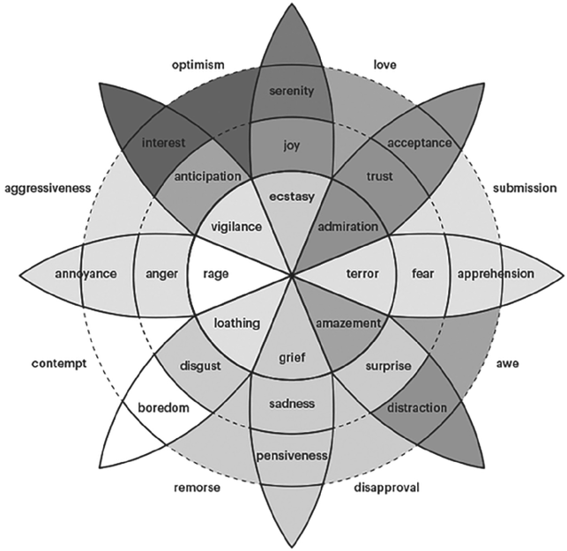
A Example of Classification of Emotions

Slide 6
Goal: Detect and recognize types of feelings through texts, such as anger, disgust, fear, happiness, sadness, and surprise
Initial GEA design
Environment:
Receive text from users, which may be as short as one sentence or as long as an article.
Context of a sentence (Meaning of sentence within different context can vary)
One sentence can contain multiple emotions
Sentence may contains typo
More possibilities: More language support
Adaptation:
Preprocessing of input sentence:
Parse down the long article piece by piece
Correction of typing
Detect emotion based on the previous sentences and sentences after the target sentence
Using weighted results to represent a mix of emotions

Slide 7
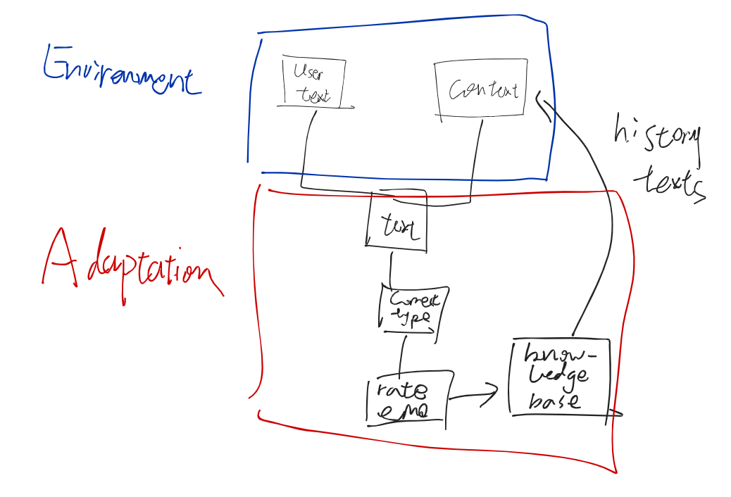
GEA design sketch

Slide 8
Other notes
Database: ISEAR, (Tweets?)
Learning model: SVM primarily, possibly others for accessory. (LSTM)

