Slide 1
AI & Capitalism
The Wolves of 7th Street
Presented by:
Jacky Lin, Andrew Whitig, Chengcheng Ding, Hanzheng Wang

Slide 2
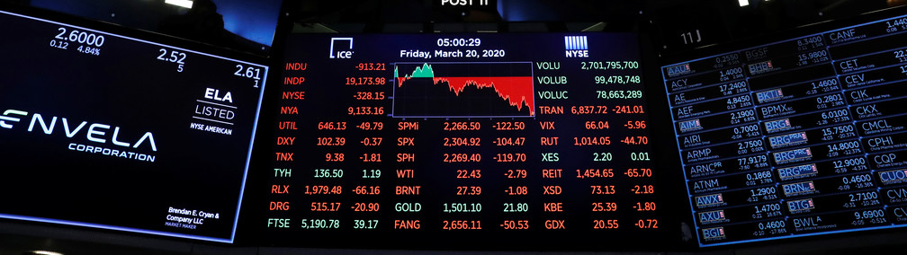
Description
We will create a market simulation environment that AIs can buys and sells stock, starting with designing AI agents implemented with Decision Trees and Neural network to operate inside that environment. The matrices to measure the performance of the AI agent would be the amount of profit the agent can earn and the accuracy of the neural network of predicting the future price. The wanted final version would be a simulation of stock market where agents competes and communicates against each other.

Slide 3

Goals
Create a stock agent which can simulate purchasing stocks
Create a stock agent which can simulate selling stocks
Create a stock agent which is able to make decisions about the value of a stock
Both the current value and future value of the stock
Have several agents with the ability to interact with and compare to each other
Be able to determine which agents are most successful in their purchase and sales of stocks.

Slide 4
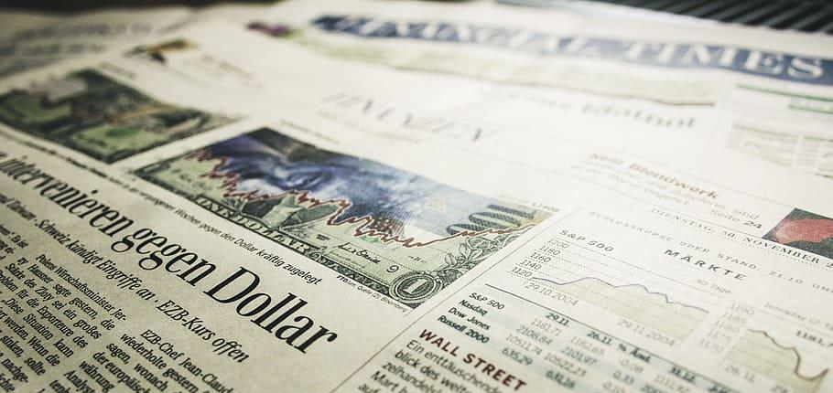

Environment
Real or simulated financial news which impacts the value of stocks
The current purchasing power and holdings of a fund
Communication from and about other buyers/agents
The historical income and performance of different stocks
Expert predictions about the future value of stocks

Slide 5
Adaptation
Buy and sell the stock at the best time for each stock
Buy at the predicted local minimum price
Sell at the predicted local maximum price
Balancing investment in multiple stocks for the global max profit
Developing different strategies in investment varying:
Between conservative and radical
Between short term investment and long term investment
Make decisions according to information of multiple stocks
Adjust prediction according to:
Daily financial news
Communication with other buyers
Experts’ prediction

Slide 6
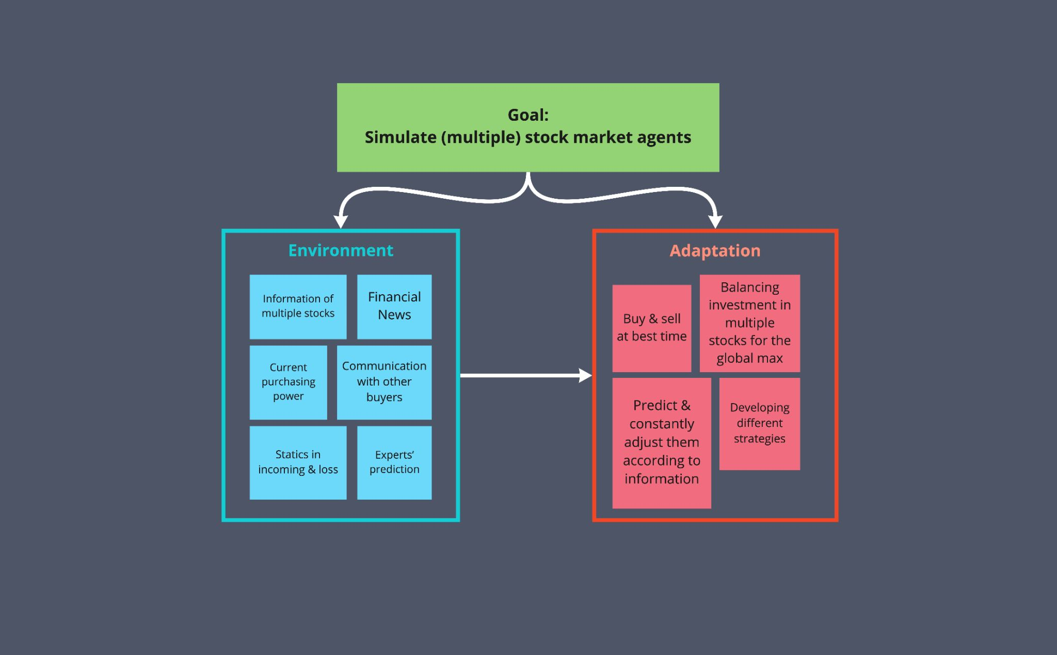

Slide 7
Scrum Roles
Name | Rules
Jacky | Scrum Master
Andrew | Product Owner
Ding | Lead Developer
Hanzheng | Society & Ethics Leader
Weekly meeting: Every Sunday Night

Slide 8
Tasks
Build virtual environment of stock market
Obtain existing information of stocks (https://finance.yahoo.com/lookup)
Build tools to visualizing the prices (something like an buying/selling app)
Build decision tree for buying and selling operations
Scikit-learn Tree (https://scikit-learn.org/stable/modules/tree.html)
Literature study
Build neural network to predict future price of stock
Keras LSTM model (https://keras.io/api/layers/recurrent_layers/lstm/)
Other models
Literature study

