Slide 1
AI & Capitalism
The Wolves of 7th Street
Presented by:
Jacky Lin, Andrew Whitig, Chengcheng Ding, Hanzheng Wang

Slide 2
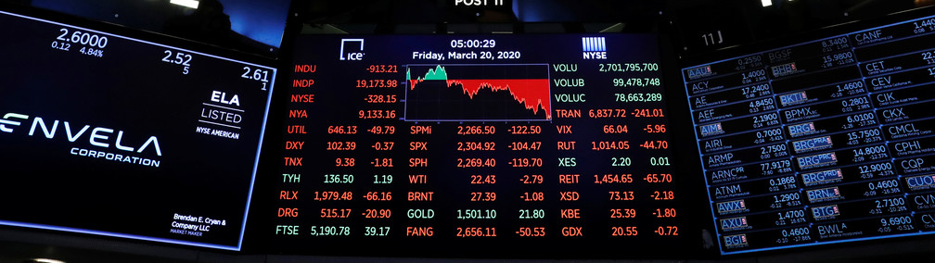
Description
We have created a market simulation environment where an AI agent can buys and sells stock. We are using a neural network to predict the trend of future price of stocks, and then implementing an AI agent with q-learning to operate on stocks. As a result, we had pretty good predictions (loss=0.2) and a rather profiting agent.

Slide 3
Motivation
The United States stock market is a large and complicated process which in some way impacts not only the daily lives of more than 300 million Americans but also the world economy. The American stock exchange is a market where shares of ownership in companies are bought and sold. It is a system which exemplifies the United States' capitalist economic policies and the free market of trade on which those policies sustain. For this reason, the US stock market and the role of AI in the sock market has become the focus of our inquiry.

Slide 4
Previous Work
In previous examples we have found most implementations of AI in the stock market either focus solely on the aspect of predicting the future value of stocks, or in determining the optimal course of action to take within the stock market but not a coupling thereof.
Using a combination of heuristics and reasoning neural networks, Tsaih et al. were able to construct a neural network which predicted the future price of the S&P 500 index
This model began by analyzing the current trend of the data following experts classifications
From these rules, the current trend was selected and price predictions were made using historical data which had been categorized as having those same characteristics
While this model ultimately used the same indicators as ours in its neural network prediction, we decided to use all of the data rather than heuristically clasify

Slide 5
Previous Work
We were also able to find an example of a model created by Lee which combined reinforcement learning with neural networks
This model solely restricted itself to stock price prediction and used the reinforcement learning portion of the model before the neural network portion.
In this model, a reinforcement learning network was trained on a selection of stocks from the Korean stock market to learn the next days price from the previous days
This process used weighted forecasting and a Markovian assumption of daily prices
In order to smooth the discrete nature of the predictions, neural networks performed gradient descent to approximate the continuous results to similar discrete situations the model had encountered

Slide 6
How We Came to This Design
As talked about in the previous works section, predicting stock prices with neural networks have been a heated and progressive field. For our prediction neural network, we took inspiration from multiple past research papers, especially from a research conducted by Guangyu Ding & Liangxi Qin, 2020. Based on which we implemented a deep recurrent neural network to predict stock prices.
And for the stock trading agent, we intuitively thought that reinforcement learning is the best approach to train our agent due to the nature of the stock market: we do not require precise outcome of operations by the agent, instead we judge our agent by the profit it makes.

Slide 7
Design

Slide 8
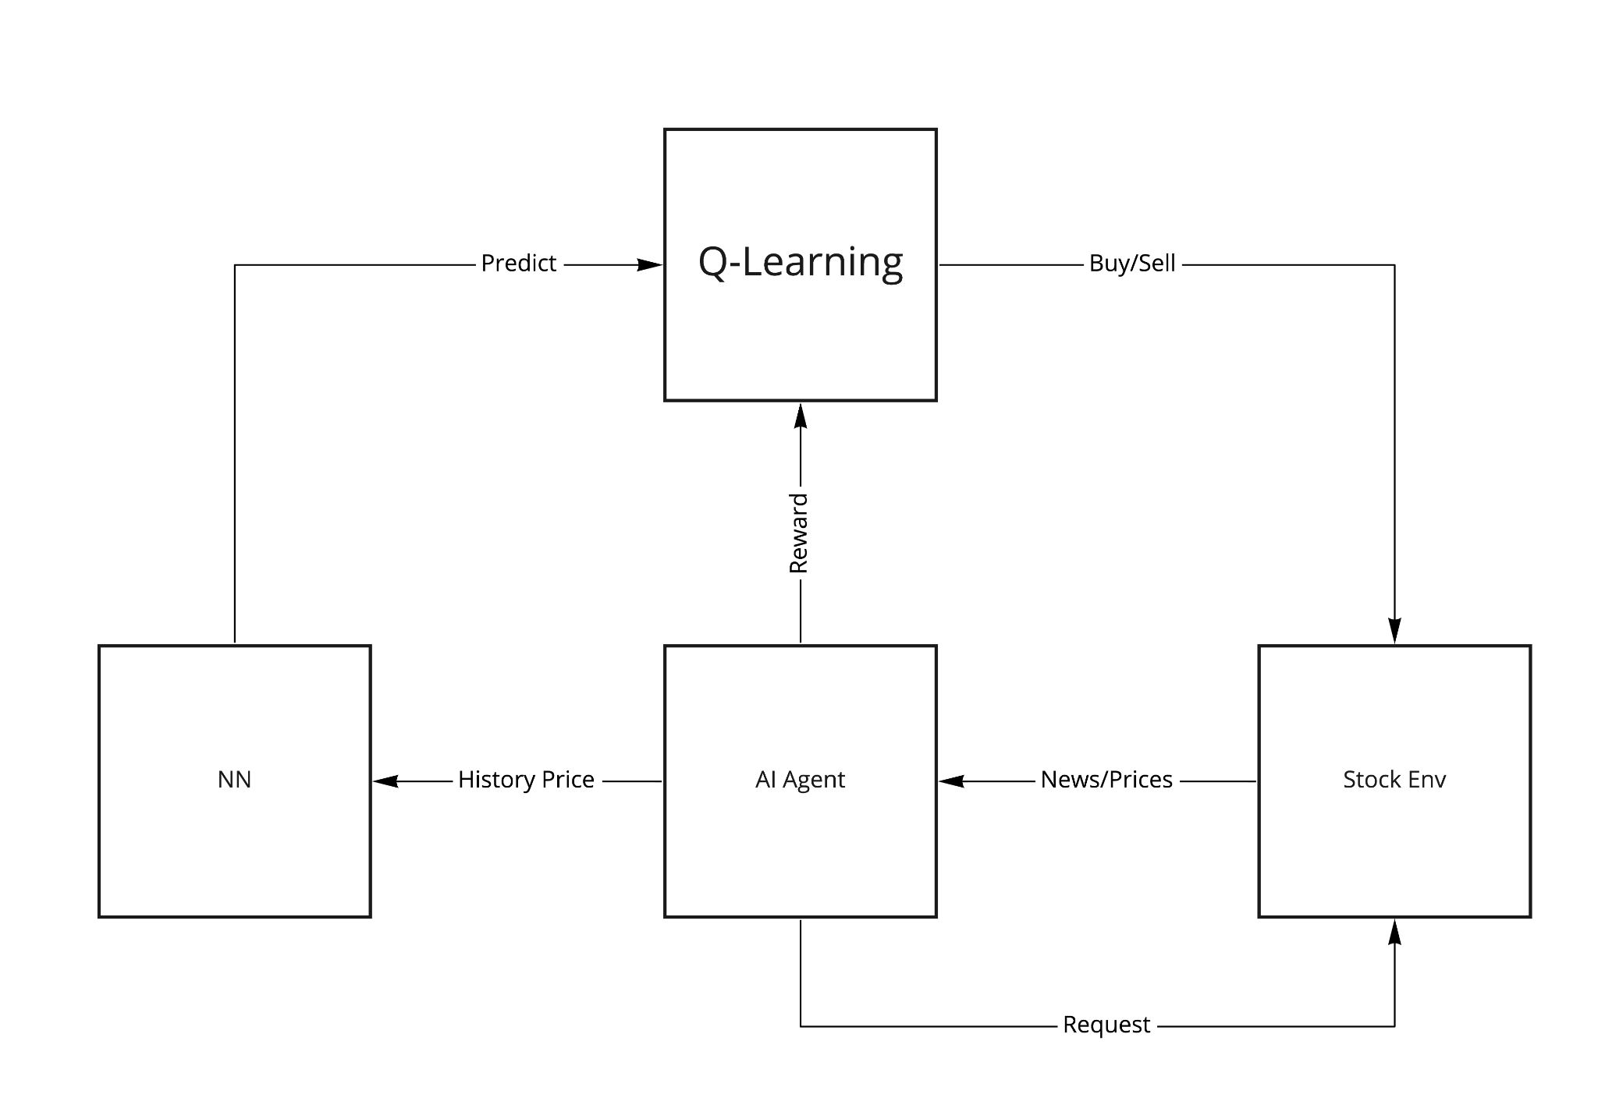
General Design
Two Model:
A neural network for price prediction
A Q-learning to manipulate stock (Buy/Sell)
Stock Environment:
Provides prices
Accept buy/sell options
Calculate earnings
Neural Network:
Receive history data
Predict future price
Q-Learning:
Buy and sell according to future price

Slide 9
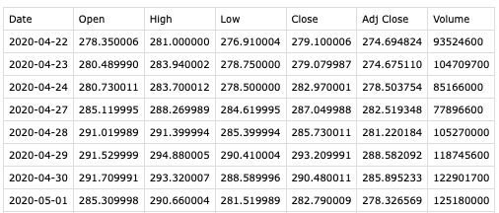
Dataset
The real historical prices of some companies, obtained from Yahoo Finance website. (https://finance.yahoo.com/) Dataset contains information:
Date, Open Price, Highest Price, Lowest Price, Close Price, Adjusted Close Price, and Volume

Slide 10

LSTM
Long Short Term Memory networks (LSTMs) is capable of connecting previous information to the present task
Passing input from last output, are able to retain information, and able to hold all information at the end to make predictions.
Input prices of previous n days into LSTM, so that the price of the latter days depends on the prices of the former days
src: https://colah.github.io/posts/2015-08-Understanding-LSTMs/

Slide 11
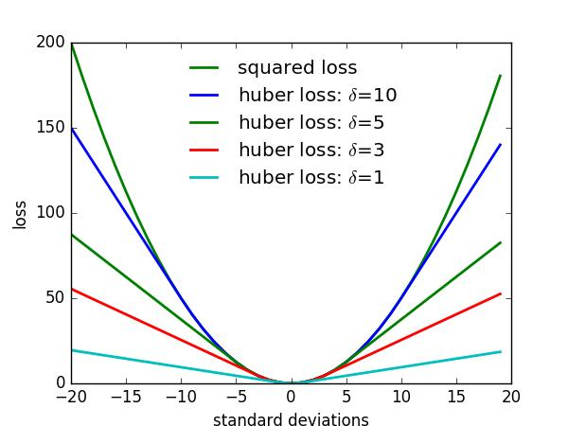
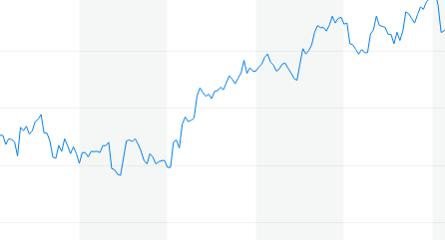
Huber Loss
Stock price has a lot of tiny fluctuations from day to day
Huber loss is a loss function used in robust regression, that is less sensitive to outliers in data than the squared error loss.
Avoid prediction affected by local small changes
src: https://finance.yahoo.com/quote/AAPL/chart?p=AAPL
src: https://www.programmersought.com/article/85295073953/

Slide 12
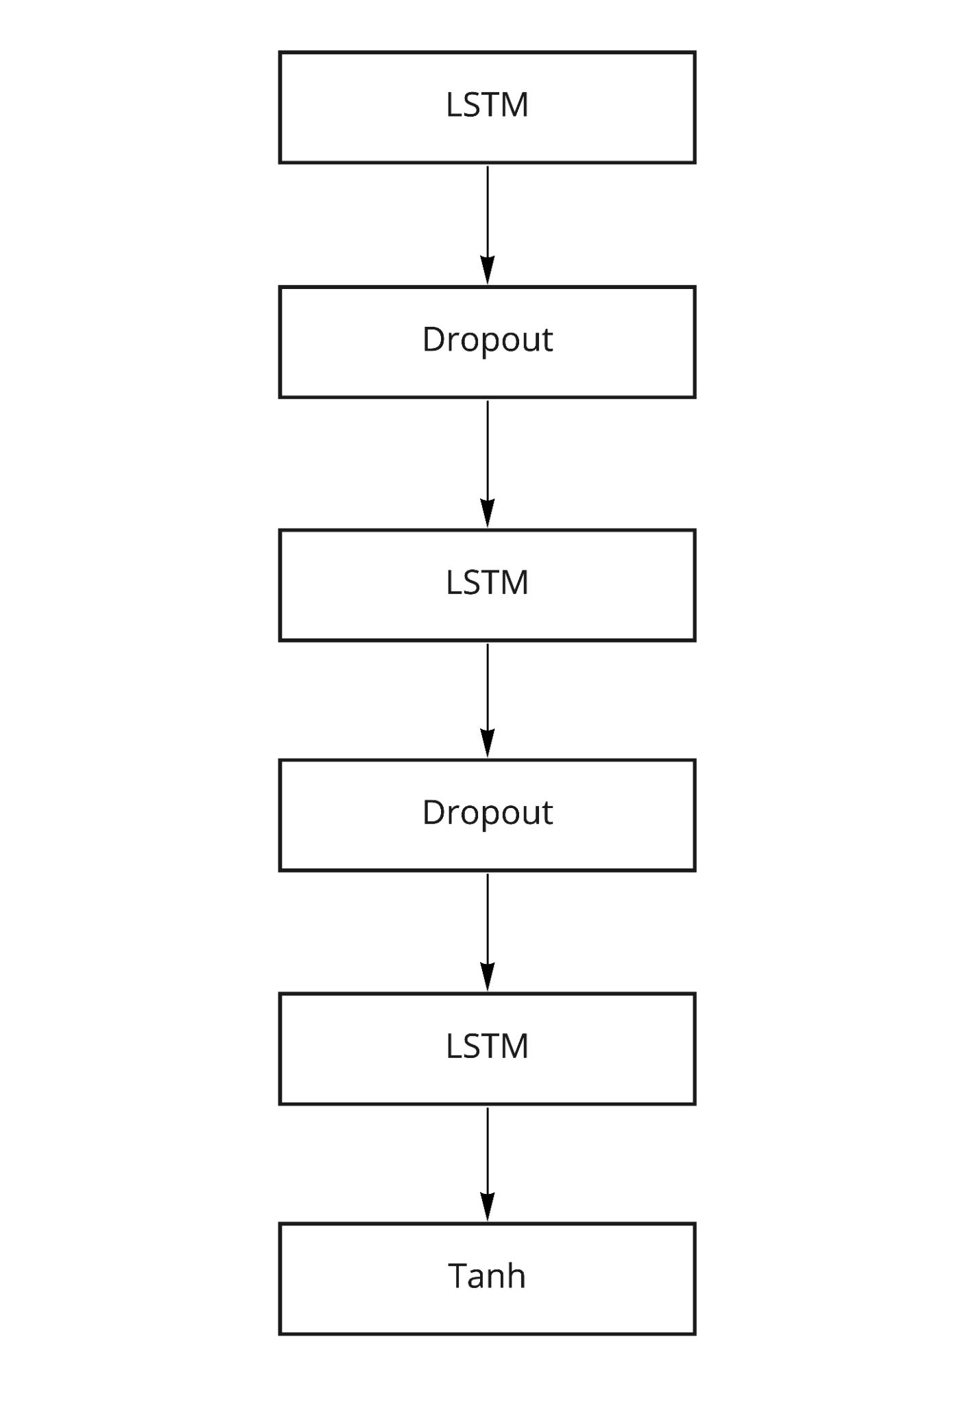
Neural Network Design
This neural network is used to predict the future price of a given stock.
Input with historical prices (Past k days)
Consists of Multi-LSTM layer
Predicted result would be used in Q-learning

Slide 13
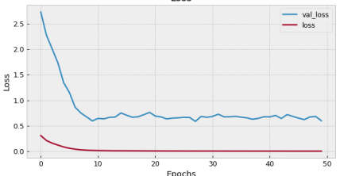
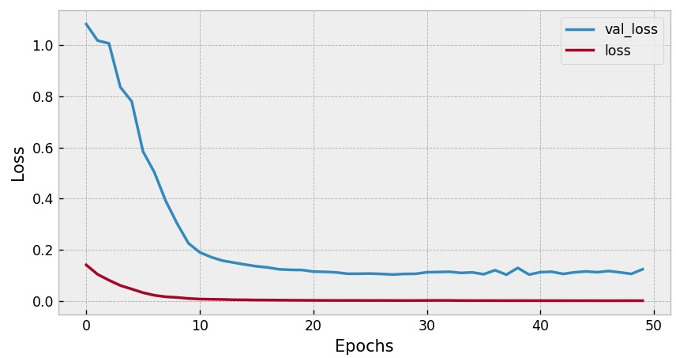
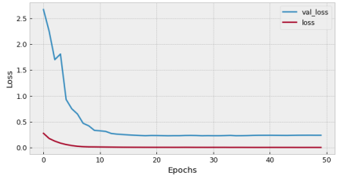
Loss Comparison
Loss Vs. Epochs
Simple LSTM Model + MSE
DRNN Model + Huber
DRNN Model + MSE

Slide 14
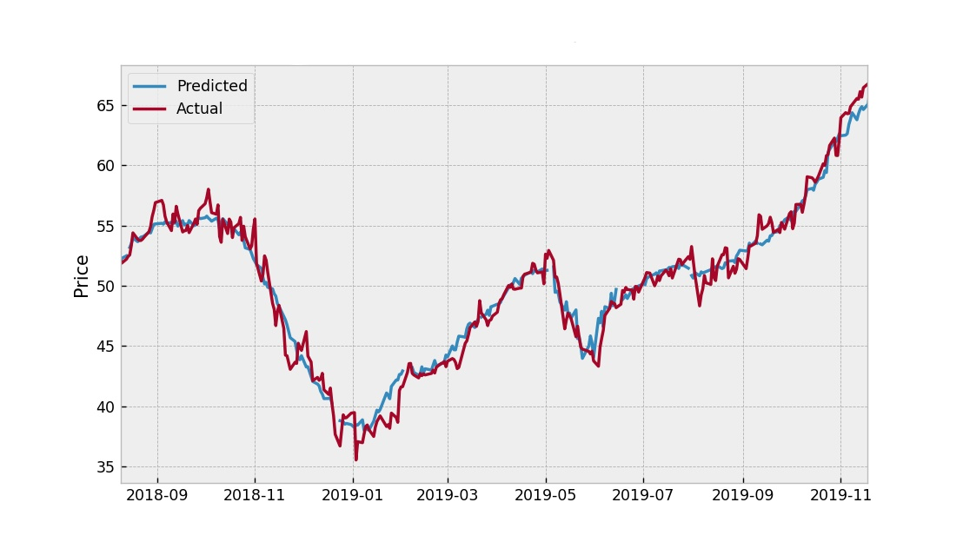
We are predict trend not exact price

Slide 15
Q-Learning
Q-Learning is a model where a reward value or Q-value is used to iteratively improve decisions using reinforcement learning. Here we use it to make the decision about when to purchase/sell a stock.
Goal: understand what decisions to make
Reward: Worth
Action Space: List of percentage indicating buy/sell/hold.
e.g. -10% means sell 10% of current shares
State: Stock prices of a period of time

Slide 16
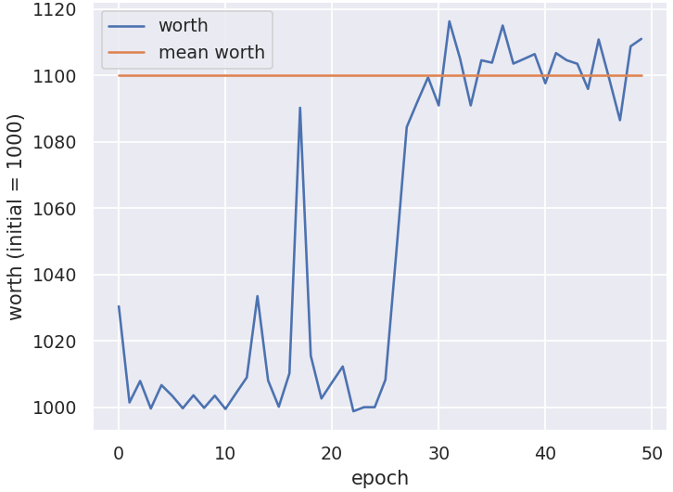
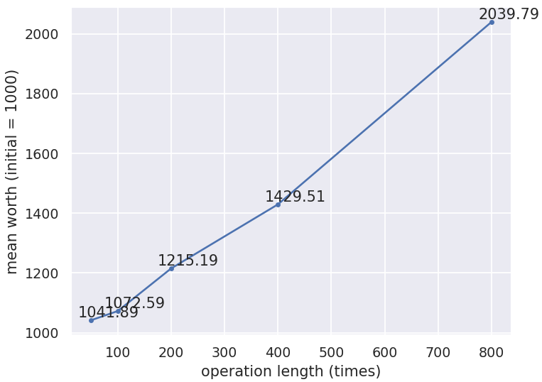
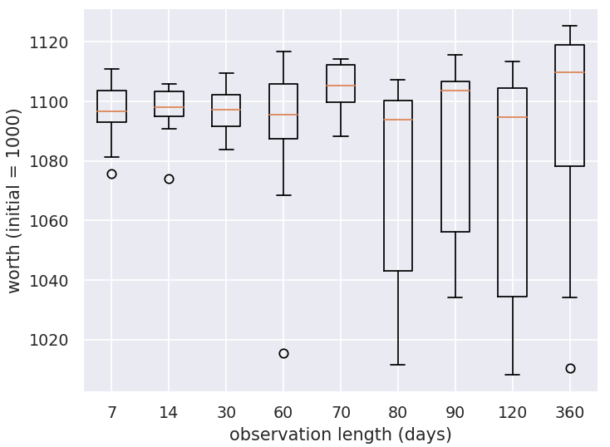
Parameter Tuning (Env)
Calculate mean worth after performance levels off
Each data point has 10 sample sizes
Operation Length affects the mean worth
Observation length affect standard deviation of mean worth of agent.

Slide 17
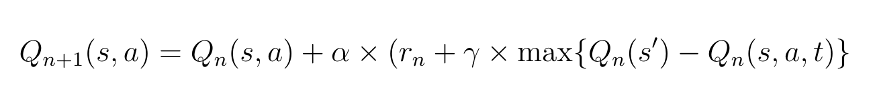
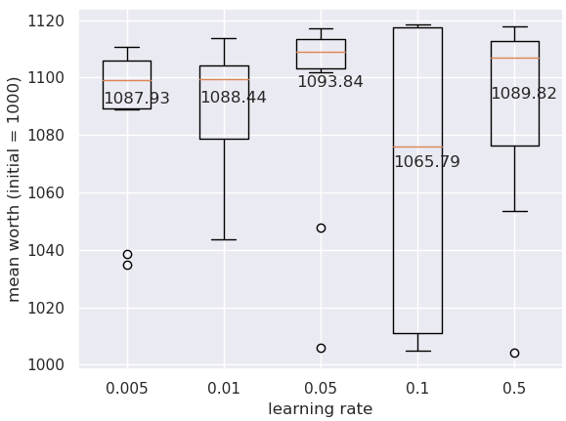
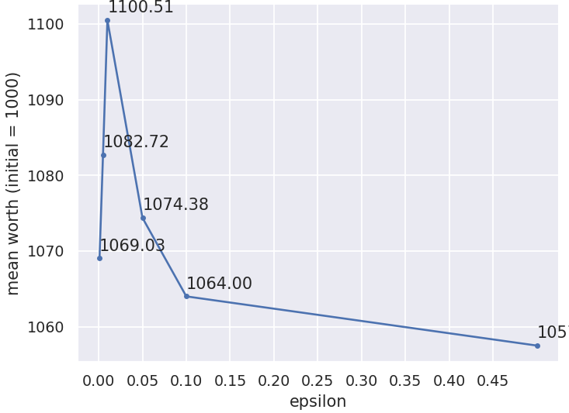
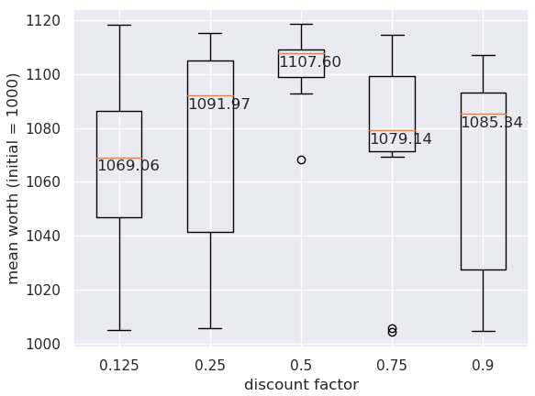
Parameter Tuning (Agent)
Learning rate = 0.05 (Lowest Std Dev + Highest Median)
Epsilon = 0.01 (Highest Mean Performance)
Discount factor = 0.5 (Lowest Std Dev + Highest Median)

Slide 18
Show Time!

Slide 19
Ethical Issues

Slide 20
Utopian and Dystopian
Utopia:
1. More and more precise prediction about stock prices as AI technique continues to make breakthrough.
2. Less and less dangers like stock market crashes and crisis would happen.
3. Adjustment according to the precise prediction by AI agent will make economy more and more stable.
Dystopia:
1. AI might cause harm to humans without reason. The logic and rationale behind AI decisions may remain opaque to the person concerned and even the person responsible for the decisions. So some wrong price predictions made by AI agent will lead to collapse of stock market and economy
2. AI agent will dominate the labor power in the stock market and then dominate the labor of management of the economy. Humans’ economic activities are controlled by AI agent.

Slide 21
Ethical Concerns
Unemployment. AI has better calculation and more precise prediction of the trend of stock market. If widely used, it may take away numerous of jobs from human who are engaging in the same area with AI.
Social instability. AI’s prediction is not one hundred percent correct. It has a possibility to make mistakes. The wrong price prediction may cause chaos and fears in the stock market even in the whole public.
Inequality wealth distribution. Wealth created by machine might be unevenly distributed. Use of AI can help individuals or companies succeed in stock market according to the correct prediction by it. But also, use of AI make people lose their jobs who engage similar jobs. So the gap of wealth difference is enlarged by use of AI.
Higher labor requirement. An additional concern about the inequality of AI systems is that it puts individuals who lack the capital and education to create, train, and maintain AI systems at a disadvantages in terms of efficiency and time to those who do. In this way, AI within the stock market serves to perpetuate existing disparities in the ability of the wealthy and the non-wealthy to maintain their long term economic health

Slide 22
Conclusion

Slide 23
Challenges
What we have learned
Q-learning: Fluctuation in performance (Mean worth)
Neural Network: No efficient formula to evaluate accuracy (only use loss function)
General: Stock prices can be volatile and do not always follow a clear pattern so any attempt to model them will only achieve a reasonable amount of success
Q-learning:
How to use gym library to build a virtual environment for reinforcement learning
How Q-learning works ?
Neural Network:
Huber loss function
DRNN (deep recurrent neural network)
Generally:
That there are many ways to predict stock prices and none are perfect
Stock market prediction can have significant benefits to users but there are major ethical concerns which arise with reckless use

Slide 24
What we would change
Our initial plan was big: a large market environment, with multiple stocks, and multiple agents will compete against each other. However, in the process, it took us long to get precise and satisfactory results from our prediction NN and stock agent.
So if we could go back to the start, we would either scale down our ambition a little bit, or reallocate our work.

Slide 25
Possible future works
Apply different matrices to measure the performance of agent. For example, instead of measure the worth rate of agents, Compound Annual Growth Rate may be interested to study.
Although we examine action spaces with different length, result does not show significantly different. But we do not exhaustively examine all different values. There may be something interesting to study by varying percentages in action space.
Use a gradually decayed randomness during training.

Slide 26
Reference
Sklearn.preprocessing.RobustScaler. (n.d.). Retrieved April 23, 2021, from https://scikit-learn.org/stable/modules/generated/sklearn.preprocessing.RobustScaler.html
Team, K. (n.d.). Keras documentation: LSTM layer. Retrieved April 23, 2021, from https://keras.io/api/layers/recurrent_layers/lstm/
Q-learning in python. (2020, April 19). Retrieved April 23, 2021, from https://www.geeksforgeeks.org/q-learning-in-python/
Chen, B., Sadd, N., & DiRisio, B. (2019, November 17). Using a LSTM RNN to Predict a Stock’s Future Value. Retrieved April 23, 2021, from https://medium.com/bucknell-ai-cogsci/using-a-lstm-rnn-to-predict-a-stocks-future-value-271345963dba

Slide 27
Questions

