Slide 1
AI & Capitalism
The Wolves of 7th Street
Presented by:
Jacky Lin, Andrew Whitig, Chengcheng Ding, Hanzheng Wang

Slide 2
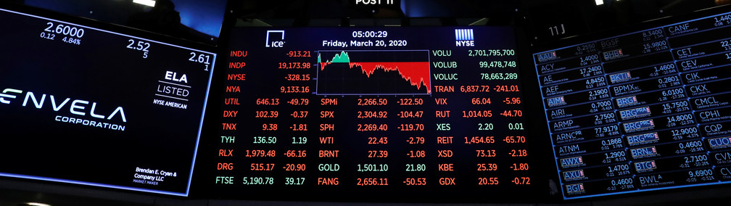
Description
We will create a market simulation environment that AIs can buys and sells stock, starting with designing AI agents implemented with Q-Learning and Neural network to operate inside that environment. The matrices to measure the performance of the AI agent would be the amount of profit the agent can earn and the accuracy of the neural network of predicting the future price. The wanted final version would be a simulation of stock market where agents competes and communicates against each other.

Slide 3
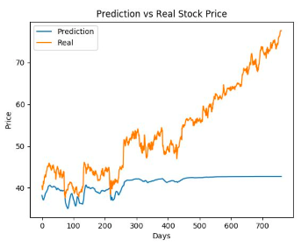
Previous Work
Previous work of Stock Price Prediction focuses only on prediction of future price using LSTM/RNN model. (Chen, Sadd, & DiRisio, Using a LSTM RNN to Predict a Stock’s Future Value 2019)
We will create a market simulation environment that AIs can buys and sells stock, starting with designing AI agents implemented with Decision Trees and Neural network to operate inside that environment. The metrics to measure the performance of the AI agent would be the amount of profit the agent can earn and the accuracy of the neural network of predicting the future price. The intended final version would be a simulation of stock market where agents compete and communicate against each other.
In our AI’s interaction and with other agents and decision making process (driven by the use of Q-Learning), we will differentiate ourselves from previous work. By not only predicting the prices of stocks but also interacting with them we have added a layer of complexity which elaborates on the foundation laid by historical projects.

Slide 4
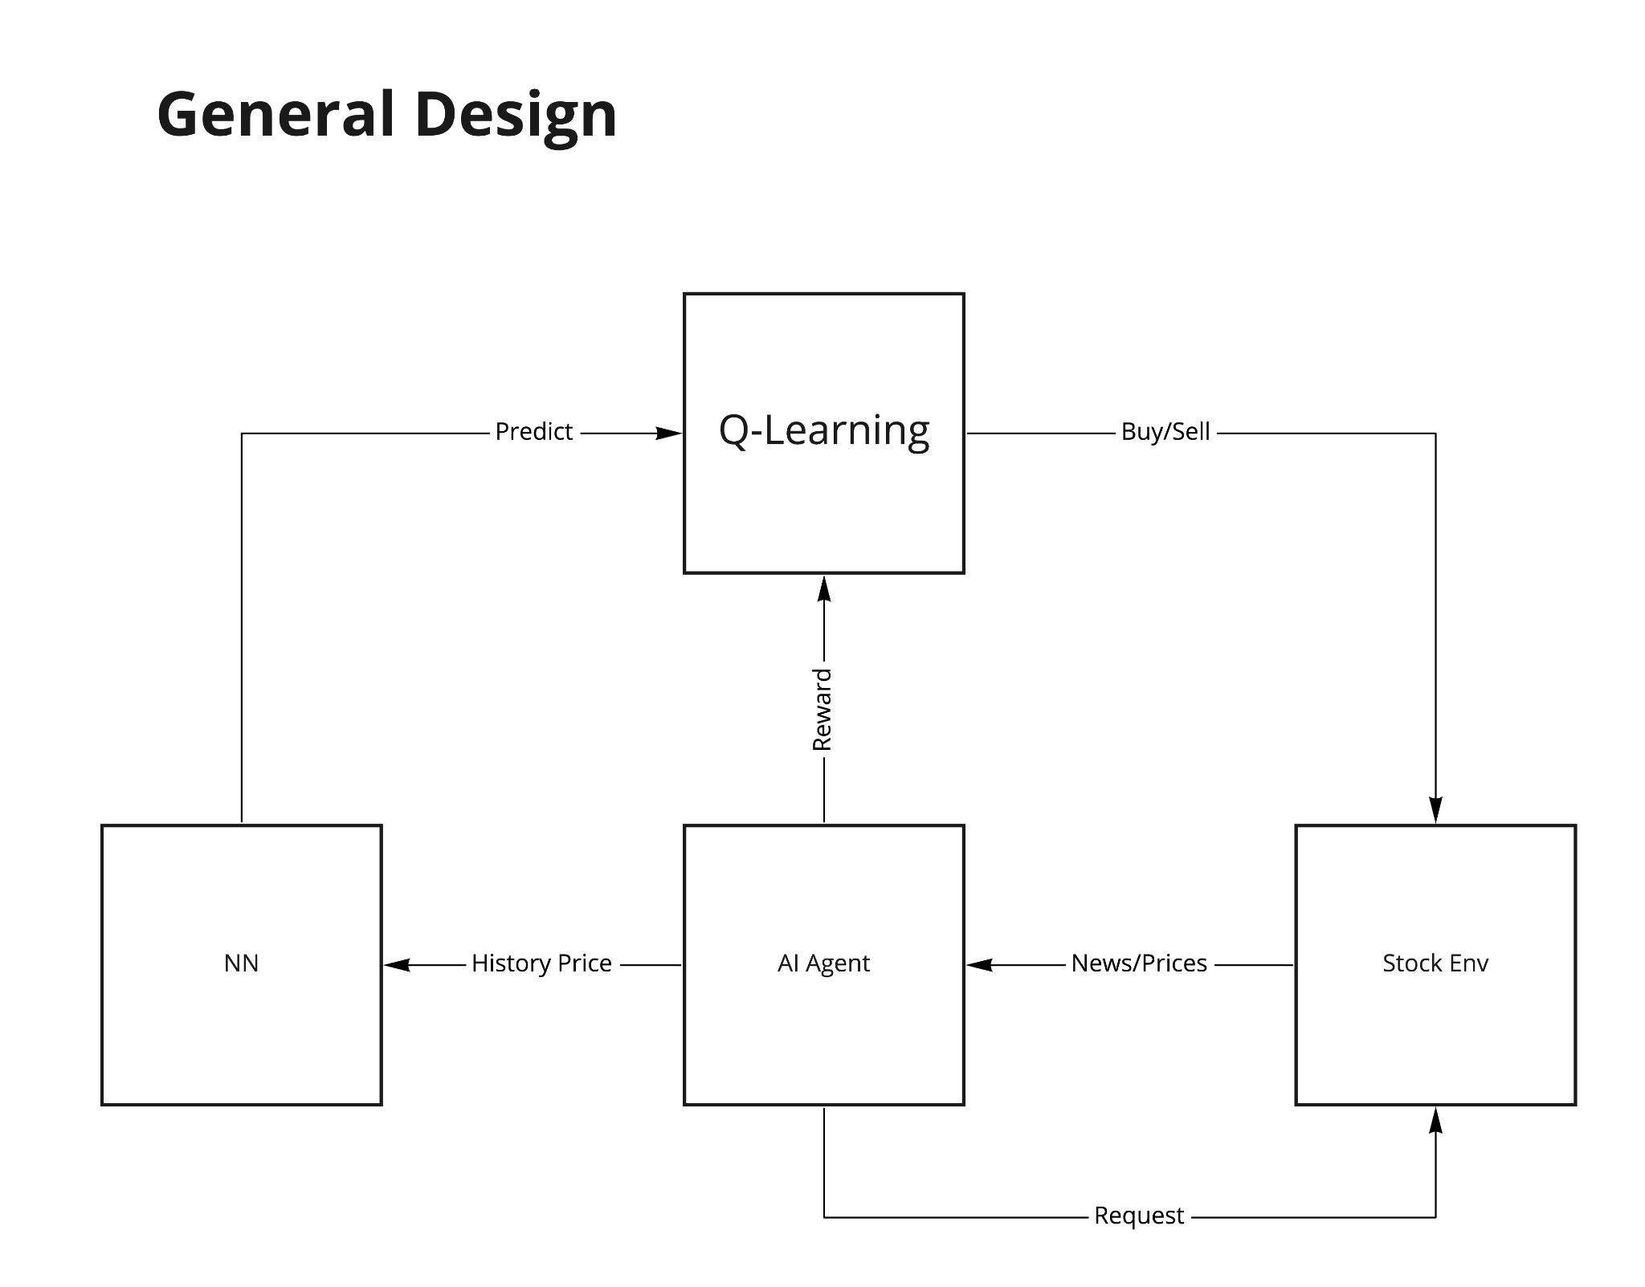

Slide 5
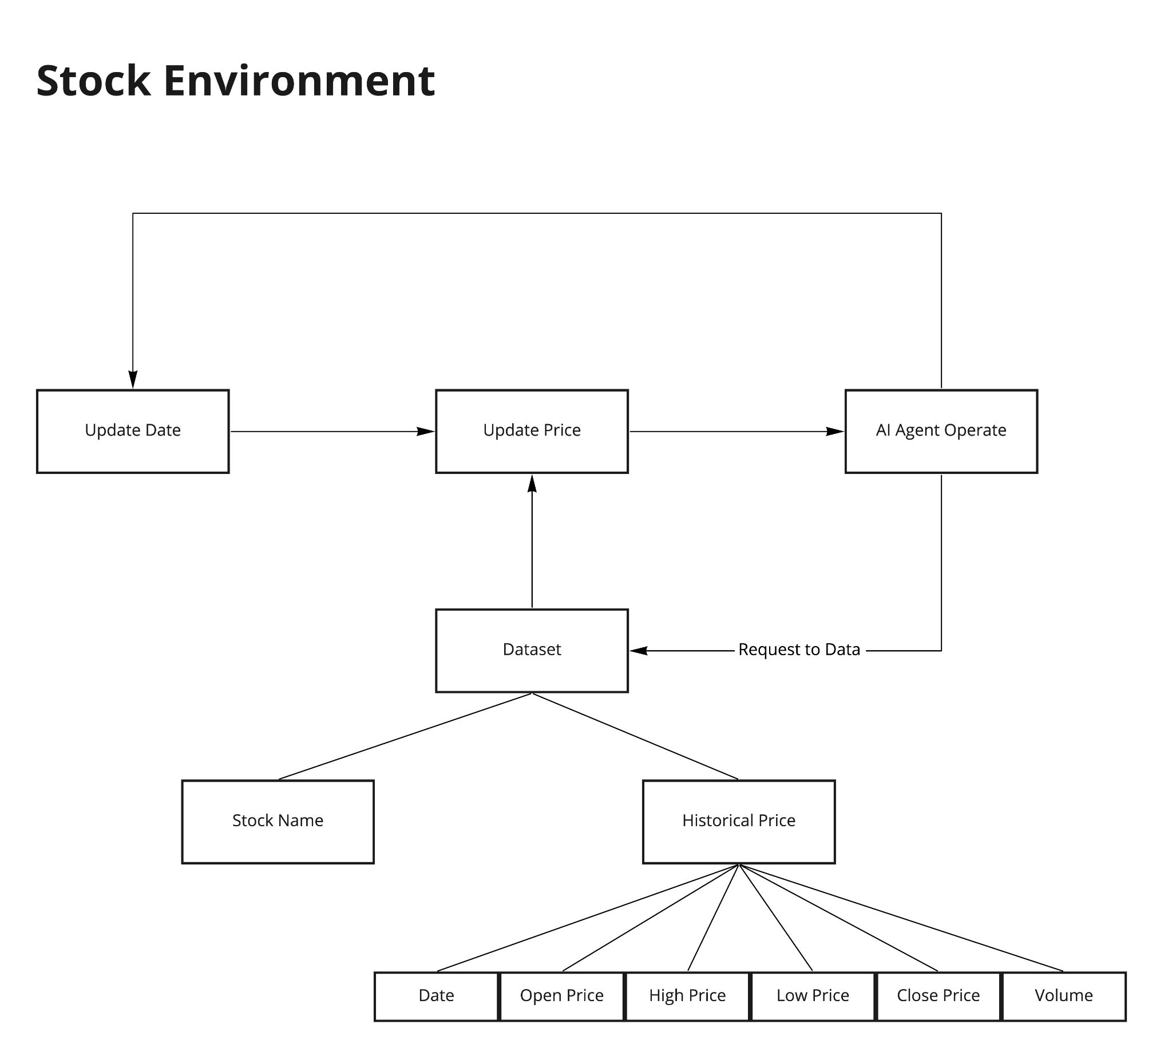

Slide 6
Q-Learning
Q-Learning is a model where a reward value or Q-value is used to iteratively improve decisions using reinforcement learning
To make the decision about when to purchase/sell a stock we are using Q-Learning
This is a type of reinforcement learning which helps our agent understand what decisions to make
Our Agent continuously makes decisions and is provided with feedback on those decisions
In this case, the rewards correspond to the change in the agent’s account value including holdings and purchasing power
Our agent chooses what decision to make based on the epsilon greedy algorithm
We choose an epsilon value between 1 and 0
With probability (1-epsilon), we choose the decision with greatest estimated Q-value (benefit)
With probability epsilon, we choose any decision
We then run the agent for a preset length of time within the environment in order to train and accurately make the decisions which provide the greatest reward

Slide 7
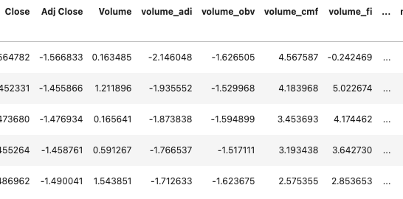
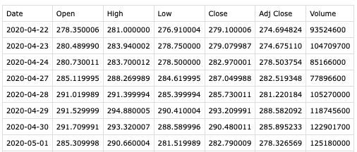
Dataset
Preprocessing
The real historical prices of some companies, obtained from Yahoo Finance website. (https://finance.yahoo.com/) Dataset contains information:
Date, Open Price, Highest Price, Lowest Price, Close Price, Adjusted Close Price, and Volume
Robust Scaler: This Scaler removes the median and scales the data according to the quantile range (defaults to IQR: Interquartile Range). The IQR is the range between the 1st quartile (25th quantile) and the 3rd quartile (75th quantile).

Slide 8

LSTM
Long Short Term Memory networks (LSTMs) are a special kind of a recurrent neural network, capable of learning long-term dependencies.
Long-term dependencies: connect previous information to the present task
Passing input from last output, are able to retain information, and able to hold all information at the end to make predictions.
Input prices of previous n days into LSTM, so that the price of the latter days depends on the prices of the former days

Slide 9
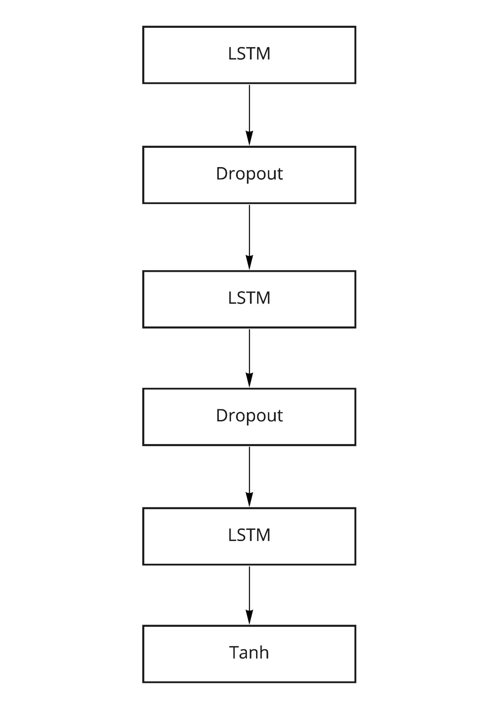
Neural Network Design
This neural network is used to predict the future price of a given stock.
Input with historical prices (Past k days)
AI Agent would make decisions based on the predicted prices
Consists of 3 LSTM layer
Haven't incorporated with financial news effects.

Slide 10
Ethical Concerns
Unemployment. AI has better calculation and more precise prediction of the trend of stock market. If widely used, it may take away numerous of jobs from human who are engaging in the same area with AI.
Social instability. AI’s prediction is not one hundred percent correct. It has a possibility to make mistakes. The wrong price prediction may cause chaos and fears in the stock market even in the whole public.
Inequality of wealth distribution. Wealth created by machine might be unevenly distributed. Use of AI can help individuals or companies succeed in stock market according to the correct prediction by it. But also, use of AI make people lose their jobs who engage similar jobs. So the gap of wealth difference is enlarged by use of AI.
An additional concern about the inequality of AI systems is that it puts individuals who lack the capital and education to create, train, and maintain AI systems at a disadvantages in terms of efficiency and time to those who do. In this way, AI within the stock market serves to perpetuate existing disparities in the ability of the wealthy and the non-wealthy to maintain their long term economic health

Slide 11
Reference
Sklearn.preprocessing.RobustScaler. (n.d.). Retrieved April 23, 2021, from https://scikit-learn.org/stable/modules/generated/sklearn.preprocessing.RobustScaler.html
Team, K. (n.d.). Keras documentation: LSTM layer. Retrieved April 23, 2021, from https://keras.io/api/layers/recurrent_layers/lstm/
Q-learning in python. (2020, April 19). Retrieved April 23, 2021, from https://www.geeksforgeeks.org/q-learning-in-python/
Chen, B., Sadd, N., & DiRisio, B. (2019, November 17). Using a LSTM RNN to Predict a Stock’s Future Value. Retrieved April 23, 2021, from https://medium.com/bucknell-ai-cogsci/using-a-lstm-rnn-to-predict-a-stocks-future-value-271345963dba

