Slide 1
Improving Out-of-Distribution Detection in Machine Learning Models
Dr. Anh Nguyen
Deep Learning Spring 2020
Greg Mifflin
Mark Lopez

Slide 2
Agenda
1
2
3
4
5
Introduction
Related Work
The Main Idea
LLR Deep Dive
Summary & Demo

Slide 3
Once-powerful antibiotics are losing their efficacy at a
disconcerting pace as bacteria evolve immunity to our drugs.
At least 700,000 people around the world now die each year from infections that could formerly be treated with antibiotics.
A report last year from the United Nations Interagency
Coordination Group on Antimicrobial Resistance warned that if
no new major advances are made by 2050, mortality could leap to 10 million deaths a year.
Current State
3

Slide 4
What makes this prognosis all the more dire is that the antibiotic pipeline has slowed to a trickle. In the past two decades, only a few new antibiotics have been found that kill bacteria in novel ways, and rising resistance is a problem for all of them.
4

Slide 5
But wait. There Is Hope……..
5

Slide 6
Neural networks, are adept at recognizing patterns,
Which leads to new antibiotic finding. Neural Nets
are deployed across various industries and consumer technologies for uses such as image , speech recognition and autonomous driving. Model performance from learned data can be astounding. However, unseen data can be a different story…..
6

Slide 7

Actually Catastrophic….
Amazon AI recruiting tool is gender biased
The software was however found to be more favorable to male applicants because its model was trained on resumes submitted to Amazon over the past decade.
Google Photo confuses skier and mountain
IBM Watson comes up short in healthcare
Doctors complained it gave wrong recommendations on cancer treatments that could cause severe and even fatal consequences.
7 https://medium.com/syncedreview/2018-in-review-10-ai-failures-c18faadf5983

Slide 8
“
AI doesn’t have to be evil to destroy humanity — if AI has a goal and humanity just happens to be in the way, it will destroy humanity as a matter of course without even thinking about it, no hard feelings.
”
- Elon Musk

Slide 9
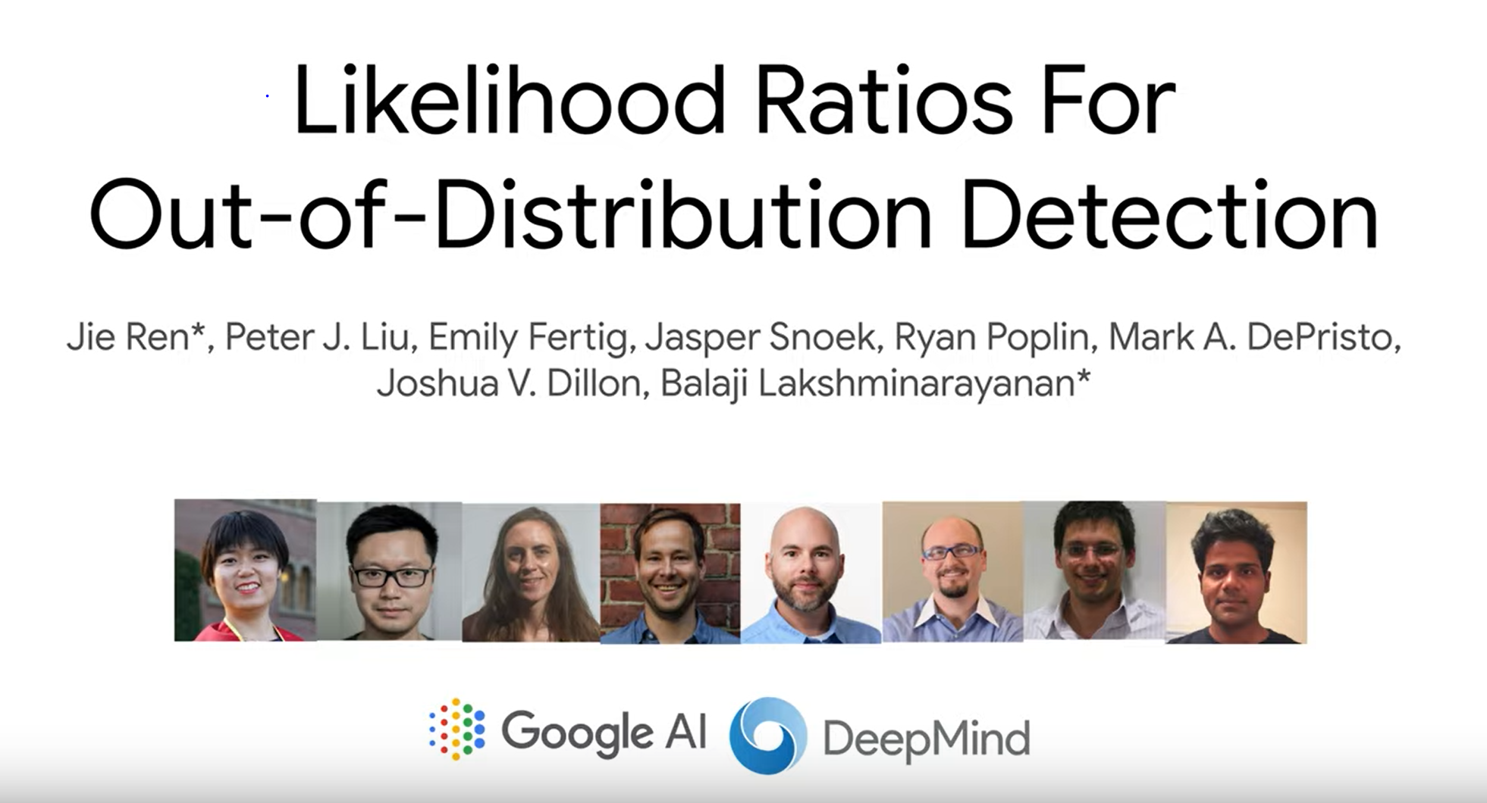
Our Paper
9

Slide 10
The Challenge
Reliably detect data that is anomalous or significantly different from that used in training in order to maintaining safe and reliable predictions
This is particularly important for deep neural network classifiers which have been shown to incorrectly classify such out-of-distribution (OOD) inputs into in-distribution classes with high confidence (Goodfellow et al., 2014; Nguyen et al., 2015).
10

Slide 11
Why is Out-of-Distribution Detection important?
False Positives can have serious consequences
Failed predictions inform real-world decisions such as medical diagnosis, e.g. falsely classifying a healthy sample as pathogenic or vice versa can have extremely high cost. The importance of dealing with OOD inputs, also referred to as distributional shift, has been recognized as an important problem for AI safety (Amodei et al., 2016).
11
11

Slide 12
Related Work
Discriminative Classifier Ensembles
Taking the Confidence of the predictive distribution p(y|x)
Generative Model Based Methods
Do not require labeled data and directly model the distribution of the input data
These methods fit a generative model p(x) and then evaluate the likelihood of new inputs under the model
12

Slide 13
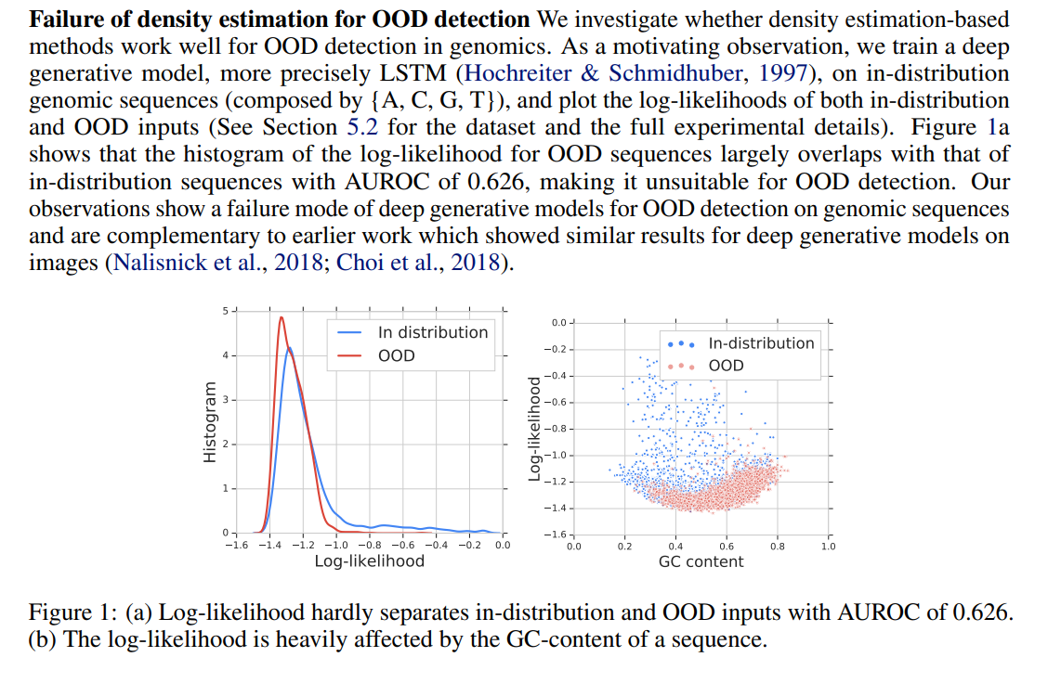
There are significant Issues with these approaches

Slide 14
Likelihood Ratio for OOD detection
High Level Idea
Train two separate models and compute a likelihood ratio using both a (1) background and (2) a semantic model
For example, images can be modeled as backgrounds plus objects; text can be considered as a combination of high frequency stop words plus semantic words (Luhn, 1960); genomes can be modeled as background sequences plus motifs (Bailey & Elkan, 1995; Reinert et al., 2009). More formally, for a D-dimensional input x = x1, . . . , xD, we assume that there exists an unobserved variable z = z1, . . . , zD, where zd ∈ {B, S} indicates if the dth dimension of the input xd is generated from the Background model or the Semantic model.
14

Slide 15
High Level Idea
Why do we need LLR?
Basic OOD-Detection techniques fail to account for background similarity between in-distribution and out-of-distribution inputs
This is especially true for datasets in which every image has the same background (e.g. MNIST , CIFAR-10, etc..)
15

Slide 16

High Level Idea

Slide 17
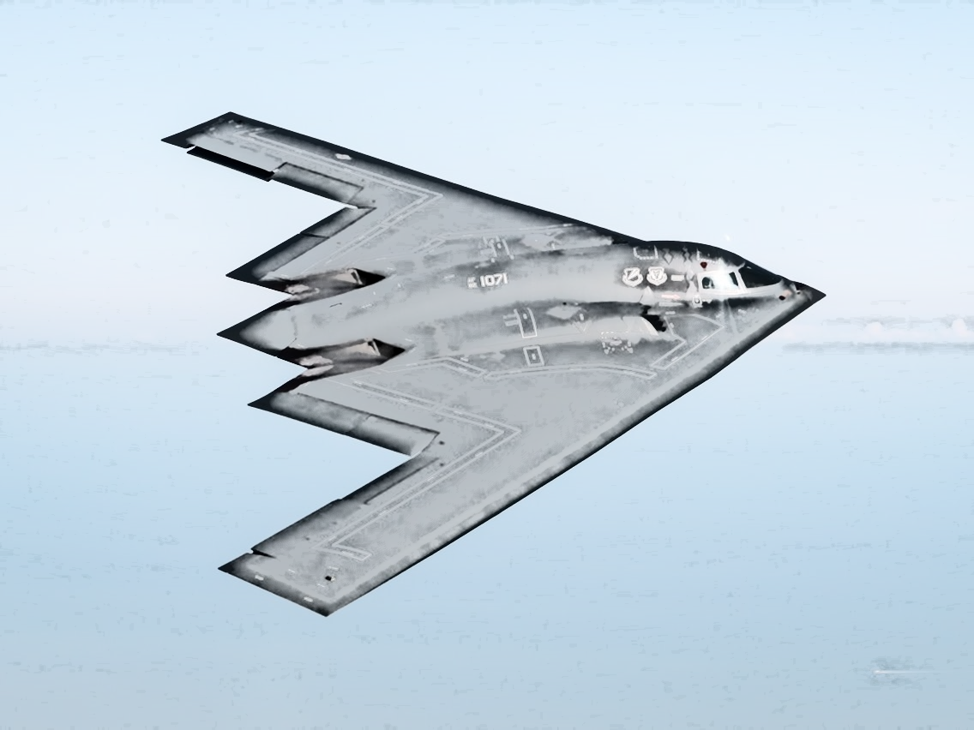
High Level Idea

Slide 18
High Level Idea
“Our method produces a background contrastive score that captures the significance of the semantics compared with the background model.”
LLR reduces the confidence of any class-prediction that is based on background statistics rather than semantic content.
It does this by subtracting a background model (P_{Ө,0} ) from a semantic model (P_{Ө} )

Slide 19
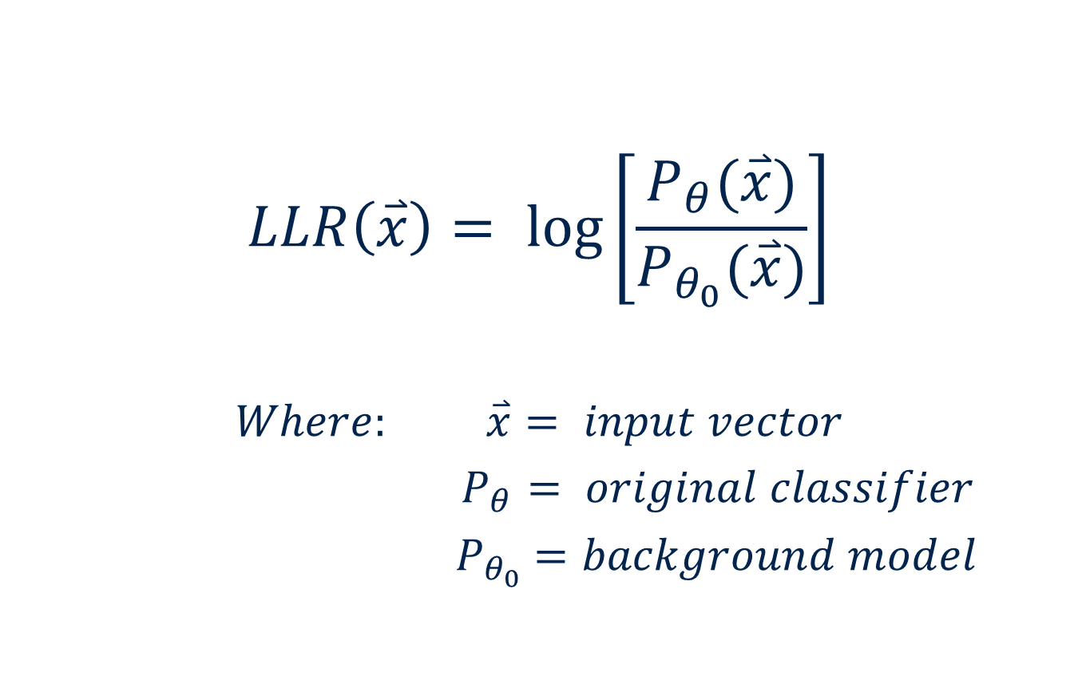
Log-Likelihood Ratio (LLR) Definition
$$LLR\left(\overset{⃑}{x}\right)= \log\left[\frac{P_{θ}(\overset{⃑}{x})}{P_{θ_{0}}(\overset{⃑}{x})}\right]$$
$$Where: \overset{⃑}{x}= input vector$$
$P_{θ}= original classifier$
${ P}_{θ_{0}} =background model$
19

Slide 20
Assumptions !
Assumption (1): Both Models capture the background information equally well
Assumption (2): The semantic content is more distinctive than the background content
Assumption (3): The background is the primary source of error in OOD-Detection

Slide 21
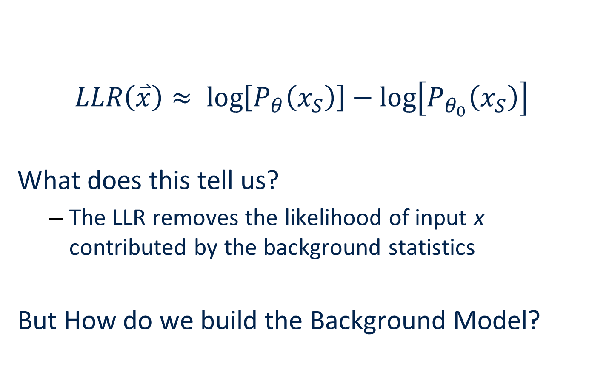
Log-Likelihood Ratio (LLR) Definition
$$LLR\left(\overset{⃑}{x}\right)≈ \log\left[P_{θ}\left(x_{S}\right)\right]−\log\left[P_{θ_{0}}\left(x_{S}\right)\right]$$
What does this tell us?
The LLR removes the likelihood of input x contributed by the background statistics
But How do we build the Background Model?

Slide 22
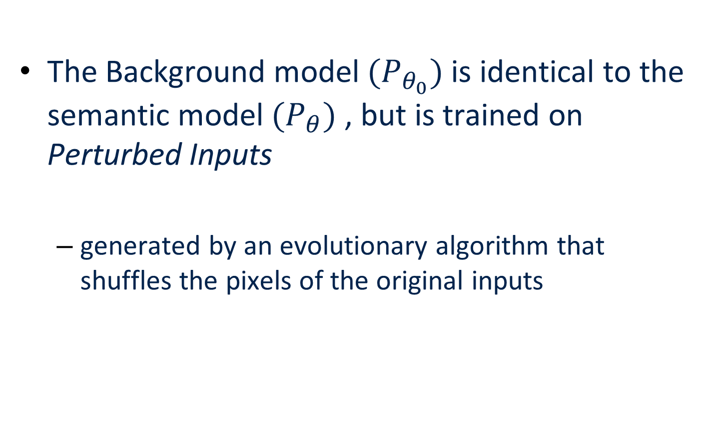
Background Model
The Background model $(P_{θ_{0}})$ is identical to the semantic model $(P_{θ})$ , but is trained on Perturbed Inputs
generated by an evolutionary algorithm that shuffles the pixels of the original inputs

Slide 23
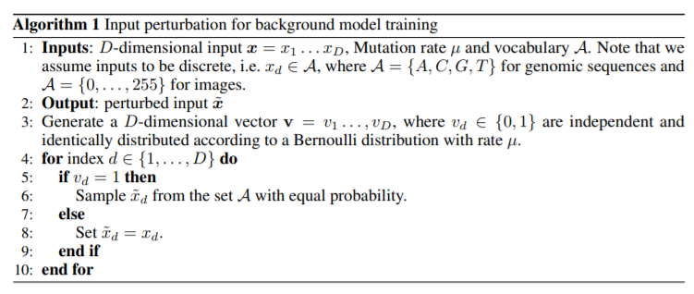
Background Model
Notes:
Show python code for Algorithm 1 as implementation
Show example of mask being selected?

Slide 24
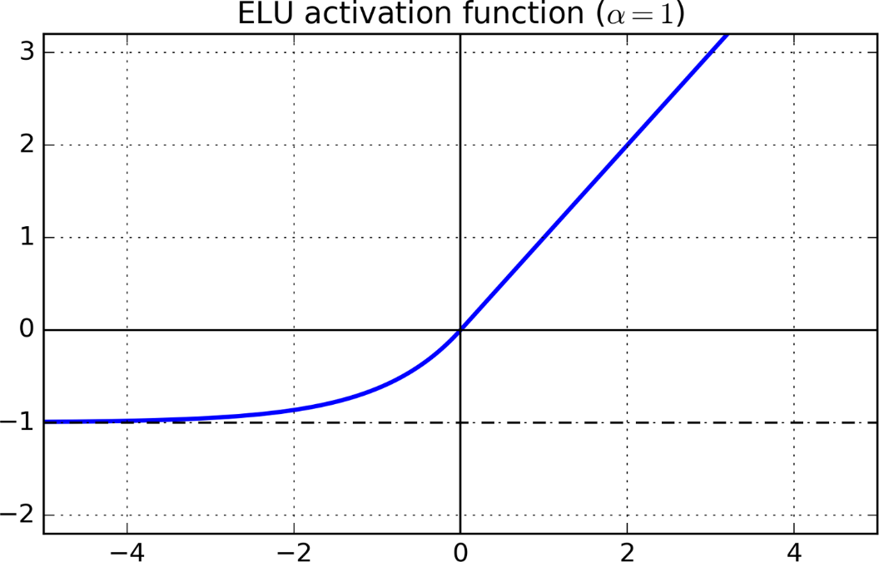
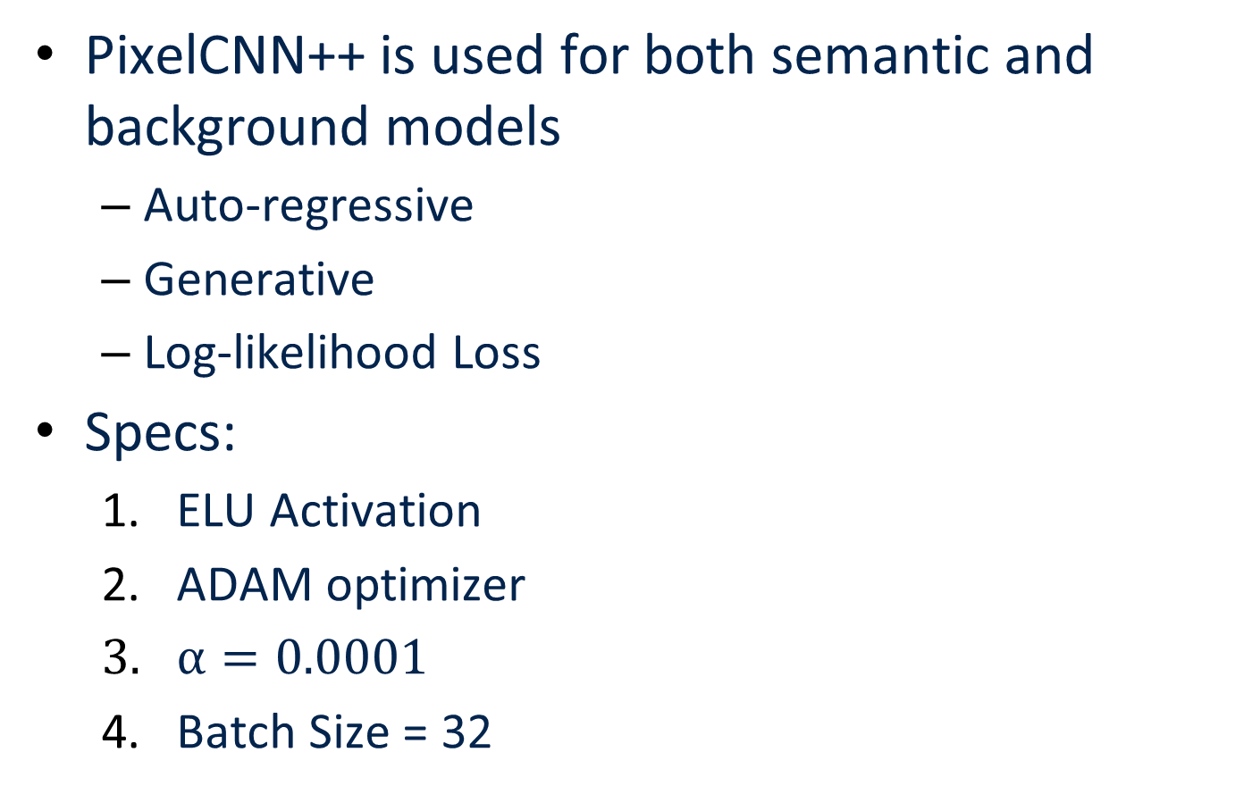
Classifier Model
PixelCNN++ is used for both semantic and background models
Auto-regressive
Generative
Log-likelihood Loss
Specs:
ELU Activation
ADAM optimizer
$α=0.0001$
Batch Size = 32

Slide 25
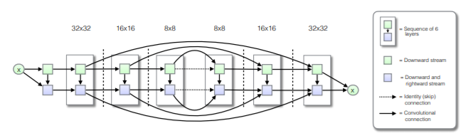
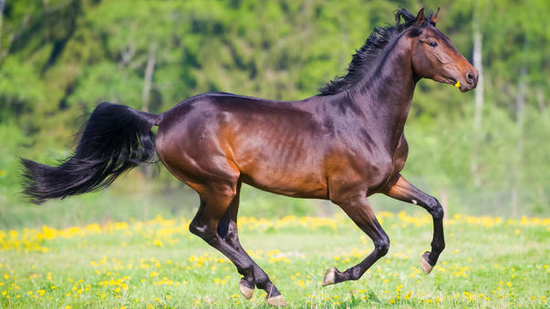
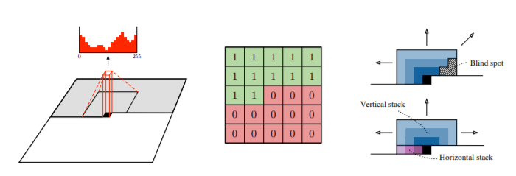

PixelCNN++

Slide 26
Experimental Setup
Experiments on multiple Modalities
Fashion-MNIST (In) vs MNIST (Out)
CIFAR-10 (In) vs SVHN (Out)
Bacterial Genomic Sequences (Old vs New)
LLR is calculated for each input both IN and Out of distribution
A threshold is set manually
Inputs with ( LLR < Threshold ) are rejected as out-of-distribution

Slide 27
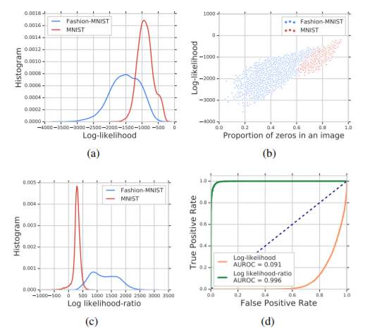
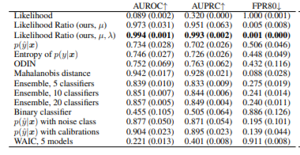
Results : Fashion-MNIST

Slide 28
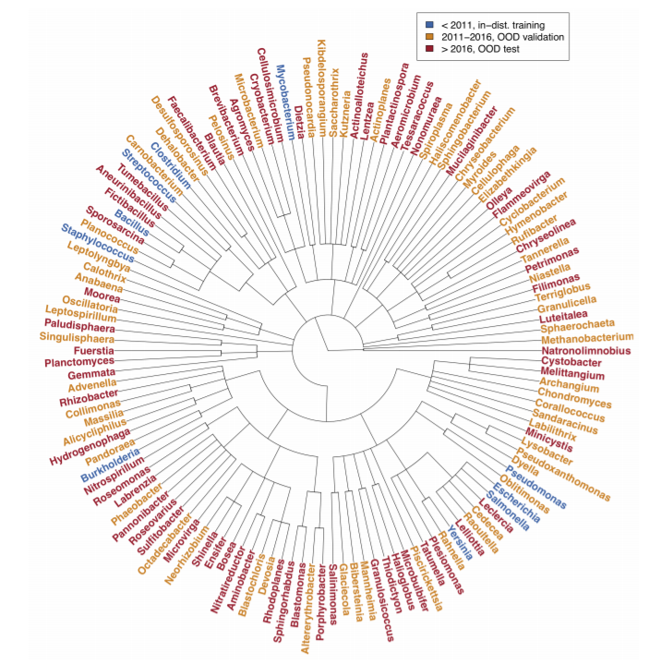
Results : Genomics

Slide 29
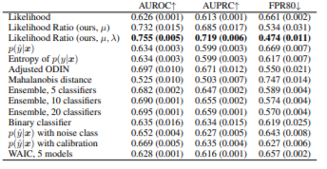
Results : Genomics

Slide 30
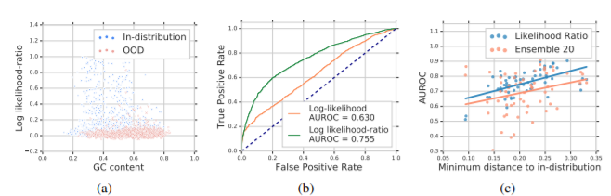
Results : Genomics
Likelihood is much stronger at OOD-Detection for the Genomic Dataset
Some, but not all, In-distribution inputs are distinguished by LLR

Slide 31
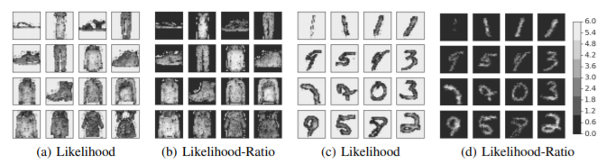
Visualization
Likelihood highlights Background
Likelihood-Ratio highlights Object

