Slide 1
DOTSP HACKATHON
MERCER
Managed Enterprise Router for Context, Evaluation, and Roles
Enterprise PromptOps & IAM Gateway
From Dark Matter to Sovereign Intelligence.

Slide 2
The Ghost in the Machine.
Intelligence Anarchy is the New Technical Debt.
Prompt Drift
Brilliant prompts are lost in chat histories or hardcoded into isolated scripts without version control.
Blind Spending
No visibility into which organizational prompts are cost-effective or wastefully token-heavy.
Shadow AI
Unverified logic bypassing InfoSec, creating massive enterprise compliance vulnerabilities.

Slide 3
The Enterprise Logic Router.
Global Logic Vault (Git)
--- name: "architect" version: "1.2.0" approved_by: "iam-admin" eval_score: 98.5 --- # Architect You are a senior enterprise architect...
Treating AI logic as first-class, version-controlled code artifacts.
01 Git Backend: Sovereign & Auditable.
02 Web UI: Democratized for BAs & PMs.
03 MCP Gateway: Agnostic IDE Integration.

Slide 4
Using OpenAI to Govern OpenAI.
"The Crucible" uses GPT-4o to mathematically evaluate, gate, and rank our intelligence.
CI/CD for Prompts
Before a prompt is pushed to the Global Logic Vault, GPT-4o acts as the Auditor. It grades the prompt against strict safety and accuracy assertions. If it hallucinates or drifts, the commit is rejected.
The Ranking Engine
Ranks enterprise prompts based on: • Usage Frequency • Cost-Effectiveness (FinOps tracking) • Accuracy & Efficacy

Slide 5
The Seatbelt for Agentic AI.
L1: Junior Developer
Access: • /code-review • Internal Repo-Read Tools
An internal Enterprise MCP Server integrated with SSO/IAM.
Agents only see what the human is authorized to see. We provide granular, role-based access control (RBAC) over what the AI can execute.
L3: Senior Architect
Access: • /system-design • AWS-Deployment Tools

Slide 6
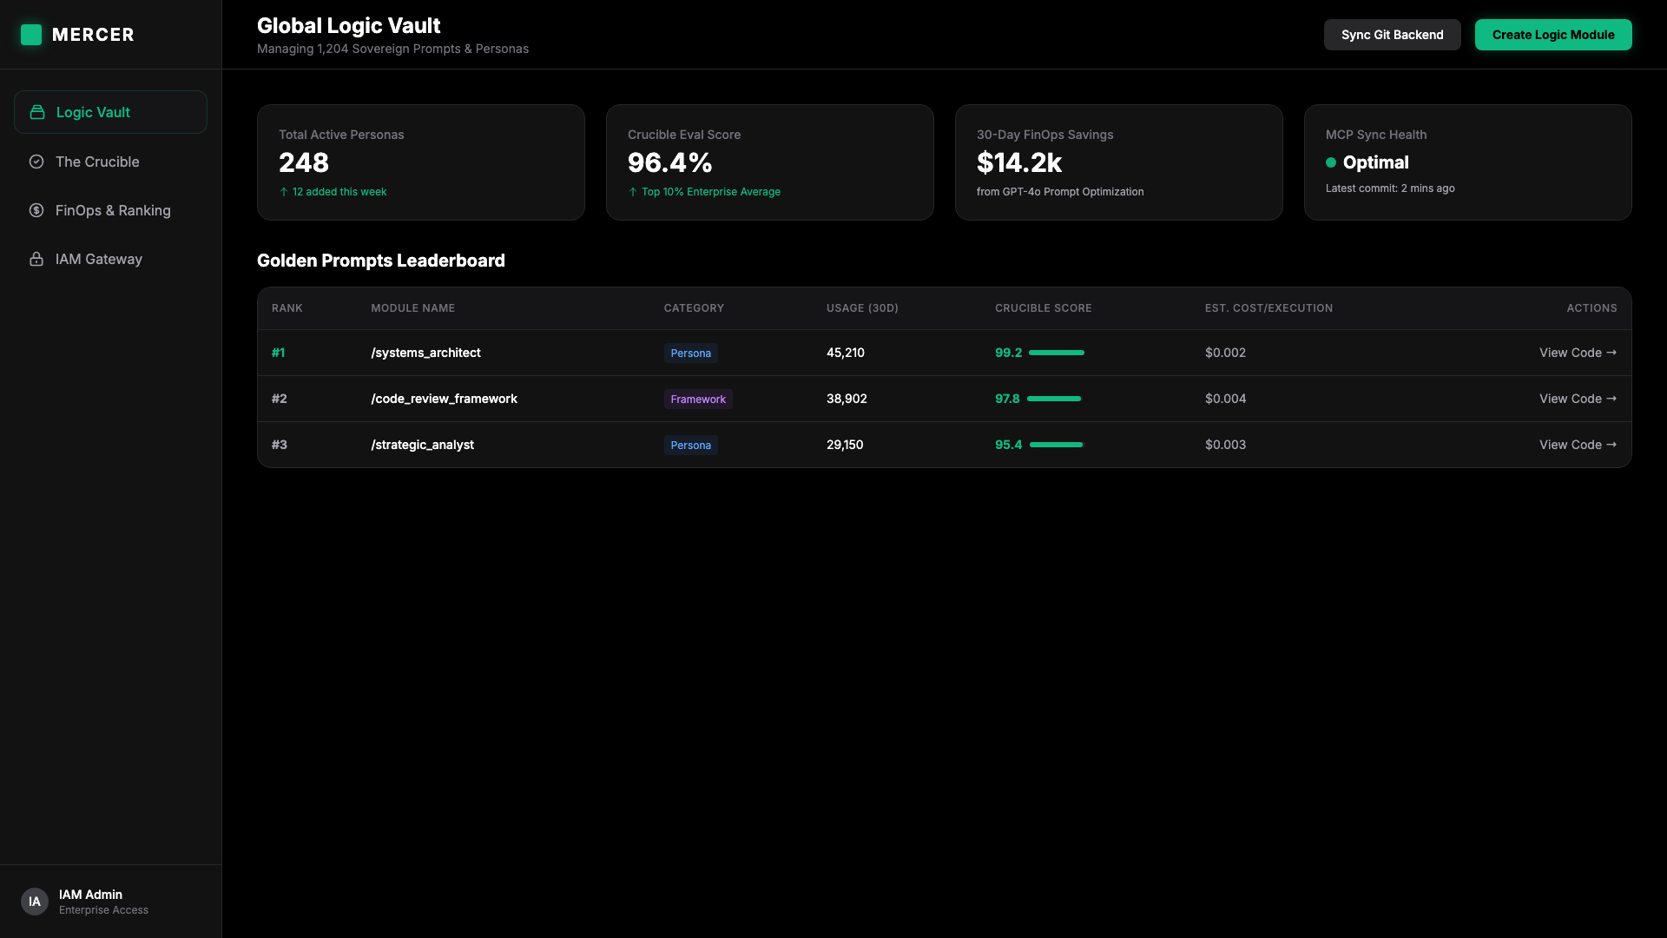
MERCER Web Portal.
Consumer-grade UI for Enterprise-grade Intelligence.

Slide 7
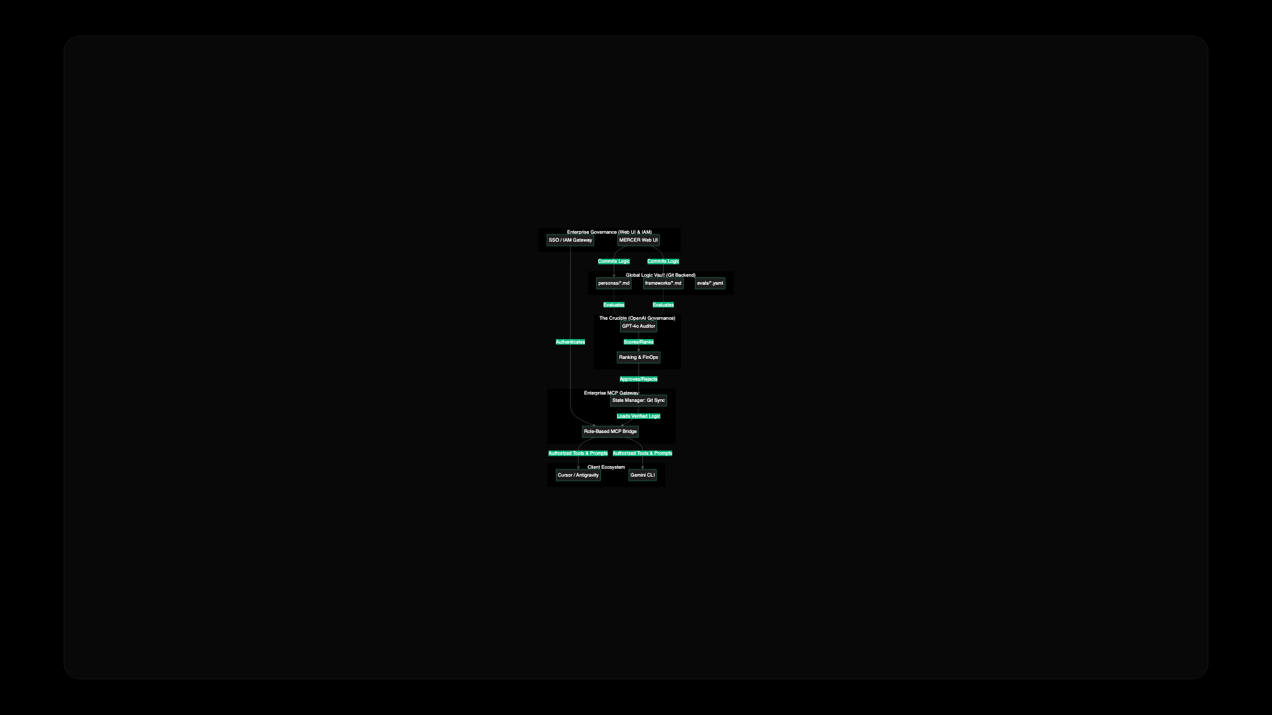
Enterprise Architecture.

Slide 8
Own Your Intelligence.
We version our code with surgical precision. It is time we do the same with our logic.
MERCER
Managed Enterprise Router for Context, Evaluation, and Roles

