Slide 1
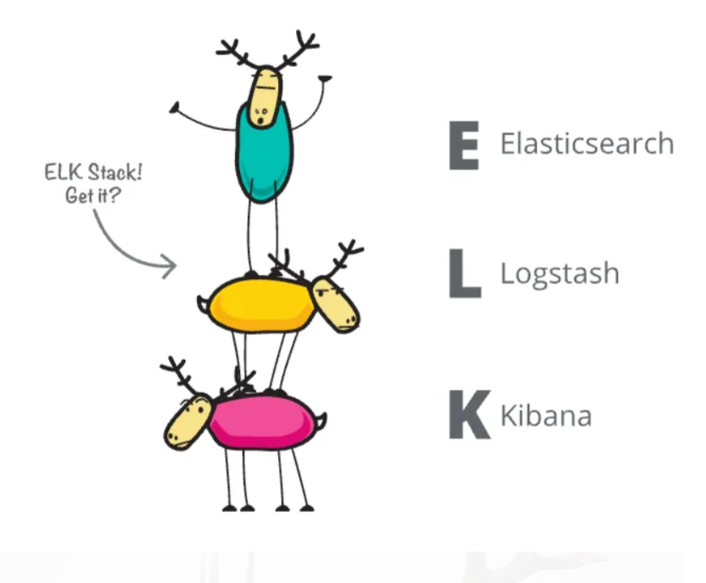
ELK Stack
Members: Hoang Linh Le - 617318
Quoc Thinh Le - 617291
Courses: Software Architecture
Professor: Rene De Jong

Slide 2
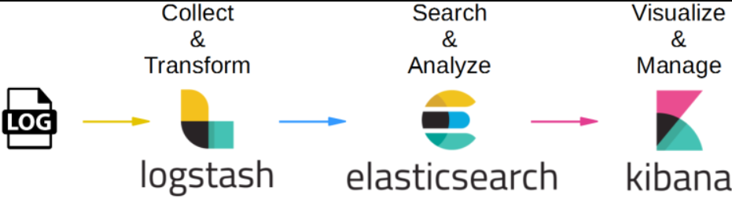
1. General Information About ELK

Slide 3
2. Our Demo
Eureka Server
Config Server
Product Service
Stock Service
API Gateway
Client Service

Slide 4
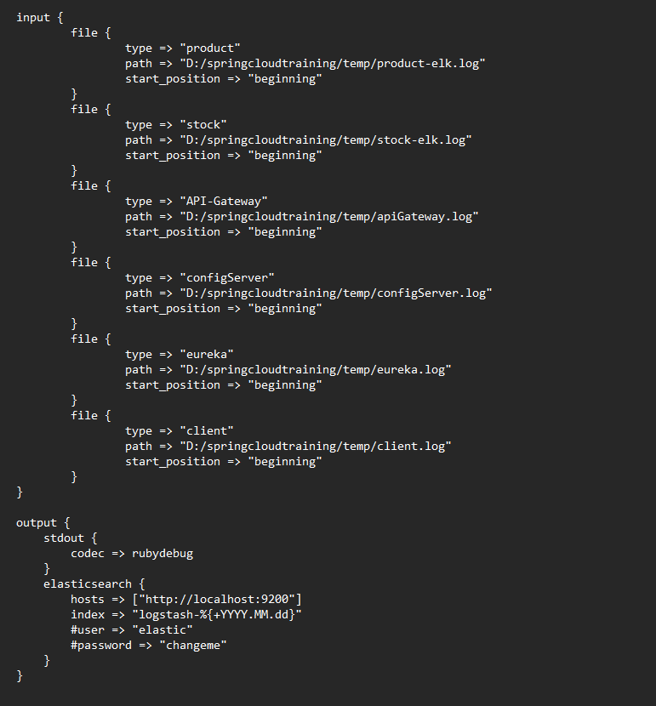
3. Logstash.conf

Slide 5
5. Steps to start (README):
Start ElasticSearch (elasticsearch.bat)
Start Kibana (kibana.bat)
Start Logstash (logstash.bat)
Start all the services in demo
Start generate logs by running Client Services
See result in Kibana (localhost:5601).

Slide 6

Thank For Listening

