Slide 1
Introduction
By: Guy Soffer

Slide 2
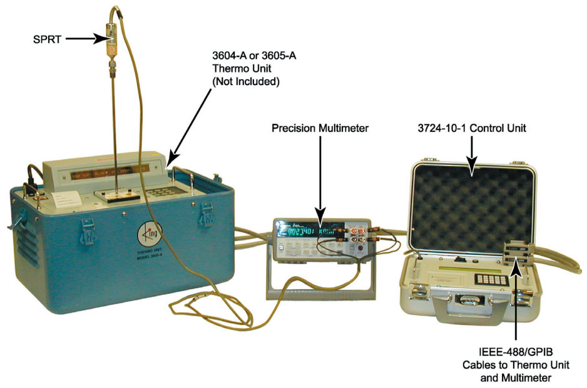
LEGACY STATION CONFIGURATION

Slide 3
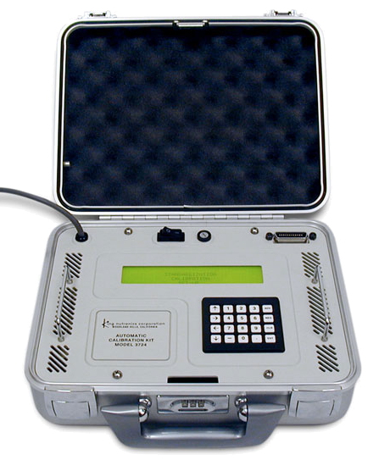
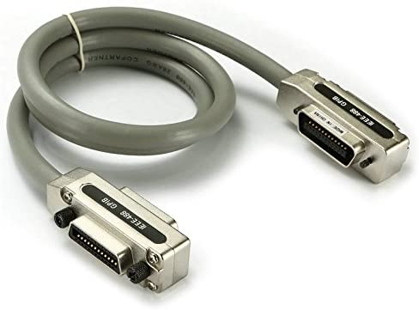
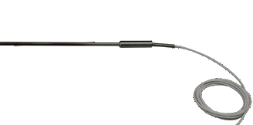
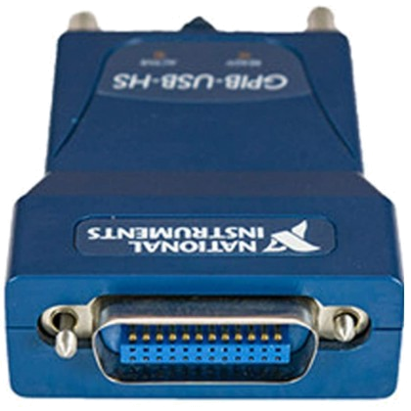

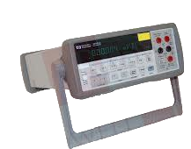
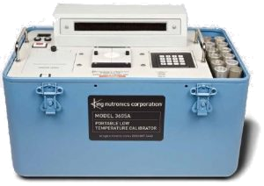
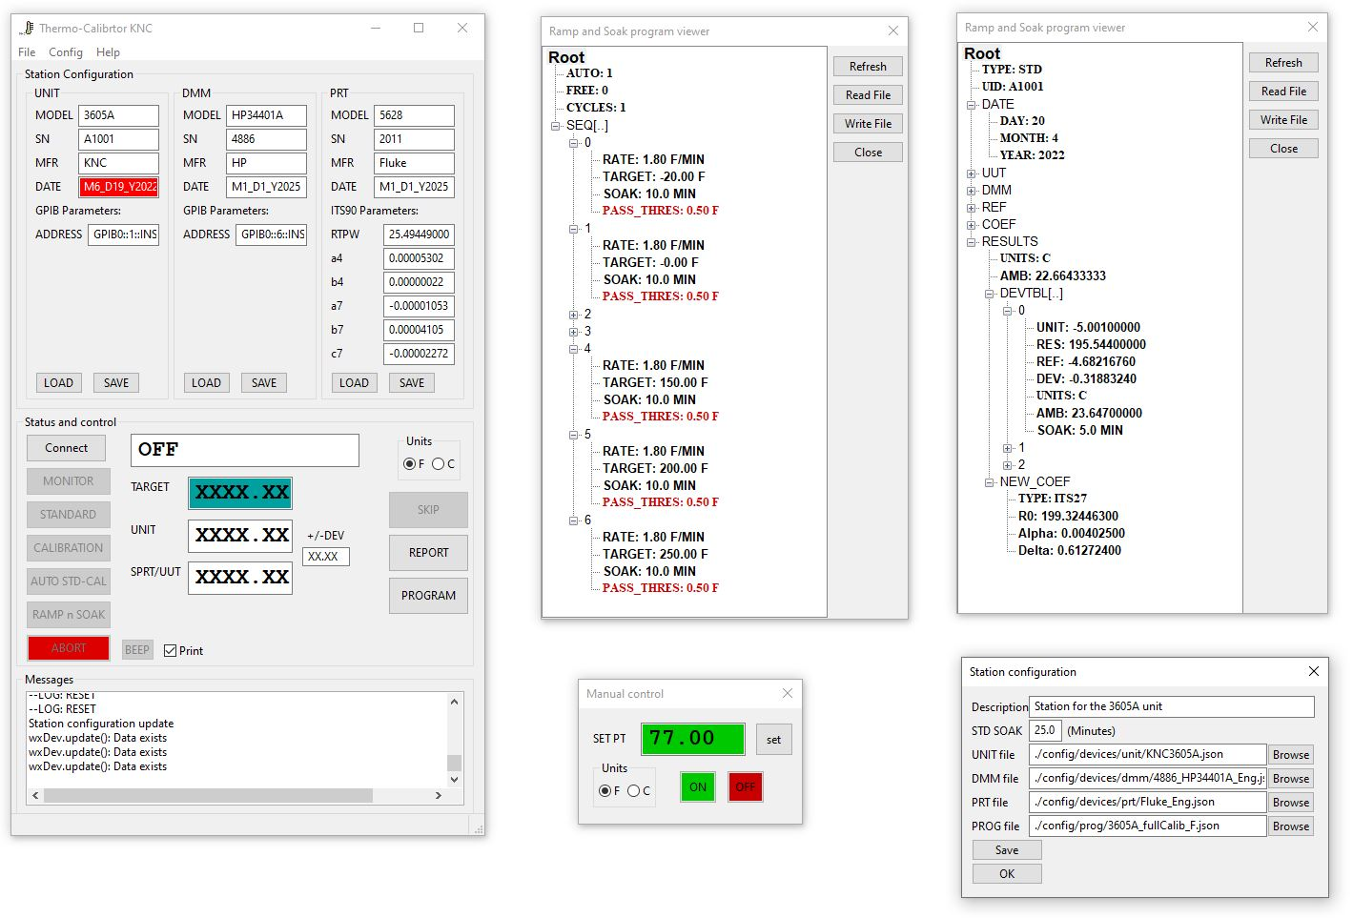

NEW STATION CONFIGURATION
1x
Optional
GPIB cable
Any computer with NI-GPIB-USB-HS
Replaces the legacy 3714
PRT/SPRT
DMM
Agilent 34401A
UNIT
By: Guy Soffer

Slide 4
Thermal-Calibrator Application Overview

Slide 5

A
Main screen
B
Procedure viewer
C
Report viewer
Station configuration
Manual control
E
D
By: Guy Soffer

Slide 6
Menus to access
files and tools
Station configuration
Real time status and control
Real time messages for debug
By: Guy Soffer

Slide 7

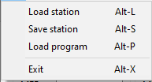

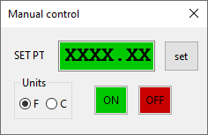
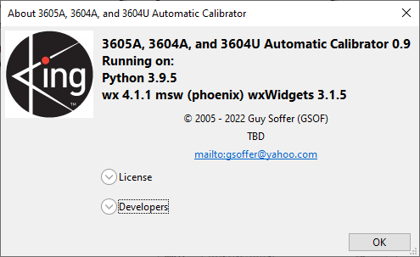

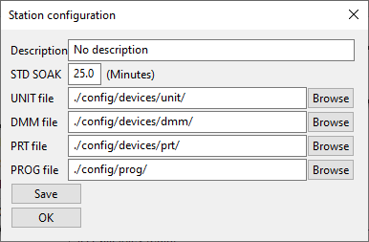
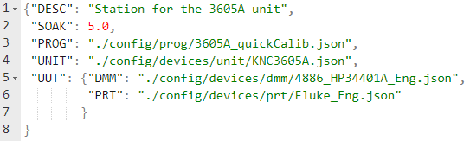
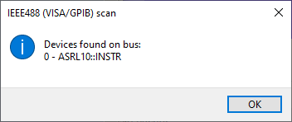
By: Guy Soffer

Slide 8
STATION CONFIGURATION

Slide 9
PRT/SPRT
DMM
UNIT
Station configuration file
Note:
Device detection tool
Station configuration editor / display
By: Guy Soffer

Slide 10
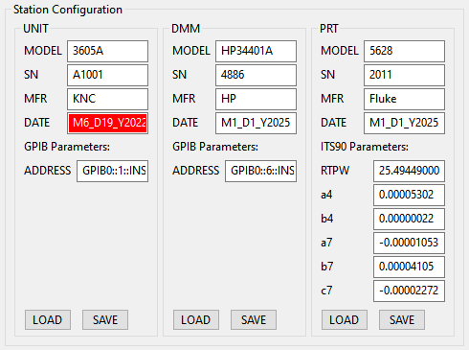
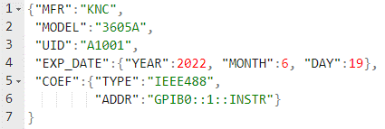
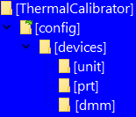
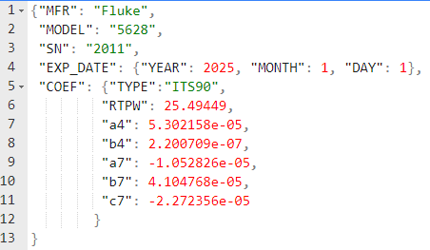
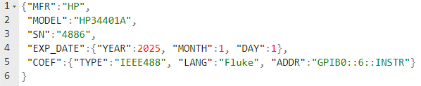
By: Guy Soffer

Slide 11
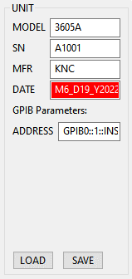
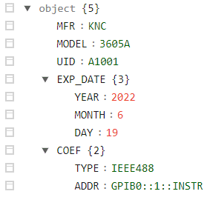
UNIT information
UNIT configuration source file (JSON)
UNIT data structure
Red background indicates that the date expired
GPIB bus#
0 if a single GPIB-USB-HS is used
Device#
KNC units are 1 by default
By: Guy Soffer

Slide 12
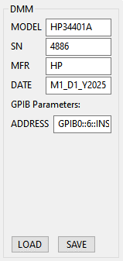
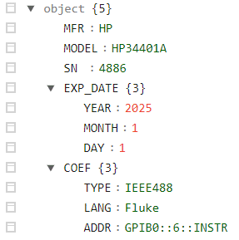
DMM information
DMM configuration source file (JSON)
DMM data structure
Should match the DMM configuration
“Fluke” or “SCPI”
Should match the DMM configuration
By: Guy Soffer

Slide 13
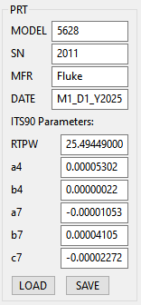
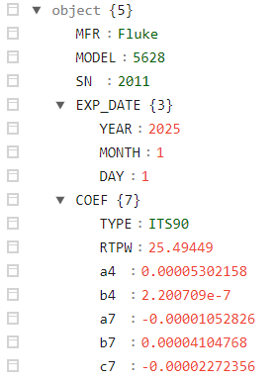
PRT information
PRT configuration source file (JSON)
PRT data structure
Should match the SPRT calibration report
By: Guy Soffer

Slide 14
STATION OPERATION

Slide 15
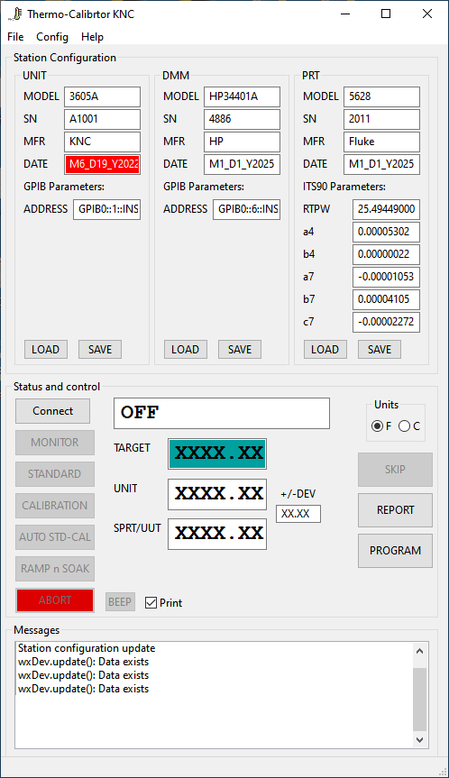
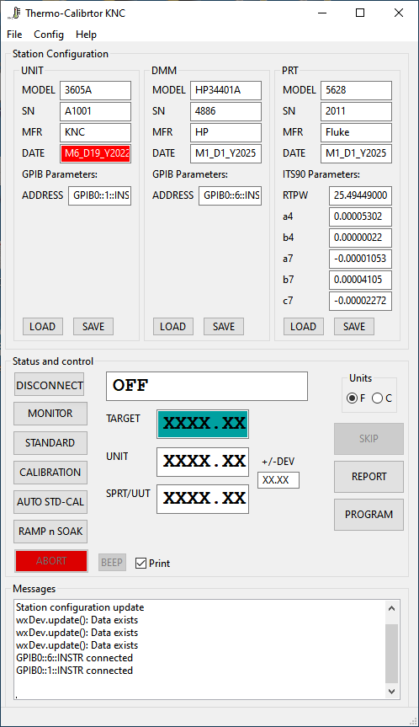
If connection successful
Click
Connect
Click disconnect
Operation buttons
disabled
Operation buttons
enabled
DMM and unit were detected
By: Guy Soffer

Slide 16
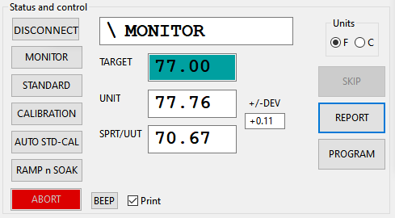
Unit’s status
Units selector
Connect / disconnect
Skip to the next temperature point
Procedures
Show the report
Show the ramp-and-soak program
Abort running procedure and turn off the unit’s well
Temperatures
Make the unit BEEP
Enable / disable the unit’s printer
Unit’s temperature minus SPRT
By: Guy Soffer

Slide 17
MONITOR or MANUAL CONTROL

Slide 18
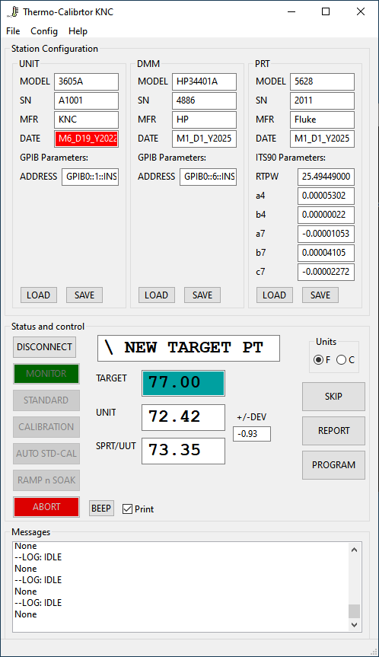
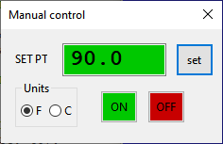
If the unit is present on the GPIB bus, it can be manually controlled via the “Manual control” dialog box (under the “Config” menu.
The “MONITOR” mode supports stations with unit only, SPRT only, or both connected configurations.
The TARGET and UNIT fields will be updated if the unit is present on the GPIB bus.
The SPRT/UUT field will be updated if the DMM is present on the GPIB bus.
By: Guy Soffer

Slide 19
STANDARDIZATION

Slide 20
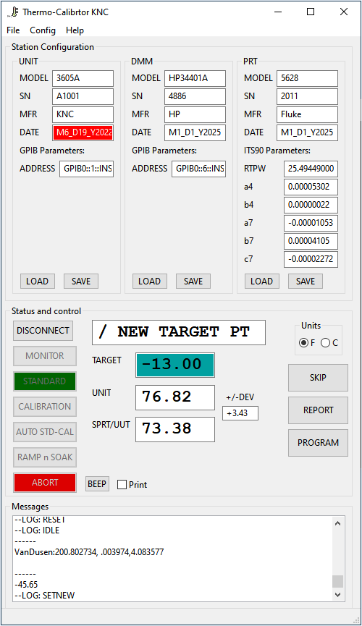
Both the unit and DMM must be present on the GPIB bus.
The SPRT/UUT field will be updated if the DMM is present on the GPIB bus.
Advance to the next standardization point.
Show the standardization report.
Not applicable in standardization mode.
Note: The unit must be place an CAL mode with activated IEEE mode. Refer to unit’s user manual to further instructions.
By: Guy Soffer

Slide 21
CALIBRATION

Slide 22
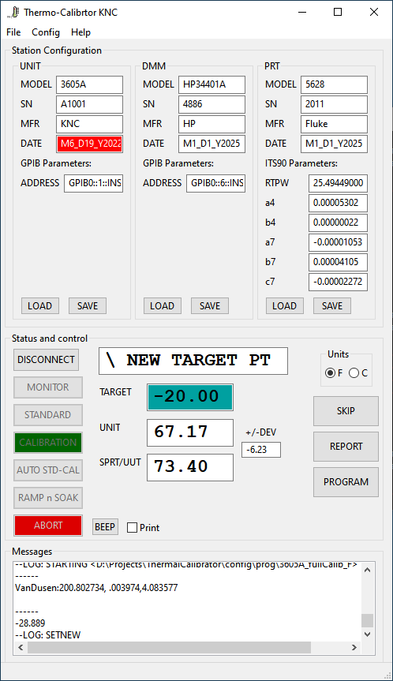
Both the unit and DMM must be present on the GPIB bus.
The SPRT/UUT field will be updated if the DMM is present on the GPIB bus.
The calibration protocol (target points, dwell times, and pass/fail criteria) is in a standard “Ramp-and-Soak” program <3605A_fullCalib_F.json>.
A quick calibration procedure can be run by loading the program <3605A_quickCalib.json> before starting the procedure. Different calibration procedures can added as well.
Advance to the next calibration point.
Show the calibration report.
Show the calibration procedure steps.
By: Guy Soffer

Slide 23
AUTOMATIC STANDARDIZATION AND CALIBRATION

Slide 24
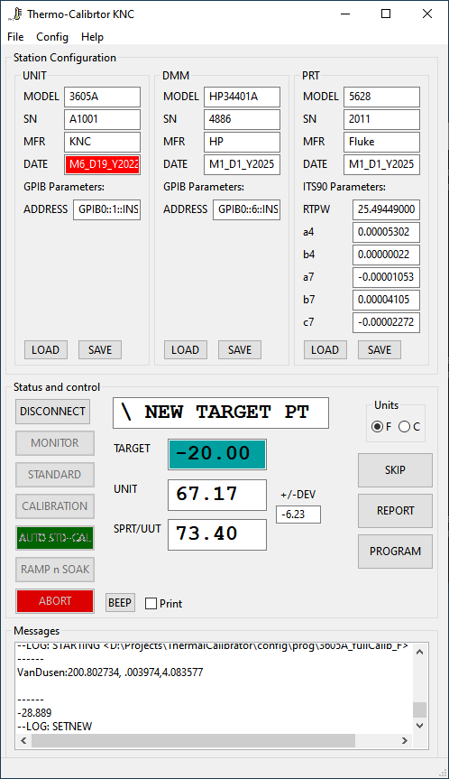
Both the unit and DMM must be present on the GPIB bus.
First the standardization procedure will run.
Than, the calibration procedure will begin.
The natural cooling time of 5 min is inserted between the end of the STD to the beginning of the CAL.
Advance to the next standardization / calibration point.
Show the current procedure report.
Show the calibration procedure steps.
By: Guy Soffer

Slide 25
RAMP AND SOAK PROGRAM

Slide 26
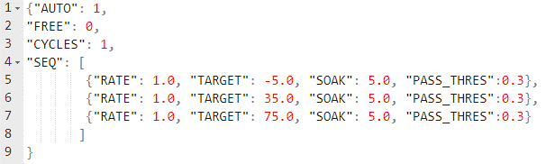
User defined test protocols (Ramp-and-Soak)
Load a program and start a “Ramp And Soak” process
Automatically transition between test points
Example of a quick calibration test program
<3605A_quickCalib.json>
Soak time after unit’s temperature is stable
How many times to repeat the sequence
The test sequence
Not implemented
(°C/minute)
Soak / dwell time (minutes)
Pass / fail criteria (°C)
Target temperature (°C)
Note: All temperature values must be entered in °C units.
By: Guy Soffer

Slide 27
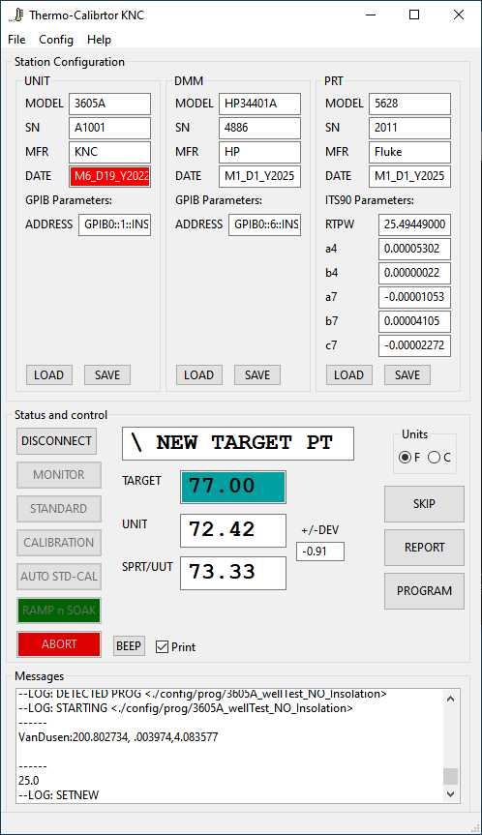
Depend on Ramp-and-Soak program configuration, only the unit or both the unit and DMM must be present on the GPIB bus.
Advance to the next target point.
Show the test report.
Show the test procedure steps.
By: Guy Soffer

Slide 28
WELL PERFORMANCE TESTING

Slide 29
WELL TESTING
STATION CONFIGURATION
Any computer with NI-GPIB-USB-HS
UNIT
Note: DMM and SPRT are optional and no being used during the well testing procedure.
By: Guy Soffer

Slide 30
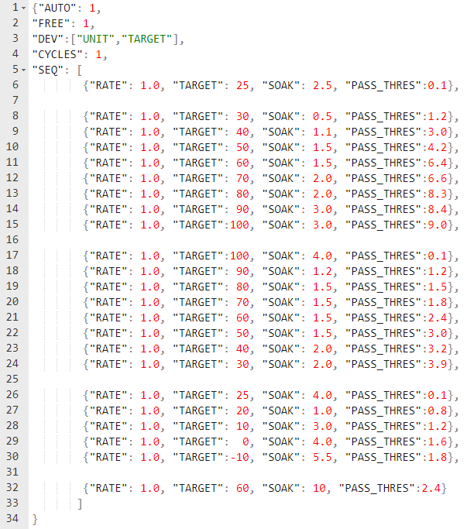
Protocol for testing the thermal performance
Load a program and start a “Ramp And Soak” process
Results of good well
Red lines indicate minimum and maximum acceptance criteria
Black line indicates the measured well’s temperature
<3605A_wellTest_NO_Insolation.json>
FREE = 1: Dwell timer starts immediately after setpoint is set
Results of defective well
Deviation is calculated between unit and set-point
By: Guy Soffer

Slide 31
Test Report

Slide 32
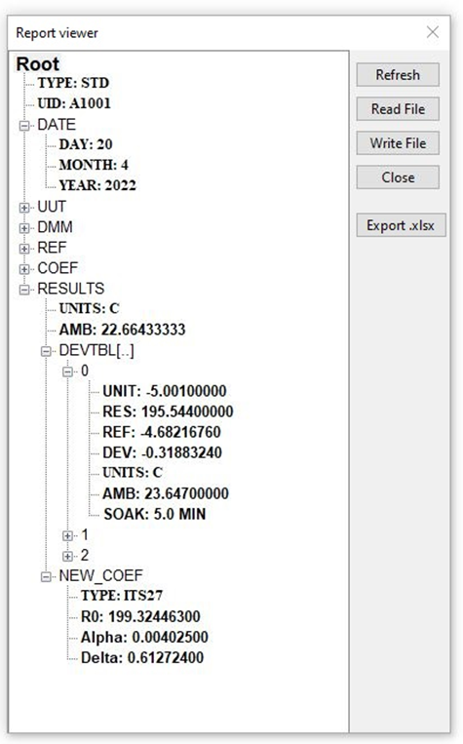

Double click “Root” to expand
Type of test
STD, CAL, MEAS
Refresh the report of a running test
Read a saved report
Station configuration during the test
Save the report to a JSON file
Generate an excel report file
Average ambient temperature during the test
Measurements at each temperature point
In case of standardization, the new calculated coefficients
Note: The reports can displayed in °C or °F units. Select the desired units in the application’s main screen before opening the report viewer windows.
By: Guy Soffer

Slide 33
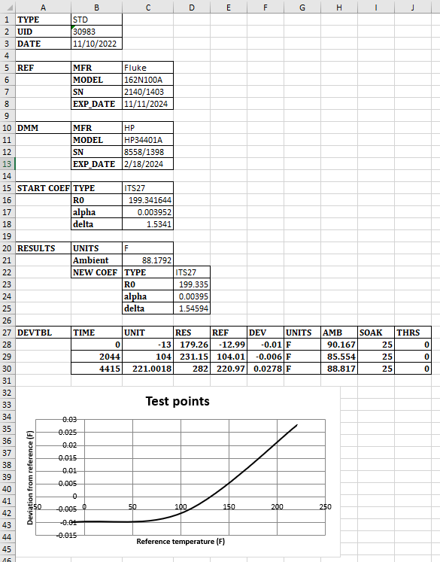
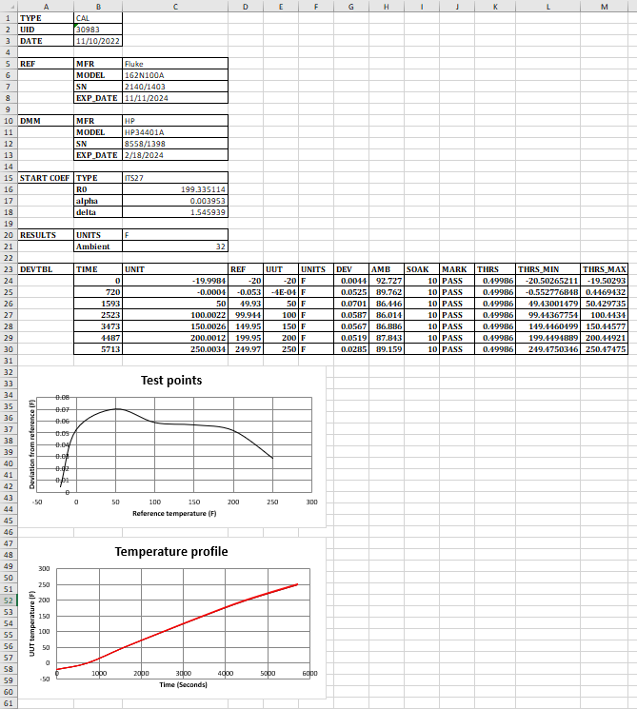
Standardization report in excel format
Calibration report in excel format
Station
setup
Station
setup
The new coefficients
Results
Results
Note: The reports can be generated in °C or °F units, depends on the Report viewer window.

Slide 34
INSTALATION

Slide 35
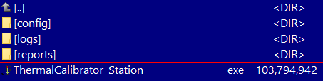
1. Download and install the NI IEEE488.2 drivers for windows
https://www.ni.com/en-us/support/downloads/drivers/download.ni-488-2.html#467646
2. Download the ThermoCalibrator application
https://drive.google.com/file/d/1KcgN22rnByD-dbM9KaY9K4KyVqcFsqsT/view?usp=share_link
3. Unzip the ThermoCalibrator files into the desired folder

Slide 36
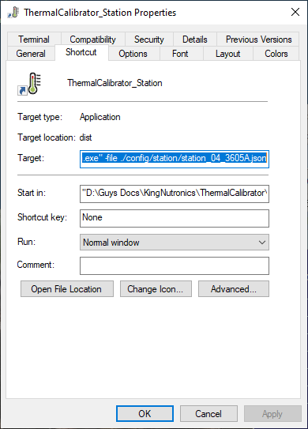
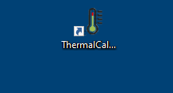
4. Make a shortcut on the desktop. The link can include the station configuration file to load on start.
"D:\KNC\ThermalCalibrator\ThermalCalibrator_Station.exe" -file ./config/station/station_04_3605A.json
The path and file name of the station configuration file to load on start
Right click and select
“Properties”

