Slide 1
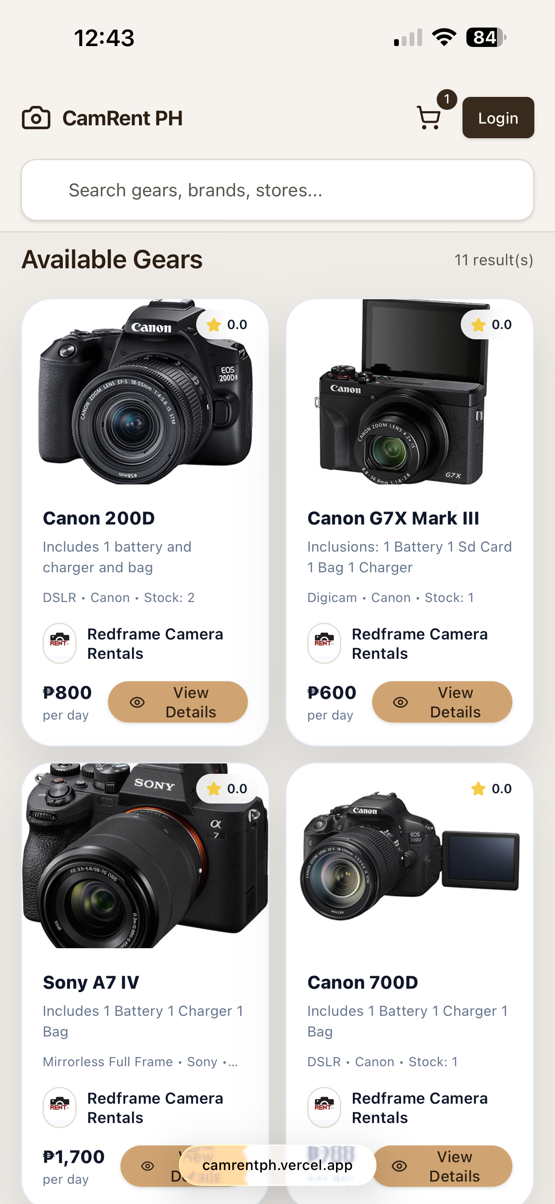
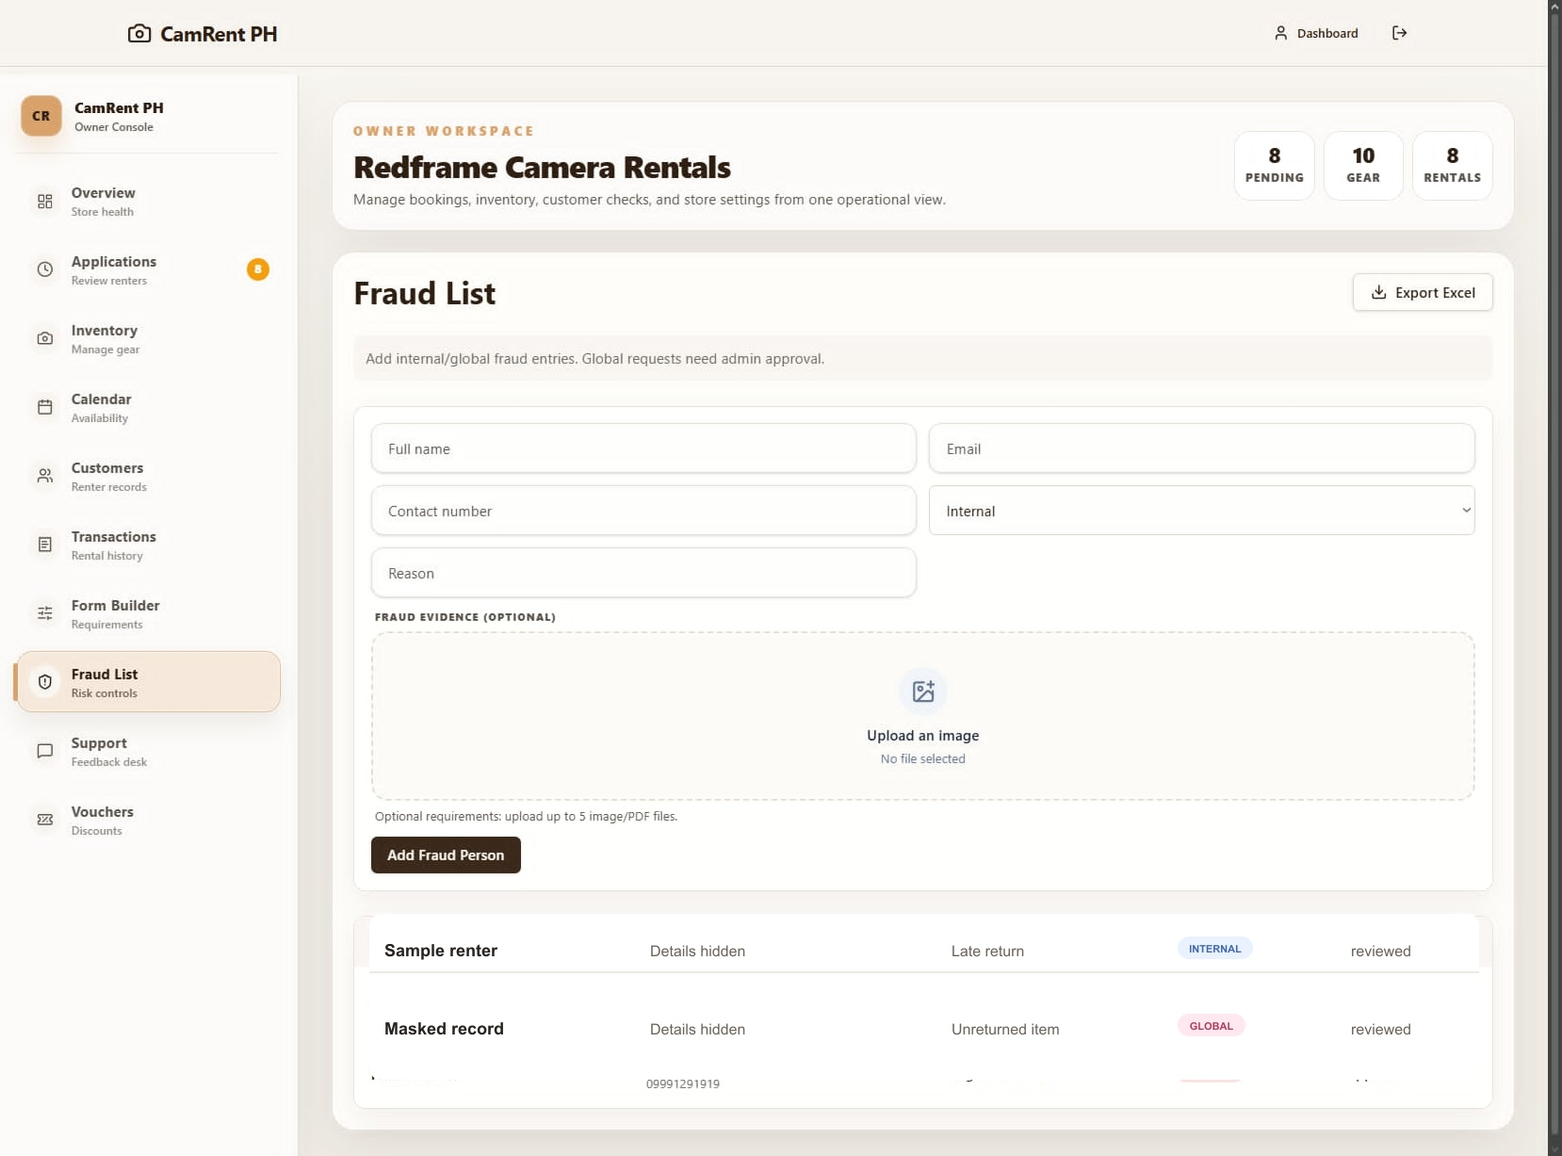
CamRent
PH
BETA
TESTERS
WANTED
Help shape the safer way to
manage camera rentals in the
Philippines.
Get early access to rental tracking, inventory
tools, booking review, and renter risk signals
informed by 5 years in the industry.
!
Redflag list access
Review renter history before
approval
01
Rental dashboard
02
Gear inventory
03
Redflag renters
04
PH community
FREE BETA ACCESS
camrentph.vercel.app
For camera, lens, and accessory rental owners
Connect with other CAMRENT PH owners

