Slide 1

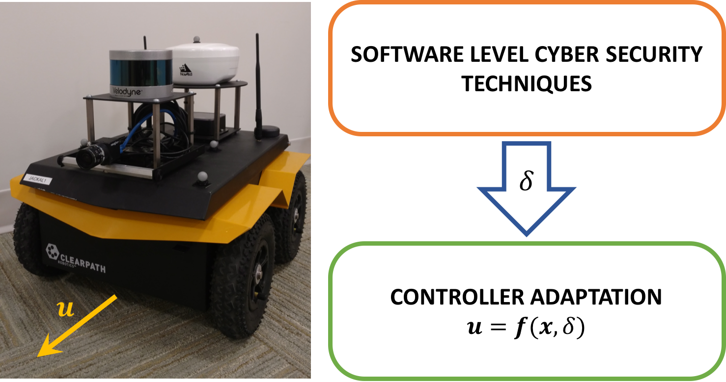
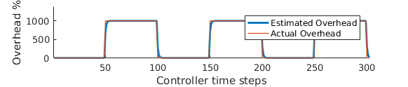
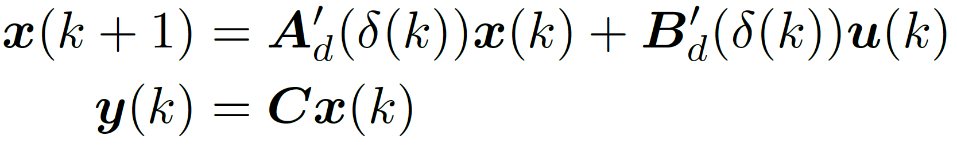
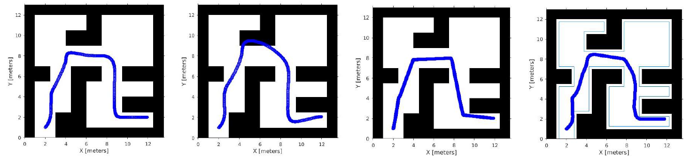
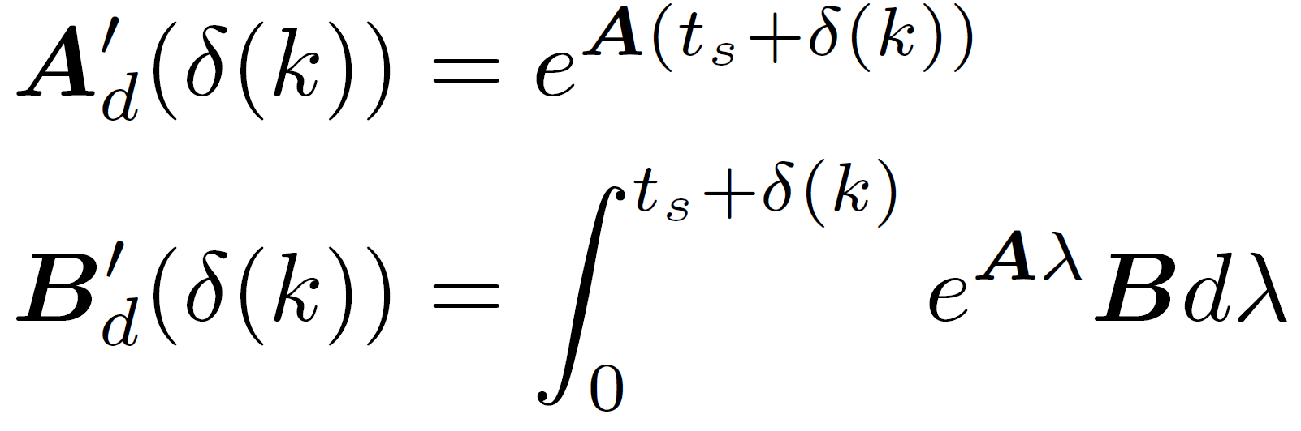
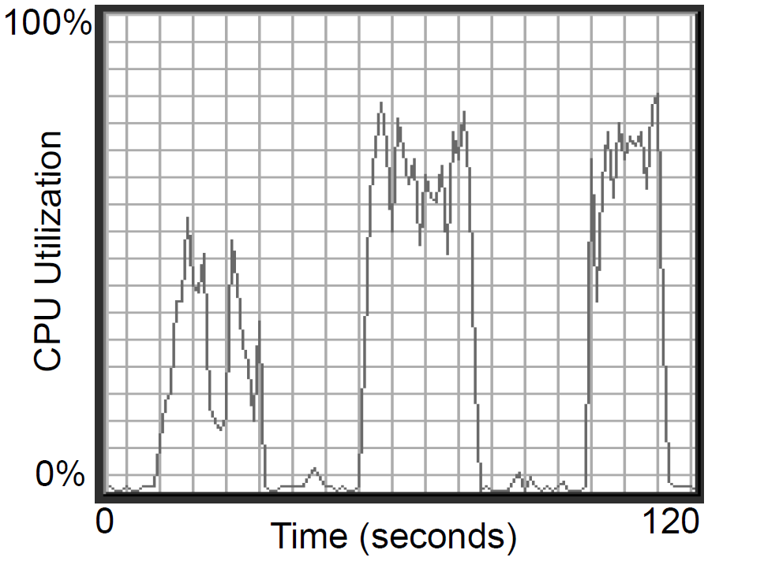
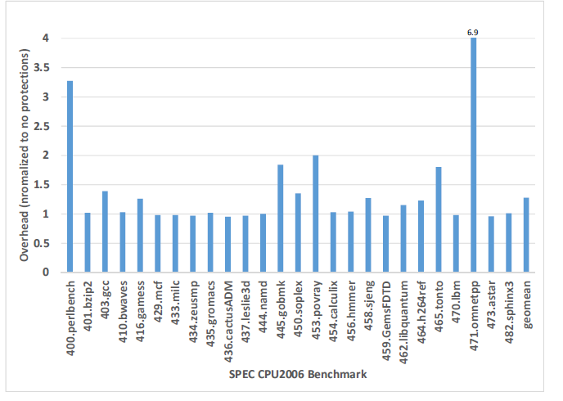
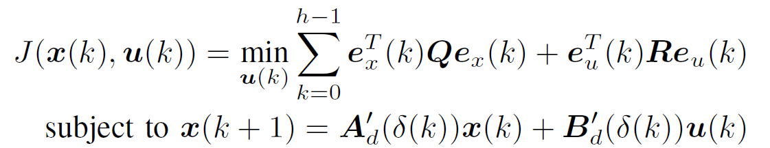
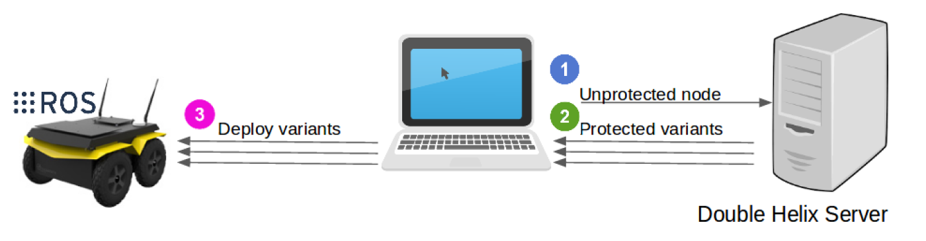


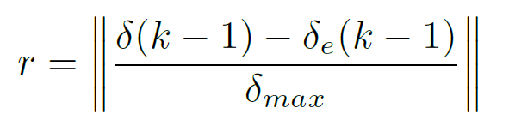
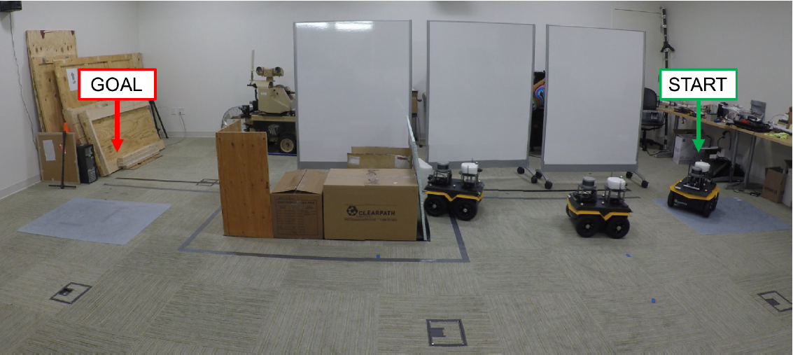
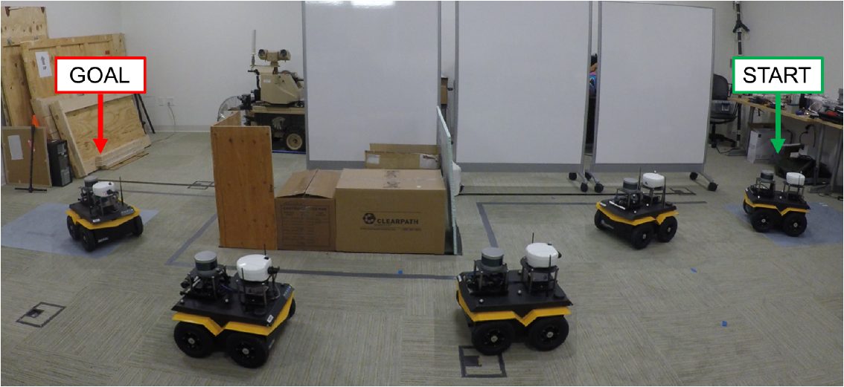
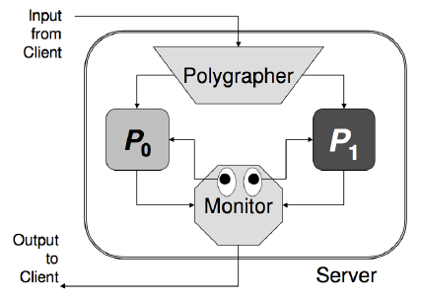





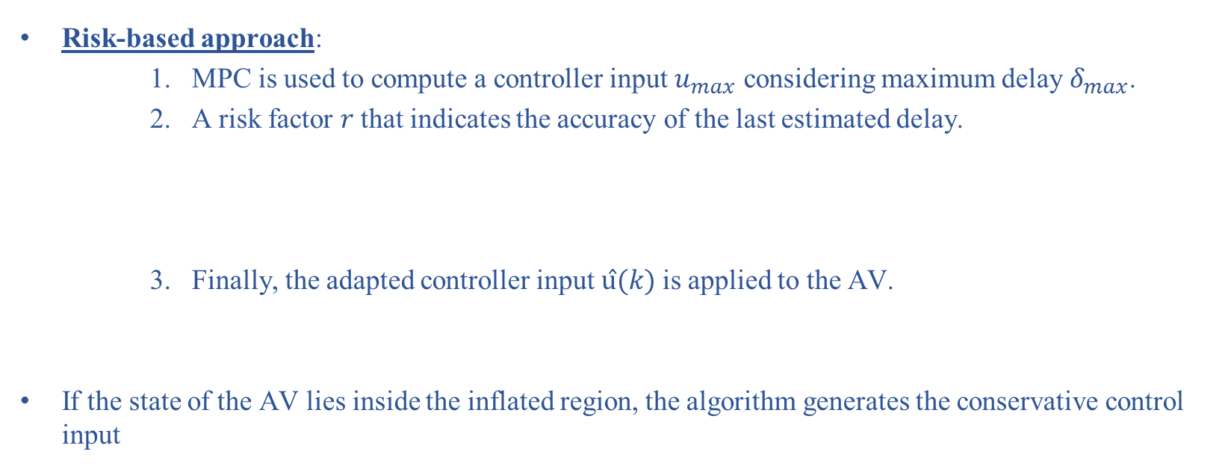
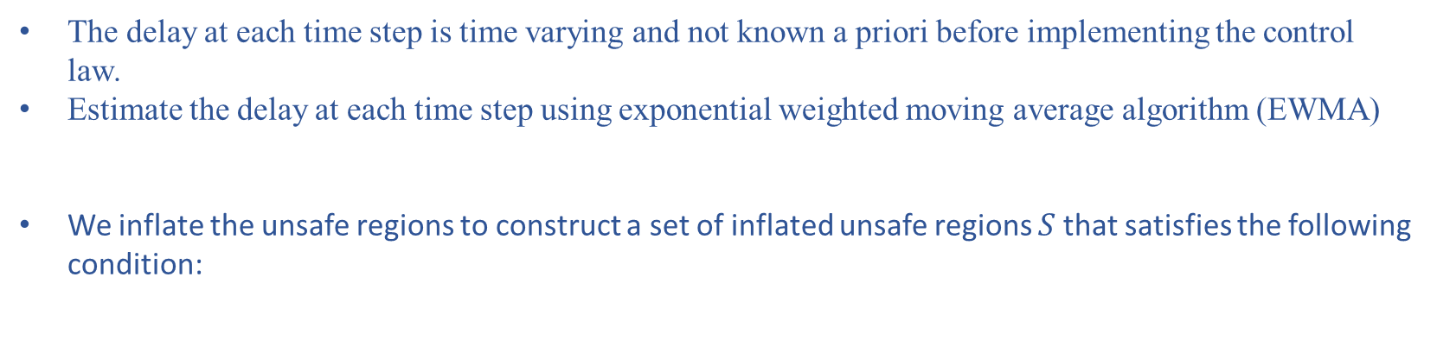
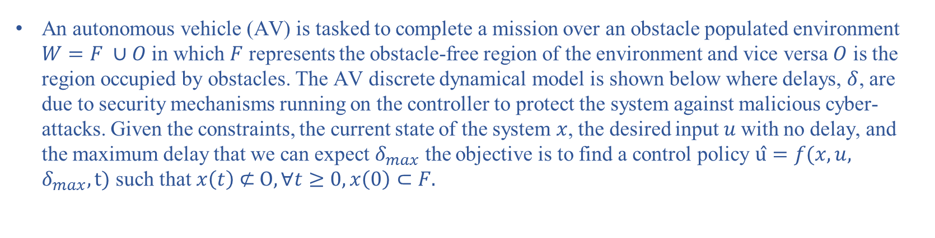
AHS’17
Online Control Adaptation for Safe and Secure Autonomous Vehicle Operations
Mahmoud Elnaggar¹, Jason D. Hiser², Tony X. Lin³, Anh Nguyen-Tuong², Michele Co², Jack W. Davidson², and Nicola Bezzo^{1,3}
¹Department of Systems and Information Engineering, ²Department of Computer Science, ³Department of Electrical and Computer Engineering
University of Virginia
INTRODUCTION
PROBLEM FORMULATION
SIMULATONS
Modern cyber-physical systems are not built with cyber-security in mind.
Adding cyber-security incurs runtime overheads that results in performance degradation and safety issues.
An autonomous vehicle (AV) is tasked to complete a mission over an obstacle populated environment $W=F ∪O$ in which $F$ represents the obstacle-free region of the environment and vice versa $O$ is the region occupied by obstacles. The AV discrete dynamical model is shown below where delays, $δ$, are due to security mechanisms running on the controller to protect the system against malicious cyber-attacks. Given the constraints, the current state of the system $x$, the desired input $u$with no delay, and the maximum delay that we can expect $δ_{max}$ the objective is to find a control policy $û=f(x,u,$ $δ_{max},t)$ such that $x\left(t\right) \text{⊄} O, ∀t≥0, x\left(0\right)⊂F.$
Simulations:
MOTIVATION
Scenario | Task Execution Time(s)
No overhead | 6.3
Overhead + conservative controller | 43.4
Overhead + online adaptation | 18.1
Numerous software techniques that have been developed to protect cyber systems from attacks.
System-level software security techniques:
Anti-virus and intrusion-detection systems.
monitor the entire system for indications of compromise.
Application-level software security techniques:
Control Flow Integrity (CFI):
Instruments the application to enforce the intended control flow at run time.
The overhead on an application can vary depending on the inputs it processes.
The N-variant system (DoubleHelix¹):
Employs the systematic application of artificial diversity to prevent large classes of attacks.
Provides formal proofs that certain classes of attacks are not possible and system can recover from an attack and continue operation.
The performance overheads can reach up to 400%.
ONLINE CONTROLLER ADAPTATION
The online controller adaptation uses Model Predictive Control (MPC)
Experiments:
Integrating Software Level Cyber Security Techniques On A Real Autonomous Vehicle:
Double Helix is used to protect ROS nodes for mapping and navigation.
We recorded the performance overhead imposed by the protected controllers measuring delays up to 30%.
Online Adaptation Control with Unknown Overhead:
The delay at each time step is time varying and not known a priori before implementing the control law.
Estimate the delay at each time step using exponential weighted moving average algorithm (EWMA)
We inflate the unsafe regions to construct a set of inflated unsafe regions $S$that satisfies the following condition:
Type of overhead | Slam_gmapping | Move_base
CPU load | 17.8% | 12.5%
Memory consumption | 3.0% | 2.56%
Risk-based approach:
MPC is used to compute a controller input $u_{max}$ considering maximum delay $δ_{max}$.
A risk factor $r$that indicates the accuracy of the last estimated delay.
Finally, the adapted controller input$û(k)$ is applied to the AV.
If the state of the AV lies inside the inflated region, the algorithm generates the conservative control input
CONCLUSION AND FUTURE WORK
We can achieve a good performance in terms of time while maintaining safety and security constraints.
Extension to aerial vehicles.
Use ML techniques to estimate the delays and adapt the controller input accordingly.
Notes:
TEXT TOO SMALL, at least 24 and titles 32
Consistency with fonts: use calibri everywhere
Not a Motivation but Cyber-security techniques
Problem formulation need to be trimmed down
No need to say ”the online controlelr adaptation uses model predictive control..instead say MPC to calculate the sequence of inputs
Delay is time varying and not known a priori
Estimation of delay using EWMA
Unsafe region sentence do not make sense ???? Add figure on the side of the equation
Last column: Remove Simulations and Experiemnts and just put Simulations and then experiments
Shrink the table…too much space
Remove ”we” ..it’s a poster…go doirectly to the point
What’s ML?
Add delay patetrn near figure of delay in simulation
Add titles on each snapshot

