Slide 1
Canada Sports and Health Web Application
Abdul Haqani, Mohammad Raahemi, Amir Hajianpour

Slide 2
The Problem:
Availability of sports event and classes
Quality of the classes and the feedback that organizations need

Slide 3
The Solution:
Designing a Web Application

Slide 4
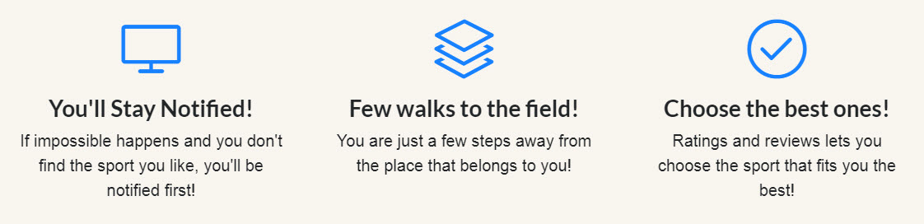
Features:

Slide 5
Features:
Local Search

Slide 6
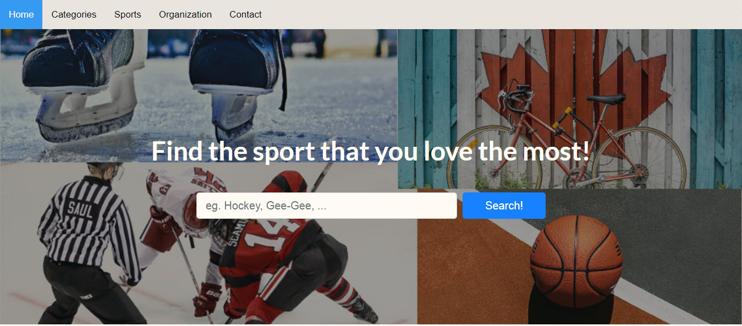
Interface:

Slide 7
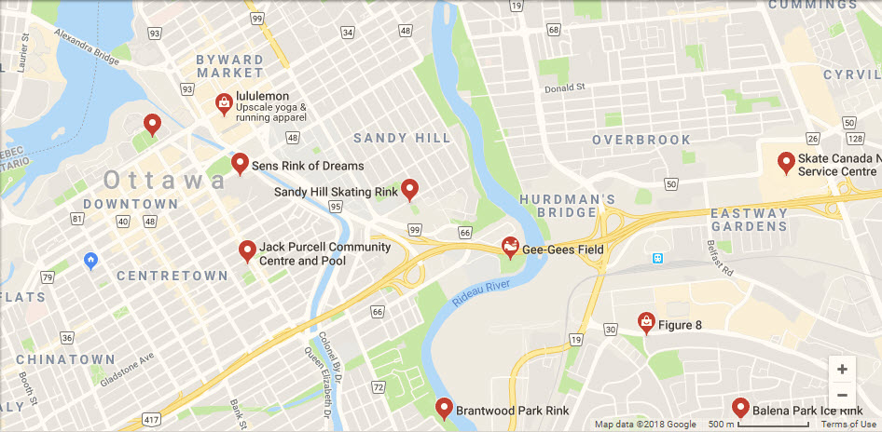
Features (cont.):

Slide 8
Features (cont.):
Rating and Reviews

Slide 9
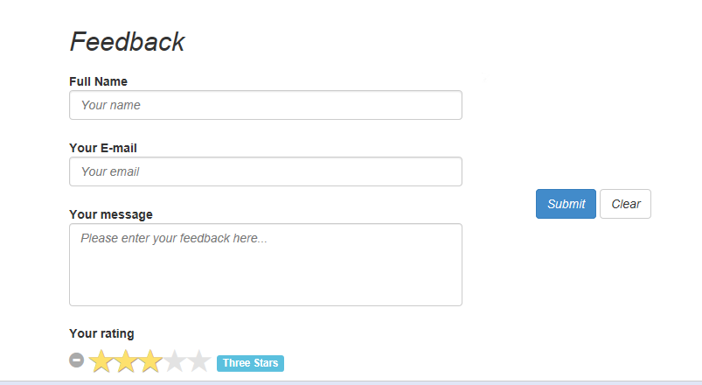
Features (cont.):

Slide 10
Features (cont.):
Notification System

Slide 11
Future:
It’s a Web Application
It Never Stops Improving!

Slide 12
Thank you!

