Slide 1



Multi-Class Animal Recognition
For Wildlife Conservation
Submitted By:
Name: Aashish Chaudhary
AICTE Student ID: STU66f8e766652761727588198
AICTE Internship ID: INTERNSHIP_173855432067a03bd0ddfb6

Slide 2

Learning Objectives
CNN for Animal Recognition – Learned to implement Convolutional Neural Networks (CNN) for classifying animal images.
MobileNetV2 Application – Utilized MobileNetV2 for efficient, lightweight deep learning in animal recognition.
Multi-Class Model Building – Developed a CNN model capable of classifying 90 different animal species.
Accuracy & Performance Analysis – Evaluated model performance using accuracy, precision, and confusion matrix.
Wildlife Conservation Applications – Explored AI’s role in wildlife monitoring, anti-poaching, and habitat surveillance.
GOAL
Source :
www.freepik.com/

Slide 3
Tools and Technology used
Programming Language: Python
Deep Learning Frameworks: TensorFlow & Keras
Pre-trained Model: MobileNetV2 (for efficient image recognition)
Development Environment: Google Colab (cloud-based Jupyter notebooks)
Data Processing & Visualization: NumPy, Matplotlib, Seaborn
Dataset: Animal Image Dataset (90 Classes) from Kaggle

Slide 4
Methodology
Data Collection – Acquired a Kaggle dataset containing 90 animal classes for training and testing.
Data Preprocessing – Cleaned, resized, and augmented images to improve model generalization.
Model Selection – Used MobileNetV2 with transfer learning for efficient animal recognition.
Model Training – Fine-tuned the model on Google Colab using TensorFlow/Keras.
Model Evaluation – Measured accuracy, precision, and recall to assess performance.
Testing – Validated the model on new images to ensure real-world usability.

Slide 5
Problem Statement:
Wildlife Threat – Animal populations are declining due to habitat loss and poaching.
Inefficient Tracking – Manual wildlife monitoring is slow and ineffective for large areas.
Need for Automation – Requires AI to instantly identify animals from images/videos.
Endangered Protection – Must detect rare species to prevent extinction and stop poaching.
Multi-Class Challenge – System should classify animals into 90+ categories for accurate tracking.

Slide 6
Solution:
MobileNetV2 Model – Deployed lightweight pre-trained CNN for efficient animal recognition.
90-Class Classifier – Custom Softmax layer accurately categorizes diverse species.
High Native Accuracy – Achieves strong performance without added regularization.
Mobile Optimization – Runs on edge devices for real-time field deployment.

Slide 7
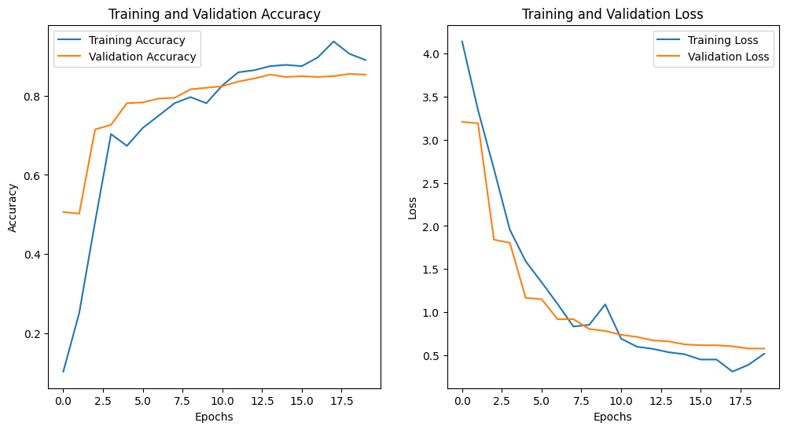
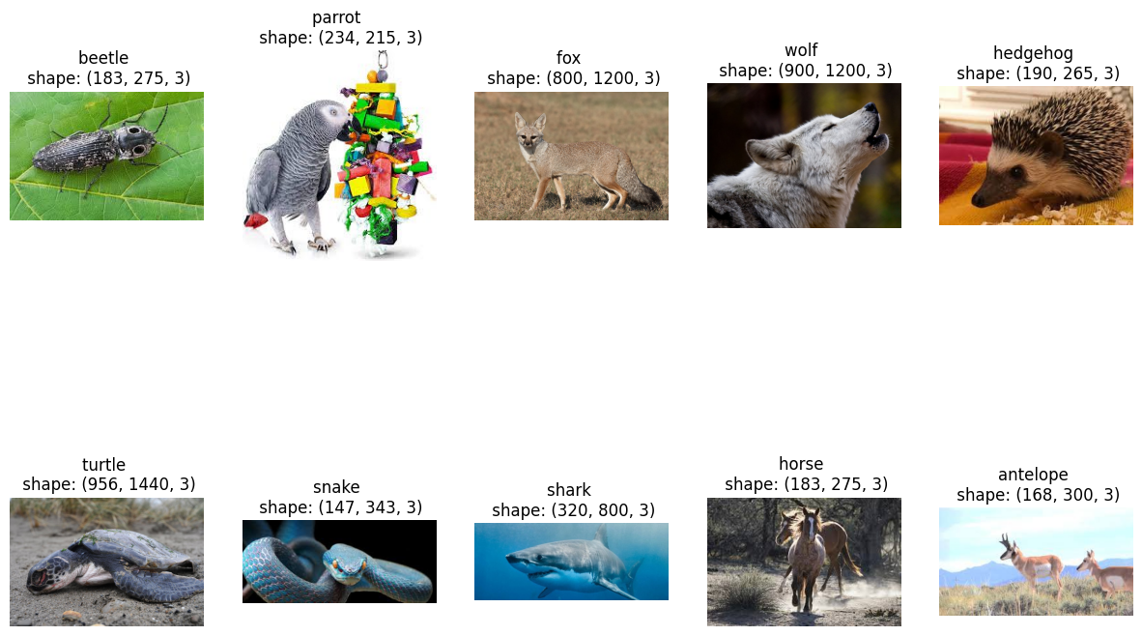
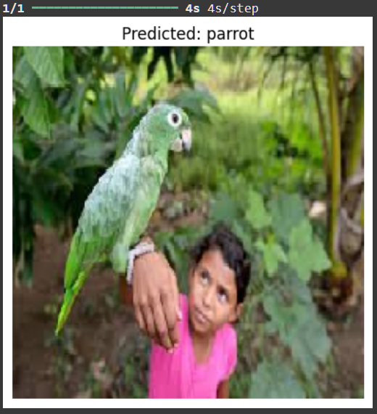
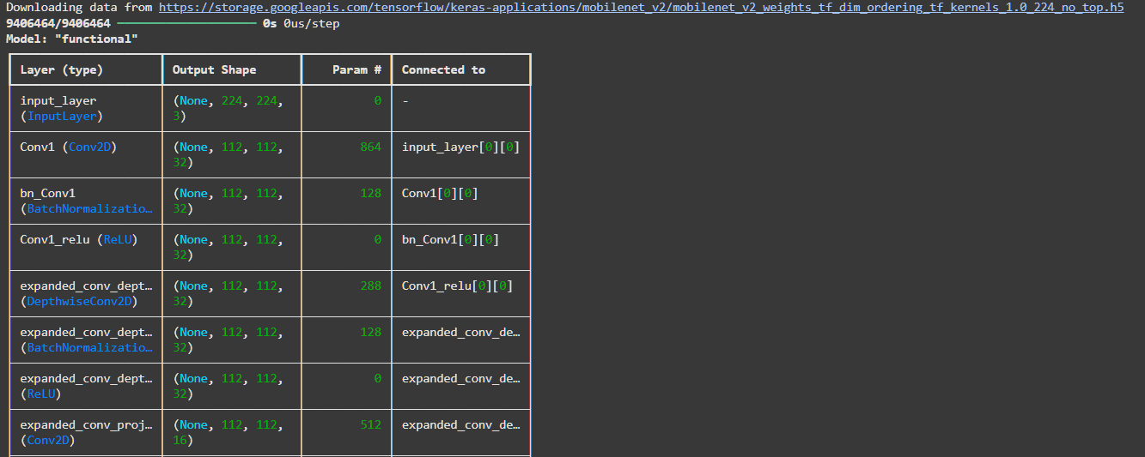
Screenshot of Output:

Slide 8
Conclusion:
86% Accuracy Achieved - Using MobileNetV2 transfer learning model
Scalable Solution - Handles high class count (90+ animals) effectively
Real-Time Ready - Optimized for mobile/edge device deployment
Future: Model Optimization - Early stopping, advanced regularization
Future: Object Detection - Can integrate YOLO/SSD for better tracking
Conservation Impact - Potential for camera traps and anti-poaching systems
GitHub Link - https://github.com/mraasary/MultiClass_Animal_Classification.git

