Slide 1
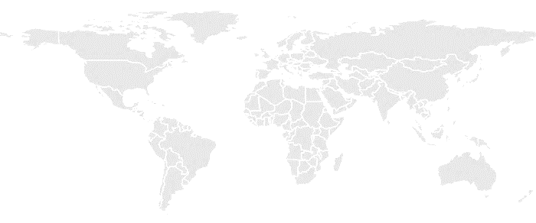


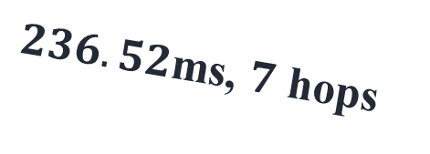
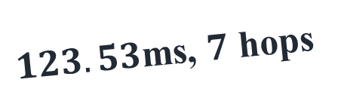
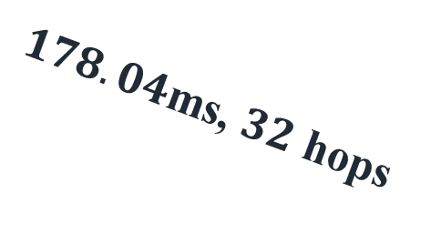
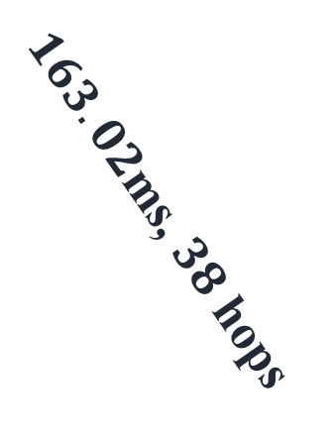

Client
Paris
Seoul
$123.53$ms, $7$ hops
$176.09$ms, $35$ hops
California
$236.52$ms, $7$ hops
37.63ms, 23 hops
$178.04$ms, $32$ hops
$163.02$ms, $38$ hops
Mumbai
Sao Paulo
Sydney

