Slide 1

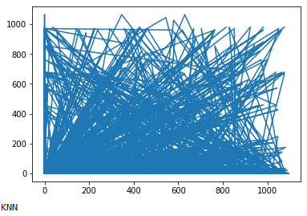
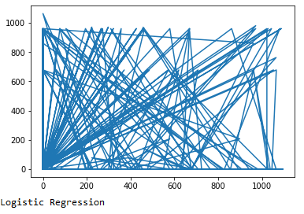
AI Project
2016-CS-101
2016-CS-107
2016-CS-108
2016-CS-114
Think of a sort of “analogy” between the complex webs of interconnected neurons in a brain and the densely interconnected units making up an artificial neural network (ANN).
Motivation
Features = [‘OpenSource’, ‘UndergradMaj’, ‘CompanySize’, ‘YearCodeing’, ‘LanguageWithWork’, ‘DatabaseWithWork’, ‘PlatformWithWork’, ‘FrameworkWithWork’, ‘Age’, ‘Country’, ‘Student’, ‘Currency’, ‘Salary’]
Data and Features
Pre Processing
-1): Eradicate Missing Data
-2): Scaling of Data
-3): Categorical Data
-4): Encoding
-5): Trap of Dummy Variable
-6): Dimensions Reduction
To find the Salary of the Stack Overflow Developers by the survey.
-KNN-Accuracy = 37%
-Logistic Regression-Accuracy = 39%
- ANN Accuracy = Increasing Every Time by learning
Artificial Neural Network system Is more better than the KNN and Logistic Regression model due to ability of its learning.
Problem Statement
Here Is the three base line methods:
1): KNN Classification model
2): Logistic Regression
3): Artificial Neural Network
Base Line Methods
The computing systems vaguely inspired by the biological neural networks that constitute animal brains.
Neural Network
Results
Disscussion
Graphical Representations

