Slide 1


BUSINESS GROWTH AND REVENUE FORECAST

Slide 2
BUSINESS PROBLEM
The company deals in supplies of printers such as ink, core etc.
We will try to analyze which customer groups , sales group and product category should be targeted in order to increase the revenue for the company.
They wish to see where there business is headed in the coming year and the growth / de-growth they can expect in the next year.
Our task is to find out factors which are significantly contributing to the revenue and forecast the revenue for the next year based on previous years.
We will perform an exploratory data analysis and try to find patterns and insights from the given data and based on that predict future revnue using time series analysis.
OUR CHALLENGE

Slide 3
OUR APPROACH
BUSINESS UNDERSTANDING
DATA CLEANING
EXPLORATORY ANALYSIS OF DATA
TIME SERIES ANALYSIS & FORECASTING
SOLUTIONS

Slide 4
DATA OVERVIEW
TOTAL CUSTOMERS
626.3K
PURCHASES
2m
REVENUE GENERATED
229.8m

Slide 5
PRODUCT CATEGORIES
Ink
Toner
SALES GROUPS
Direct Sales
Inside sales
CUSTOMER GROUPS
Commercial
State government
Others
ISA
Web
Supply
Partners
SSI
Core
Non Profits
Local Government
Independent Dealers
Dealers
Federal Government
Strategic

Slide 6
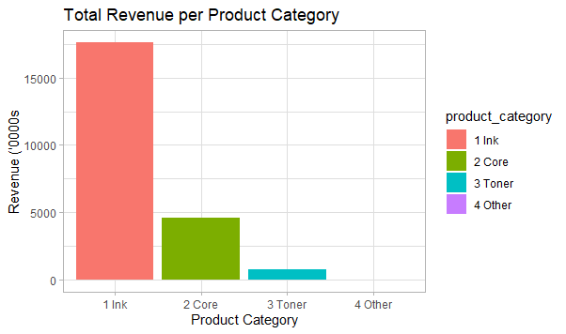
CONTRIBUTION TO REVENUE(PRODUCT CATEGORY)
INK
TONER
OTHER
CORE
76.7%
20.0%
3.29%
0.004%
From EDA we found that the contribution of Ink and Core to the revenue over the time period(2016-19) is high (76.7% and 20.0% respectively) as compared to toner and other(3.29% and 0.004% respectively).

Slide 7
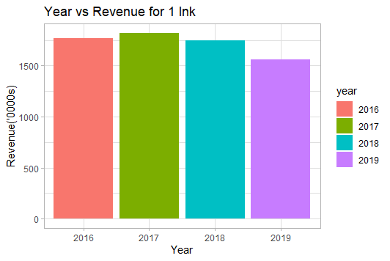
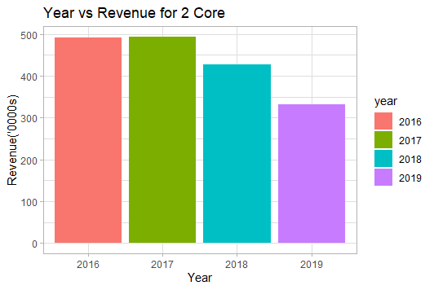
TOTAL REVENUE FROM EACH PRODUCT (YEARWISE)
On comparing the revenue for Ink for four months() for every year, we can see that there is a decrease in revenue from ink in 2019.

Slide 8
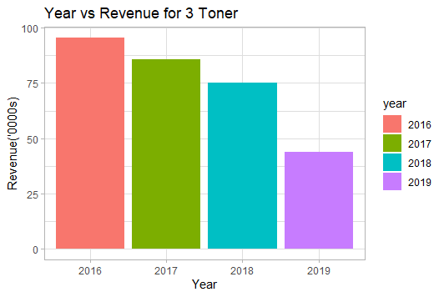
TOTAL REVENUE FROM EACH PRODUCT (YEARWISE)
TOTAL REVENUE FROM EACH PRODUCT (YEARWISE)
TONER

Slide 9
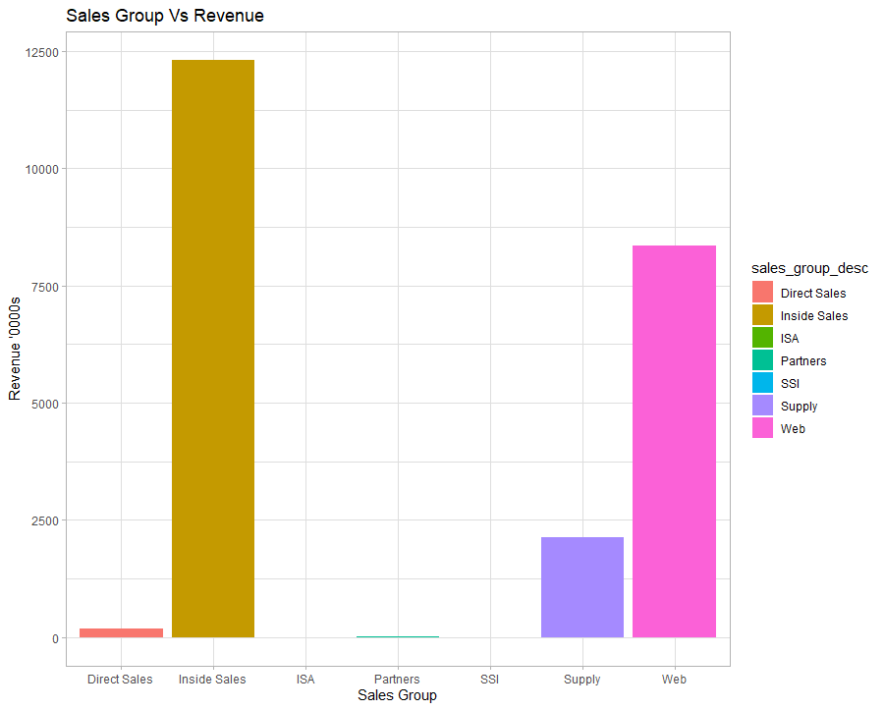
CONTRIBUTION TO REVENUE(SALES GROUP)
DIRECT SALES
SUPPLY
WEB
PARTNERS
I ISA
SSI
INSIDE SALES
0.78%
53.6%
0.0%
0.02%
0.003%
9.29%
36.36%

Slide 10
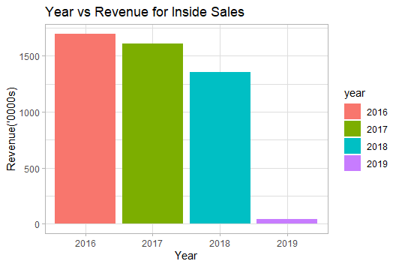
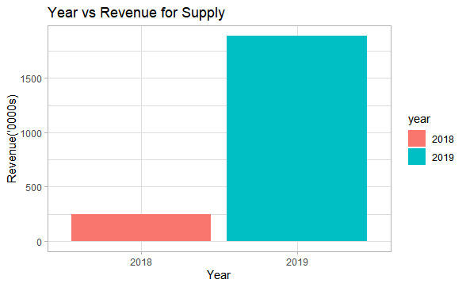
TOTAL REVENUE FROM EACH SALES GROUP (YEARWISE)
INSIDE SALES
SUPPLY

Slide 11
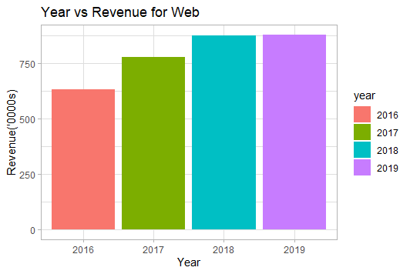
TOTAL REVENUE FROM EACH SALES GROUP (YEARWISE)
TOTAL REVENUE FROM EACH SALES GROUP (YEARWISE)
WEB

Slide 12
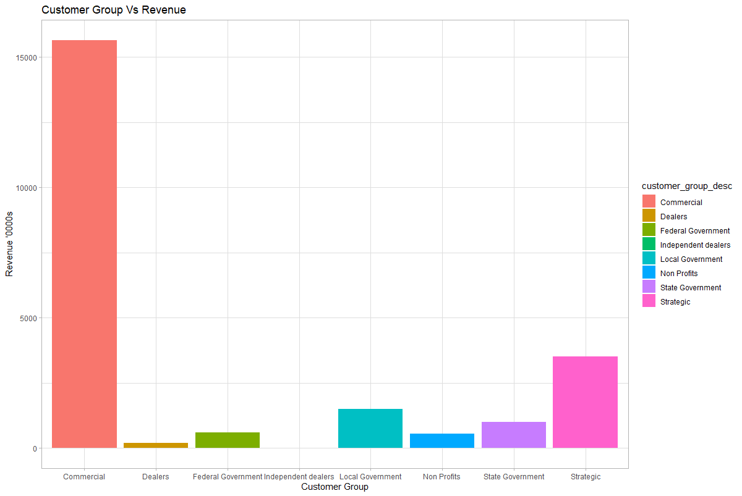
CONTRIBUTION TO REVENUE(CUSTOMER GROUP)
COMMERCIAL
STATE GOVERNMENT
STRATEGIC
LOCAL GOVERNMENT
I FEDERAL GOVERNMENT
NON PROFITS
DEALERS
68.09%
0.851%
2.546%
6.517%
2.36%
4.334%
15.3%

Slide 13
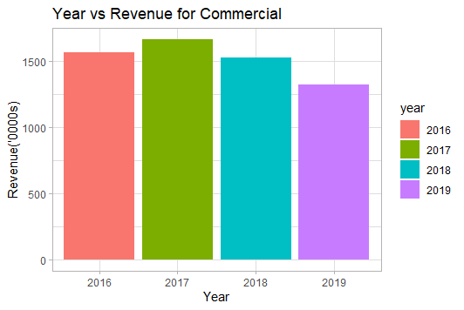
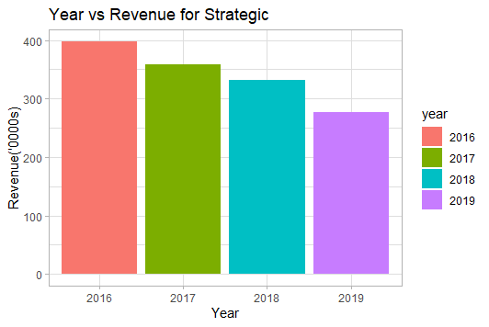
TOTAL REVENUE FROM EACH CUSTOMER GROUP(YEARWISE)
COMMERCIAL
STRATEGIC

Slide 14
KEY INSIGHTS
From EDA we found that the contribution of Ink and Core to the revenue over the time period(2016-19) is high (76.7% and 20.0% respectively) as compared to toner and other(3.29% and 0.004% respectively).
On comparing the revenue for Ink for four months() for every year
So we will forecast the revenue from these two and

Slide 15
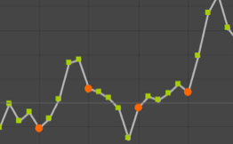
WHAT IS A TIME SERIES?
Time Series
Seasonal
Trend
Random
Cyclic
Is there a variation in data with seasons?
Series of values of a quantity obtained at successive times.
Is the data moving upwards or downwards?
Is there a boom or downfall in data in long term?
Is the data effected by some sudden movements?

Slide 16
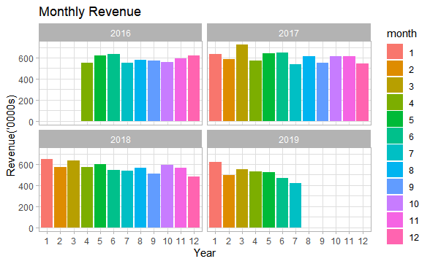
TIME SERIES ANALYSIS FOR FORECASTING GROWTH OR DEGROWTH
The data starts from April 2016 and ends at July 2019.
A decline in revenue can be seen in the later months of 2019 but we want to be certain if it is just a seasonal effect or the revenue is really decreasing this year.

Slide 17
2019 DATA VS 2019 FORECASTS
Original Data
Data with forecast for 2019
Mean Absolute Percentage Error:-7%

Slide 18
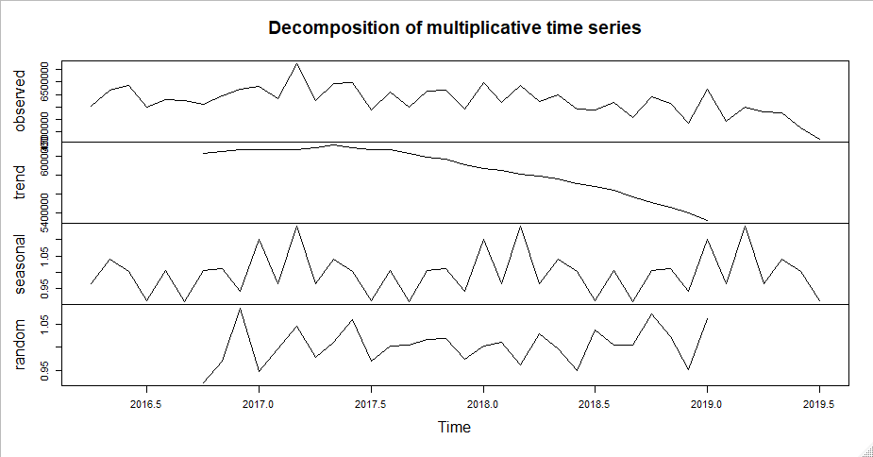
Exponential Smoothing
When to use?
Which order to use?
TECHNIQUE USED
When the data doesn’t have a clear pattern.
First order gives less weight to past observations and more weight to recent observations.
Second order deals with the trends in data.
Third order deals with the seasonality in data.

Slide 19
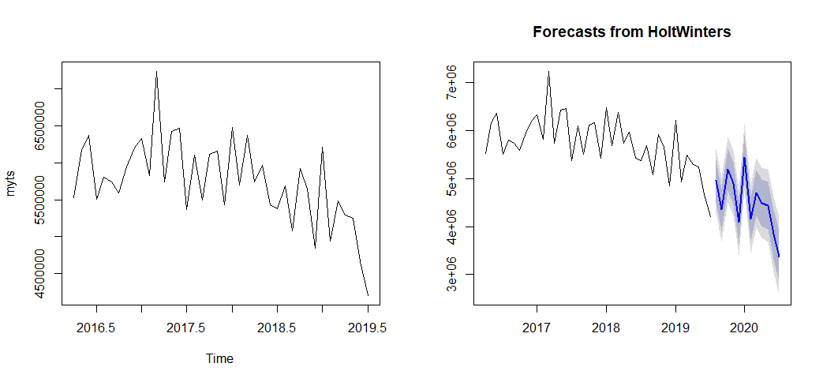

TOTAL REVENUE FORECASTS

Slide 20
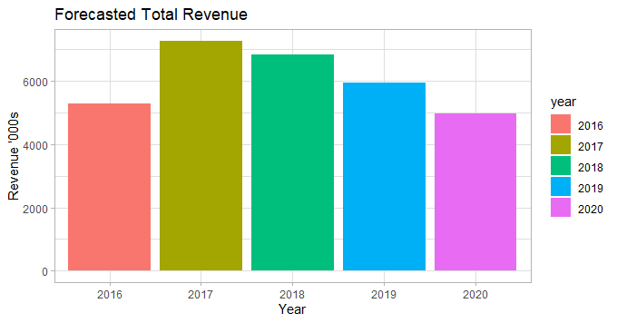
FORECASTS IN ALIGNMENT WITH PREVIOUS YEAR REVENUE
PREDICTED
PREDICTED

