Slide 1
PAL (Personal Assistant for living)
Team:
Harsh panchal
Raeesha Musani
Vaishnav kaldate
Sharique Anwar
Yash Javalkar

Slide 2
Problem Statement
Modern homes face challenges in entertainment, family connectivity, energy efficiency, accessibility, personalization and restricted accessibility for people with disabilities. To improve living standards, a comprehensive solution is needed.

Slide 3
Vision - Effortless Living, Enriched Minds - PAL's AI Predicts for Your Well-Being.
Mission - PAL harnesses the power of AI to improve quality of life through customization and seamlessly caters to the users.

Slide 4
Our overarching goal is to:
Develop an intelligent system that seamlessly integrates into users' daily lives, anticipating user’s needs and preferences through advanced AI algorithms.
By leveraging predictive technologies, the system will proactively assist users with tasks, recommendations, and automated processes.
Ultimately, PAL strives to create a harmonious and effortless living experience, allowing users to focus on what truly matters while promoting overall mental health and quality of life.

Slide 5
Operational Model
User Interaction Layer:
Voice User Interface (VUI) for natural language voice commands
Sign Language Recognition for visual gesture controls
Mobile app
Data Collection:
Sensors to capture user data
User consent and privacy controls
Secure data storage and transmission
Data Processing and AI Decision Engine:
AI algorithms for personalization, automation routines
Rules engine for smart home device control
Machine Learning models for predictive recommendations
Knowledge bases for health, education, entertainment content
Device Integration:
APIs and protocols for smart home/IoT device interoperability
Hub for coordinating various connected devices.
Cloud services for remote access and updates

Slide 6
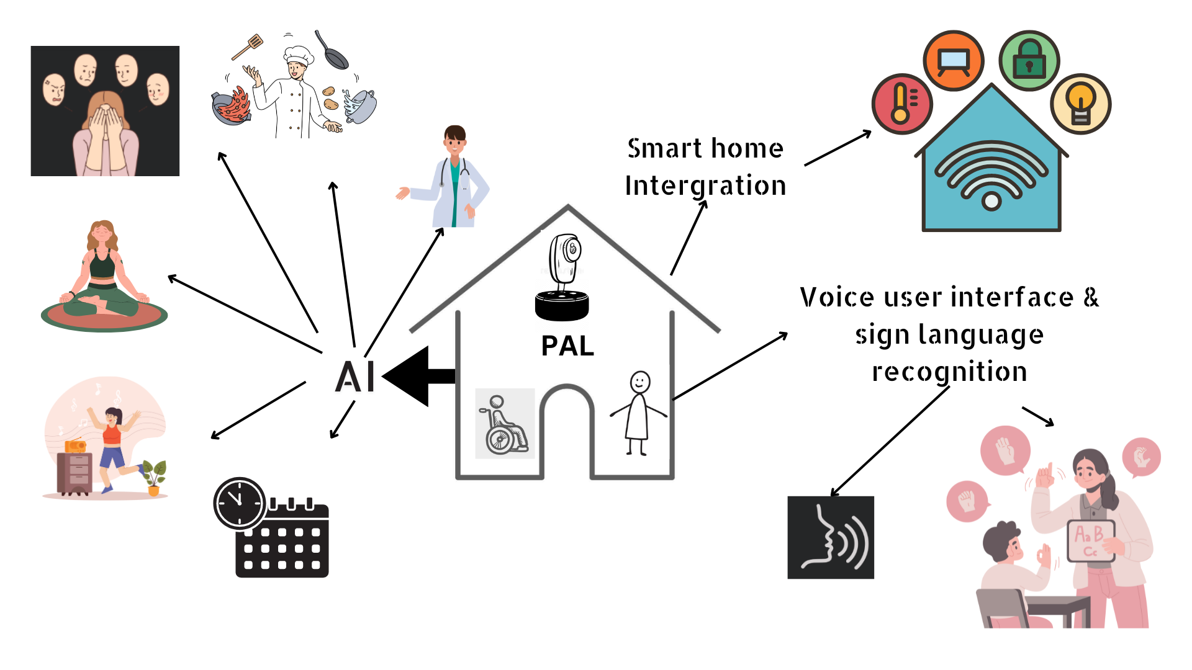

Slide 7
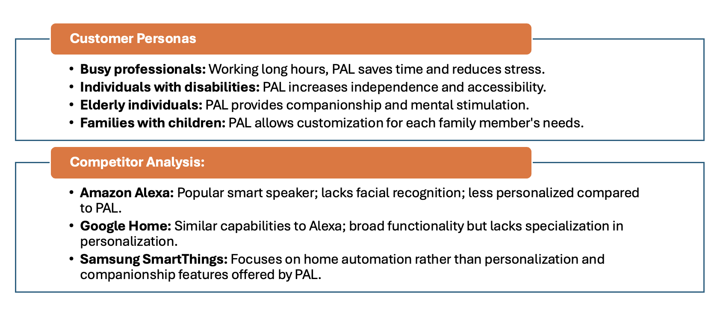
Market Assessment

Slide 8
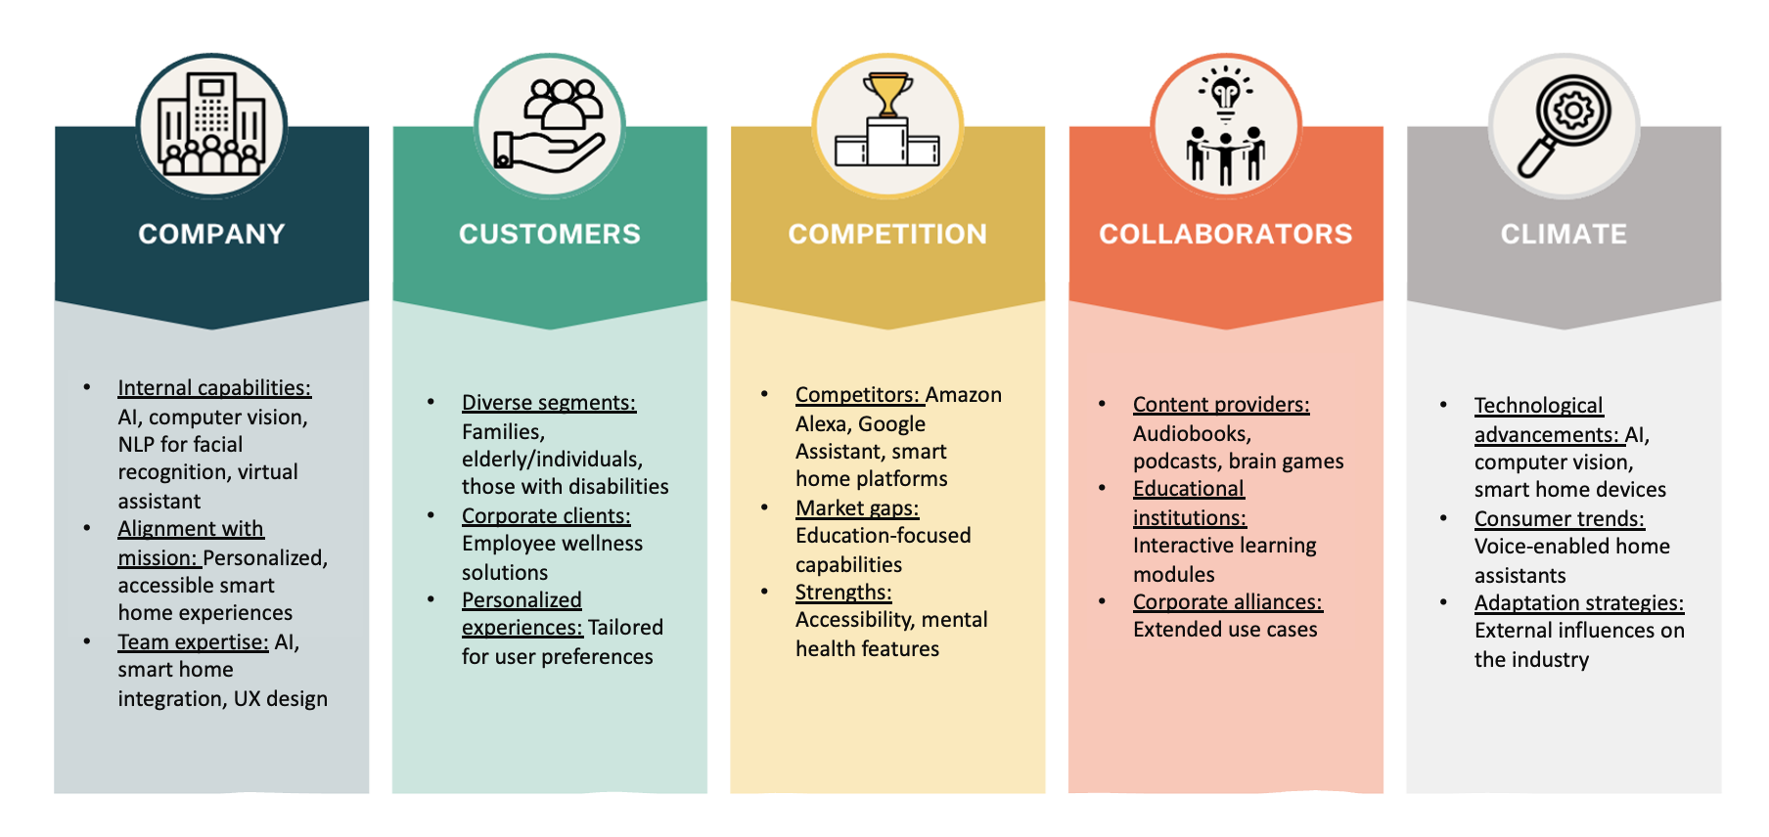
5C Marketing Analysis

Slide 9
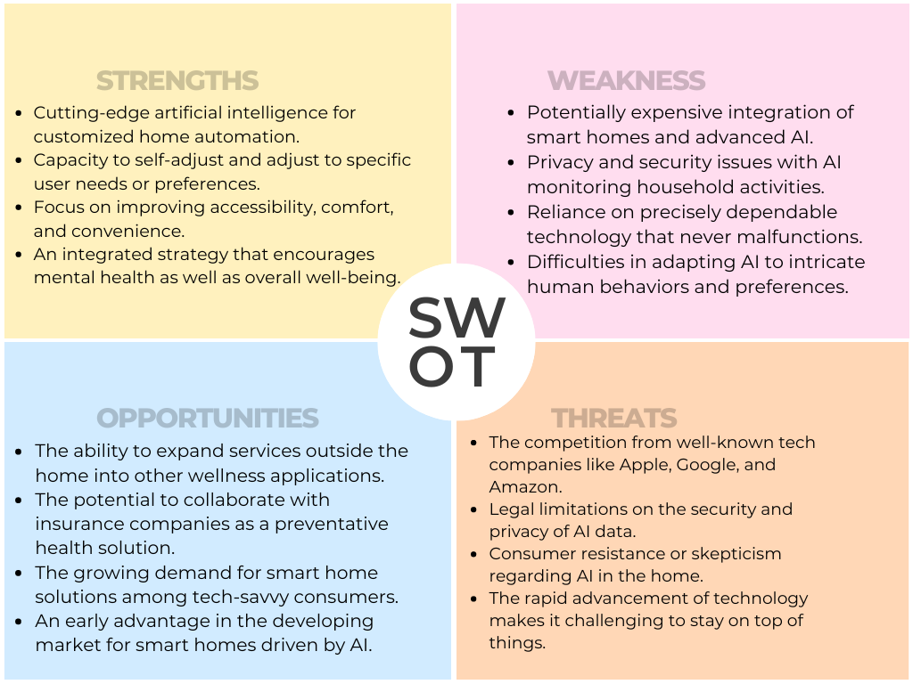

Slide 10
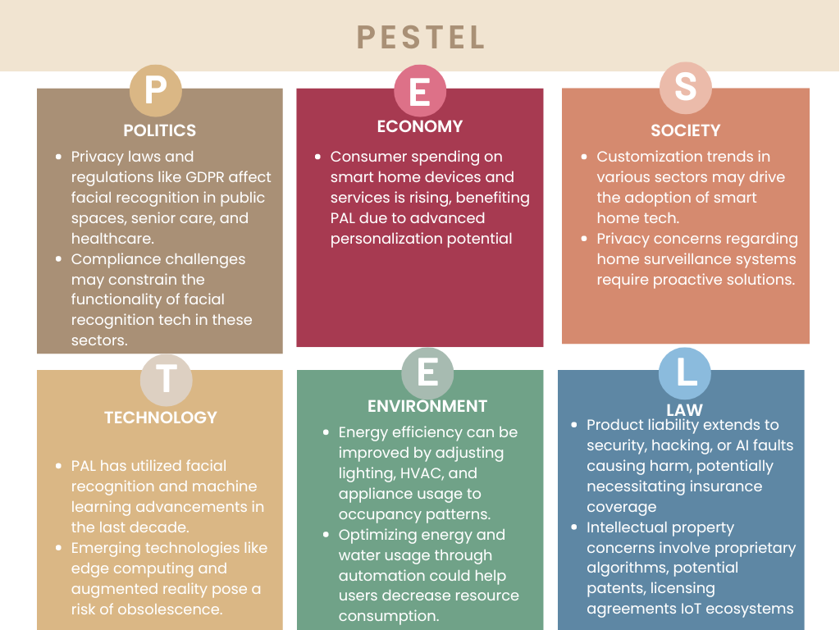

Slide 11
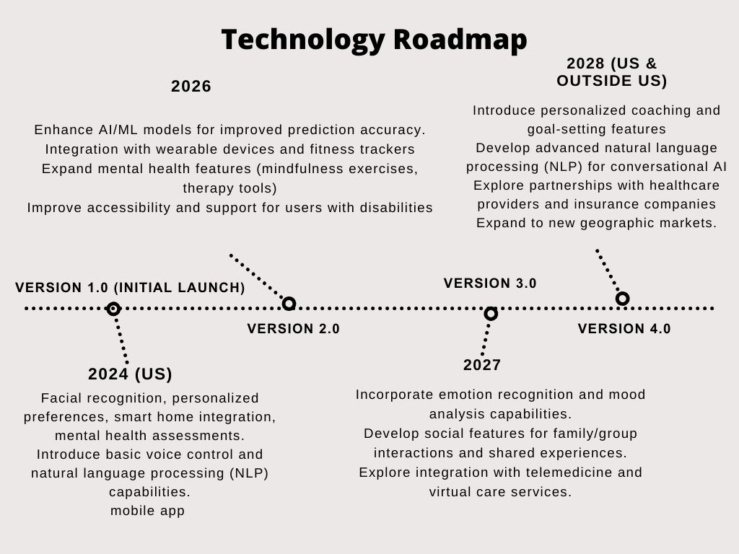

Slide 12
Ongoing Development (Continuous)
Regularly update AI/ML models with new training data and algorithms
1
Incorporate emerging technologies (e.g., edge computing, 5G, augmented reality)
2
Continuously improve system performance, security, and user experience
3
Develop industry-specific solutions (e.g., healthcare, education, workplace well-being, disabilities)
4
Explore new revenue streams and business models (e.g., subscription-based, data monetization)
5

Slide 13
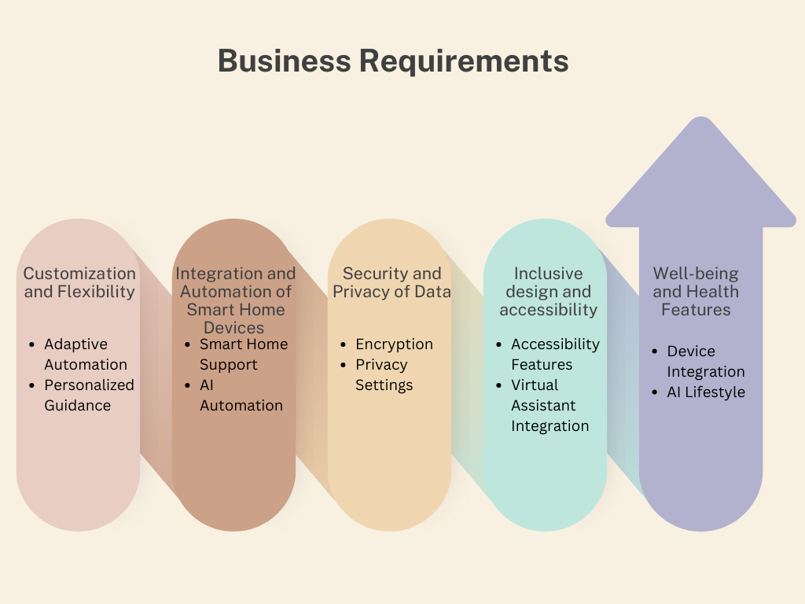

Slide 14
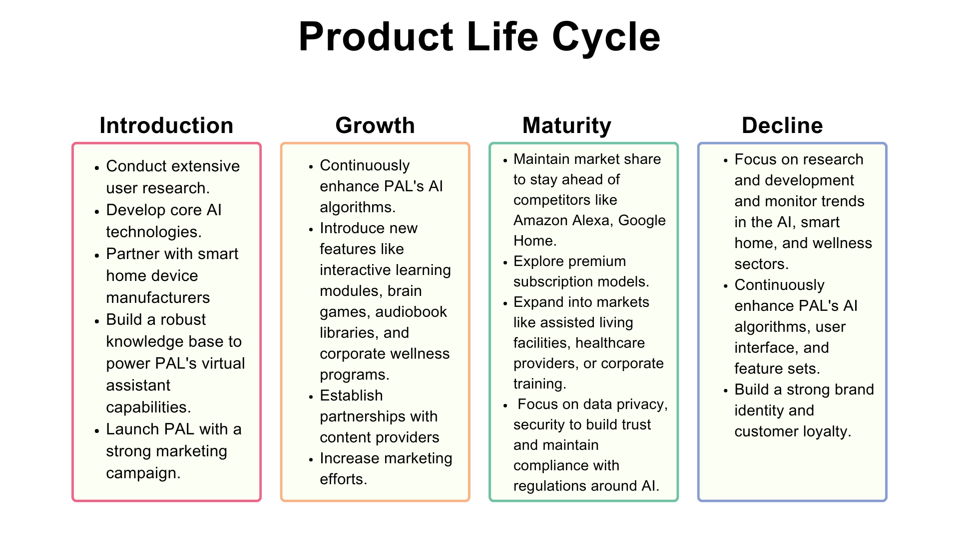

Slide 15
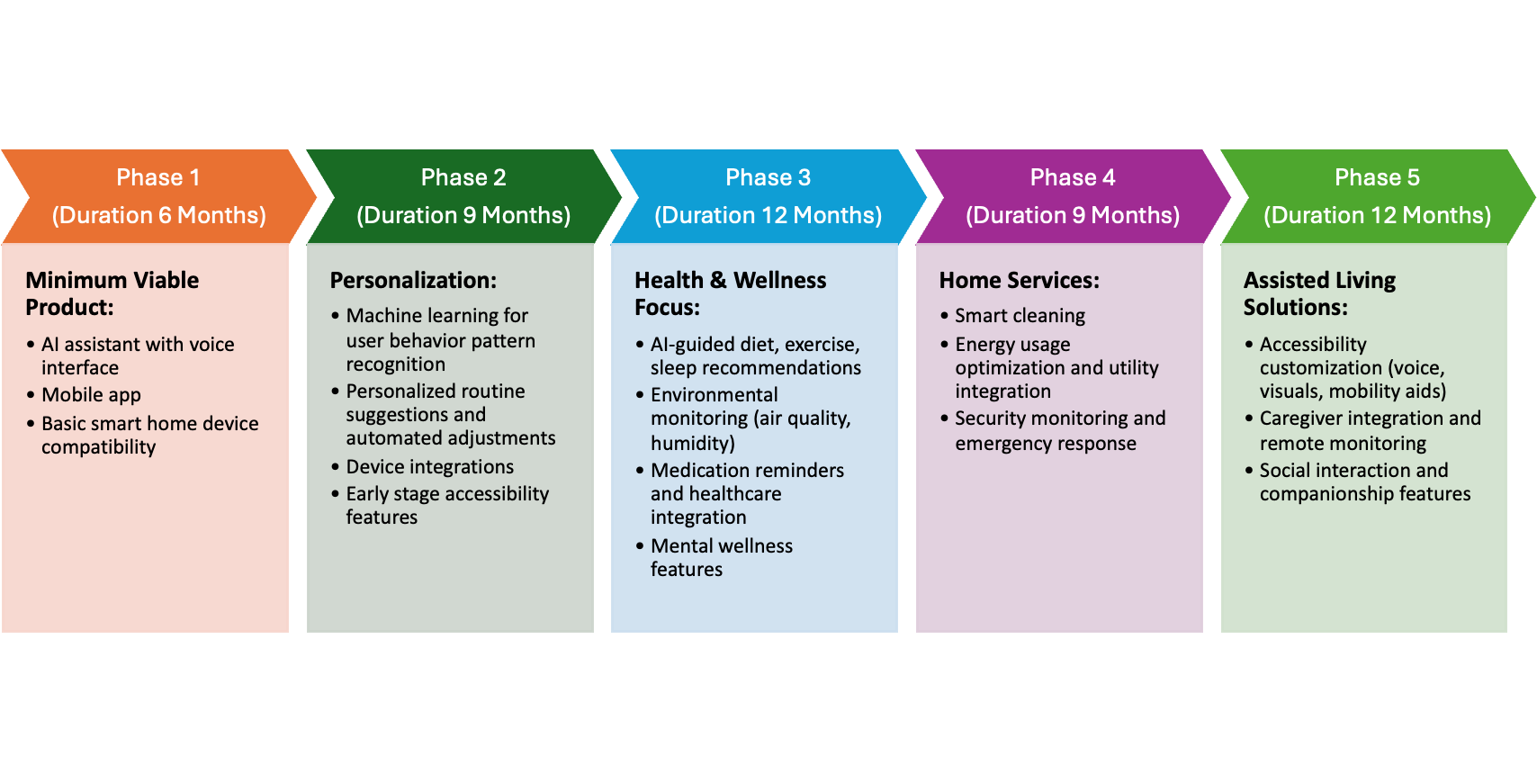
Product launch strategies

Slide 16
Go-to-Market Strategy
Target
Target early adopters and tech enthusiasts initially
Partner
Partner with smart home device manufacturers for bundled offerings
Leverage
Leverage influencers for marketing and social media campaigns.
Offer
Offer free trials and introductory pricing for early user acquisition.

Slide 17
Growth Strategy
Expand
Expand to mainstream consumers through strategic partnerships.
Integrate
Integrate with healthcare providers and insurance companies.
Develop
Develop industry-specific solutions (e.g., workplace well-being)
Pursue
Pursue strategic acquisitions to enhance capabilities and market reach.
Focus on
focus on data privacy, security, and ethical practices to build user trust and compliance. Continuously gather user feedback and adapt the product roadmap accordingly.

Slide 18
Potential risks associated with the PAL
Data Privacy and Security Risks
Mitigation: Implement robust encryption and access controls, obtain relevant certifications
Mitigation: Implement bias testing and monitoring processes and ensure transparency and explainability of AI models
User Adoption and Trust Risk
Mitigation: Offer customizable privacy settings and data control options
Market and Competition Risk
Mitigation: Continuously innovate and enhance product offerings.
Foster strategic partnerships and collaborations.
Mitigation: Adapt pricing and business models based on market dynamics.
Ethical AI Risk

Slide 20
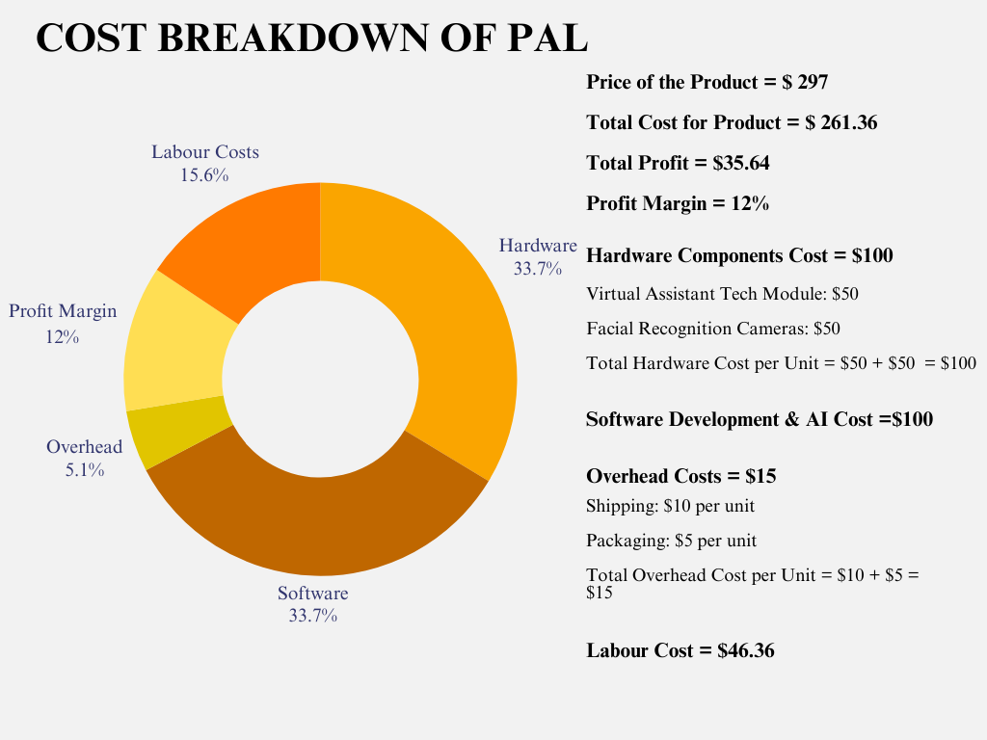

Slide 21
Stakeholders Matrix
Stakeholder | Interest | Influence
Users/Home Owners | High | High
Health Professionals | High | Low
Privacy and Security Experts | High | High
Product Managers and Business Stakeholders | High | High
Regulatory Bodies | Low | High
Integration Partners | Medium | Medium
Developers/Engineers | High | High

Slide 22
After Market Strategy
Offer premium support and maintenance plans
Introduce subscription-based models for continuous updates and features
Monetize user data (with consent) through targeted advertising
Explore licensing opportunities for the AI/ML technology
Develop complementary hardware and accessory products

Slide 23
Conclusion
PAL aims to develop an AI-driven intelligent home system that provides a seamless, personalized experience tailored to individual needs and preferences. By leveraging cutting-edge technologies like facial recognition, voice interfaces, and smart home integration, PAL enhances convenience, accessibility, mental well-being, and energy efficiency. Strategic partnerships, targeted marketing, and proactive risk mitigation will ensure PAL's long-term success in the rapidly evolving smart home and wellness industry.

Slide 24
Thank you

