Slide 1
Time Series Competition
Presentation
Mragank Sharma • 20.07.2025
Notes:
Hello

Slide 2
Overview
This presentation overviews:
My initial approach
Flaws in my initial approach
Final approach that landed me the 2nd position
Notes:
So I will discuss about how i initially approached the problem statement, what were the flaws in my initial approach, how I countered those flaws and what was my final approach that landed me to the 2nd position in competition.

Slide 3
Initial approach
Splitted the train into two parts: train and valid
Determined the seasonality using fast fourier transform which turned out to be 12.
Plotted ACF, PACF of the differenced data. A few observations, the lags were partially autocorrelated suggesting an autoregressive model.
First submission was made using the AR model which gave MSE of 21.
Tried using autoARIMA but again high MSE.
.
Notes:
So first of all I started by splitting the data into two parts train and valid sets with train size of 0.8 which was roughly around 640 data points of 800. Then I used fast fourier transform to find the seasonality in the data. The seasonality was roughly around 12. Then I plotted PACF and ACF plots of the data after removing the trend and seasonal components in the data. The lags in the PACF plot were autocorrelated to a good extent which suggests that the problem requires an autoregressive model. So I applied simple AR model with p=2 but that gave me an MSE of 21. I tried using MA, ARMA and ARIMA as well but still didn’t get a desired MSE.

Slide 4
Flaws in initial solution
While approaching with autoARIMA, the model performed well on first 10-15 values of the validation set.
But as we move towards the final values the difference between actual and predicted kept on increasing contributing high MSE.
Notes:
So what were the flaws in my initial approach. I used autoARIMA but the flaw was that model performed well in the initial 10-15 values but after that the predictions kept drifting away from the actual values on the validation set contributing high MSE.

Slide 5
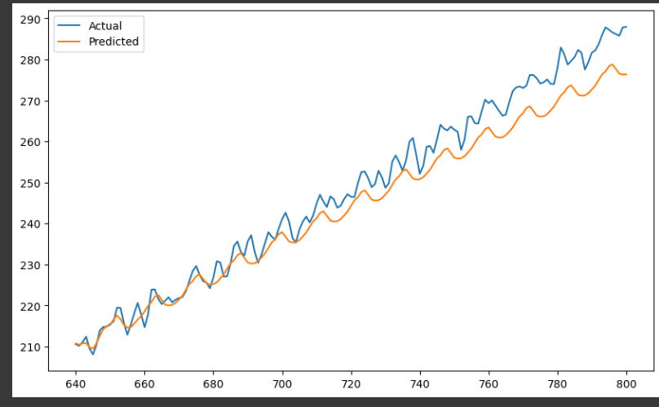
Flaws in initial solution

Slide 6
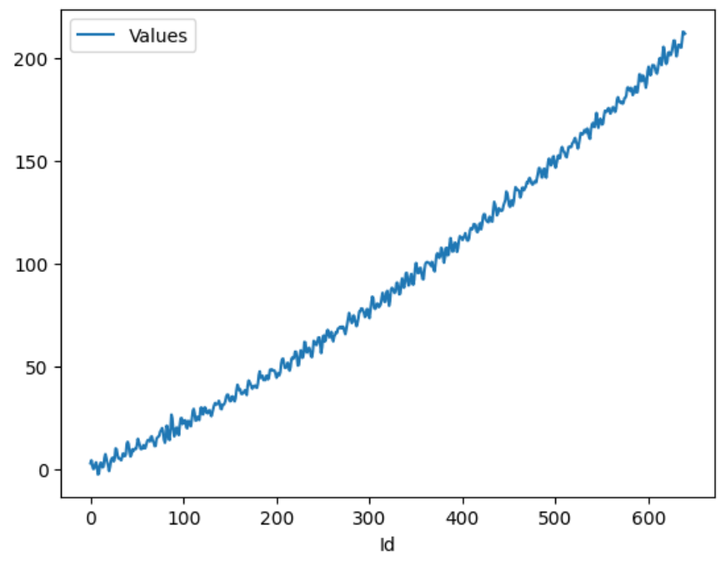
Final Solution
It was observed that there is some sort of non linearity in the data.
The curve of data doesn’t look linear.
Notes:
Then after clearly observing the data, I realized that the trend in the data has non linearity. As you can see the plot and the y value was roughly around 86 for the x value 320 and it was 214 when the x value is 640. This clearly suggests that the trend in the data is quadratic in nature.

Slide 7
Final Solution
So I used the autoARIMA again to sort out the best model.
The best model turned out to be (2, 1, 1)(0, 1, 1).
Then I tuned this model with exog hyperparameter.
The exog parameter was set to [x, x**2] which are the polynomial features which helped me counter the flaws of initial models.
The model performed well on the validation.
Finally added some noise to the predictions which would help counter the uncertain or noisy data points and made the submission.
Notes:
So first of all I sorted out the best model with the least AIC using autoARIMA. The main task was to add polynomial features so that the model knows that the data is not linear. So the best model I got using autoARIMA was turned out to be (2,1,1)(0,1,1). Then I used SARIMAX with these values of p, q and d and tuned the exog hyperparameter so that the model knows that our independent variable is not linear. The exog parameter was set to [x, x**2]. The model finally performed well on the validation set. At the end I added some noise to the predictions which helped to counte the noisy and uncertain data. Finally, the competition was a great exercise applying modelling and ML techniques to tackle the forecasting problems.

