Slide 1
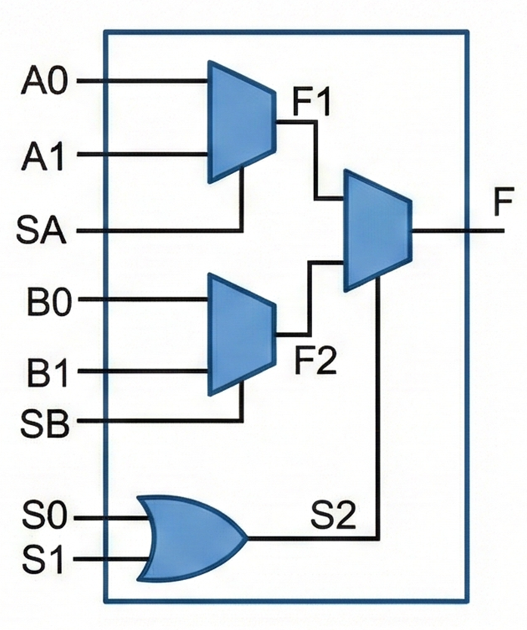
CA3_xor
0
in_1
1
out
1
0
in_2
0

Slide 2
CA3_inv
1
0
0
out
0
0
0
in
0

Slide 3
CA3_and_2
0
in_1
1
0
out
1
0
in_2
0

Slide 4
CA3_and_3
0
in_1
0
0
out
0
in_2
0
in_3

Slide 5
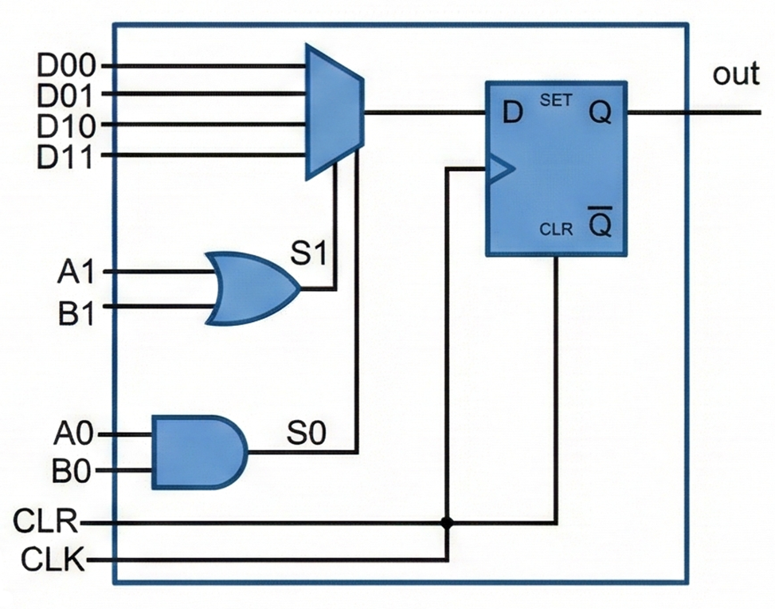
CA3_reg
out
in
seed
init
0
en_1
en_2
(rst)
(clk)

Slide 6
CA3_irg
~init
0
out
0
inc_1
inc_2
(rst)
(clk)

Slide 7
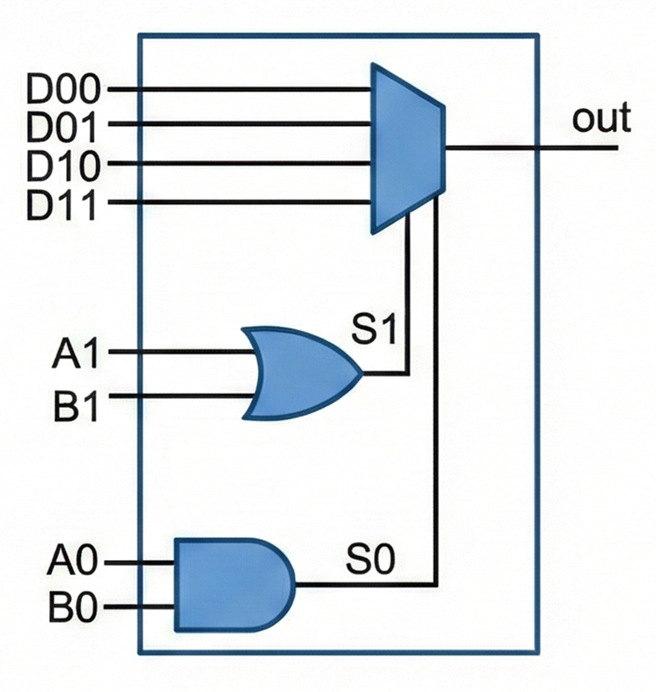
RND_counter
CA3_irg
Bit_0
~init
en
inc_1
out
1
inc_2
0
Co_logic
CA3_and_2
1
CO
CA3_irg
CA3_inv
0
init
Bit_1
~init
en
inc_1
out
0
inc_2
CA3_irg
Bit_2
~init
en
inc_1
out
inc_2

Slide 8
RND_shift_register
For i in {0,1,2,3,4,5,6,7} :
out[i-1]
out[i]
seed[i]
if i = 0: fb
init
0
en
1
(rst)
(clk)

Slide 9
HG_mux
For i in {0,1,2,3,4,5,6,7} :
in1[i]
in2[i]
out[i]
in3[i]
sel[0]
in4[i]
sel[1]
0

Slide 10
HG_pipeline_reg
For i in {0,1,2,3,4,5,6,7} :
d_in[i]
q_out[i]
INIT[i]
rst
0
load_enable
1
(0)
(clk)

Slide 11
HG_M_mem
For i in {0,1,2,3,…,28,29,30,31} :
msg_in[i]
M_out_k[j]
0
k = 4 – (i // 8)
j = i % 8
load_msg
1
(0)
(clk)

Slide 12
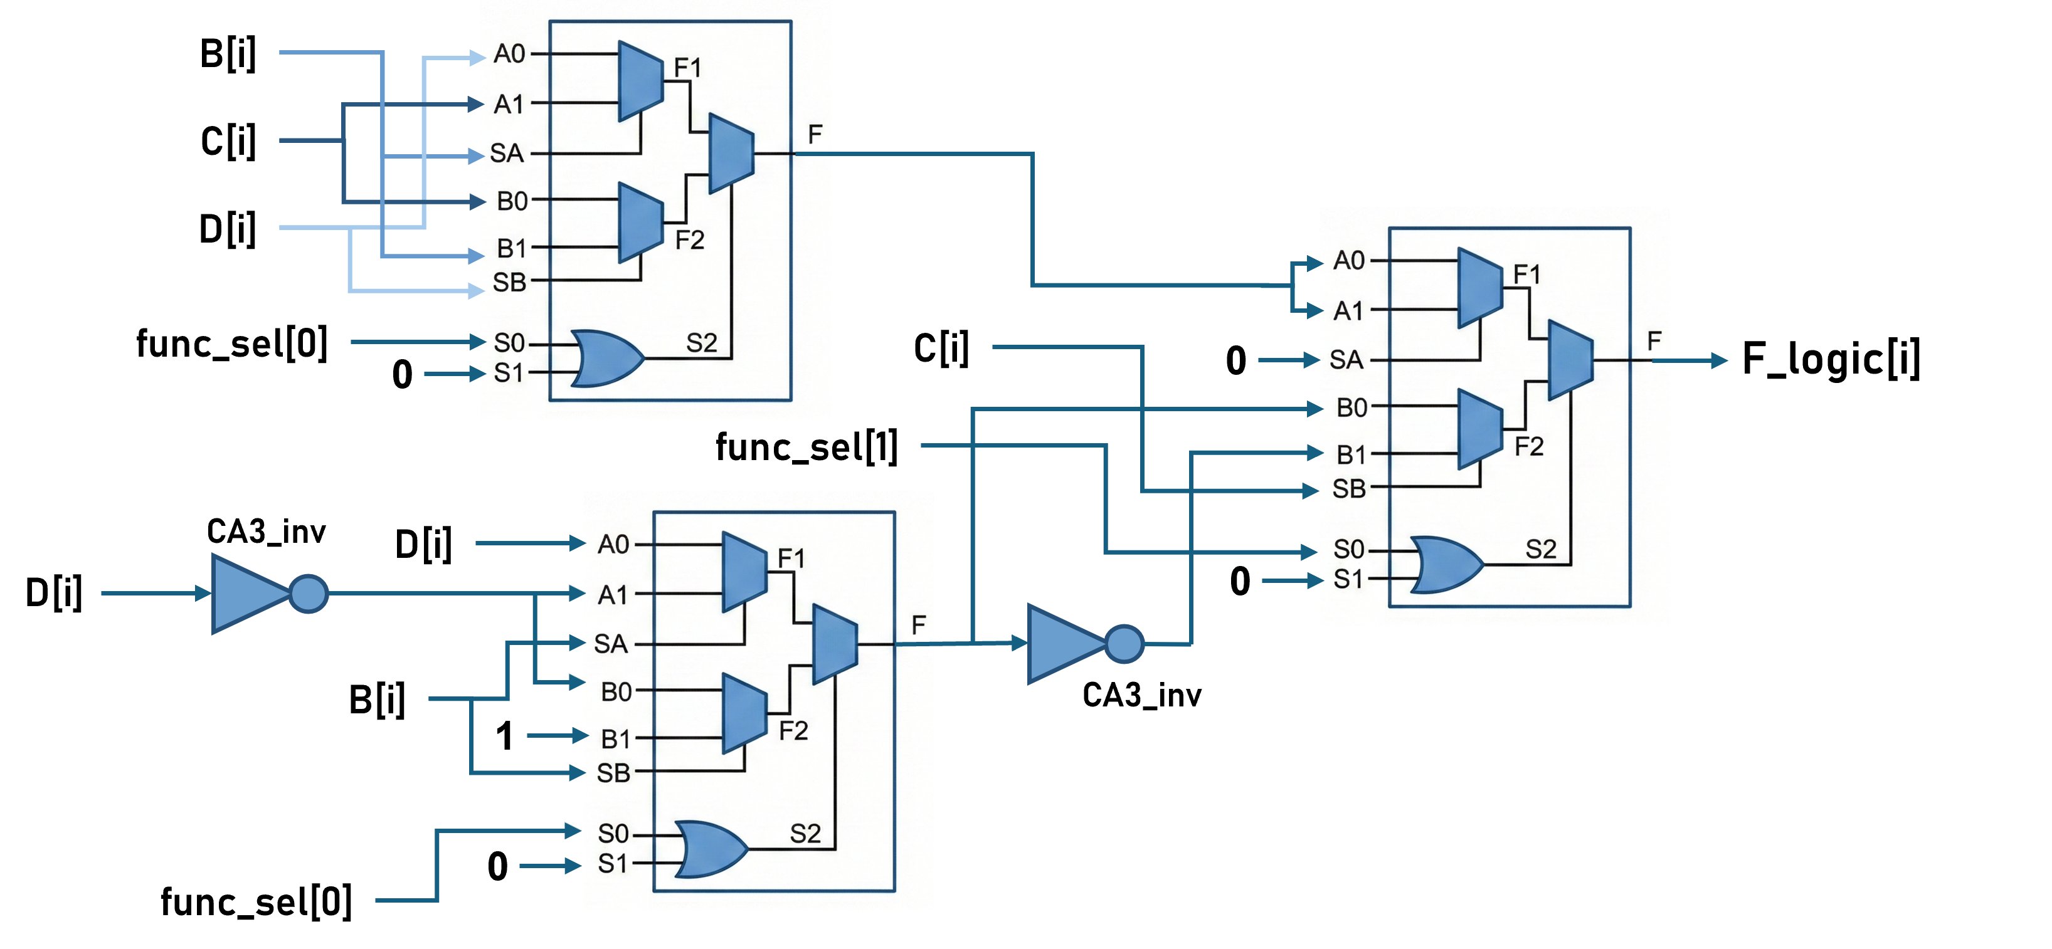
B[i]
C[i]
D[i]
func_sel[0]
C[i]
0
F_logic[i]
0
HG_F_logic_ALU
func_sel[1]
CA3_inv
D[i]
D[i]
0
For i in {0,1,2,3,4,5,6,7} :
B[i]
CA3_inv
1
0
func_sel[0]

