Slide 1

Genesys Routing Design Overview
Rules Based Routing Design
March 6th, 2018

Slide 2
Agenda
Current State Call Flow Routing and Customization
Genesys Rules Based Routing System and Standards
High Level Review of Genesys Rules Structure

Slide 3
Current Technology and Business State
Custom Technology Implementation
Highly Customized Business Rules
Custom IVR implementation (~70+ IVR’s)
Custom agent routing (~60K+)
Custom reporting
Custom business and agent dashboards
Custom CRM integrations (~30+)
Custom Screen pops (~800+)
Custom Agent Desktop Configuration
Custom Transfer lists (~34K+ transfers)
Wide range of TFN and how utilized (~66K TFN’s)
Wide range of Skill sets (~9,600 Skills)
Custom Containment goals
Custom SLA’s
Custom Compliance
Custom CRM systems (~ 30 integrations)
Custom Reporting Requirements
Custom Self Service goals
Custom Call Steering Options
Custom Personalization offers
Custom Time of Day
Variety of packaged business solutions requiring cross LOB interactions
~25+ LOB’s with ~100+ business units (see Appendix)
Result: Hardcoded TFN, Call Flows, etc.

Slide 4
Agent Routing Design: VCC vs. Omni
VCC
Genesys - Omni
Toll Free Numbers
Toll Free Numbers
IVR
IVR
Agent Routing
Common Modules
Version control enhances Peak Season Change Mgmt.
Cisco ICM Script
(enterprise Routing)
Classification and Segmentation
External Routing Apps
Individual systems and logic
Features
Avaya Node Scripts
(business routing)
Rules
Engine
Target Selection
Each Line of business call flow requires a custom set of coordinated logic and scripts
What are the holiday routing rules?
Treatment
Orchestration Scripts
80% Build Effort
High Reuse, Minimal Changes
Rules Engine
20% Build Effort
Highly Configurable

Slide 5
Key Aspects of Routing
Who Are You and What Are You Calling About
What Features/Adjuncts Are Available For You
Call Back
Conversation Manager
ANI based Search
Survey
Last Agent Routing
Load Balancing
Reporting and WFM element
What State/Condition is My Contact Center In
Hours of Operations
Holiday Calendar
Emergency, Meeting…
Who Can Handle Your Call
Target Skill
Priorities
What Treatments Am I Going to Apply
On Hold Music
Announcements
On Hold
Emergency
After hours Message
Holiday

Slide 6
Advantages of a Rules-based Routing System
Based on a Standard Call Flow Framework built in (SCXML)
Configurable Business Rules will have the logic and routing conditions (not hard-coded)
Conversation Manager for personalization
Standardization of Rules templates across multiple lines of business (LOBs)
Available Conditions and Actions will remain consistent across all lines of business
A standard set of Actions will remain mostly static across LOBs
Each LOB will have the ability to customize the Conditions and Actions that impact their routing to suit their business need

Slide 7
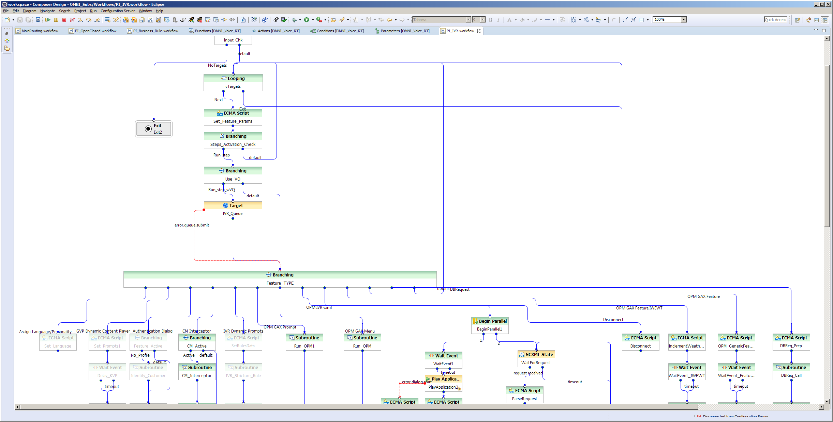
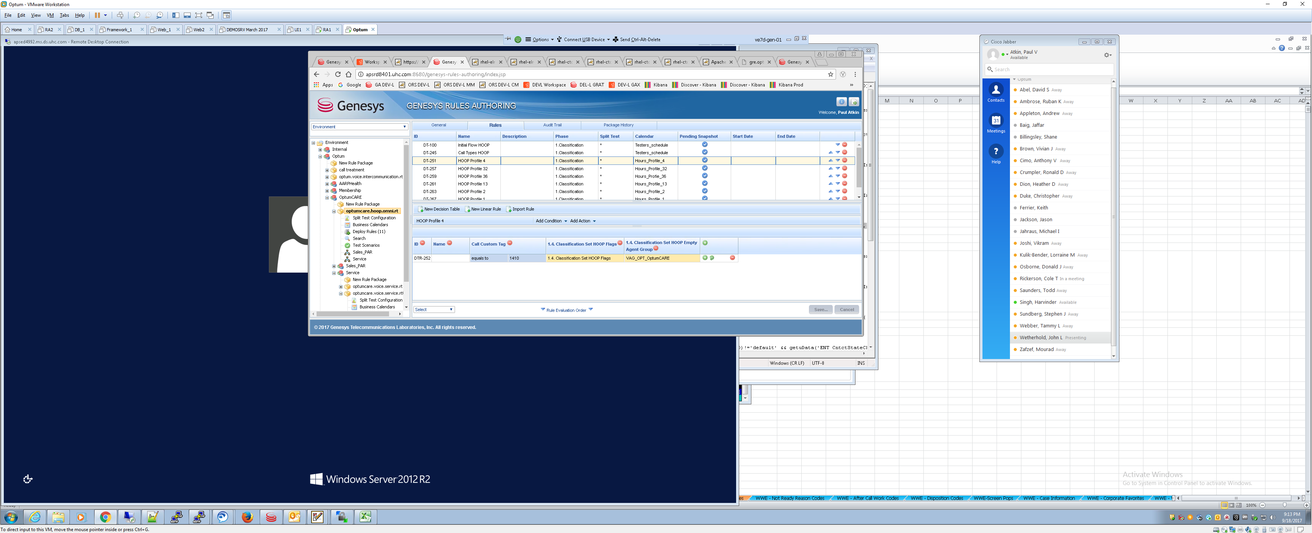
Genesys Tools Used for Routing Configuration and Rules Creation
Composer
Build/Edit ORS Scripts
Edit Rules Templates
Genesys Rules Authoring Tool
Call type segmentation and classification
Call Flow actions per each call type
Targeting and Prioritization by call type/skill
In-Queue treatments and whispers
Hours of Operation

Slide 8
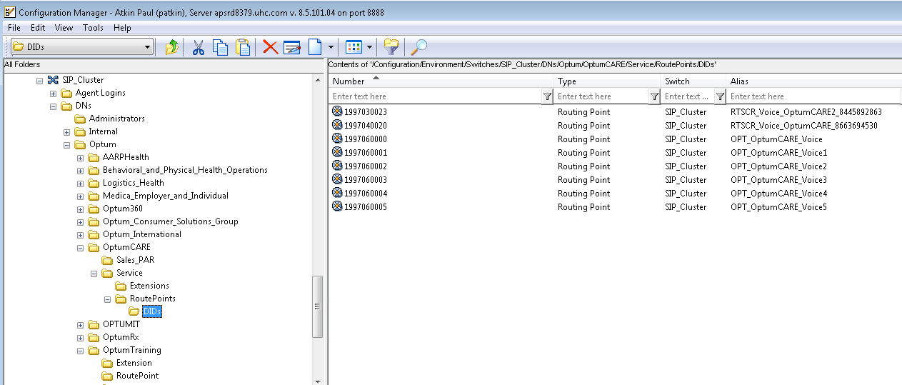
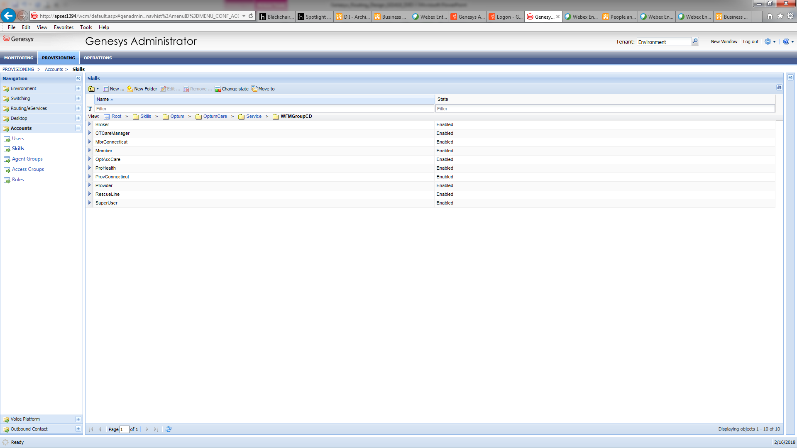
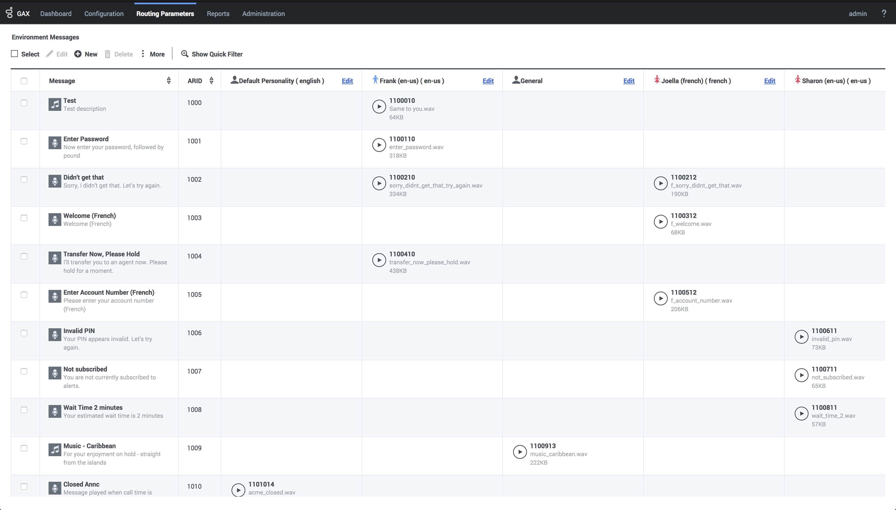
Genesys Tools Used for Routing Configuration and Rules Creation
Configuration Manager (CM)
Original UI for all Genesys Configuration
All functionality from CM has been replaced with GA/GAX
Still used by developers
Genesys Administrator (GA)
Agents Configuration and assign Skills to agent
Additional ancillary controls via Parameters in Script object or Transaction Lists
Genesys Administrator Extensions (GAX)
Call type overrides and closures via Operational Parameters Mgmt.
Audio Resources upload to Genesys Media Platform.

Slide 9
Genesys Rules System Components
GRS-Genesys Rules System; Provides the ability to develop, author, and evaluate business rules. GRS consists of the three software components listed below.
GRDT-Genesys Rules Development Tool
Provides the ability to build/modify templates to be used in GRAT
GRAT-Genesys Rules Authoring Tool
Provides the ability to build/modify Rules Packages, Calendars, HOOP Rules and Routing Rules.
Used to promote rules to GRE for rule evaluation in routing.
GRE-Genesys Rules Engine
Maintains all of the deployed rules
Queried by ORS, Conversation Manager, and iWD
Executes Rule evaluation and returns routing data.

Slide 10
Routing Design Components
Component | Description
Classification | Uses known data about the interaction to assign data elements (KVP's) to be used in future rules phases to make routing and data decisions
Segmentation | Uses current interaction data to identify the appropriate contact type and action to be executed in the workflow
Features Setup | Uses contact type and additional relevant data to turn on and off features and assign appropriate feature parameters
Call Flow Structure | Uses contact type, contact center status, and additional relevant data to identify what messages, prompts, and/or IVR dialogues to include in the workflow
Targets Setup | Uses contact type and additional relevant data to identify appropriate targets for the interaction
Treatments | Uses contact type and additional relevant data to identify what treatment to provide while waiting for a target
Classification
Segmentation
Features Setup
Call Flow Structure
Targets Setup
Treatments

Slide 11
Progression of Rules through the Call Flow
Start
Design- Pre IVR Validation
Design-Post IVR Validation
Classification
Initialize the variables
Call BPE Web service
Use TFN to identify Call Type
Check ANI
Check HOOP
Set the KVP
Segmentation
Based on the KVP\Attribute identify the call type
KVP List
Unit = Opt
Segment = OptumRX
Function=HomeDelvry
Product=default
SubFunction=HomeDelvry
Language=English
ConstituentType=Provider or Member
SubjectConstituentType=default
WFMGroup=Pharmacy
Location=default
Feature Setup
Based on call Type start Call Back
Enable
Voice Mail
Enable
Survey
Enable
Conversation Manager
Last Agent Routing
Call Flow Structure
Based on Call Type set Call Flow
Holiday
Emergency
Closed
No Agents
Target Setup
Based on Call type set Target skill
Treatment
Set Music File Name
Set Prompt File
Set the EWT
Stop

Slide 12
Demonstration
Rules Driven Routing

Slide 13
Questions?

