Slide 1
Conversation Manager & Orchestration Server
Solution Engineering
Prepared By: [Shubam Kumar Awasthi]

Slide 2
Table of Contents
Introduction : Conversation Manager Solution Engineering
Impact Of Conversation Management
Conversation Manager
Orchestration Server
Orchestration Server Architecture(High Level Overview)
ORS Architecture in conjunction with LightSpeed
Universal Contact Server (UCS)
Context Services
The Life of an EVP IVR QA Test Analyst

Slide 3
Introduction :Conversation Manager Solution Engineering
For many consumers, understanding their healthcare needs and options can be a very complex process.
Additionally, the industry is becoming more competitive with recent reform and regulations. This has created a demand for service offerings to be more tailored to the individual in an effort to better help consumers navigate their healthcare options.
In an effort to provide service that is contextual and personalized, OptumIT Contact Center Services implemented an Experience Management Solution that can utilize a consumer’s identity, relevant health data, and past interaction history to deliver personalized service strategies to the consumers.
In Order to Implement Experience Management Solution, we are using various components. For Example : Experience Manager/Conversation Manger, Orchestration Server etc.

Slide 4
Impact of Conversation Management
The Conversation Management capability currently impacts the customer experience in the following areas.
IVR Treatment
Message and Transfer – A caller can be presented with an experience specific message and then transferred to an agent after authentication. Additionally, data will be attached to the call for further processing or reporting.
Yes/No Question w/Transfer – A caller can be presented with an experience specific Yes/No question after authentication. If they respond “Yes”, the caller will be transferred to an agent. After a “No” response, the caller will be allowed to continue in the IVR. Additionally, data will be attached to the call for further processing or reporting.
Call Routing – Call data will be provided to the Routing Engine (ICM) that can be used to make routing decisions

Slide 5
Impact of Conversation Management
Call Routing – Call data will be provided to the Routing Engine (ICM) that can be used to make routing decisions
Desktop Screen Pops – A screen pop will be generated for the agent providing relevant data to drive the conversation with the consumer.

Slide 6
Conversation Manager
Conversation Manager is a capability that will enable UHG to turn customer interactions across multiple touch points (such as WEB, IVR, contact center, outbound notifications, email, chat and issue management) into seamless customer conversations, leveraging information known about a customer combined with their interaction history to personalize the experience. It does this with a powerful customer context system that tracks the member’s identity, products and actions for each interaction to ensure a consistent experience, regardless of the channel the member chooses, and drive personalization of the customer contact.

Slide 7
Orchestration Server
Genesys Orchestration Server (ORS) is the new session-based Genesys Routing component that takes Genesys' core capability of routing and extends it, generalizes it, and integrates it more tightly with other Genesys products.
Orchestration provides dynamic management of interactions through the use of business rule tools, dynamic data, and applications that are based on open standards.
For example: A bank customer calls an 800 number inquiring about mortgage preapproval. An IVR prompts him to enter his account number, then transfers him to an agent, who fills in an application form for him and asks him to fax some supporting documents. After he faxes the documents, he receives an automated SMS message thanking him and informing him that he will receive a response within 48 hours. The next day he receives an e-mail congratulating him on the approval of his application.

Slide 8
Orchestration Server
The Orchestration Server in conjunction with the Universal Routing Server (URS) can direct interactions from a wide variety of platforms, such as toll-free carrier switches, premise PBXs or CDs, IVRs, IP PBXs, e-mail servers, web servers, and workflow servers.
the Orchestration Server executes routing applications that are written in SCXML (State Chart Extensible Markup Language). SCXML-based applications are hosted on an Application Server/Web Server and provisioned through Genesys Administrator by defining the HTTP definition
It can handle pure-voice, non-voice, and multimedia environments, enabling routing of each media type based on appropriate criteria. Routing strategies and business processes automate interaction routing to the most appropriate agent/resource based on factors such as the type of inquiry, the business value of the customer interaction, context and customer profile, and the media channel.

Slide 9
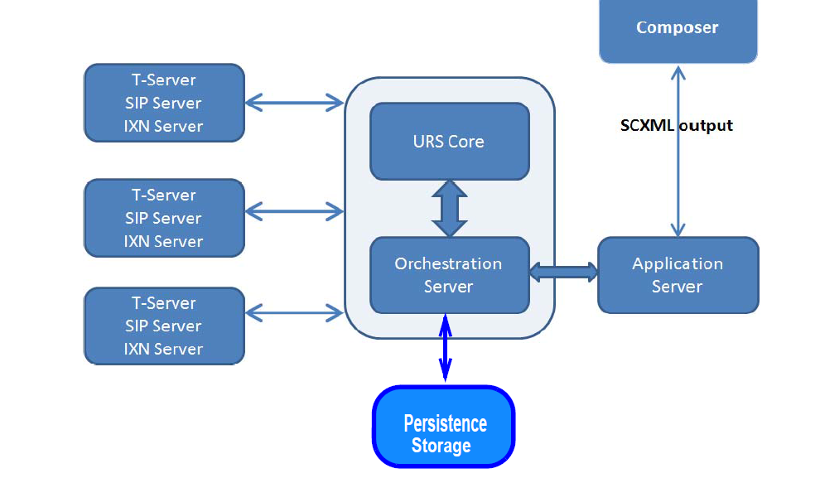
Orchestration Server Architecture(High Level Overview)

Slide 10
Orchestration Server Architecture
Persistence Storage is used to store SCXML sessions and documents, as well as scheduled activities (such as start and stop).

Slide 11
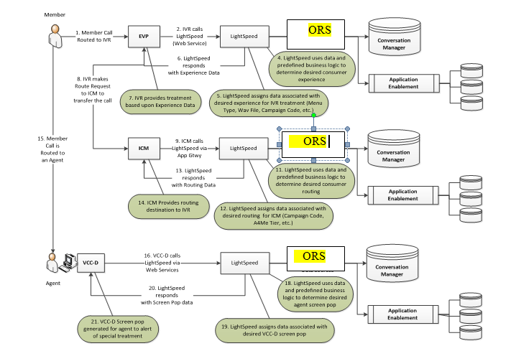
Orchestration Server Architecture in conjunction with LightSpeed

Slide 12
Universal Contact Server (UCS)
Universal Contact Server (UCS) interfaces with a database that stores data on contacts (customers). As the classic UCS.
It works with Genesys eServices (Multimedia).
With an optional set of additional capabilities known as Context Services.
It works with other Genesys products and solutions, such as Genesys Voice Portal and Conversation Manager.

Slide 13
Context Services
Context Services is a data repository that provides real-time and historic customer-centric data to SCXML applications through an interface that allows the application users to make important business decisions.
For example, it allows you to determine whether a customer should be offered a given service or that the customer is a high value client, or if there are existing SCXML application sessions are already running for this customer.
Context Services exposes a set of RESTful APIs to access the customer context data. Refer to Context Services for more information about the RESTful interface and Context Services.
Example: Context Service--> ClaimDetails ,CrossChannelExtension ,OutboundContactExtension

Slide 14

Questions and Answers

Slide 15
Thank you.
Contact information
Shubam Kumar Awasthi
Ph: +91-7893856325 Land Line: 4033549921
Shubam_awasthi4@optum.com

