Slide 1
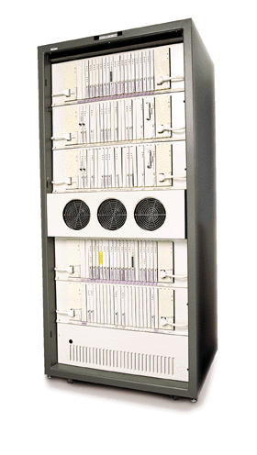
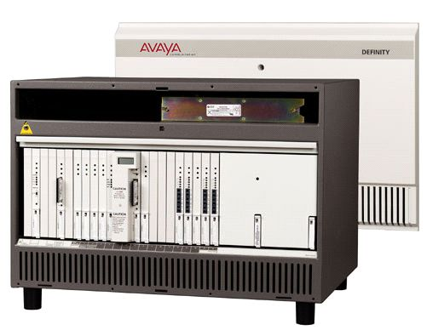
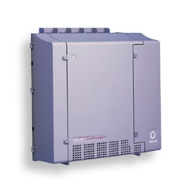
Traditional Offerings
Definity G3si with SCC1 Gateway
Definity G3r with MCC1 Gateways
Definity csi with CMC1 gateways

Slide 2
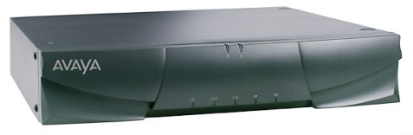
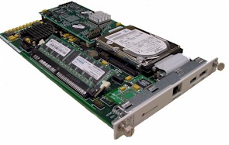
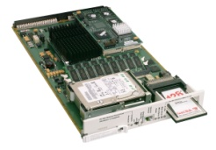
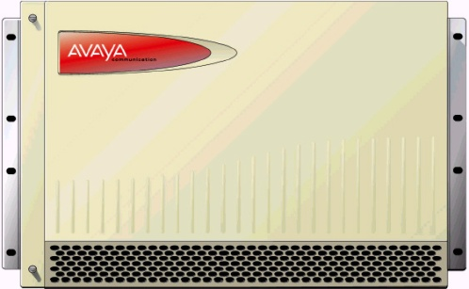
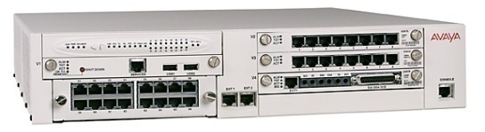
Enterprise Class IP Solutions Portfolio Goes Modular
Avaya Communication Manager
Avaya Media Servers
Avaya™ S8700
Media Server
Avaya™ S8100 Media Server
Avaya™ S8300 Media Server
LAN/WAN Connectivity
Media Module
Avaya Media Gateways
Avaya™ G700
Media Gateway
Avaya™ G600 Media Gateway
Avaya - Proprietary Use pursuant to Company instructions
Notes:
Avaya Media Servers and Media Gateways
Avaya Media Servers and Media Gateways powered by Avaya MultiVantage Software provide highly flexible and scalable components that can be mixed and matched to create customized solutions. A wide range of custom configurations can be deployed to meet the spectrum of business needs: from a single-location, IP network, to a complex global multi-protocol network.
Avaya Media Servers: Provide a robust application platform based on industry standard operating systems to support distributed IP networking and centralized call processing across multi-protocol networks. These servers are available as an integrated solution or can operate independently, with the ability to handle up to 300,000 busy hour call completions (BHCC).
Avaya Media Gateways: Are stackable and modular hardware elements that deliver application enabling voice, data, fax, video, and messaging capabilities to your network. They house hardware elements such as control interfaces and port interfaces routing both bearer and signaling traffic routed between packet- switched and circuit switched networks. Avaya Media Gateways are optimized for enterprise IP telephony and provide a variety of flexible, cost effective deployment options ranging from blended (I.e. IP and TDM) to a 100% IP environment. They are interoperable with standards based data networks to provide maximum flexibility and reduce total cost of ownership.
We will discuss the details of each solution shortly.

Slide 3
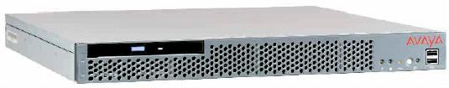
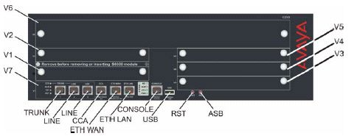
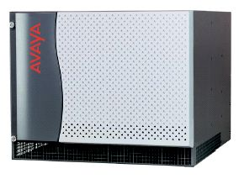
Newest Additions to ECLIPS Family of Solutions
The S8500 Simplex Media Server
The G350 Media Gateway with/without a S8300 Media Server
The G650 rack-mountable Media Gateway

Slide 4
Flavors of Definity
Definity csi or Prologix :- Small solution with max 50-500 extensions. Uses CMC1 cabinets. Can stack max 3 CMCs.
Definity G3si :- Medium scale solution with a max 2800 ports capacity. Uses SCC1 cabinet stacks. At one location, can stack maximum of 4 SCCs. Can have 3 such stacks with direct fiber connections.
Definity G3r :- Large scale solution with max 36000 ports. Uses SCC1 or MCC1 cabinets. Can have direct-connect configuration for up to 3 locations. For higher number of locations, CSS connection needed. Can go up to 44 locations.

Slide 5
System Architecture
The system consists of 2 main components:
The Oryx/Pecos real-time, multiprocessing operating system.
Oryx/Pecos supports the SPE
Applications layer consisting of 3 major subsystems:
— Call processing: starts up and completes calls and manages
voice and data in the system.
— Maintenance: detects faults, recovers operations, and
performs tests in the system.
— System management: controls the internal processes
necessary to install, administer, and maintain the system.

Slide 6
Brief System Capacities
 | Definity® Prologix (csi) | Definity® G3si | Definity® G3r (till R11)
Total Number of Ports | 1300 | 2800 | 36000
Stations / Trunks | 900*(including ones w/o hardware) /400 | 2400 / 400 | 25000 / 4000
Trunk Groups | 99 | 99 | 666
Dial Plan | 6 /7 digits | 6 / 7 digits | 6 / 7 digits
Max admin sessions | 15 | 15 | 15
Max number of Locations | 1 | 3 (1 PPN + 2 EPN) | 44 (1 PPN + 43 EPN)
IP Trunks | 400 | 400 | 4000

Slide 7
AVAYA Servers
Avaya Servers provide a robust application platform based on industry-standard operating systems. This platform supports distributed IP networking and centralized call processing across multi-protocol networks. These servers are available as an integrated solution, or they can operate independently.
Major Media Servers used:
S8300
S8400
S8500
S8700

Slide 8
Voice Solution Offerings
Traditional TDM-based PBXs with IP capability. These are known as the Definity® range of products.
IP-based solutions. These solutions migrate the call signaling and other signaling information into IP networks. They are called Enterprise Class IP Solutions (ECLIPS). They are built on server-gateway architecture, and include the S8700, S8500 and S8300 Media Servers, as well as the SCC1, MCC1, G350, G600, G650, G700 Media Gateways.

Slide 12
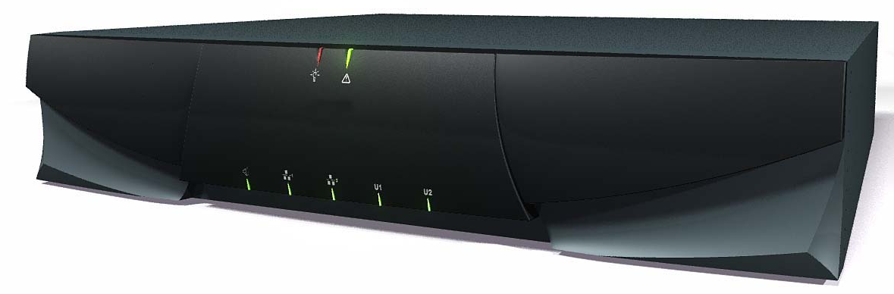
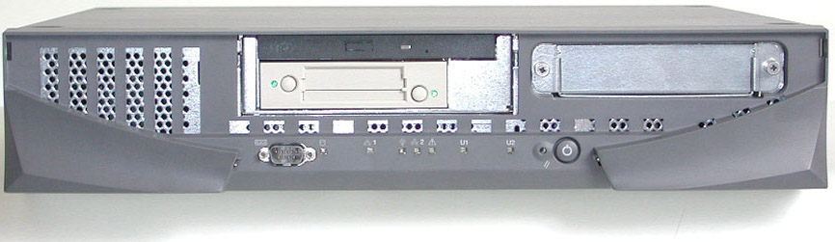
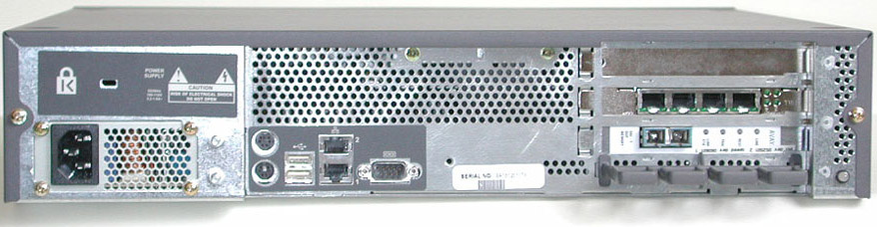
The S8700 Media Server
The S8700 Media Server, Front View
S8700 Media Server with the front cover removed.
Rearview of S8700 Media Server.

Slide 14
Duplication
S8720 Software Duplication-One of the features of the S8720 Server is software duplication. Duplication is the process where data is duplicated, or shadowed between the active and standby servers.
S8720: Duplication Cards :Hardware duplication on the S8720 in XL requires the DAL-2 Duplication Card. DAL-1 Card is used for all other 87XX series for duplication.

Slide 15
Survivability
Communication Manager and its corresponding servers and gateways employ a variety of options to obtain high survivability. Some survivability options are:
Standard Local Survivability (SLS): SLS is capable of providing limited functionality to endpoints connected to the media gateway.
Local Survivable Processor (LSP): If a failure at the main server occurs and the H.248 media gateway at the remote location cannot communicate with the primary server, the LSP takes over active call processing and gateway and endpoint management for the remote site, allowing continuous operation with minimal loss of features until the outage is repaired.
Enterprise Survivable Server (ESS):With an Enterprise Survivable Server (ESS), back up servers are placed in various places in a network so in the event of a failure or lost connectivity to the main server, a server designated as an ESS takes control and communications continue.

Slide 16
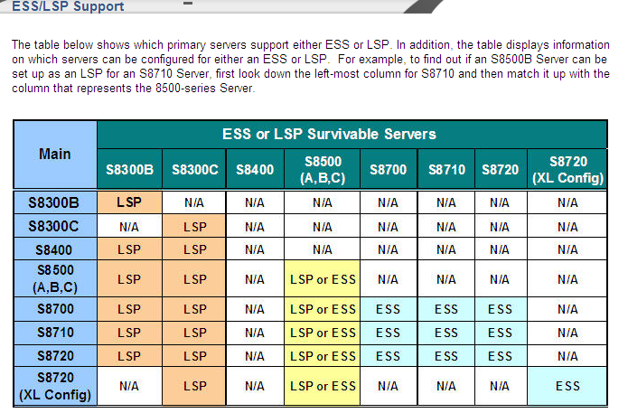

Slide 17
Communication Manager
Communication Manager is designed to provide interconnection of both traditional analog, digital, and IP communication devices in a single communications environment. The ability to act as the bridge for a variety of devices, is given by a mixture of hardware and the use of signaling and protocol support.
Standards-based computing supports the Linux operating system.

Slide 18
Features
Communication Manager offers many features that support systems, not only multinational enterprises but enterprises within a single country. Some of these features are:
Dial Plans
Automatic Alternate Routing (AAR)
Automatic Route Selection (ARS)
Quality of Service (QoS)
Call Admission Control (CAC)
Inter-gateway Alternate Routing

Slide 19
Features …
The Dial Plan feature provides information that Communication Manager uses to interpret the digits that a user dials.
Communication Manager uses (Automatic Alternate Routing)AAR routing information to route calls within a company over a private network.
The system uses (Automatic Route Selection)ARS routing information to route calls that go outside your company over public networks. The system also uses ARS routing information to route calls to remote company locations if you do not have a private network.
Call admission control (CAC) bandwidth management feature of CM allows the customer to specify a VoIP bandwidth limit between any pair of IP network regions.
Inter-Gateway Alternate Routing (IGAR) ensures high quality & availability voice traffic on converged networks. IGAR provides a means of alternately using the PSTN when the IP-WAN is incapable of carrying the bearer connection.

Slide 20
Security
Class of Restriction (COR) allows a system administrator to control the usage of the phone system. Each COR is a class of calling privileges that provide controlled access to special features.
Class of Service (COS) defines groups of users and controls user access to certain features.
Facility Restriction Levels is used to restrict some types of calls to specific users.
Time of Day Station Lock feature is the result of a customer request to enable automatic station locking. With the Time of Day Station Lock feature, the system automatically locks the telephone based upon tables, to prevent others from placing outgoing calls.

Slide 21
Call Routing Intelligence
VDN: A VDN is a “soft” extension number not assigned to a physical equipment location. When answering a call, the answering agent sees the information associated with the VDN on their display. This operation provides dialed number identification service (DNIS), allowing the agent to identify the purpose of the call.
Call Coverage Call Coverage is a feature which defines how an incoming call is handled and routed. Calls can go to an individual or a group of individuals, such as a Hunt Group, to ensure the call is answered.
Collaboration Under the collaboration heading are conferencing features which allow employees to gather from every part of an organization. These features include:
3 and 6 party conferencing
Meet-Me Conferencing
Expanded Meet-me conferencing

Slide 22
Support for End-Users - Call Handling
Last Number Dialed : With the last Number Dialed feature, users can automatically redial the last number dialed at their station.
Abbreviated Dialing is sometimes called speed dialing. This feature allows users to dial a short code to access a desired number.
Automatic Call Back allows users who place a call to an internal phone and receive a busy signal, to be called back with the phone becomes available. With this feature, the system monitors the called telephone. When the called phone becomes available, the system generates the Automatic Call Back and the originating party receives priority.

Slide 23
Avaya Media Gateways
Avaya Media Gateways connect to an Avaya Server, either directly or indirectly through other media gateways. Media gateways are the stackable and modular hardware elements of a communication system. They deliver connectivity to a variety of endpoint and trunk types allowing data, voice, FAX, video, and messaging capabilities on the network. Avaya Media Gateways support both bearer network connections, and control network connections.
Avaya Media Gateways also provide a variety of flexible deployment options, including 100% Internet Protocol (IP) environments and blended environments such as IP and Time Division Multiplexing (TDM).
There are two types of media gateways that may be described as H.248 Gateways and Port Network (PN) Gateways.
H.248 gateways use media modules (MM prefix) to connect to endpoints and trunks.
PN Type media gateways use circuit packs.

Slide 24
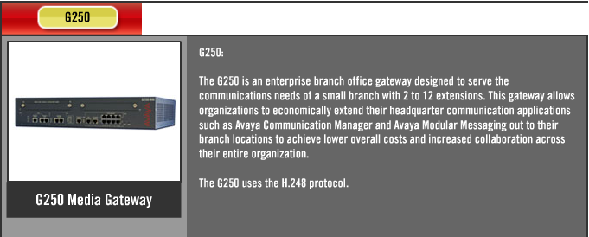

Slide 25
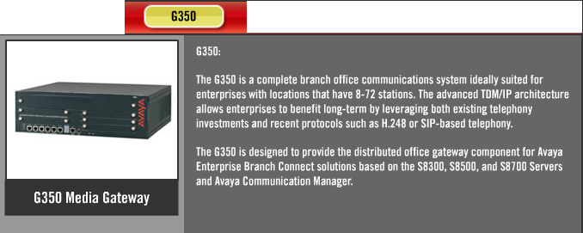

Slide 26
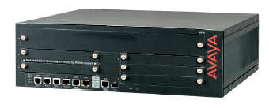
G350 Media Gateway
High density Media Module slot (V6)
V2
Optional S8300 slot (V1)
Built-in analog media module (V7)
Media Module slots (V3 to V5)

Slide 27
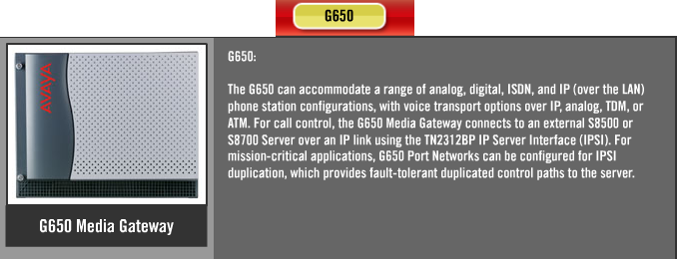

Slide 28
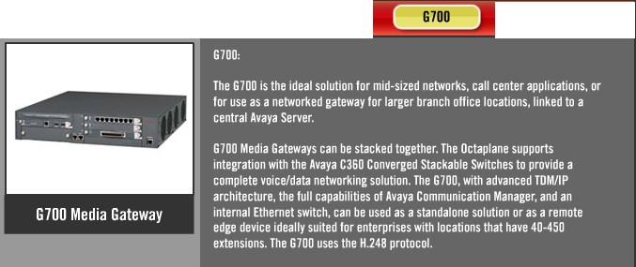

Slide 29
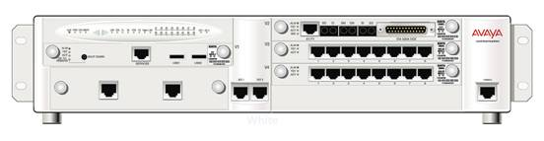
G700 Media Gateway – The Box
S8300 Integrated Media Server (optional)
LED Module
Media Module Bays
Expansion Module
10/100 Base-T Ethernet Ports
Serial CLI Connector

Slide 30
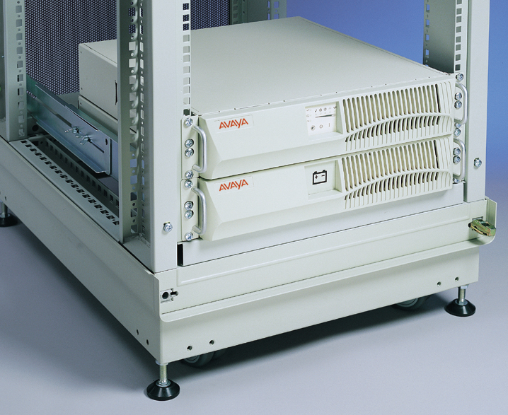
UPS Units in Rack

Slide 31
Thank You

