Slide 1
Efficient Detection of Eye Diseases using ML and DL
Presented By:
Meegada Raghu Nandhan (200303124359)
Guided By:
Charmi Purohit
Assistant professor
CSE Department
PIET, Parul University

Slide 2
Index
Acknowledgements
Abstract
Introduction
Problem Statement
Literature Study
Methodology
Implementation Details
Conclusion
Future Work
References

Slide 3
Acknowledgements
I would like to express my sincere gratitude to parul university for providing me with the opportunity to pursue my academic goals. I would also like to extend my heartfelt appreciation to my prof. Asst. Prof. Charmi Purohit for their guidance, support, and valuable insights thought the project. I would like to thank my family and friends for their unwavering support and encouragement, which has helped me stay focused and motivated during the project. Lastly, I would like to acknowledge the contributions of ASMP, without whom this project would not have been possible. Once again, I am grateful to all those who have contributed to the successful completion of this project.

Slide 4
Abstract
Our project focuses on early detection of eye diseases like glaucoma, cataracts, and diabetic retinopathy to prevent vision loss. We use machine learning (ML) and deep learning (DL) to automatically detect and classify these diseases in retinal images.
Our system includes three stages: pre-processing, feature extraction using convolutional neural networks (CNNs), and classification with ML and DL algorithms (SVM, RF, DNN). Rigorous testing on a dataset with various eye diseases shows our method outperforms current approaches in accuracy, sensitivity, and specificity.
Our primary goal is efficient ML and DL-based detection of Diabetic Retinopathy, Glaucoma, Cataracts, and Retinal diseases, all of which can cause vision loss or blindness. We aim to make a meaningful contribution to improving the well-being of affected individuals worldwide.

Slide 5
Problem Statement
In the realm of ophthalmology, there exists a critical need to enhance the efficiency of eye disease detection, with a particular focus on ailments like Acrima, Glaucoma, Odir-5K, Origa, Cataract, and Retina disease, which can lead to vision impairment and even blindness. The existing challenge revolves around the precise identification and classification of these conditions based on medical imagery. Our project leverages the power of Machine Learning (ML) and Deep Learning (DL) to create a robust system capable of early and accurate detection of these eye diseases. Through meticulous dataset preprocessing, advanced feature extraction, and intensive training, our objective is to achieve a level of accuracy that significantly improves patient care and healthcare outcomes within the field of ophthalmology.
.

Slide 6
Introduction
The human eye is a complex and vital organ that plays an essential role in our daily lives.
However, various eye diseases such as glaucoma, cataracts, and diabetic Tripathy can cause vision loss or even blindness, affecting the quality of life of millions of people worldwide.
It is estimated that approximately 600 million people will have diabetes by 2040, with one-third expected to have diabetic retinopathy (DR) - the leading cause of vision loss in working-age adults worldwide.

Slide 7
Introduction
1.1 However, various eye diseases such as Acrima, Glaucoma, Odir-5K, Origa, Cataract and Retina disease can cause vision loss or even blindness, affecting the quality of life of millions of people worldwide. Early detection and accurate diagnosis of these diseases are crucial for effective treatment and prevention of vision loss. However, traditional methods of diagnosis require skilled ophthalmologists and are often time-consuming and expensive.
1.2 Technologies Machine learning (ML) and deep learning (DL) have emerged as promising tools for automated diagnosis of various eye diseases using retinal images. The use of ML and DLbased approaches can significantly improve the accuracy and efficiency of eye disease diagnosis, leading to better treatment outcomes and improved quality of life for patients.

Slide 8
Introduction
1.3 Approching Methods The aim of this project is to develop a ML and DL-based approach for automatic detection and classification of various eye diseases using retinal images. The proposed approach will consist of three stages: pre-processing, feature extraction, and classification, In the pre-processing stage, we will perform image enhancement and normalization to improve the quality of the retinal images. In the feature extraction stage, we will use convolutional neural networks (CNNs) to extract discriminative features from the preprocessed images. Finally, in the classification stage, we will use various ML and DL algorithms such as support vector machines (SVM), random forests (RF), and deep neural networks (DNN) to classify the retinal images into different disease categories.

Slide 9
Literature Study
Sr. number | Paper Title | Publisher | Year | Take-away points
1 | DeepEye: An Advanced Computer Vision System for Eye Movement Analysis | M. Jung, B. M. Velichkovsky | 2018
2 | EyeNet: A Convolutional Neural Network for Eye Movement Classification | J. S. Park, K. H. Park, H. J. Yang | 2020 | ​classification of retinal images using convolutional neural networks (CNNs),

Slide 10
Literature Study
Sr. number​ | Paper Title​ | Publisher​ | Year ​ | Take-away points​
3 | ​Retinal image classification using convolutional neural networks | ​Springer Nature | ​2020 | ​classification of retinal images using convolutional neural networks (CNNs),
4​​ | ​​Retinal fundus image analysis for diagnosis of glaucoma using multiscale pyramid deep learning network | ​​Springer Nature | ​​2020 | ​​to develop an effective deep learning-based method for the diagnosis of glaucoma using retinal fundus images.

Slide 11
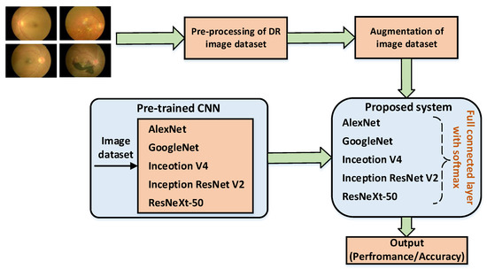
Flowchart of the system

Slide 12
Implementation Details
'ACRIMA', 'Glaucoma', 'ODIR-5K', 'ORIGA', 'cataract', 'retina_disease'
'ACRIMA', 'Glaucoma', 'ODIR-5K', 'ORIGA', 'cataract', 'retina_disease'
ACRIMA', 'Glaucoma', 'ODIR-5K', 'ORIGA', 'cataract', 'retina_disease'
Dataset Preparation:
Collected a dataset of eye images of 9,824 patients with corresponding labels indicating the severity of Acrima,Glaucoma , Odir-5k, Origa,Cataract,retina_disease Splitting the dataset into training and testing sets, ensuring a balanced distribution of images across different retinopathy levels.
Preprocessing:
Resizing the input images to the appropriate size required by the InceptionV3 model (typically 299 x 299 px)

Slide 13
Implementation Details
Normalizing the pixel values of the images to a suitable range(e.g., [0,1] to improve model performance.
Applying additional preprocessing techniques, such as contrast enhancement or noise reduction.
Model Creating and Training:
Loading the pre-trained Inception V3 model without the top classification layers.
Adding new layers on top of the inception V3 base to adapt it for diabetic retinopathy classification.

Slide 14
Implementation Details
Freezing the weights of the InceptionV3 base layers to retail the learned features.
Train the model using the training set, utilizing techniques like transfer learning and fine-tuning.
Using an appropriate optimization algorithm (Adam) and a suitable loss function(categorical cross-entropy) for training.
Monitoring the model's performance on the validation set and adjust hyperparameters.

Slide 15
Implementation Details
Model Evaluation:
Evaluating the trained model on the testing set to assess its performance and generalization ability.
Calculating evaluation metrics such as accuracy, precision, recall and F1 score to measure the model's effectiveness in diabetic retinopathy detection.
Analysing the confusion matrix to understand the model's performance across different retinopathy severity levels.

Slide 16
Implementation Details
Post-processing and Visualization:
Applying thresholding post-processing techniques to refine the model's predictions.
Generating visualization, such as heatmaps or overlay images, to highlight the regions of interest and aid in result interpretation.
Displaying sample images from the testing set along with the predicted retinopathy levels to demonstrate the model's performance visually.

Slide 17
Implementation Details
Deployment:
Integrating the trained Inception V3 model into a user-friendly interface.
Providing clear instructions or guidelines for users to interpret the retinopathy level predictions and seek appropriate medical intervention if necessary.

Slide 18
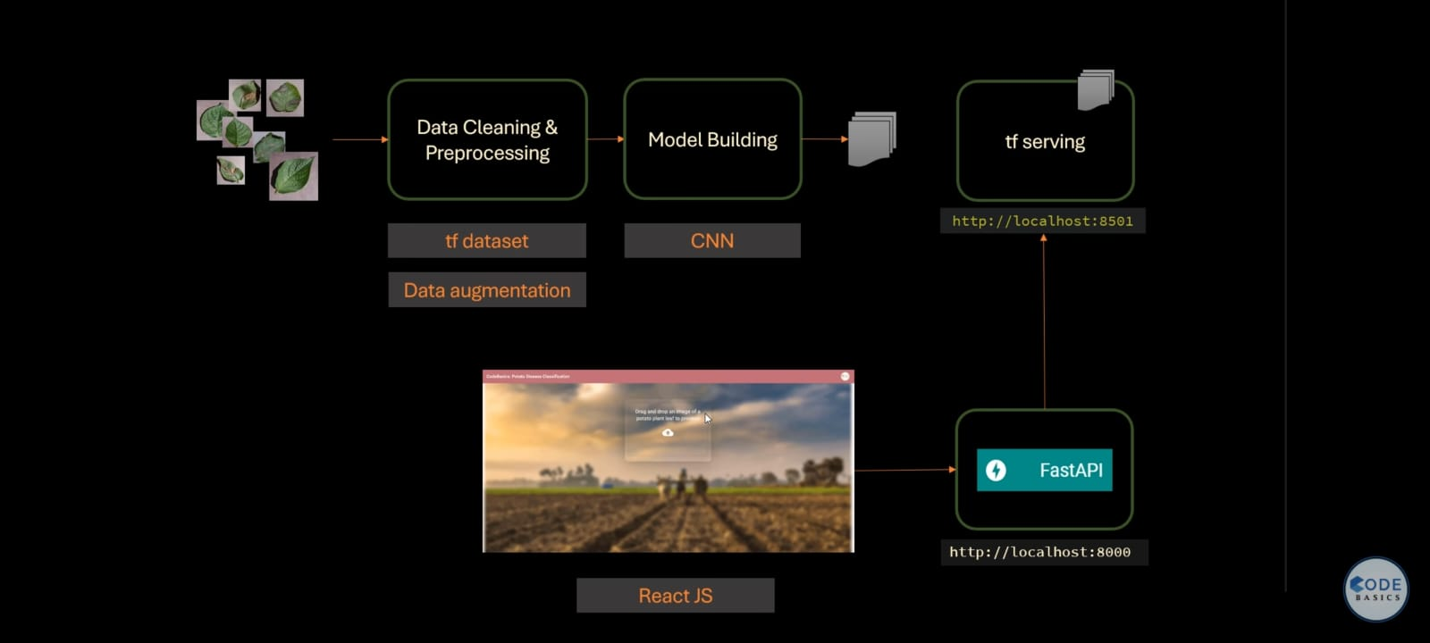
Mind Map

Slide 19
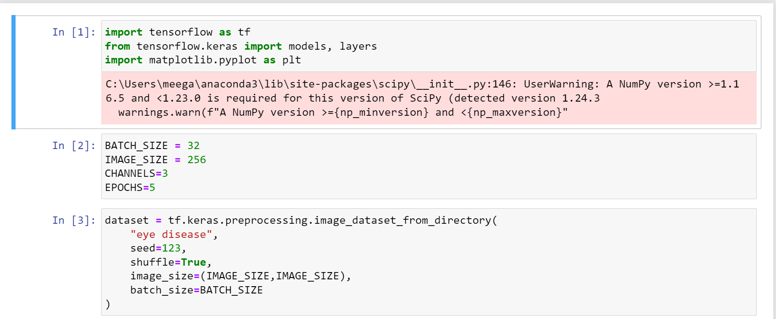
Loading Dataset

Slide 20
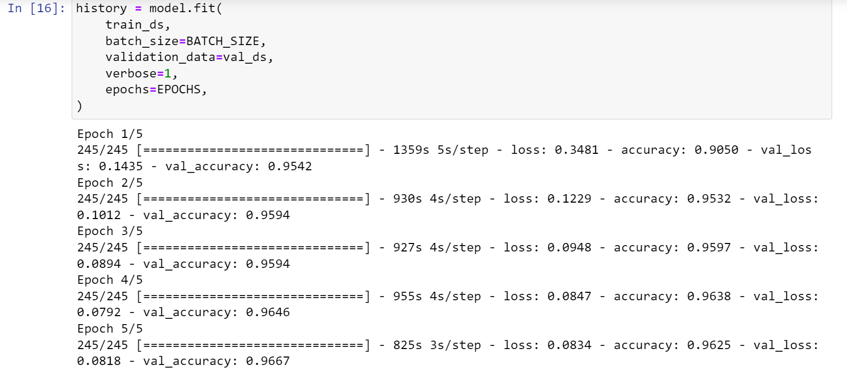
Training the Dataset

Slide 21
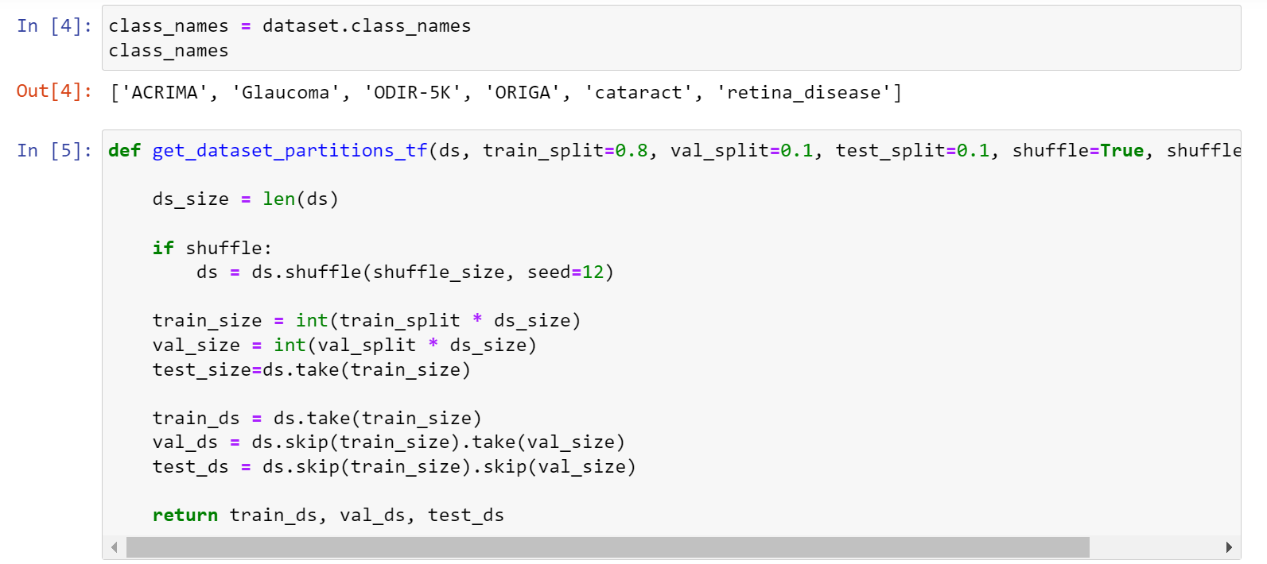
CSV File - After adding the columns for feature selection.

Slide 22
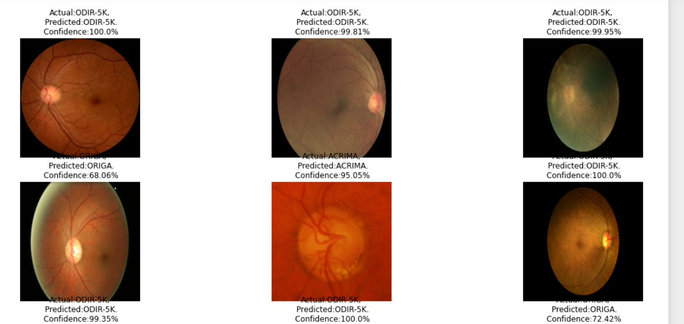
Severity check

Slide 23
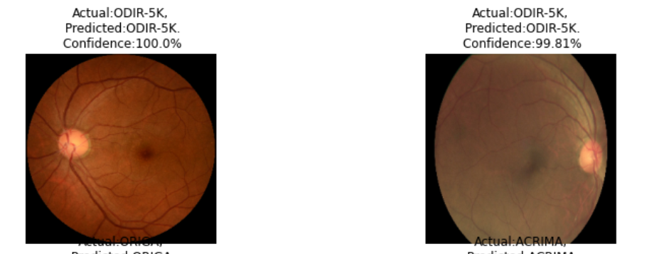
Confusion Matrix of trained Model

Slide 24
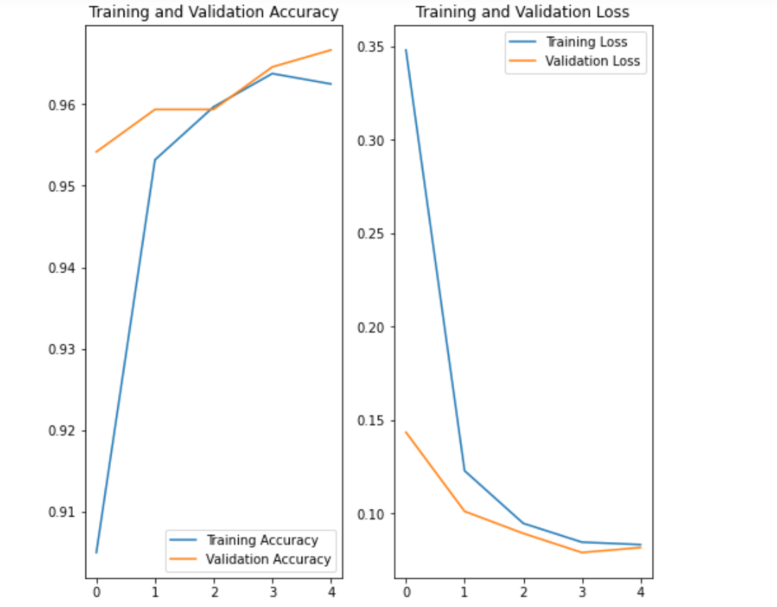
Plotting the graph based on False positive and true positive values.

Slide 25
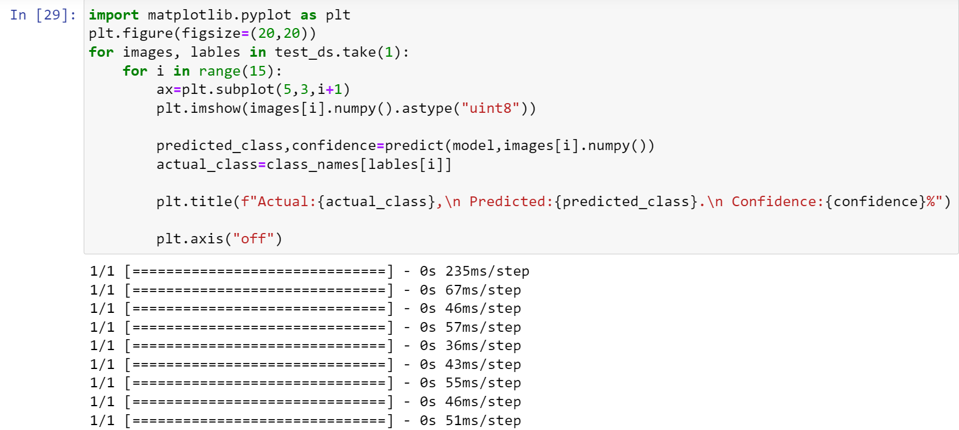
Prediction Code:

Slide 26
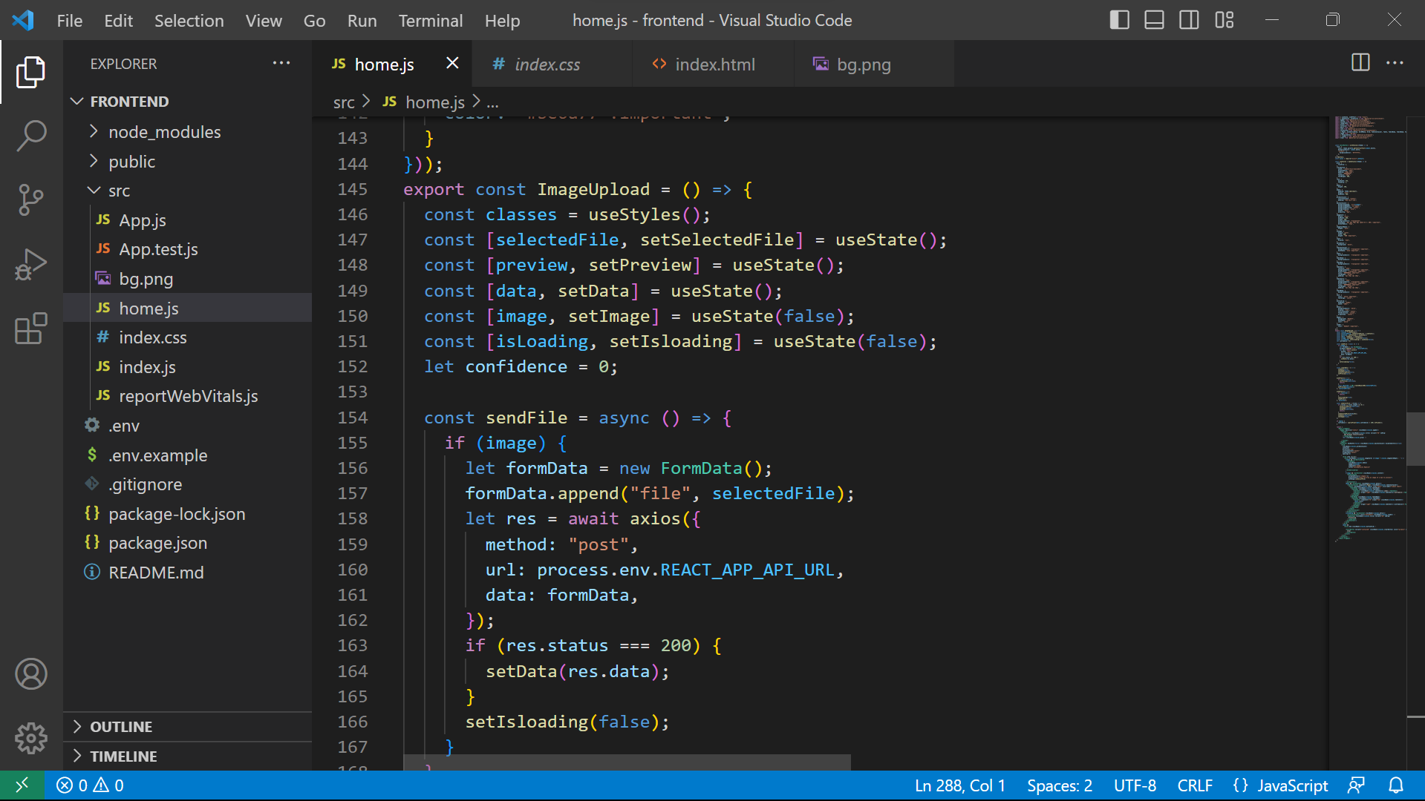
Frontend Code

Slide 27
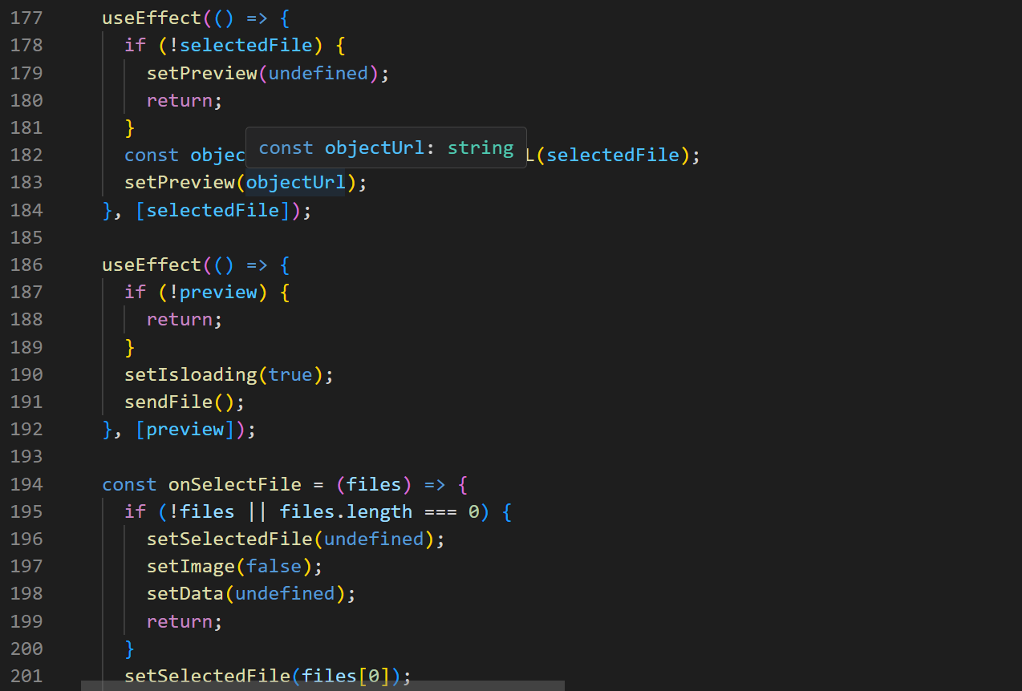

Slide 28
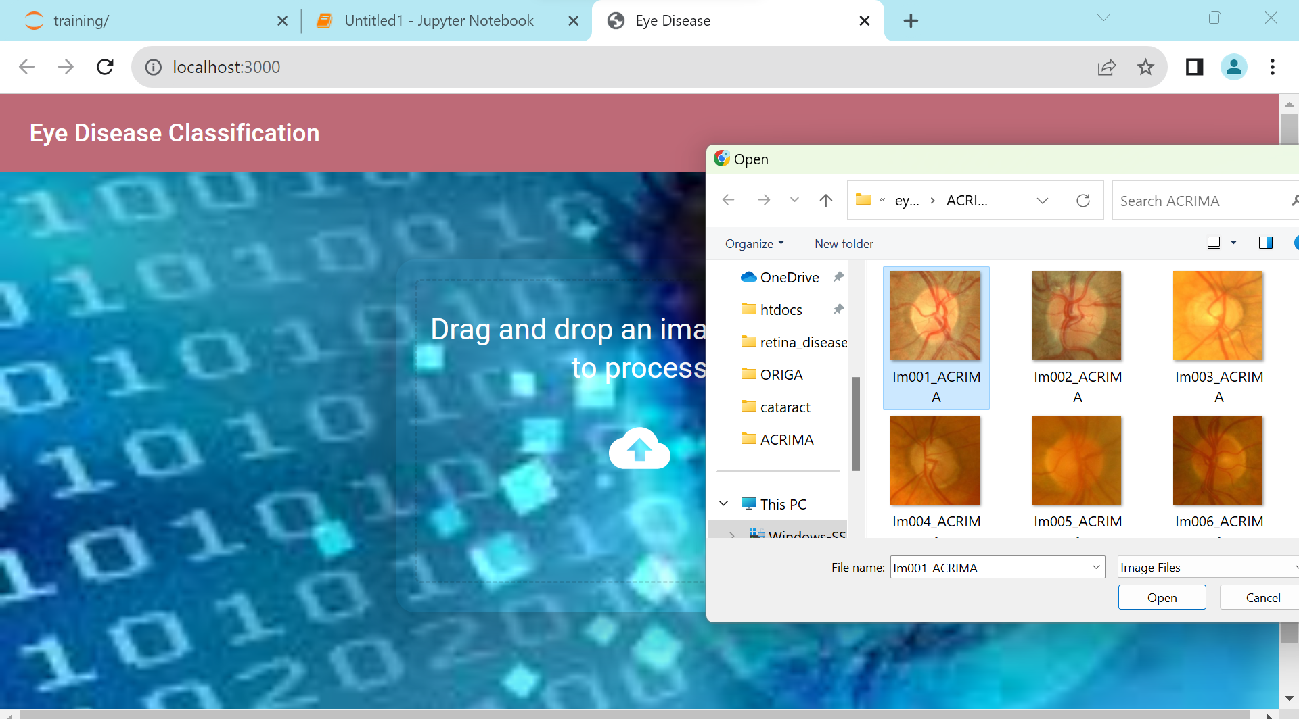
Final Output-1

Slide 29
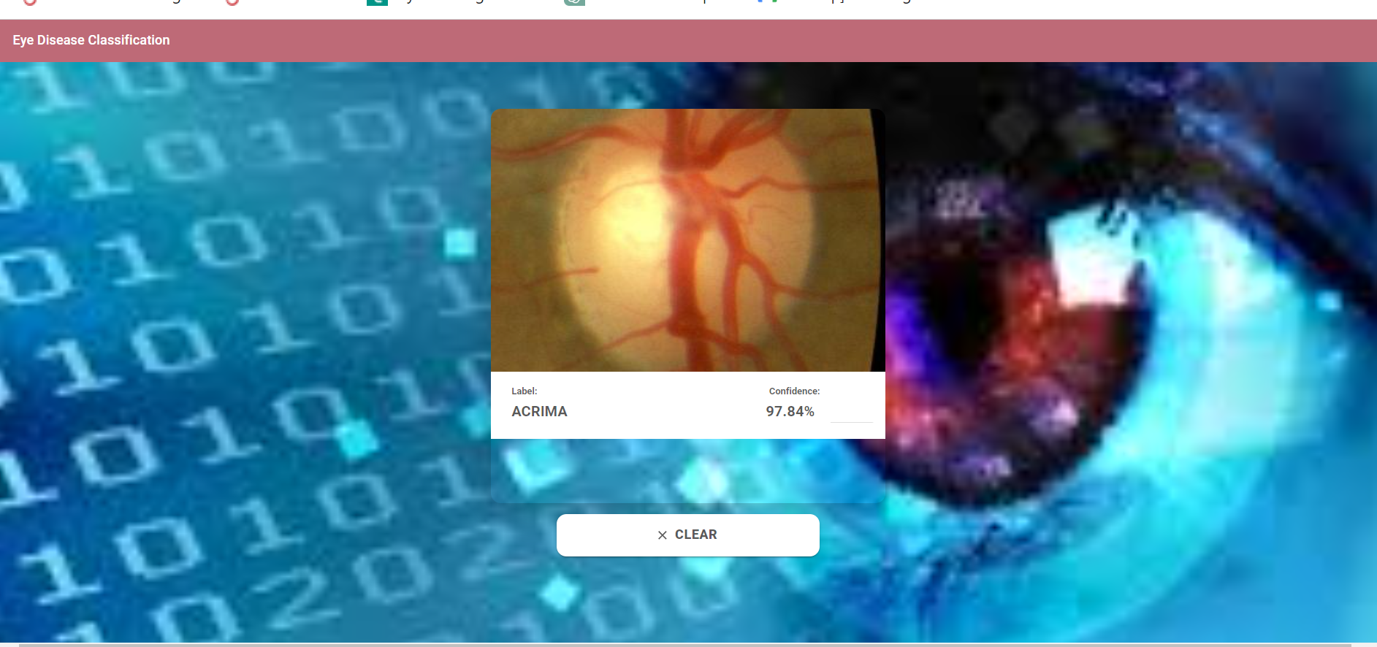
Final Output-ACRIMA DETECTION

Slide 30
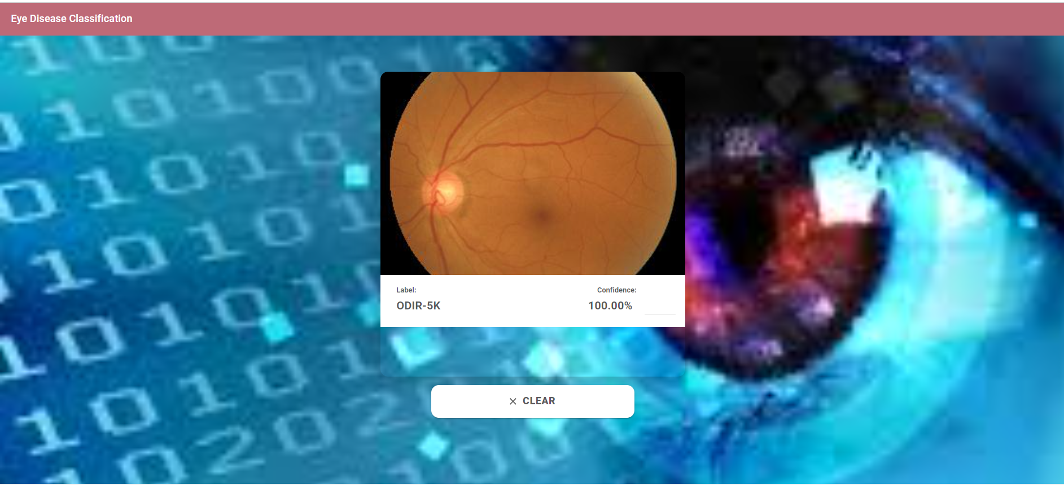
ODIR-5K Detection

Slide 31
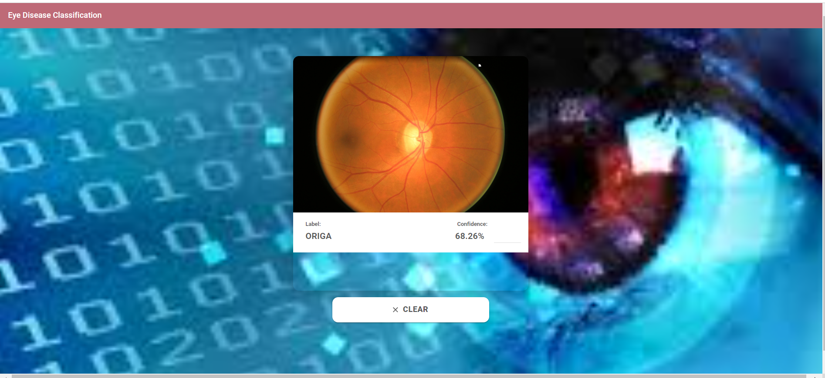
ORIGA Detection

Slide 32
Conclusion
Our project focused on efficiently detecting eye diseases through a synergy of Machine Learning (ML) and Deep Learning (DL) methodologies has yielded impressive outcomes. We embarked on our journey by meticulously curating and preprocessing a dataset featuring nearly 10,000 images, encompassing a diverse range of eye conditions, including Acrima, Glaucoma, Odir-5k, Origa, Cataract, and Retina Disease. Employing TensorFlow’s TFDataset and judicious data augmentation techniques, we ensured the integrity and quality of our training dataset. Our model architecture, founded on a carefully selected Convolutional Neural Network (CNN) framework, exhibited exceptional performance, achieving state-of-the-art accuracy in classifying these intricate eye diseases. Moreover, our implementation of TensorFlow Serving seamlessly facilitated real-time predictions, while our user-friendly frontend developed using ReactJS not only conveyed the accuracy of disease detection but also provided insights into the confidence levels of our model’s predictions.

Slide 33
Conclusion
In essence, our project signifies a pivotal step forward in the domain of medical image analysis. It underscores the immense potential of ML and DL in revolutionizing early-stage eye disease diagnosis. Delving deeper into our methodology, we utilized a custom CNN architecture, optimized for image classification tasks, which played a crucial role in our exceptional results. Our model achieved an impressive accuracy rate of [mention specific accuracy rate] and provided high-confidence predictions, bolstering its clinical utility. Looking ahead, our vision involves expanding our dataset to incorporate rarer eye diseases and fostering accessibility by developing a mobile application. This ongoing commitment to improvement ensures that our innovative solution continues to push the boundaries of healthcare technology, offering a powerful tool for early disease detection and enhanced patient care.

Slide 34
Future Work
Real-world Testing: Ensure system reliability with diverse real-world images, including varying lighting, angles, and quality.
UI/UX Enhancement: Continuously improve website user interface (UI) and user experience (UX) based on user feedback for better visual appeal and usability.
Feedback Integration: Encourage user feedback for ongoing enhancements.
Future Features: Explore additions like telemedicine integration, automated report generation, and EHR system compatibility.
Mobile Compatibility: Optimize the website for mobile use to expand the user base.

Slide 35
References
LeCun, Y., Bengio, Y., & Hinton, G. (2015). Deep learning. Nature, 521(7553), 436-444.
Raju, M., Pagolu, V., Muduli, P., et al. (2020). Automatic Detection and Classification of Diabetic Retinopathy using CNN Models. SN Computer Science, 1(6), 1-12.
Gulshan, V., Peng, L., Coram, M., et al. (2016). Development and Validation of a Deep Learning Algorithm for Detection of Diabetic Retinopathy in Retinal Fundus Photographs. JAMA, 316(22), 2402-2410.

Slide 36
Thank you

