Slide 1

EDA
Nutritional Insight through Data Exploration and Its Impact on Disease Risk & Analysis

Slide 2

Problem Statement:This includes analyzing the nutritional values of various foods, uncovering patterns and relationships between different nutrients,¶
The goal of this project is to perform an in-depth Exploratory Data Analysis (EDA) on a comprehensive nutrition dataset.
and extracting insights that can guide healthy food choices

Slide 3
AIM OF THE PROJECT
This project can simulate real-world applications such as:
Fitness & diet planning
Diabetic and heart-health diet customization
Micronutrient deficiency alert systems
Balanced school/canteen meal planning

Slide 4
Dataset Analysis:
Macronutrients: calories, protein, total_fat, fat, saturated_fat, saturated_fatty_acids, monounsaturated_fatty_acids, polyunsaturated_fatty_acids, fatty_acids_total_trans, carbohydrate, fiber, sugars, fructose, galactose, glucose, lactose, maltose, sucrose
Micronutrients – Vitamins: vitamin_a, vitamin_a_rae, carotene_alpha, carotene_beta, cryptoxanthin_beta, lutein_zeaxanthin, lucopene, vitamin_b12, vitamin_b6, niacin, folate, folic_acid, pantothenic_acid, riboflavin, thiamin, vitamin_c, vitamin_d, vitamin_e, tocopherol_alpha, vitamin_k
Micronutrients – Minerals: calcium, copper, irom, magnesium, manganese, phosphorous, potassium, selenium, zink, sodium, choline Amino Acids: alanine, arginine, aspartic_acid, cystine, glutamic_acid, glycine, histidine, hydroxyproline, isoleucine, leucine, lysine, methionine, phenylalanine, proline, serine, threonine, tryptophan, tyrosine, valine
Other Components: cholesterol, alcohol, ash, water, caffeine, theobromine

Slide 5
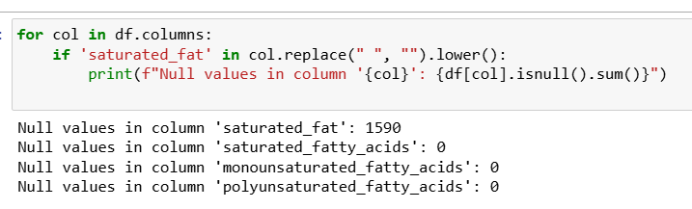

MISSING VALUES

Slide 6
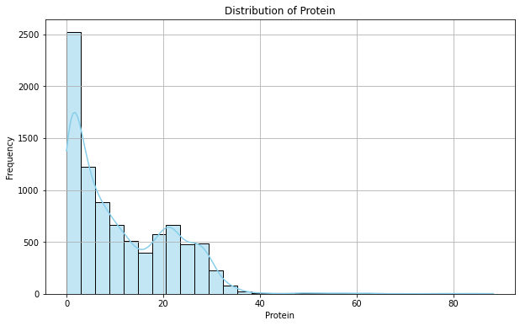
HISTOGRAM PLOT Mean: 11.35, Median: 8.02, Std: 10.53 Skewed Right: A small number of foods are very high in protein Recommendation: - Aim for protein-rich foods (>10g) for muscle and repair

Slide 7
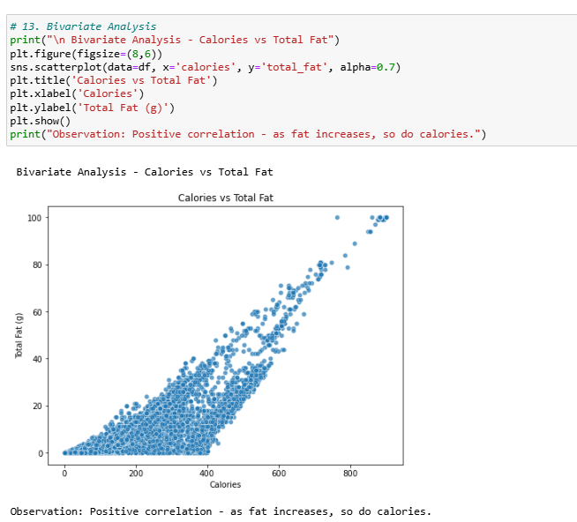

Slide 8
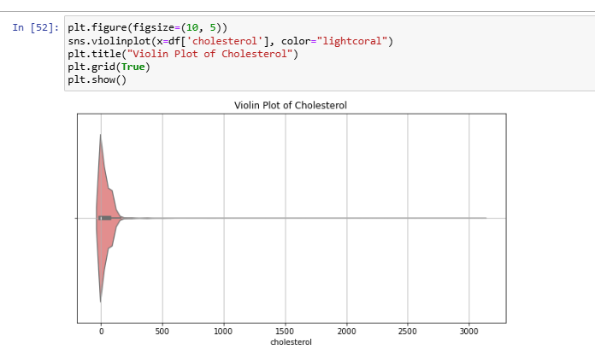
Violin plot
A violin plot is a powerful data visualization tool that combines the features of a box plot and a kernel density plot (KDE).
A violin plot shows:
The distribution of a continuous variable.
The probability density of the data at different values.
Summary statistics like median, interquartile range (like a box plot).
A mirror image of a KDE plot around the center.

Slide 9
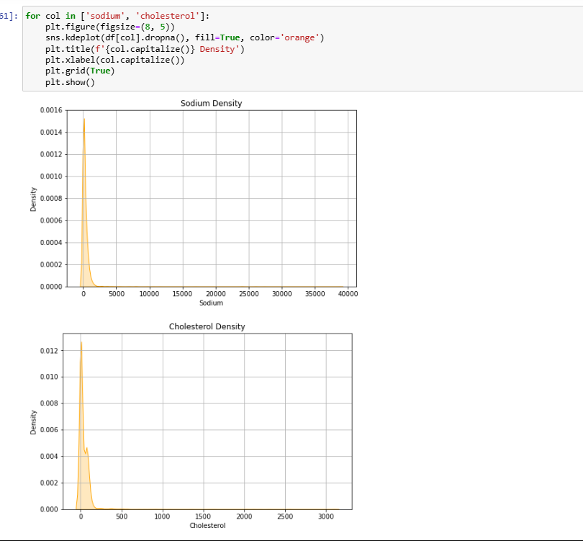
KDE plot: Kernel Density Estimate is a smooth curve that estimates the probability distribution of a continuous variable. It’s an alternative to histograms but smoother and more precise.

Slide 10
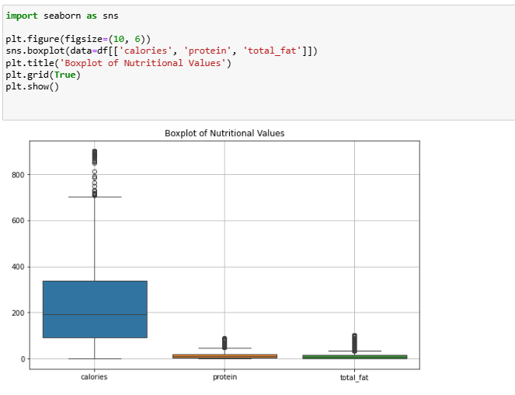
A box plot is a graphical representation of the distribution of a numerical dataset that highlights its central value, spread, and outliers. It's one of the most effective tools for univariate analysis in EDA.

Slide 11

THANK YOU

