Slide 1
Platform as code, governance and costs
Part 4 · Soumaya
Who can change the platform, who sees which data, and what it costs
Notes:
[Soumaya, 15 seconds.]
Thank you Hadiqa. My part is everything around the pipeline: how the platform itself is built and changed, who is allowed to see which data, and what all of this costs. Three questions the pharmacy network would ask before trusting us with its stock data: can anyone break it by hand, can a pharmacist see another hospital's prices, and is it worth the money.

Slide 2
One repo controls Snowflake and AWS, and its state lives in S3
GitHub repo
terraform/
one file per topic: platform, roles, governance, archive, costs
Terraform
plan, read it, apply
then plan again: "No changes"
Snowflake · Paris (Snowflake's own AWS)
warehouse, database, schemas, roles, access rules, archive stage
›
›
Our AWS account · Stockholm
state bucket, archive bucket with its lifecycle, IAM access
›
Remote state in S3
Versioned, encrypted, locked during a run: two people cannot apply at once
Least privilege
RSA-key service user: SYSADMIN for objects, SECURITYADMIN for grants, never ACCOUNTADMIN
Kept out, on purpose
Tables (dbt and ingestion own them); dbt project, task, dashboard (deployed from Git)
Terraform 1.17.1 · providers snowflakedb/snowflake 2.22.1 and hashicorp/aws 6.71.0, all pinned · full diagram in the appendix (docs/terraform_architecture.png)
Notes:
[Soumaya, 45 seconds.]
Everything that lasts in our platform is written as code in one repo: the Snowflake warehouse, database, schemas, roles and access rules, and on our own AWS account the buckets and the IAM access. Terraform keeps its memory, the state, in an S3 bucket that is versioned, encrypted and locked during a run, so two of us can never apply at the same time. It signs in as a service user with a key, never as ACCOUNTADMIN. Tables are not in Terraform on purpose: they change every day and belong to dbt and the ingestion jobs. For the hospitals, this means the platform can be rebuilt identically and every change is reviewed.

Slide 3
A change made by hand is caught by the next plan
LIVE DEMO
1 · Plan
Snowflake matches the code
2 · Edit by hand in Snowsight
Someone changes the auto-suspend
›
No changes. Your infrastructure
matches the configuration.
ALTER WAREHOUSE MEDIRELAIS_WH
SET AUTO_SUSPEND = 300;
3 · Plan shows the drift
Terraform wants the code's value back
4 · Apply, then plan again
Reviewed, typed yes, back in line
›
~ auto_suspend = 300 -> 60
Plan: 0 to add, 1 to change, 0 to destroy.
Apply complete! 0 added, 1 changed
No changes.
Also caught for real: the resource monitor attached by hand showed up as drift, so it is now declared in platform.tf. Imports took over the first objects without recreating them; prevent_destroy guards the database and schemas.
Notes:
[Soumaya, 45 seconds. Run it live if time allows; the screenshots are the backup.]
This is what remote state and a plan buy us. First, the plan says no changes: Snowflake matches the code. Then someone sets the warehouse's auto-suspend to 300 seconds by hand in Snowsight. The next plan shows exactly that change, 300 back to 60, one resource to change. I read it, apply it, and the plan is clean again. It happened for real today too: attaching the cost monitor by hand appeared as drift, so I declared it in the code. A forgotten manual setting is what quietly costs money or opens access; here it cannot hide.

Slide 4
Old raw data leaves Snowflake for cheap S3 tiers
Days 0–90 · S3 Standard
readable at once
After 90 days · Glacier
cheaper, restore first
After 1 year · Deep Archive
storage costs almost nothing
›
›
What goes there
Each hospital's daily consumption rows, as Parquet, one folder per day
Kept to replay a day after an incident, and for audit
How Snowflake writes
Today: an IAM user allowed on this bucket only; its key is never typed
Target, already coded: no key, an IAM role trusted by the storage integration
Known trade-off
Snowflake is in Paris, the bucket in Stockholm: the only region the AWS Free plan allows
Both in the EU; the copy is a billed cross-region transfer
terraform/archive.tf · bucket private (public access blocked) and encrypted (AES256) · the nightly copy is tested by hand; running it as the last Airflow step is planned
Notes:
[Soumaya, 40 seconds.]
Raw data that bronze no longer needs leaves Snowflake for our own S3 bucket, as Parquet, one folder per day. For example, each hospital's daily consumption rows. It stays readable for 90 days for replays and audits, moves to Glacier, then to Deep Archive after a year, where storage costs almost nothing. Today Snowflake writes with an IAM user restricted to this bucket; the keyless version with a role is already coded, but the AWS Free plan blocks it. One trade-off I want to be clear about: the bucket is in Stockholm, so the copy crosses regions. It is tiny today, and moves to Paris after an upgrade.

Slide 5
Each role sees only what its job needs, enforced by Snowflake
Role | Rows in GOLD | Purchase price
Pipeline (builds the tables) | all | visible
Finance | all | visible
Reader: the network dashboard | all | hidden
Pharmacist H01, H04 | own hospital only | hidden
Platform admins (SYSADMIN, ACCOUNTADMIN) | all | hidden
No patient data
Stock and consumption per hospital and product only
Data owners
Manel: sources, bronze
Hadiqa: silver, gold
Soumaya: access rules, platform, archive, costs
Reader roles read GOLD only: READER querying BRONZE is refused · rules in terraform/governance.tf and roles.tf
Notes:
[Soumaya, 40 seconds.]
Governance starts with a simple rule: each role sees only what its job needs, and Snowflake enforces it, not the dashboard. Finance and the pipeline see negotiated purchase prices; nobody else does, not even the platform admins. A pharmacist sees only their own hospital. The network dashboard sees every hospital but no prices. Reader roles only ever read the gold layer. There is no patient data at all: only stock and consumption per hospital and product. And every layer has an owner: Manel for sources and bronze, Hadiqa for silver and gold, me for the access rules, the platform, the archive and the costs.

Slide 6
The rules live in Terraform and survive every daily rebuild
LIVE DEMO
Terraform
defines 2 row rules and 1 price mask
dbt
rebuilds gold every morning
Post-hooks
re-attach the rules; cannot rewrite them
Each role queries
rows filtered, prices masked
›
›
›
CURRENT_ROLE()
Snowsight turns on all roles: otherwise an admin testing as H01 sees everything
Dashboard made by READER
A Streamlit app runs with its owner's rights: all hospitals, no prices
Audit
ACCESS_HISTORY: who read which gold table, with which role (257 reads in 7 days)
Live check: H01 sees only H01 · H04 sees the transfer H09 → H04 · READER: 21 batches, prices empty · FINANCE: prices (max €1,150) · READER on BRONZE: refused
Rules: terraform/governance.tf · re-attached by medirelais_dbt/dbt_project.yml · checked with snowflake/04_access_check.sql
Notes:
[Soumaya, 50 seconds. Live: run 04_access_check.sql block by block.]
The rules themselves live in Terraform: two row rules, one for hospitals and one for transfers, and a mask on the purchase price. dbt rebuilds gold every morning, which would drop them, so its post-hooks attach them again; the pipeline can apply the rules but cannot change them. Two details matter. The rules check the current role, because Snowsight activates all your roles at once. And the dashboard is created by the READER role, so it shows every hospital and no prices. Live: H01 sees only its batch, H04 sees the heparin coming from H09, finance sees prices, and the reader is refused on bronze.

Slide 7



FinOps on MédiRelais: see it, cap it, then optimise it
Visibility
Control
Optimization
COST_CENTER tag on the warehouse and the database
Query tags: dashboard now, dbt from the next deploy
Showback per role: roles map to teams
Daily cost queries in 05_costs.sql
Resource monitor: 10 credits a month (≈ €33)
Email at 75%, no new queries at 90%, stop at 100%
Auto-suspend after 60 s idle
AWS budget alert: planned
Query acceleration off: our tables are small
XSMALL warehouse, right-sized
Dashboard cache of 1 hour, from the next deploy
Cold data to Glacier and Deep Archive
The three pillars from the FinOps session (2 Nov) · code: terraform/costs.tf, terraform/platform.tf, snowflake/05_costs.sql
Notes:
[Soumaya, 40 seconds.]
For costs I followed the three FinOps pillars from the course. Visibility: every object that bills carries a cost-center tag, queries carry query tags, and because our roles map to teams, we can show each team what it spends. Control: a resource monitor caps the warehouse at 10 credits a month, about 33 euros, with an email at 75% and a stop at 90 and 100%, plus auto-suspend after 60 seconds idle. Optimization: query acceleration is off because our tables are small, the warehouse is extra-small, the dashboard reuses results for an hour, and cold data goes to Glacier.

Slide 8
Building the platform cost €16 in 30 days; the daily dbt build costs about €4 a month
€0.14
per dbt build: 25–40 s, ≈ 0.04 credits
€0.001 a month
storage: the database holds 57 MB
0.09 MB
archive copy Paris → Stockholm: cross-region, billed
Measured on 3 Nov 2026 with snowflake/05_costs.sql, last 30 days · $3.90 per credit (Snowflake rate sheet) · €/$ 0.86 assumed · dbt build measured on the task runs of 31 Oct and 1 Nov
Notes:
[Soumaya, 45 seconds.]
These are measured numbers, not estimates: 16 euros 35 over the last 30 days, at 3.90 dollars a credit, and almost all of it is the cost of building the project. The showback tells the real story: 55% is idle time, the warehouse running with no query, and 37% is the dashboard; the pipeline itself is only 6%. One dbt build takes 25 to 40 seconds and costs about 14 cents, so about 4 euros a month. Storage is negligible at 57 megabytes. And here is the cross-region transfer to Stockholm: tiny, but billed, and I would rather show it than have it found.

Slide 9
Every euro of platform saves about €470 of medicine
Next steps
€7,700
saveable by 5 transfers, out of €38,474 at risk
€16.35
platform cost, last 30 days
≈ €470 saved per €1 spent
Workload isolation: the dashboard on its own small warehouse, so its cost and idle time are separate
Chargeback later: showback now; real budgets per team once the numbers are trusted
TCO: count Airflow's maintenance time: open source is free to license, not to run
Shutdown plan: suspend the warehouse, delete the archive key and the buckets after the course
€7,700: suggested transfers on the latest snapshot (one day) · €16.35: platform cost over 30 days, mostly development · the next steps are recommendations, not built
Notes:
[Soumaya, 40 seconds.]
To link it back to the business: on our latest snapshot, five suggested transfers can save 7,700 euros of medicine, against 16 euros of platform over 30 days, about 470 euros saved per euro spent. To be fair, the 7,700 is one day and the 16 euros is a month of mostly development, so it is an order of magnitude, not a forecast. Next, I would give the dashboard its own warehouse to isolate its cost, keep showback before moving teams to chargeback, count Airflow's maintenance time in its total cost of ownership, and shut the platform down cleanly after the course.

Slide 10
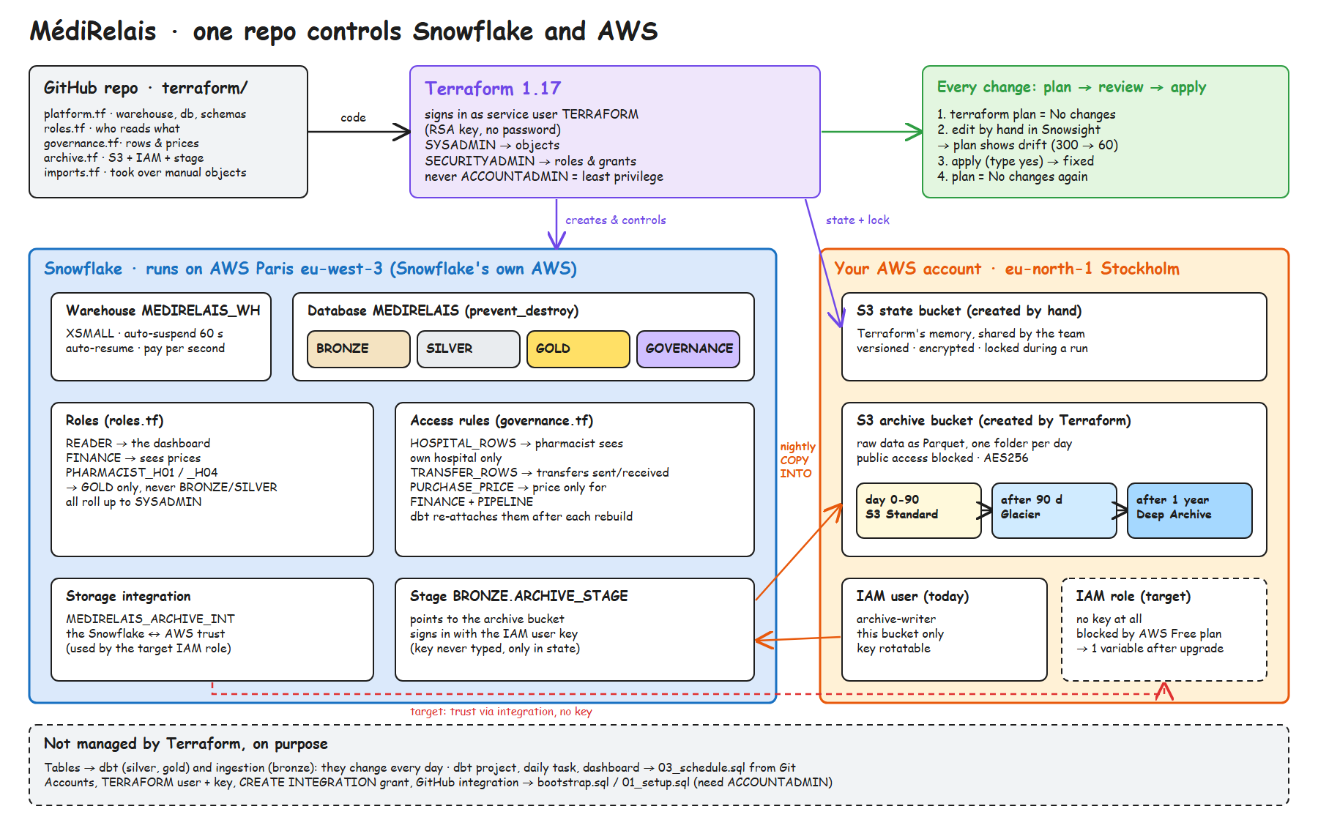
Architecture in detail
Editable source: docs/terraform_architecture.excalidraw
Notes:
[Backup slide, for questions.]
The full picture: what each Terraform file creates in Snowflake and in our AWS account, how the archive stage reaches the bucket, the keyless target with the storage integration, and what stays outside Terraform on purpose.

Slide 11
Q&A on Terraform
Question | Short answer
Why Terraform if Snowflake is SaaS? | Warehouse, roles and access rules are still configuration: in code they are reviewed, reproducible, and drift is detected.
Why remote state and locking? | The team shares one state in S3; the lock stops two applies running at once and corrupting it.
What is in the state file? | Every managed object, including the archive key: private bucket, encrypted, versioned, never in Git.
Why not ACCOUNTADMIN? | Least privilege: SYSADMIN for objects, SECURITYADMIN for grants. A leaked key cannot change the account itself.
Why are tables not in Terraform? | They change daily: dbt owns silver and gold, ingestion owns bronze. Terraform holds what lasts.
Terraform or OpenTofu? | OpenTofu is the open-source fork, same language and workflow. We pinned Terraform 1.17.1 and both providers.
What if someone edits Snowflake by hand? | The next plan shows the drift; we apply the reviewed plan to restore the code's value.
Notes:
[Backup slide, for questions on Terraform.]

Slide 12
Q&A on governance and costs
Question | Short answer
Why Stockholm when Snowflake is in Paris? | The AWS Free plan allows only eu-north-1. Both are in the EU; the bucket moves to Paris after an upgrade.
Why an IAM key and not a role? | The Free plan's guardrails refuse Snowflake's AWS account. The keyless role is coded; one variable switches it.
Does masking reduce cost? | No: the query still runs in full. Masking only hides the column for that role.
What happens at 100% of the quota? | The warehouse stops, so the pipeline stops too: a deliberate cap that an admin can raise.
Why is 55% of the cost idle? | Development sessions and open dashboards kept the warehouse running between queries. Fix: auto-suspend, cache, own warehouse.
Showback or chargeback? | Showback first: each team sees its cost per role. Chargeback with real budgets once the numbers are trusted.
Who can see purchase prices? | Finance and the pipeline only. Admins see all rows but no prices: least privilege.
Notes:
[Backup slide, for questions on governance and costs.]

