Slide 1
Advanced Data Structures for A-level Computer Science
Session 2: Graphs

Slide 2
Course overview
Session: | Title: | Type:
1 | Data structures recap and linked lists | PDL Led
2 | Graphs | PDL Led
3 | Implementing a graph- practical | Participant Led
4 | Trees | PDL Led
5 | Tree traversal | PDL Led
6 | Exam Question Practice | PDL Led
Notes:
Timings: 1 min
Key outcomes: Understand structure of course
Activity: Explain the slide

Slide 3
Learning Outcomes
Understand why graphs are used
Understand the structure of graphs
Understand the ways to represent graphs
Notes:
Timings: 1 minute
Key outcomes: Understand the outcomes for this session
Activity:
Make sure participants understand what this session covers

Slide 4
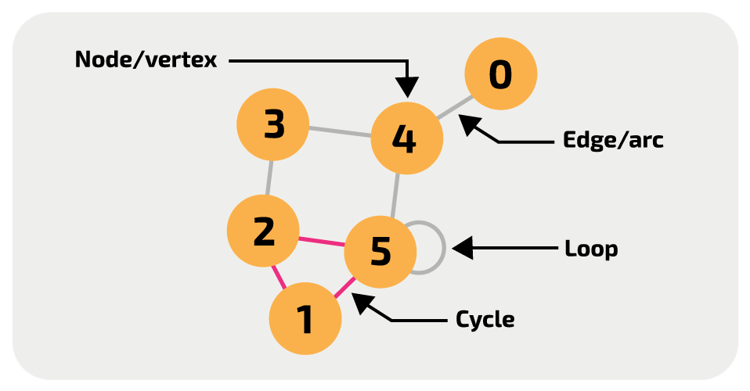
What is a graph?
A graph is an abstract data type that can be used to represent complex, non-linear relationships between objects.
A graph consists of nodes (also called vertices) that are connected by edges (also called arcs).
Notes:
Timings: 1 minute
Key outcomes: Understand the definition of a graph
Activity:
Give participants time to read the slide
Definition and image from Isaac CS
The following key terms will be covered on later slides: Graph, edge, node, Neighbour, degree, loop, path, cycle, undirected, directed, unweighted, weighted
Assets: https://isaaccomputerscience.org/concepts/dsa_datastruct_graph?examBoard=ocr&stage=a_level

Slide 5

Why use a graph?
Transport maps
Computer networks
Social network connections
Virus modelling
Notes:
Timings: 3 minutes
Key outcomes: Understand uses of graphs
Activity:
Highlight that these problems have similarities. They all have items that can be connected to one or more other items.
Pose the question ‘Are there any other situations where items may be connected in a similar way?’ There may not be any answers at this stage but encourage participants to come back to this question as they go through this session.
Assets: https://pixabay.com/illustrations/communication-digital-computer-4871245/

Slide 6
Structure of a graph
Undirected
F
Unweighted
B
A
C
E
G
E
D
D
Edge
Node
Neighbour
Notes:
Timings: 3 minutes
Key outcomes: Understand the structure of a graph
Activity:
Explain the structure of the graph using the key terms:
Undirected- Indicates that connection is two way on every edge. E.g., can go from B to F and F to B
Unweighted- There is no value associated with going between nodes
Node- An item in the graph
Edge- The connection between two nodes
Neighbour- A node directly connected to another node
Animations will highlight parts of the graph linked to key words

Slide 7
Structure of a graph – 2
Directed
F
Weighted
B
5
4
2
5
3
A
C
4
4
7
3
E
8
G
D
2
Notes:
Timings: 3 minutes
Key outcomes: Understand the structure of a graph
Activity:
Explain the structure of the graph using the key terms:
Directed- Indicates that the there is a single direction between two nodes. To travel both ways between two nodes, two edges will be needed
Weighted- There is a value (cost) associated to each edge. This is often a distance, time, financial cost to get from one node to another
Animations will highlight parts of the graph linked to key words
It is worth mentioning to participants that weighted graphs can be undirected and directed graphs can be unweighted.
Also explain that sometimes there may be different ‘costs’ associated with travel in each direction between two nodes (example in A and B)

Slide 8
Structure of a graph – 3
Degree = 3
F
B
5
B
Loop
4
2
5
3
C
A
C
4
4
7
3
Cycle
Path
G
E
8
G
D
2
Notes:
Timings: 3 minutes
Key outcomes: Understand the structure of a graph
Activity:
Explain the structure of the graph using the key terms:
Loop - an edge that connects a node to itself
Path - Any sequence of nodes connected by edges
Cycle - A closed path. The path starts and ends at the same node with no node revisited, e.g.
Degree - Number of nodes directly connected to a node. Node F has a degree of 3 because it has edges that join it to B, C and G (edges FC and FG are bi-directional, not really two edges as they appear)
Animations will highlight parts of the graph linked to key words
It is worth mentioning to participants that weighted graphs can be undirected and directed graphs can be unweighted

Slide 9
Key terms
Node
Edge
Neighbour
Degree
Loop
Path
Cycle
Undirected
Directed
Unweighted
Weighted
Notes:
Timings: 1 minute
Key outcomes: recap keywords
Activity: This slide just lists all of the key words that should have been explained on the previous slides
Directed- Indicates that the there is a single direction between two nodes. To travel both ways between two nodes, two edges will be needed
Weighted- There is a value (cost) associated to each edge. This is often a distance, time, financial cost to get from one node to another
Node- An item in the graph
Edge- The connection between two nodes
Neighbour- A node directly connected to another node
Loop- an edge that connects a node to itself
Path- Sequence of nodes connected by edges
Cycle- A closed path. The path starts and ends at the same node with no node revisited
Degree- Number of connected nodes
Background:
Misconceptions:
Assets:
Links:

Slide 10

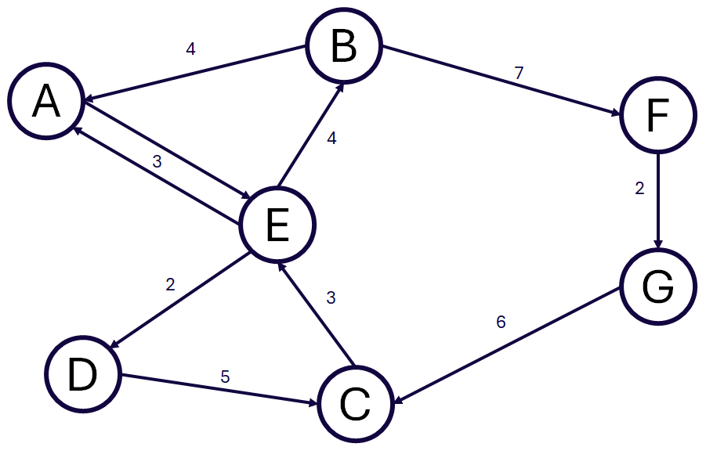
Activity- Understanding graphs
Handout 1
7 minutes
Complete Session 2 Activity 1
Notes:
Timings: 7 minutes
Key outcomes: Participants are able to label graphs correctly
Activity: Participants to complete Session 2 activity 1
Background: Links to slides 6-9

Slide 11
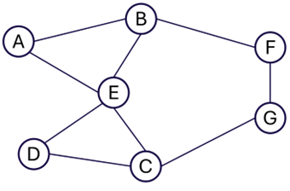
Solution- Understanding graphs
1a- Undirected and unweighted
1b- A, B, F, G/ A, B, E, C, G/ A, E, C, G/ A, B, E, D, C, G/ A, E, D, C, G
1c- F, G, C, E, B, F
1d- A, E, F
Notes:
Timings: 1 minute
Key outcomes: Participants are able to label graphs correctly
Activity:
a) Identify the type of graph shown in Figure 1.
Highlight that it is both undirected and unweighted
b) State a path from node A to G in Figure 1.
Any of the answers given are valid
c) State the smallest possible cycle from F back to itself in Figure 1.
Only valid answer
d) Which nodes are neighbours to node B in Figure 1?
All nodes are needed
Background: Links to slides 6-9

Slide 12

Solution- Understanding graphs
2a- Undirected and weighted
2b- B, F, G/ B, E, C, G/ B, A, E, C, G/ B, E, D, C, G/ B, A, E, D, C, G
2c- 13
Notes:
Timings: 1 minute
Key outcomes: Participants are able to label graphs correctly
Activity:
a) Identify the type of graph shown in Figure 2.
Highlight that it is both undirected and weighted
b) State a path from node B to G in Figure 2.
Any one of the paths is valid
c) What is smallest possible cost of a path from Node D to F in Figure 2?
Talk through the path: D, E, B, F
Background: Links to slides 6-9

Slide 13
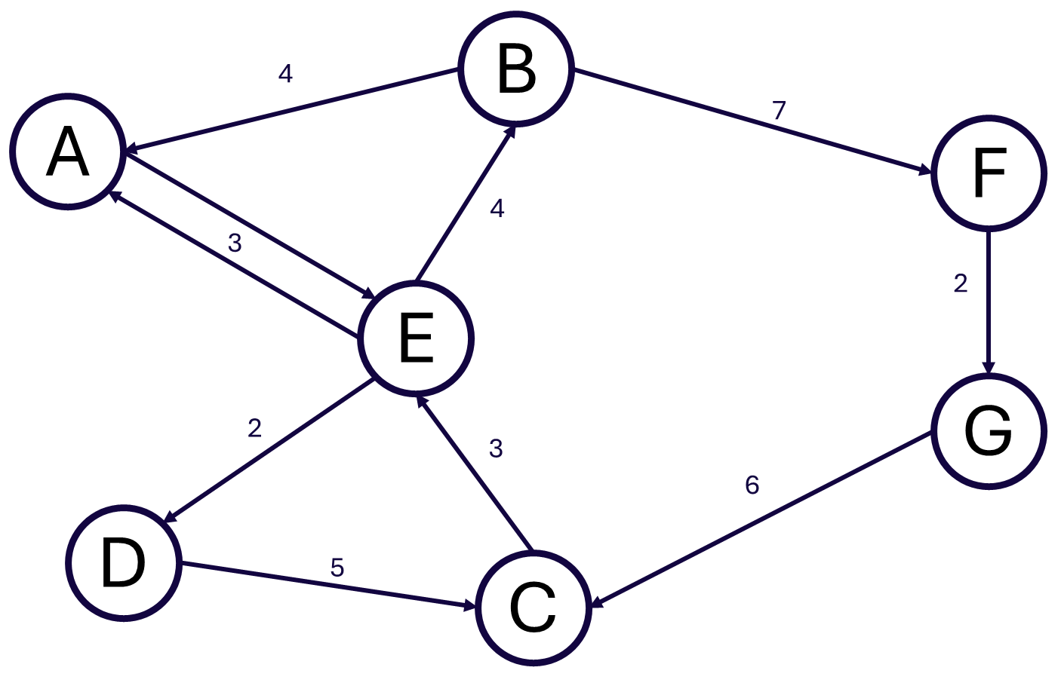
Solution- Understanding graphs
3a- Directed and weighted
3b- B, F, G/ B, E, C, G/ B, A, E, C, G/ B, E, D, C, G/ B, A, E, D, C, G
3c- B, A, E, D/ B, F, G, C, E, D
3d- 7
Notes:
Timings: 1 minute
Key outcomes: Participants are able to label graphs correctly
Activity:
a) Identify the type of graph shown in Figure 3.
Highlight that it is both directed and weighted
b) State a path from node G to D in Figure 3.
Any of the paths is valid
c) State a path from node B to D in Figure 3.
Two possible paths
d) What is the smallest possible cost from node A to B?
Path must follow the directions so is: A, E, B
Background: Links to slides 6-9

Slide 14
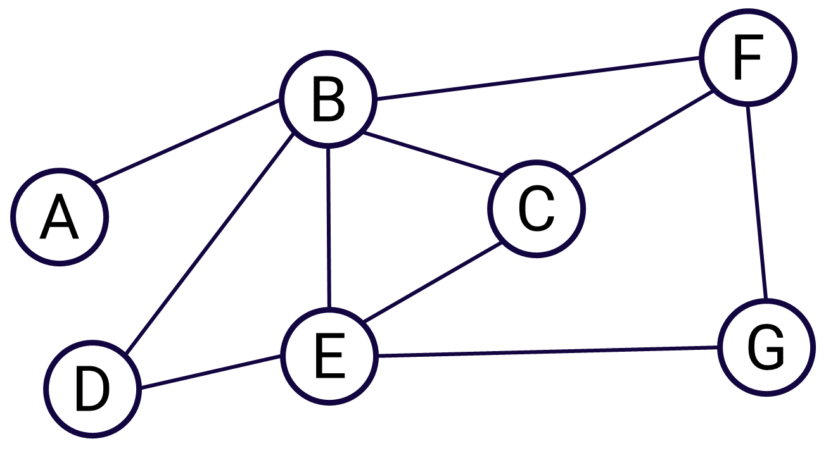
Representing unweighted and undirected graphs
Adjacency matrix
 | A | B | C | D | E | F | G
A | 0 | 1 | 0 | 0 | 0 | 0 | 0
B | 1 | 0 | 1 | 1 | 1 | 1 | 0
C | 0 | 1 | 0 | 0 | 1 | 1 | 0
D | 0 | 1 | 0 | 0 | 1 | 0 | 0
E | 0 | 1 | 1 | 1 | 0 | 0 | 1
F | 0 | 1 | 1 | 0 | 0 | 0 | 1
G | 0 | 0 | 0 | 0 | 1 | 1 | 0
Notes:
Timings: 1 minute
Key outcomes: Understand the adjacency matrix and list representations of unweighted and undirected graphs
Activity:
Explain the slide, show the graph first and then the matrix
1 represents there is a connection from one node to the other in the matrix and 0 represents no link
Highlight the symmetry of the matrix

Slide 15
Representing unweighted and undirected graphs
Adjacency list
 | Connected to
A | B
B | A, C, D, E, F
C | B, E, F
D | B, E
E | B, C, D, G
F | B, C, G
G | E, F
Notes:
Timings: 1 minute
Key outcomes: Understand the adjacency matrix and list representations of unweighted and undirected graphs
Activity:
Explain the slide, show the graph first and then the list
In the list, the neighbours to a node are listed

Slide 16

Representing weighted and undirected graphs
Adjacency matrix
 | A | B | C | D | E | F | G
A | 0 | 4 | 0 | 0 | 0 | 0 | 0
B | 4 | 0 | 3 | 5 | 4 | 8 | 0
C | 0 | 3 | 0 | 0 | 3 | 4 | 0
D | 0 | 5 | 0 | 0 | 2 | 0 | 0
E | 0 | 4 | 3 | 2 | 0 | 0 | 8
F | 0 | 8 | 4 | 0 | 0 | 0 | 5
G | 0 | 0 | 0 | 0 | 8 | 5 | 0
Notes:
Timings: 1 minute
Key outcomes: Understand the adjacency matrix and list representations of weighted and undirected graphs
Activity:
Explain the slide, show the graph first and then the matrix
The number represents there is a connection from one node to the other and what the weighting is in the matrix and 0 represents no link
Note the symmetry of the matrix across the diagonal

Slide 17
Representing weighted and undirected graphs
Adjacency list
 | Connected to
A | B, 4
B | A, 4; C, 3; D, 5; E, 4; F, 8
C | B, 3; E, 3; F, 4
D | B, 5; E, 2
E | B, 4; C, 3; D, 2; G, 8
F | B, 8; C, 4; G, 5
G | E, 8; F, 5
Notes:
Timings: 1 minute
Key outcomes: Understand the adjacency matrix and list representations of weighted and undirected graphs
Activity:
Explain the slide, show the graph first and then the list
In the list, the neighbours to a node are listed with their weighting

Slide 18
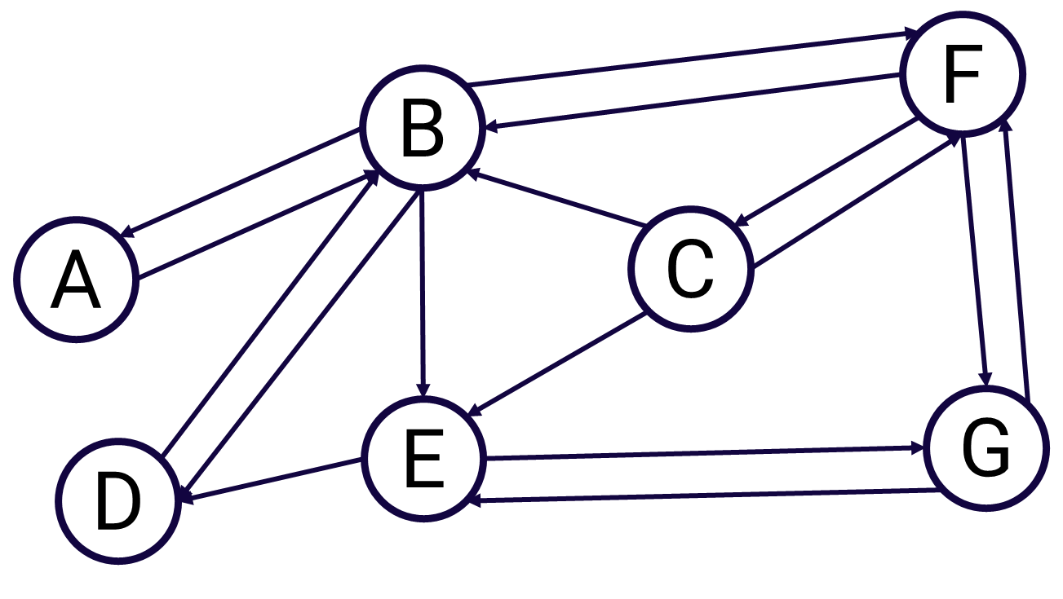
Representing directed and unweighted graphs
Adjacency matrix
 | A | B | C | D | E | F | G
A | 0 | 1 | 0 | 0 | 0 | 0 | 0
B | 1 | 0 | 0 | 1 | 1 | 1 | 0
C | 0 | 1 | 0 | 0 | 1 | 1 | 0
D | 0 | 1 | 0 | 0 | 0 | 0 | 0
E | 0 | 0 | 0 | 1 | 0 | 0 | 1
F | 0 | 1 | 1 | 0 | 0 | 0 | 1
G | 0 | 0 | 0 | 0 | 1 | 1 | 0
Notes:
Timings: 1 minute
Key outcomes: Understand the adjacency matrix and list representations of unweighted and directed graphs
Activity:
Explain the slide, show the graph first and then the matrix
1 represents there is a connection from one node to the other in the matrix and 0 represents no link
Highlight that there may not be symmetry in the matrix unlike with an undirected graph

Slide 19
Representing directed and unweighted graphs
Adjacency list
 | Connected to
A | B
B | A, D, E, F
C | B, E, F
D | B
E | D, G
F | B, C, G
G | E, F
Notes:
Timings: 1 minute
Key outcomes: Understand the adjacency matrix and list representations of unweighted and directed graphs
Activity:
Explain the slide, show the graph first and then the list
In the list, the neighbours to a node are listed

Slide 20

Representing directed and weighted graphs
Adjacency matrix
 | A | B | C | D | E | F | G
A | 0 | 4 | 0 | 0 | 0 | 0 | 0
B | 4 | 0 | 0 | 5 | 4 | 8 | 0
C | 0 | 3 | 0 | 0 | 3 | 3 | 0
D | 0 | 5 | 0 | 0 | 0 | 0 | 0
E | 0 | 0 | 0 | 2 | 0 | 0 | 9
F | 0 | 8 | 3 | 0 | 0 | 0 | 5
G | 0 | 0 | 0 | 0 | 8 | 5 | 0
Notes:
Timings: 1 minute
Key outcomes: Understand the adjacency matrix and list representations of weighted and directed graphs
Activity:
Explain the slide, show the graph first and then the matrix
The number represents there is a connection from one node to the other and what the weighting is in the matrix and 0 represents no link
Highlight the fact there may not be symmetry in the matrix

Slide 21
Representing directed and weighted graphs
Adjacency list
 | Connected to
A | B, 4
B | A, 4; D, 5; E, 4; F, 8
C | B, 3; E, 3; F, 3
D | B, 5
E | D, 2; G, 9
F | B, 8; C, 3; G, 5
G | E, 8; F, 5
Notes:
Timings: 1 minute
Key outcomes: Understand the adjacency matrix and list representations of weighted and directed graphs
Activity:
Explain the slide, show the graph first and then the list
In the list, the neighbours to a node are listed with their weighting

Slide 22
Comparing representations
Matrix
Time efficient for finding connected nodes
List
Space efficient
Best for adding/ removing nodes
Best for removing edges
Notes:
Timings: 2 minutes
Key outcomes: Understand how to compare representations
Activity:
Explain the main differences and that it is important to understand the likely operations before making a decision
Matrix:
Best for removing edges as the cell can be found using indexes and updated easily
Time efficient for finding connected nodes as the indexes of cells can be easily used to check connections
List:
Adding/ removing nodes is most efficient using a list
A list is most space efficient for sparsely populated graphs but finding the presence of an edge is more difficult due to requiring a linear search
The process of adding edges is equally as efficient in both representations
Links: Further explanation can be found here: https://isaaccomputerscience.org/concepts/dsa_datastruct_graph_implementation?examBoard=ocr&stage=a_level&topic=data_structures

Slide 23
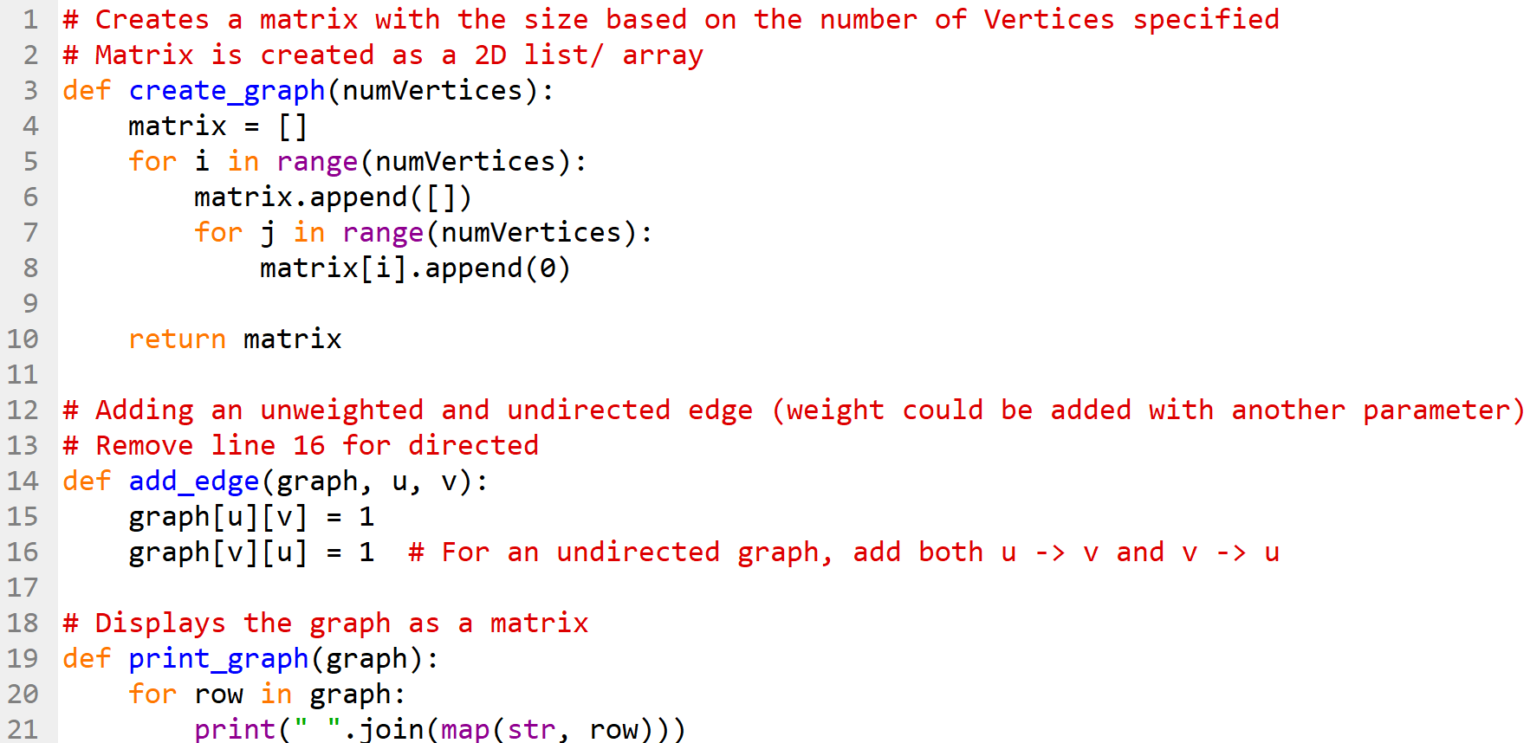
Implementing an adjacency matrix in Python
Open the code at https://trinket.io/python3/676862a2af17
Notes:
Timings: 4 minutes
Key outcomes: Understand the implementation of an adjacency matrix in Python
Activity:
Explain the code, comments have been added to the code. It may be more useful to demonstrate the code in action
Lines 3-10 Create a matrix with the size based on the number of Vertices specified, as a 2D list/ array
Lines 14-16 Add an unweighted and undirected edge (weight could be added with another parameter)- Remove line 16 for a directed graph and then the procedure will need to be called for each direction between two nodes
Lines 19-21 Display the graph as a matrix using a loop
https://trinket.io/python3/676862a2af17

Slide 24
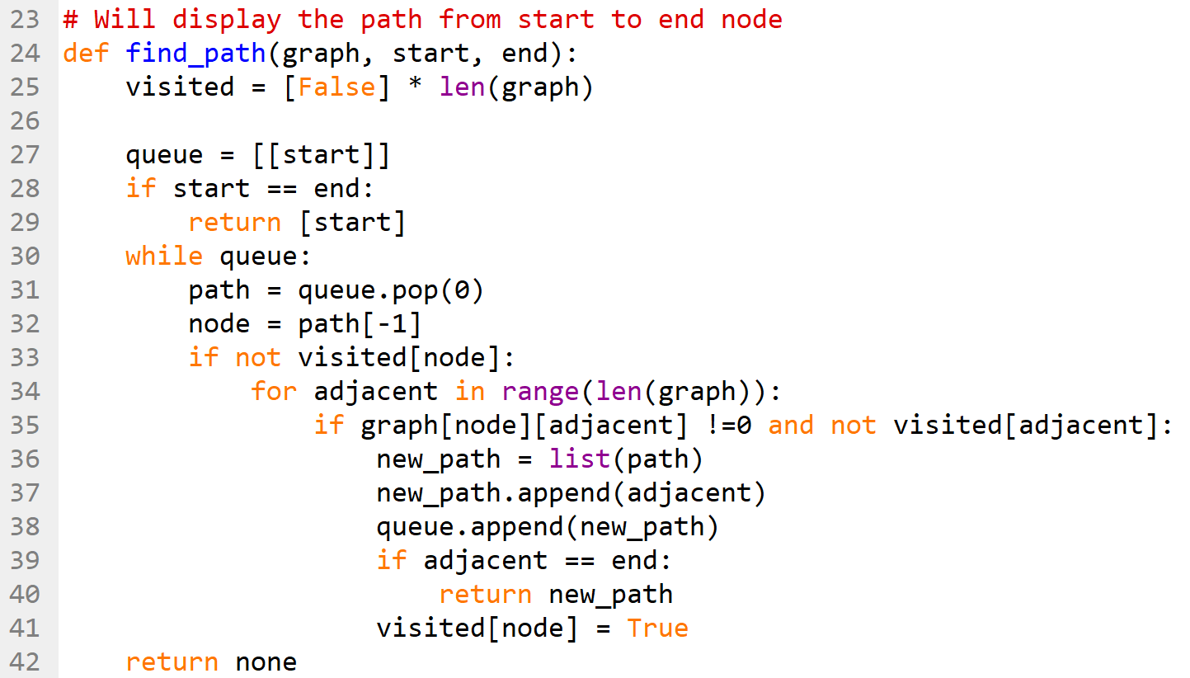
Implementing an adjacency matrix in Python
Notes:
Timings: 4 minutes
Key outcomes: Understand the implementation of finding the cost of a path in an adjacency matrix
Activity:
Explain the code, comments have been added to the code. It may be more useful to demonstrate the code in action (Adjacency matrix.py)
Lines 24-44 Will display the path from start to end node. Nested loops are used to check for the paths and keep a record of the nodes visited in a queue and printing popped items
https://trinket.io/python3/676862a2af17

Slide 25
Learning Outcomes
Understand why graphs are used
Understand the structure of graphs
Understand the ways to represent graphs
Notes:
Timings: 1 minute
Key outcomes: Understand the outcomes for this session
Activity:
Revisit the outcomes

Slide 26
Thank you

