Slide 1

AN EXPERIANTIAL LEARNING PRESENTATION
ON
Comparative Analysis BER OF QOSTBC (Quadrature orthogonal space-time block codes) over Frequency Flat Rayleigh Fading Channel for QPSK modulation using MATLAB
UNDER THE SUPERVISION OF
DR. AJAY YADAV
(ASST. PROFESSOR ECE)
PRESENTED BY :
GROUP 1
DEPARTMENT OF ELECTRONICS AND COMMUNICATION ENGINEERING

Slide 2
OUTLINES
OBJECTIVE
INTRODUCTION
PROBLEM STATEMENT AND MOTIVATION
BLOCK DIAGRAM
MATHEMATICAL PRESENTATION
OBSERVATION AND ANALYSIS
RESULTS
REFERENCE

Slide 3
OBJECTIVE
The objective of this study is to evaluate the performance of QOSTBC under different fading channel conditions (Rayleigh) and compare it with other space-time coding techniques. The simulation results obtained from this study will be useful in selecting an appropriate space-time coding technique for wireless communication systems.

Slide 4
INTRODUCTION
QOSTBC is a type of space-time code used in wireless communication systems to transmit data over multiple antennas.
It is designed to provide high spectral efficiency and reliability by reducing the effects of multipath fading and interference.
It employs the concept of Orthogonal Design, where the transmitted signals are orthogonal to each other.
QOSTBC is a four-transmit-antenna code that can be used in multiple-input multiple-output (MIMO) systems.
It transmits two complex symbols simultaneously on four antennas.

Slide 5
PROBLEM STATEMENT
Comparative Analysis BER OF QOSTBC (Quadrature orthogonal space-time block codes) over Frequency Flat Rayleigh Fading Channel for QPSK modulation using MATLAB.

Slide 6
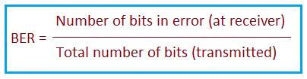
BIT ERROR RATE
Bit error rate (BER) is defined as the rate at which errors occur in a transmission system.
This can be directly translated into the number of errors that occur in a string of a stated number of bits.
The definition of bit error rate can be translated into a simple formula:

Slide 7
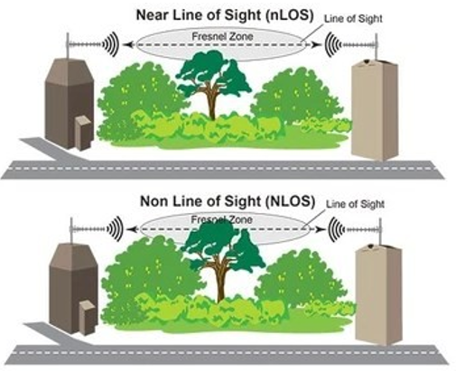
RAYLEIGH FADING CHANNEL
In wireless communication systems, the signal experiences fading due to the presence of obstacles and reflections.
Rayleigh fading is most applicable when there is no dominant propagation along a line of sight between the transmitter and receiver.
Rayleigh fading is most applicable when there is no dominant propagation along a line of sight between the transmitter and receiver.

Slide 8
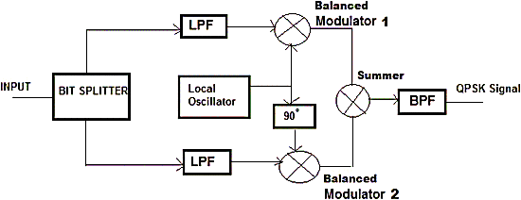
QPSK MODULATION
QPSK (Quadrature Phase Shift Keying) is a digital modulation technique that uses four distinct phases of a carrier wave to transmit two bits of digital information per symbol.
It is widely used in wireless communication systems due to its simplicity and efficiency.
In this study, we will use QPSK modulation to transmit data over the simulated frequency flat Rayleigh fading channel. The performance of QOSTBC will be evaluated by measuring the bit error rate (BER) at different signal-to-noise ratios (SNRs).

Slide 9
RESULT ANALYSIS

Slide 11
CONCLUSION

Slide 12
REFERENCES

